Slide 1
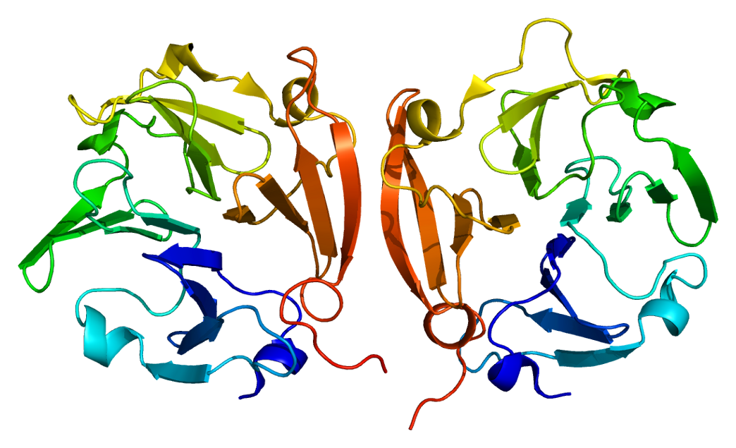
Analysis of relationship between activated plasma MMP9 levels and volumes of subcortical regions.
2022/11/13
The department of Neuropsychiatry, the University of Tokyo
Shunsuke Mori, Naohiro Okada, Kiyoto Kasai

Slide 2
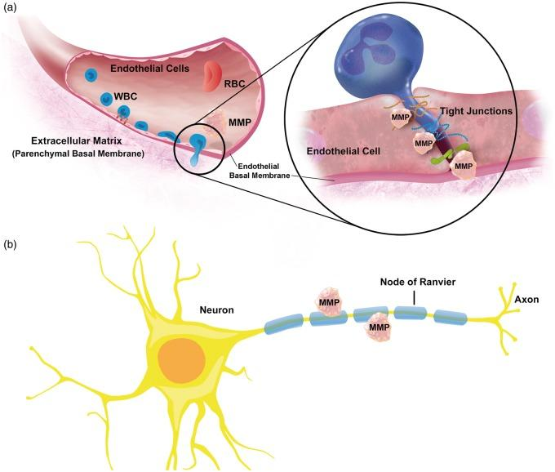
What is MMP9?
Matrix Metalloproteinase 9（MMP9） is a protein which has function of degrading type IV collagen.
This figure shows MMP9 is degrading a part of basement membrane so that neutrophil can migrate in the site of inflammation.

Slide 3
What is MMP9?
Normal physiological processes
embryogenesis, reproduction, angiogenesis, osteogenesis, wound healing,
cell migration, learning, memory, plasticity
Pathological processes
arthritis, intracerebral hemorrhage, metastasis

Slide 4
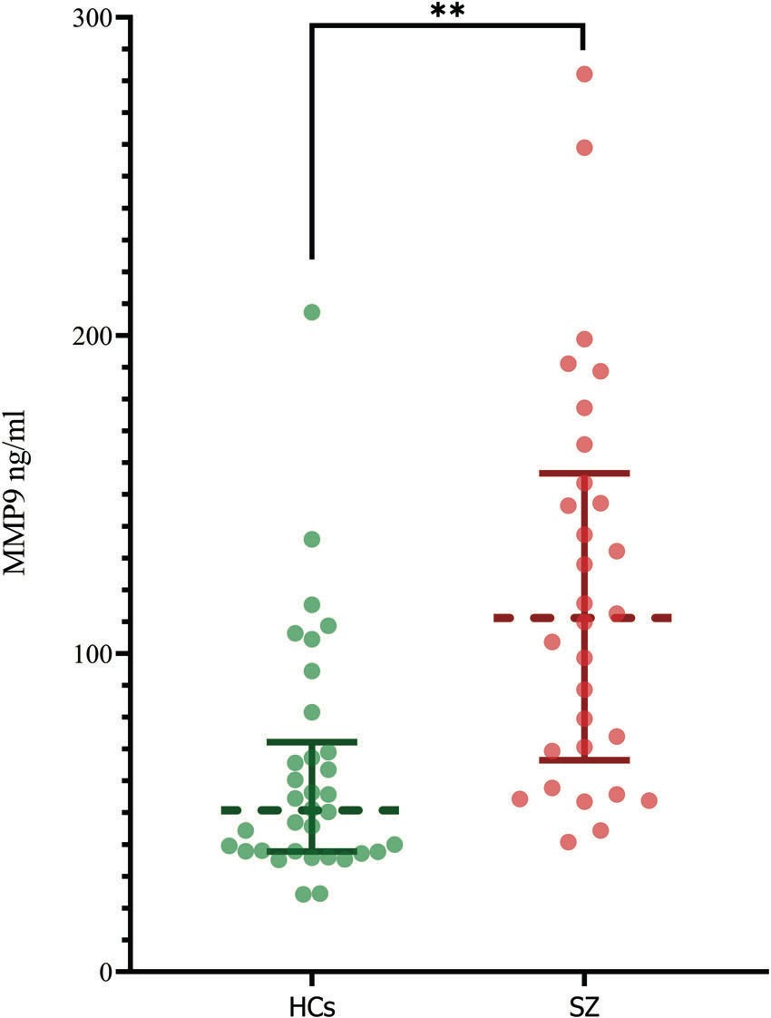
MMP9 and schizophrenia
The association of matrix metalloproteinase 9 with hippocampal volume in schizophrenia: a preliminary MRI study. Johanna Seitz-Holland et al. Neuropsychopharmacology (2021) 0:1-7
ANCOCA (corrected for age and sex)
F = 21.19, p < 0.0001
Mann-Whitney U test
U = 188, p < 0.0001

Slide 5
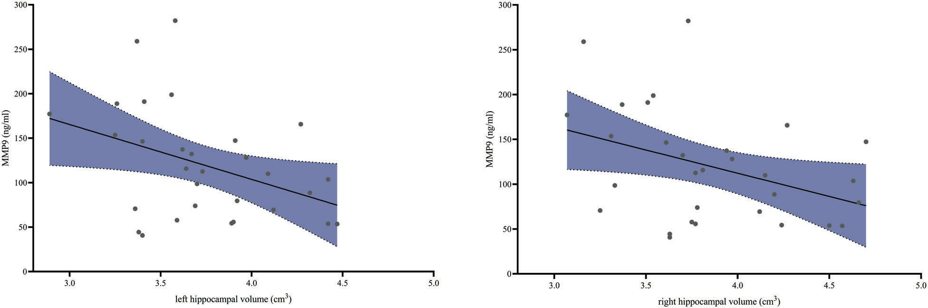
MMP9 and schizophrenia
The association of matrix metalloproteinase 9 with hippocampal volume in schizophrenia: a preliminary MRI study. Johanna Seitz-Holland et al. Neuropsychopharmacology (2021) 0:1-7
Both side of hippocampal volumes are negatively corelated with plasma MMP9 concentration in schizophrenia.
Left (R = −0.39, p = 0.034) , Right (R = −0.37, p = 0.046)

Slide 6
Materials and Methods
It remains to be elucidated whether activated type of plasma MMP9 and volumes of subcortical regions including hippocampus are related.
Question:
（Schizophrenia, healthy control）
Whether activated plasma MMP9 and volumes of subcortical regions are related or not?
Analyzed using activated plasma MMP9 and volumes of subcortical regions measuring with FreeSurfer.

Slide 7
Subjects
Demographics (Healthy individuals and Individuals with schizophrenia)
Demographics
 | Healthy individuals | Individuals with schizophrenia | Test-statistic
Number of participants | 50 | 28
Age in years (mean ± std) | 37.42 ± 7.69 | 29.79 ± 8.85 | T=-3.98, df=76, p=0000155
Sex | male = 17, female = 33 | male = 18, female = 10 | X2=6.66, df=1, p=0.017
MMP9 | 2.48 ± 2.19 | 5.87 ± 4.89
Duration of education | 15.56 ± 2.25 | 13.64 ± 2.51 | T=-3.46, df=76, p=0.000889
Chlorpromazine equivalent | 0 | 598.99 ± 401.47

Slide 8
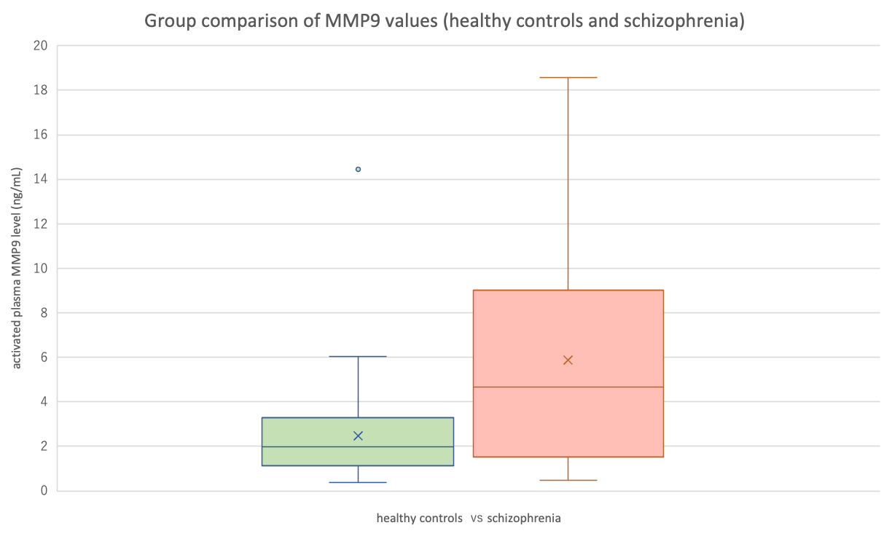
Group comparison of activated plasma MMP9 values in healthy controls and schizophrenia
Multiple regression analysis was conducted with active MMP9 levels of each group as the objective variable, diagnosis as the explanatory variable, and age sex, ICV as covariates to examine for group differences in active MMP9 levels.
cohen’s_d: 0.889, p-value: 0.000868
These results showed that the group difference of active plasma MMP9 between healthy controls and schizophrenia was significant.

Slide 9
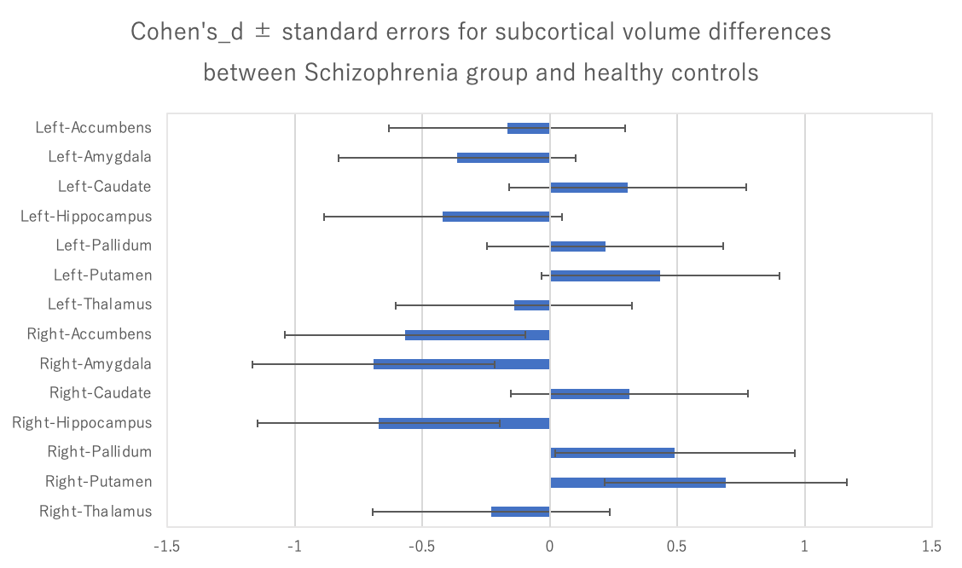
Group comparison of activated plasma MMP9 values in healthy controls and schizophrenia
Multiple comparison analysis was conducted with volumes of each brain region as the objective variable, diagnosis as the explanatory variable, and age, sex, and ICV as covariates to investigate which regions of volume difference were significant in 14 subcortical regions (left and right of nucleus accumbens, amygdala, caudate, hippocampus, globus pallidus, putamen, and thalmus). Regions indicated significant group difference was detected with Benjamini-Hochberg method of false discovery rate p-value (FDRp < 0.05).

Slide 10
Group comparison of activated plasma MMP9 values in healthy controls and schizophrenia
 | Left-Accumbens | Left-Amygdala | Left-Caudate | Left-Hippocampus | Left-Pallidum | Left-Putamen | Left-Thalamus | Right-Accumbens | Right-Amygdala | Right-Caudate | Right-Hippocampus | Right-Pallidum | Right-Putamen | Right-Thalamus
cohen's_d | -0.1672617 | -0.3633766 | 0.3040004 | -0.419254 | 0.21698074 | 0.43398512 | -0.1400984 | -0.5668785 | -0.6922434 | 0.31126059 | -0.6724543 | 0.490533 | 0.68980159 | -0.2305267
uncorrected_p_value | 0.509 | 0.168 | 0.211 | 0.082 | 0.326 | 0.03 | 0.58 | 0.024 | 0.006 | 0.19 | 0.003 | 0.038 | 0.001 | 0.257
FDRp | 12.7457614 | 38.8523918 | 30.8632597 | 79.8021359 | 19.922951 | 218.284361 | 11.1800075 | 274.94359 | 1109.60531 | 34.2834027 | 2215.85909 | 172.84933 | 6656.37626 | 25.2809079
The results of multiple comparison analyses were
Right amygdala：cohen’s d = -0.692、FDRp = 0.028
Right hippocampus：cohen’s d = -0.672、FDRp = 0.021
Right putamen：cohen’s d = 0.690、FDRp = 0.014
The volumes of right amygdala and right hippocampus in patients with schizophrenia were significantly smaller than in healthy individuals, and the volume of right putamen was the opposite.

Slide 11
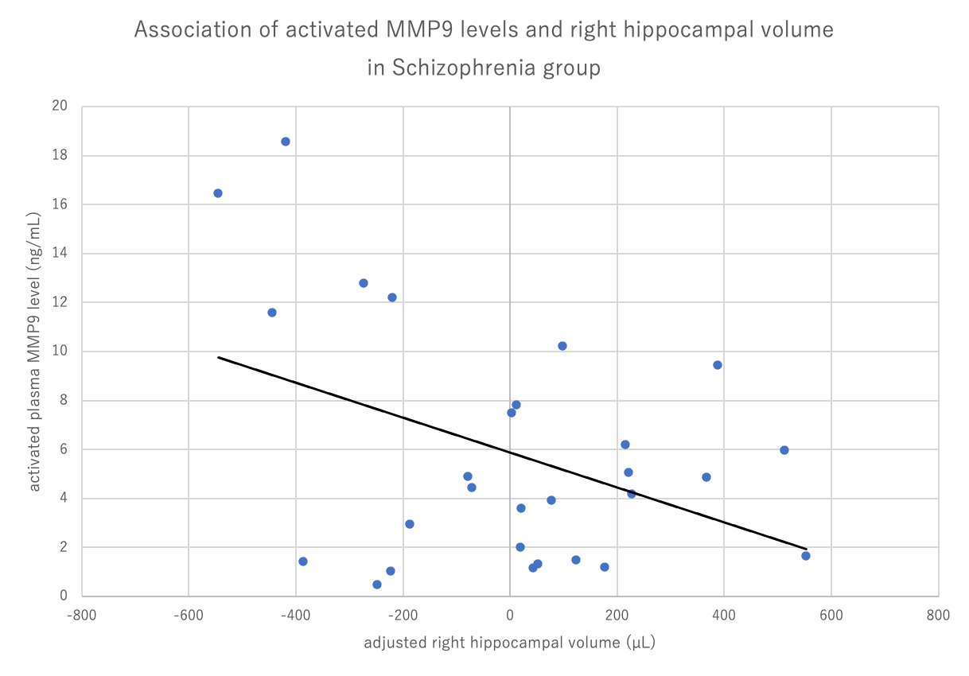
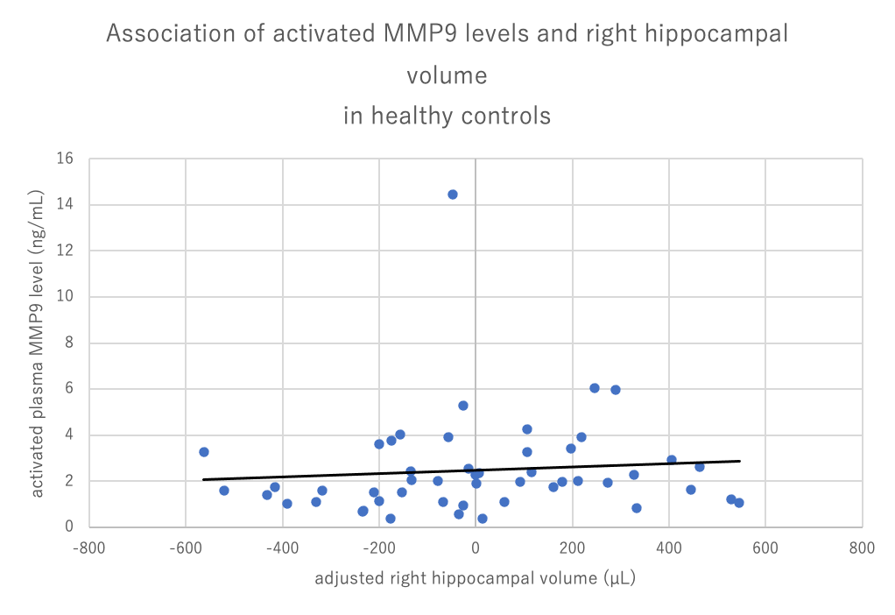
Association between active MMP9 levels and volumes of subcortical regions (Schizophrenia)
Simple regression analysis was performed with each volume of subcortical region corrected with age, sex, and ICV as the objective variable, and active MMP9 level as the explanatory variable to investigate the effect of active MMP9 level on volume of brain regions which showed significant group difference. In this analysis, it was regarded as significant when the signs of the regression coefficient of active MMP9 level and the cohen’s_d which indicated the group difference of volumes of brain regions, considering the function of active MMP9 as breaking basement membrane. Therefore, one-tailed p-value of the simple regression was calculated in this analysis.
Analysis with volume of right hippocampus in patients with schizophrenia demonstrated significant association (FDRp = 0.0435). Right amygdala: FDRp = 0.0938, Right putamen: 0.396

Slide 12
Association between active MMP9 levels and volumes of subcortical regions (Healthy control)
Similar analyses were performed with healthy control.
（Right amygdala：FDRp = 0.464）
Right hippocampus：FDRp = 0.396
（Right putamen：FDRp = 0.396）
Analysis with volume of right amygdala,
right hippocampus, and putamen in healthy control
did not demonstrate significant association.
Multiple regression analysis with volume of
right hippocampus corrected with age, sex, and
ICV as the objective variable indicated marginal
significance of group difference of associations
of active MMP9 levels – volume of
right hippocampus (p = 0.061).

Slide 13
Discussion
・This analysis has novelty because relationship between active plasma MMP9 and subcortical regions in patients with schizophrenia was not reported.
・This study strengthen the result of the relationship between MMP9 function of plasticity for brain and right hippocampus in Marek’s research through obtaining the similar result in active MMP9.

Slide 14
summary
This study demonstrated that active MMP9 level was significantly related to volume of right hippocampus in patients with schizophrenia.
On the other hand, the relationship in healthy control was not significant.
The group difference of schizophrenia- healthy control about obtained results shown above has significant trend.

Slide 16
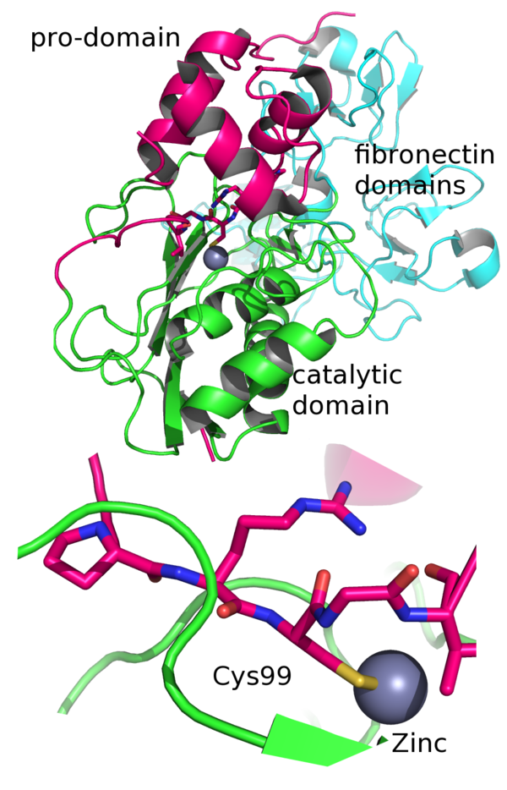

Slide 17
Association between active MMP9 levels and volumes of subcortical regions
 | 非標準化係数 |  | 標準化係数
 | B | 標準誤差 | ベータ | t値 | p値 | FDRp
(定数) | 77.69 | 63.372 |  | 1.226 | 0.116
MMP9 | -13.231 | 8.355 | -0.297 | -1.584 | 0.0625 | 0.09375
従属変数 | Unstandardized | Residual | Right amygdala
Right amygdala
 | 非標準化係数 |  | 標準化係数
 | B | 標準誤差 | ベータ | t値 | p値 | FDRp
(定数) | 140.595 | 78.49 |  | 1.791 | 0.0425
MMP9 | -23.944 | 10.348 | -0.413 | -2.314 | 0.0145 | 0.0435
従属変数 | Unstandardized | Residual | Right hippocampus
Right hippocampus
 | 非標準化係数 |  | 標準化係数
 | B | 標準誤差 | ベータ | t値 | p値 | FDRp
(定数) | -29.761 | 144.155 |  | -0.206 | 0.419
MMP9 | 5.068 | 19.006 | 0.052 | 0.267 | 0.396 | 0.396
従属変数 | Unstandardized | Residual | Right putamen
Right putamen
analysis with volume of right hippocampus in patients with schizophrenia demonstrated significant association (FDRp = 0.0435)

Slide 18
Group comparison of activated plasma MMP9 values in healthy controls and schizophrenia
Multiple regression analysis was conducted with active MMP9 levels of each group as the objective variable, diagnosis as the explanatory variable, and age sex, ICV as covariates to examine for group differences in active MMP9 levels.
 | 非標準化係数 |  | 標準化係数
 | B | 標準誤差 | ベータ | t値 | 有意確率
(定数) | -1.688 | 5.646 | -0.299 | 0.766
diagnosis | 3.343 | 0.937 | 0.429 | 3.569 | 0.000868
Age_at_MRI | 0.016 | 0.048 | 0.038 | 0.336 | 0.738
Sex_M1_F2 | -0.464 | 0.945 | -0.062 | -0.492 | 0.625
ICV | 3.03E-06 | 0 | 0.121 | 1.009 | 0.316
従属変数 | MMP9
cohen’s_d: 0.889, p-value: 0.000868
These results showed that the group difference of active plasma MMP9 between healthy controls and schizophrenia was significant.

Slide 19
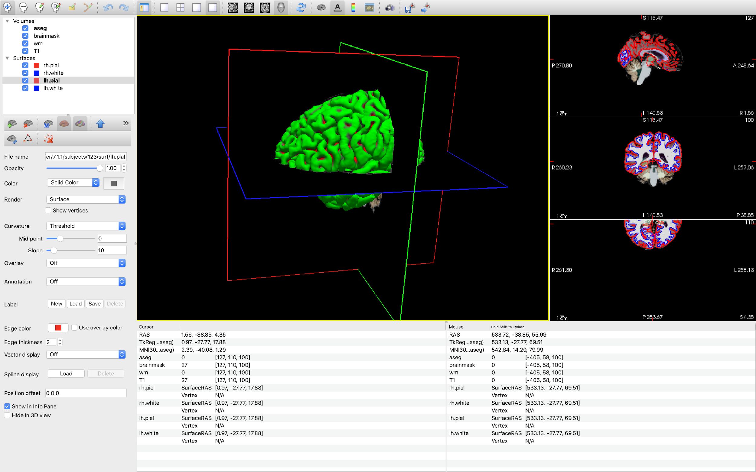
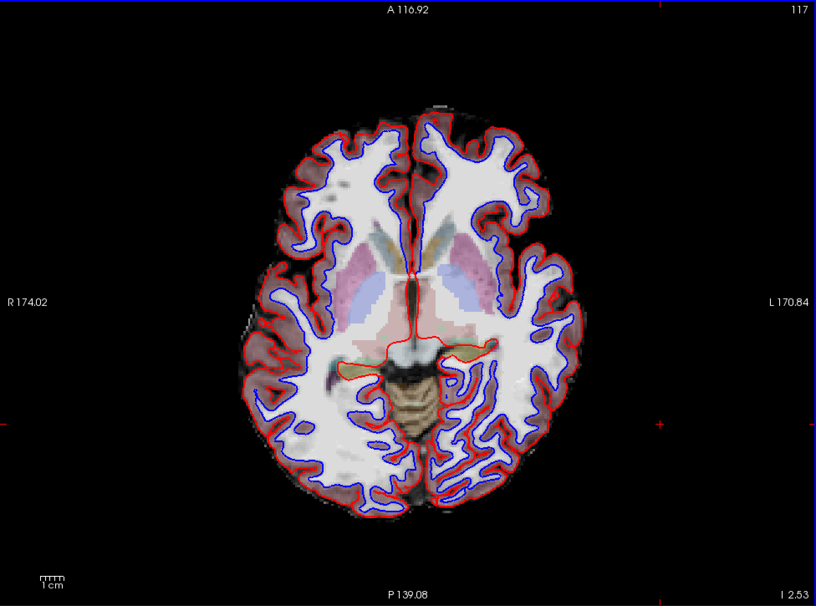

Slide 20
 | 非標準化係数 |  | 標準化係数
 | B | 標準誤差 | ベータ | t値 | p値
(定数) | 3111.234 | 497.255 | 6.257 | 0
MMP9 | 12.954 | 18.716 | 0.138 | 0.692 | 0.491
diagnosis | -8.859 | 120.316 | -0.012 | -0.074 | 0.942
MMP9*Dx | -42.497 | 22.341 | -0.487 | -1.902 | 0.061
Age_at_MRI | -7.047 | 3.959 | -0.177 | -1.78 | 0.079
Sex_M1_F2 | -146.103 | 79.299 | -0.207 | -1.842 | 0.07
ICV | 0.001 | 0 | 0.503 | 4.719 | 0
従属変数 | Right-Hippocampus

