Slide 1


2022 BESETO
Analyses of REM sleep without atonia
and neurocognitive function
in REM sleep behavior disorder
Ji Soo Kim¹, Suk-Hoon Kang², Youjeong Yuk³, In-Young Yoon^{1,4}
¹Department of Psychiatry, Seoul National University Bundang Hospital, Seongnam, Republic of Korea
²Department of Medicine, Graduate School of Yonsei University, Seoul, Republic of Korea
³Department of Medicine, Seoul National University College of Medicine, Seoul, Republic of Korea
⁴Department of Psychiatry, Seoul National University College of Medicine, Seoul, Republic of Korea
Seoul National University Bundang Hospital
Department of Psychiatry
Ji Soo Kim M.D.

Slide 2
Background
REM sleep behavior disorder (RBD) is a parasomnia characterized by dream enactment behaviors during REM sleep and REM sleep without atonia (RSWA)
Isolated RBD (iRBD) is considered the prodromal expression of underlying synucleinopathies
Among iRBD patients, predictors for synucleinopathies include:
1) Higher percentage of RSWA 2) Cognitive dysfunction in attention, executive function, and verbal memory 3) Higher delta and theta power in quantitative electroencephalogram (qEEG)
Iranzo A, et al. (2016) Idiopathic rapid eye movement sleep behavior disorder: diagnosis, management, and the need for neuroprotective interventions.
Liu Y, et al. (2019) Electromyography activity level in rapid eye movement sleep predicts neurodegenerative diseases in idiopathic rapid eye movement sleep behavior disorder: a 5-year longitudinal study.
Fereshtehnejad SM, et al. (2019) Evolution of prodromal Parkinson’s disease and dementia with Lewy bodies: a prospective study.
Rodrigues Brazete J, et al. (2013) Electroencephalogram slowing in rapid eye movement sleep behavior disorder is associated with mild cognitive impairment.

Slide 3
Objective
The goal of this study is to distinguish patients with potential risk of neurodegeneration by identifying the details of relationship between RSWA and neurocognitive dysfunction

Slide 4
Cohort
A retrospective cohort study Baseline polysomnographic and neurocognitive data (qEEG, Neuropsychological test)
Patients diagnosed with iRBD between March 2014 and December 2018
1) had a history of repetitive or video-PSG-captured dream enactment behavior 2) showed excessive EMG activity during REM sleep according to the PSG assessment
Exclusion criteria
1) comorbid with narcolepsy 2) RBD secondary to previously diagnosed neurodegenerative diseases 3) pseudo-RBD (severe obstructive sleep apnea, etc.)

Slide 5
RSWA scoring
American Academy of Sleep Medicine (AASM) manual for scoring sleep, 2007
1) Excessive transient muscle activity (Phasic RSWA) ≥5 mini-epochs (3 s) with bursts of EMG activity (>4x background, lasting 0.1-5 s) 2) Sustained muscle activity (Tonic RSWA) ≥50% epoch with a chin EMG activity (>minimum amplitude in NREM)
The artifacts of EMG activity associated with arousal, respiratory events, or periodic limb movements were excluded
In data analyses
1) Phasic RSWA was grouped into low (<12%) and high (≥12%) - median 2) Tonic RSWA was grouped into low (<11%) and high (≥11%) - median

Slide 6
No confounding factors
 | Phasic RSWA
 | Low (n=23) |  | High (n=22)
 | Mean | SD | Mean | SD | P-value
BDI | 8.29 | 6.12 | 8.16 | 9.32 | .959
PSQI | 6.86 | 3.32 | 5.95 | 3.84 | .426
ESS | 8.95 | 5.03 | 8.79 | 4.14 | .912
Polysomnography
Total sleep time | 328.98 | 74.73 | 354.23 | 62.56 | .227
Sleep efficiency | 68.07 | 15.53 | 74.67 | 13.62 | .137
Sleep latency | 38.96 | 39.27 | 22.45 | 27.39 | .111
Wake after sleep onset | 118.23 | 83.09 | 99.35 | 61.79 | .393
REM latency | 177.22 | 98.61 | 128.11 | 88.12 | .086
Stage 1 | 9.44 | 6.79 | 12.52 | 7.71 | .162
Stage 2 | 41.15 | 10.65 | 41.71 | 14.91 | .884
Stage 3 | 12.59 | 9.63 | 6.77 | 7.21 | .027
Stage REM | 13.14 | 6.17 | 16.96 | 8.22 | .084
AHI | 9.83 | 12.31 | 10.82 | 12.72 | .792
PLMI | 25.17 | 36.36 | 17.84 | 28.51 | .457
Respiratory arousal | 5.62 | 8.62 | 6.99 | 9.75 | .620
PLM arousal | 3.85 | 10.24 | 1.66 | 3.63 | .348
Tonic RSWA
Low (n=23) |  | High (n=22)
Mean | SD | Mean | SD | P-value
8.19 | 6.36 | 8.26 | 9.14 | .977
6.19 | 3.63 | 6.68 | 3.56 | .667
8.86 | 3.82 | 8.89 | 5.39 | .980
353.00 | 56.90 | 329.12 | 80.06 | .253
73.34 | 11.22 | 69.16 | 17.89 | .350
34.61 | 37.31 | 27.00 | 31.96 | .467
94.16 | 53.86 | 124.52 | 87.80 | .167
145.72 | 70.32 | 161.05 | 118.05 | .598
9.72 | 6.44 | 12.22 | 8.12 | .258
42.05 | 12.73 | 40.77 | 13.06 | .742
11.41 | 8.90 | 8.00 | 8.84 | .205
15.75 | 6.68 | 14.24 | 8.21 | .502
8.20 | 12.61 | 12.53 | 12.02 | .246
22.44 | 35.49 | 20.69 | 30.09 | .859
4.58 | 8.45 | 8.07 | 9.62 | .202
1.53 | 3.22 | 4.09 | 10.54 | .271

Slide 7
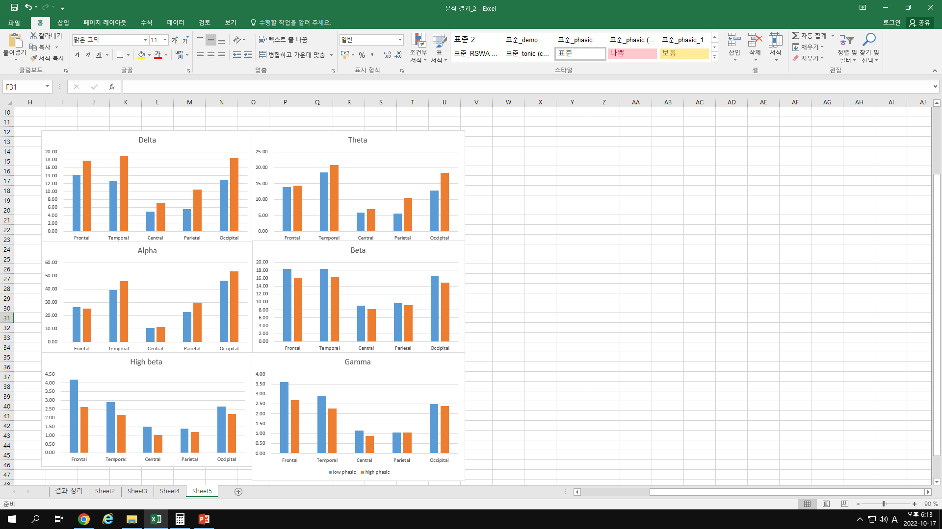
Phasic RSWA
 | Phasic RSWA
 | Low (n=23) |  | High (n=22)
 | Mean | SD | Mean | SD | P-value
Male, n(%) | 13 (56.5%) |  | 12 (54.5%) |  | .585
Age | 68.87 | 6.43 | 68.76 | 8.35 | .962
Education | 11.52 | 4.14 | 9.05 | 5.34 | .092
NP test, z-score
Categorical fluency | 0.31 | 1.06 | 0.12 | 1.35 | .614
Boston naming test | 0.42 | 1.07 | 0.34 | 0.92 | .802
MMSE-KC | -0.19 | 0.94 | -0.85 | 1.60 | .101
Word list memory | 0.51 | 0.97 | 1.49 | 7.77 | .551
Recall of constructional praxis | -0.16 | 0.85 | 0.51 | 1.02 | .143
Word list recall | -0.10 | 1.00 | -2.27 | 8.25 | .216
Word list recognition | -0.24 | 0.78 | -0.55 | 1.26 | .331
Constructional praxis | 0.02 | 1.78 | 0.18 | 0.97 | .566
Trail making test A | 0.72 | 0.85 | 0.72 | 0.74 | .970
Trail making test B | 0.57 | 1.19 | 0.77 | 1.21 | .969
Digit span forward | 0.83 | 1.05 | -0.03 | 0.95 | .008
Digit span backward | 0.36 | 1.23 | 0.38 | 1.38 | .971
Frontal assessment battery | 0.22 | 0.66 | 0.28 | 0.91 | .818
qEEG absolute power
*
*
*
Phasic RSWA was significantly correlated with absolute delta power and theta power, categorical fluency, and MMSE-KC

Slide 8
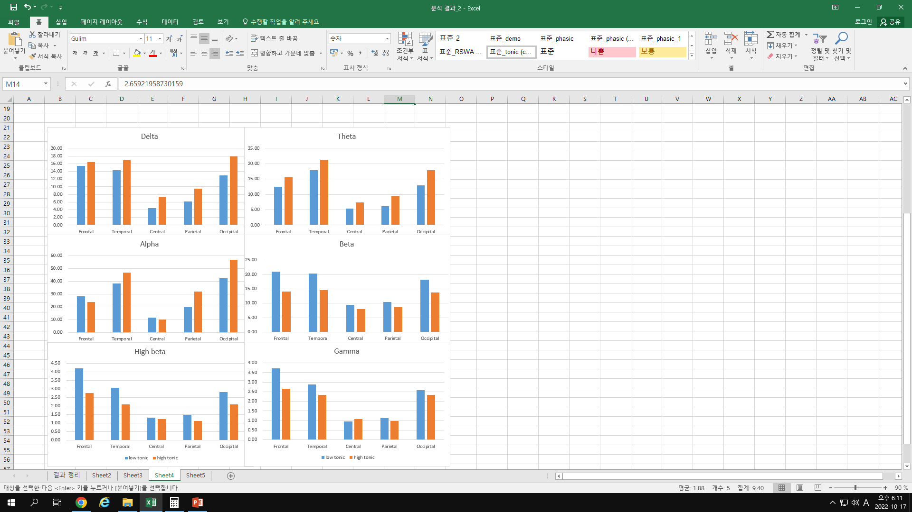
Tonic RSWA
 | Tonic RSWA
 | Low (n=23) |  | High (n=22)
 | Mean | SD | Mean | SD | P-value
Male, n(%) | 13 (56.5%) |  | 12 (54.5%) |  | .585
Age | 67.64 | 7.22 | 70.00 | 7.40 | .290
Education | 10.09 | 5.42 | 10.59 | 4.34 | .737
NP test, z-score
Categorical fluency | 0.47 | 0.98 | -0.03 | 1.36 | .167
Boston naming test | 0.60 | 1.14 | 0.17 | 0.78 | .158
MMSE-KC | -0.17 | 0.98 | -0.83 | 1.54 | .100
Word list memory | 2.10 | 7.43 | -0.15 | 1.09 | .167
Recall of constructional praxis | -0.01 | 0.71 | 0.21 | 1.11 | .430
Word list recall | -1.55 | 7.98 | -0.64 | 0.93 | .607
Word list recognition | -0.37 | 1.25 | -0.41 | 0.77 | .899
Constructional praxis | 0.53 | 1.03 | -0.25 | 1.79 | .087
Trail making test A | 0.78 | 0.97 | 0.66 | 0.58 | .626
Trail making test B | 1.22 | 1.01 | 0.16 | 1.12 | .009
Digit span forward | 0.54 | 1.06 | 0.32 | 1.12 | .521
Digit span backward | 0.43 | 1.52 | 0.30 | 1.01 | .754
Frontal assessment battery | 0.42 | 0.66 | 0.07 | 0.86 | .145
qEEG absolute power
There was no significant correlation other than Boston naming test

Slide 9
Conclusion
These results suggest that phasic RSWA rather than tonic RSWA reflects changes in underlying neurocognitive function of iRBD patients.
Previous studies
1) A longitudinal study reported the optimal cut-off for phenoconversion at five years : 15.4% for tonic EMG activity (sensitivity, 0.69; specificity, 0.57) 7.8% for phasic EMG activity (sensitivity, 0.79; specificity, 0.47) 2) Phasic RSWA : associated with a higher risk of conversion to DLB 3) Tonic RSWA : associated with higher risk of conversion to PD 4) DLB converters showed more pronounced cognitive alterations at baseline with faster progression
Liu Y, et al. (2019) Electromyography activity level in rapid eye movement sleep predicts neurodegenerative diseases in idiopathic rapid eye movement sleep behavior disorder: a 5-year longitudinal study.
McCarter SJ, et al. (2020) REM sleep atonia loss distinguishes synucleinopathy in older adults with cognitive impairment.
Fereshtehnejad SM, et al. (2019) Evolution of prodromal Parkinson’s disease and dementia with Lewy bodies: a prospective study.

Slide 10
2022 BESETO
Thank you for your attention !

Slide 11
Neurocognitive data
Quantitative electroencephalogram (qEEG)
Waking EEG was recorded for 15 minutes. Data processing: NeuroGuide (Applied Neuroscience, Inc., St. Petersburg, FL, USA) High pass filter (100 Hz), Low pass filter (0.3Hz) Spectral analysis with fast Fourier transform - six bands (delta: 1.0-4.0 Hz, theta: 4.0-8.0 Hz, alpha: 8.0-12.0 Hz, beta: 12.0-25.0 Hz, high beta: 25.0-30.0 Hz, and gamma: 30.0-80.0 Hz), five cerebral regions (frontal, temporal, central, parietal and occipital)
Neuropsychological test (NP test)
Verbal fluency, Boston naming test Word list memory, Word list recall, Word list recognition, Constructional Recall Constructional Praxis, Trail making test, Digit span test, Frontal assessment battery Mini-Mental State Examination in the Korean version of the CERAD assessment packet (MMSE-KC)

