Slide 1

세계 의료의 표준을 선도하는 국민의 병원
SNUBH TEMPLATE
Comparison of Autonomous sensory meridian response and binaural auditory beats effects on stress reduction : A randomized double-blind trial
Minji Lee, MD, Hyuk Joo Lee, MD, Junseok Ahn, MD, Jung Kyung Hong, MD & In-Young Yoon, MD, PhD
Presenter : Minji LEE
Notes:
Good evening, ladies and gentlemen, thank you for having me here today. I am Min-ji Lee, a clinical fellow at Seoul National University Bundang Hospital.
I will present the results of comparing the effects of ASMR and BB on stress reduction.

Slide 2
Introduction
세계 의료의 표준을 선도하는 국민의 병원
SNUBH TEMPLATE
Method
Result
Discussion
Conclusion
Notes:
Good evening, ladies and gentlemen, thank you for having me here today. I am Min-ji Lee, a clinical fellow at Seoul National University Bundang Hospital.
I will present the results of comparing the effects of ASMR and BB on stress reduction.
There are 5 part to my talk, Introduction/ Method/ Result/ Discussion/ and conclusion. If you have any questions, please hold them until the end. I have no conflicts of interest.

Slide 3
Introduction
Stress
“Transactional process that emerges from real or perceived environmental demands, depending on the availability of an individual’s adaptive coping strategy”
Stress is one of the trigger for psychiatric disorders such as mood and anxiety disorders
Autonomous sensory meridian response (ASMR)
“Sensory-emotional phenomenon in which specific auditory, audiovisual, or tactile stimuli elicit tingling sensations on the scalp, neck, and arms”
Barratt & Davis (2015): ASMR affects mood in a positive way and relieves chronic pain
Paszkiel et al. (2020): listening to ASMR calms subjects faster than silence by measuring stress levels with EEG, blood pressure, pulse, and questionnaire
Notes:
Stress can be defined as transactional process/ that emerges from real or perceived environmental demands,/ depending on the availability of an individual’s adaptive coping strategy.
As we all know, stress can trigger many diseases, including mood disorder and anxiety disorder.
Attempts have been made to use sound as a non-pharmacological method to reduce this stress.
One of them is Autonomous sensory meridian response. This word may be unfamiliar, but as digital media has been widely viewed recently, you can easily access videos titled ASMR on YouTube.
ASMR is a Sensory-emotional phenomenon in which specific auditory, audiovisual, or tactile stimuli elicit tingling sensations on the scalp, neck, and arms.
Doctors generally agree that ASMR can decrease negative affect and stress level.

Slide 4
Introduction
Binaural beat (BB)
“Perceptual phenomena that occur when two similar, pure tones are delivered to each ear separately”
Originate from the medial nucleus of the superior olive complex
Garcia-Argibay et al. (2019): BB showed efficacy on memory, attention, anxiety, and analgesia to a modest degree
Padmanabhan et al. (2005): BB before surgery was more effective in reducing anxiety than listening to music
Binaural Beat
5Hz
Left Tone
255Hz
Right Tone
260Hz
Notes:
Binaural beats can also be easily accessed through a video titled that it helps emotional and physical healing. The binaural beat may be more unfamiliar than the ASMR.
If you look at the picture below, you will see the tone of 255Hz on the left and a tone of 260Hz on the right ear.
Instead of hearing two different tones, you instead hear a tone at 5 Hz in addition to the two tones given to each ear.
These beats are thought to originate from the medial nucleus of the superior olive complex which receives bilateral input for the first time.
Binaural beats are known to be associated with improving memory, reducing anxiety, and pain.
So far, we've looked at two different sounds with similar effects.

Slide 5
Introduction
There were no studies directly comparing the effectiveness of the two.
This study aimed to compare the effects of Autonomous sensory meridian response (ASMR) and binaural beat (BB) on stress reduction.
Notes:
However, despite the similar effects of the two sounds, there have been no studies directly comparing the two.
We compared the ASMR and Binaural Beat to see which one is more acceptable and more effective on stress reduction.
From now on, I’ll call binaural beats as BB for convenience.

Slide 6
Method
Screening
PSS ≥ 14
BDI-II 20-45 or ISI 8-21 or STAI-S ≥ 39
Intervention (3 weeks, randomized double-blind)
ASMR
(1) Scraping non-woven fabric sound, (2) Birdsongs, (3) White noise
Daytime: 15min, Nighttime: 30min
BB
(1) Debussy - Arabesque No. 1, (2) Mozart - Concerto for flute, harp & orchestra in C major, K. 299 (K. 297c), (3) Mozart - Piano Concerto No. 21 in C, K 467, Elvira Madigan
Daytime: 15min, (8Hz BB) Nighttime: 30min, (5Hz BB)
*PSS: perceived stress scale, BDI-II: Beck depression inventory-II, ISI: insomnia severity index
Notes:
Now we introduce our experimental method.
We first screened people with stress.
PSS is one of the most widely used stress scales that evaluates the subject's perceived stress experience. Those with PSS score 14 or higher were evaluated to be stressful.
As stress can induce depressed mood, insomnia and anxiety, we also used BDI-II, ISI and STAI-S scores. Any one of the followings in criteria thought to be stressed.
Subjects were assigned to the groups by the randomization.
Subjects in the ASMR group listened to the ASMR sound. Since the sound of ASMR can be uncomfortable for some people, we prepared three types of sounds: (1) scraping non-woven fabric sound, (2) birdsongs, (3) white noise. They listened for 15 minutes during the day and 30 minutes at night.
In BB group, we targeted 8Hz binaural beat for daytime, and 5Hz binaural beat for nighttime. Three kinds of music were selected for the trial.
A three-week intervention was conducted.

Slide 7
Method
Efficacy evaluation
Questionnaires: PSS, BDI-II, ISI, STAI-S, PSQI, QOL-BREF
Quantitative electroencephalogram (QEEG)
Statistical analysis
The independent t-test or Mann-Whitney U test was performed for numerical variables and the chi-squared test was performed for categorical variables.
Within-group differences: paired t-test.
Group-by-time interaction: repeated measures analysis of variance (RM ANOVA)
Significance tests : two sided, p-value < 0.05
*STAI-S: state-trait anxiety inventory-state anxiety, PSQI: Pittsburgh Sleep Quality Index, QOL-BREF: Quality of Life scale abbreviated version
Notes:
To evaluate the effect, we conducted a questionnaire before and after the intervention. The QEEG was also used to assess objective change.
We used independent t-test or Mann-Whitney U test for numerical variables and the chi-squared test for categorical variables.
We compared within-group differences of QEEG by using the paired t-test in each group, and group-by-time interaction of all QEEG power by using RM ANOVA. All significance tests were two sided and p-value was set at < 0.05.

Slide 8
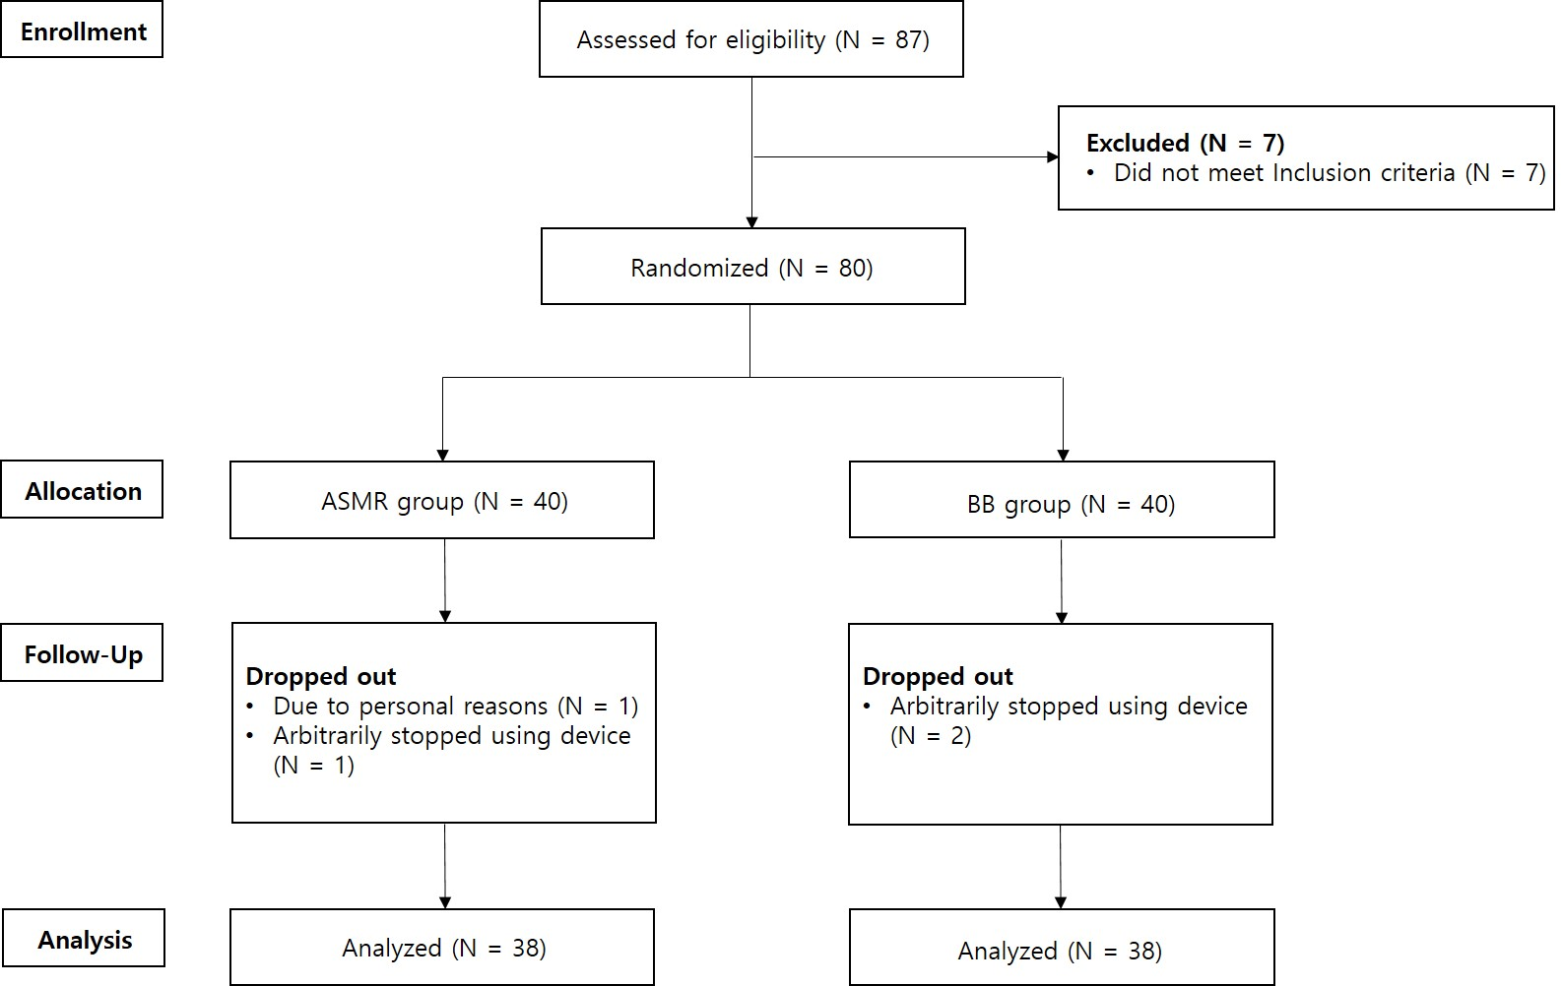
Result
Figure 1. Flow chart summary of the participants.

Slide 9
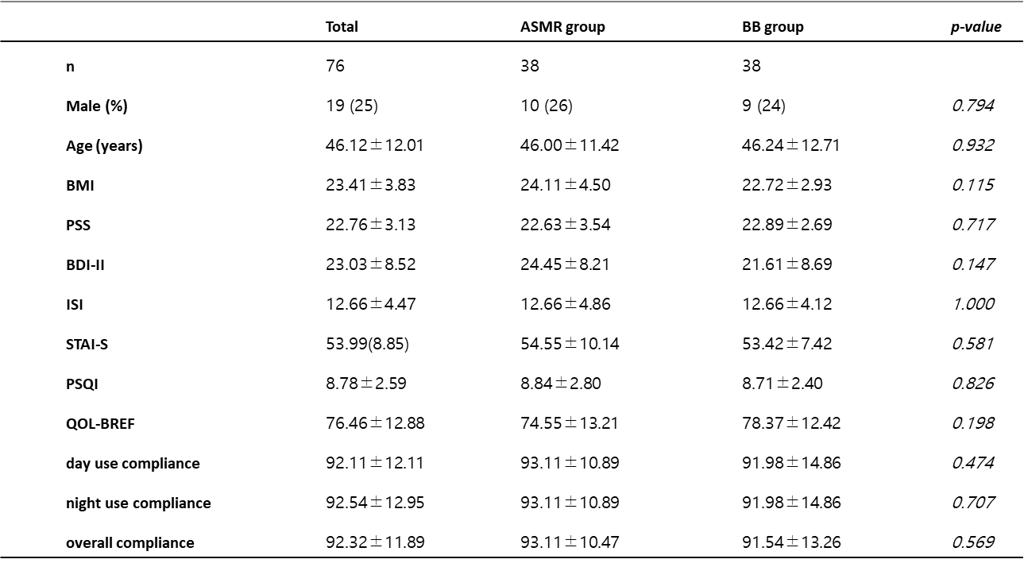
Result
Table 1. Demographic characteristics of participants (N=76)

Slide 10
Result
Table 2. Mean comparison of questionnaires before and after application use
P*: Between-group differences.

Slide 11
Result
Table 3. Band power comparison of before and after application use measured by quantified electroencephalogram
P*: Between-group differences.

Slide 12
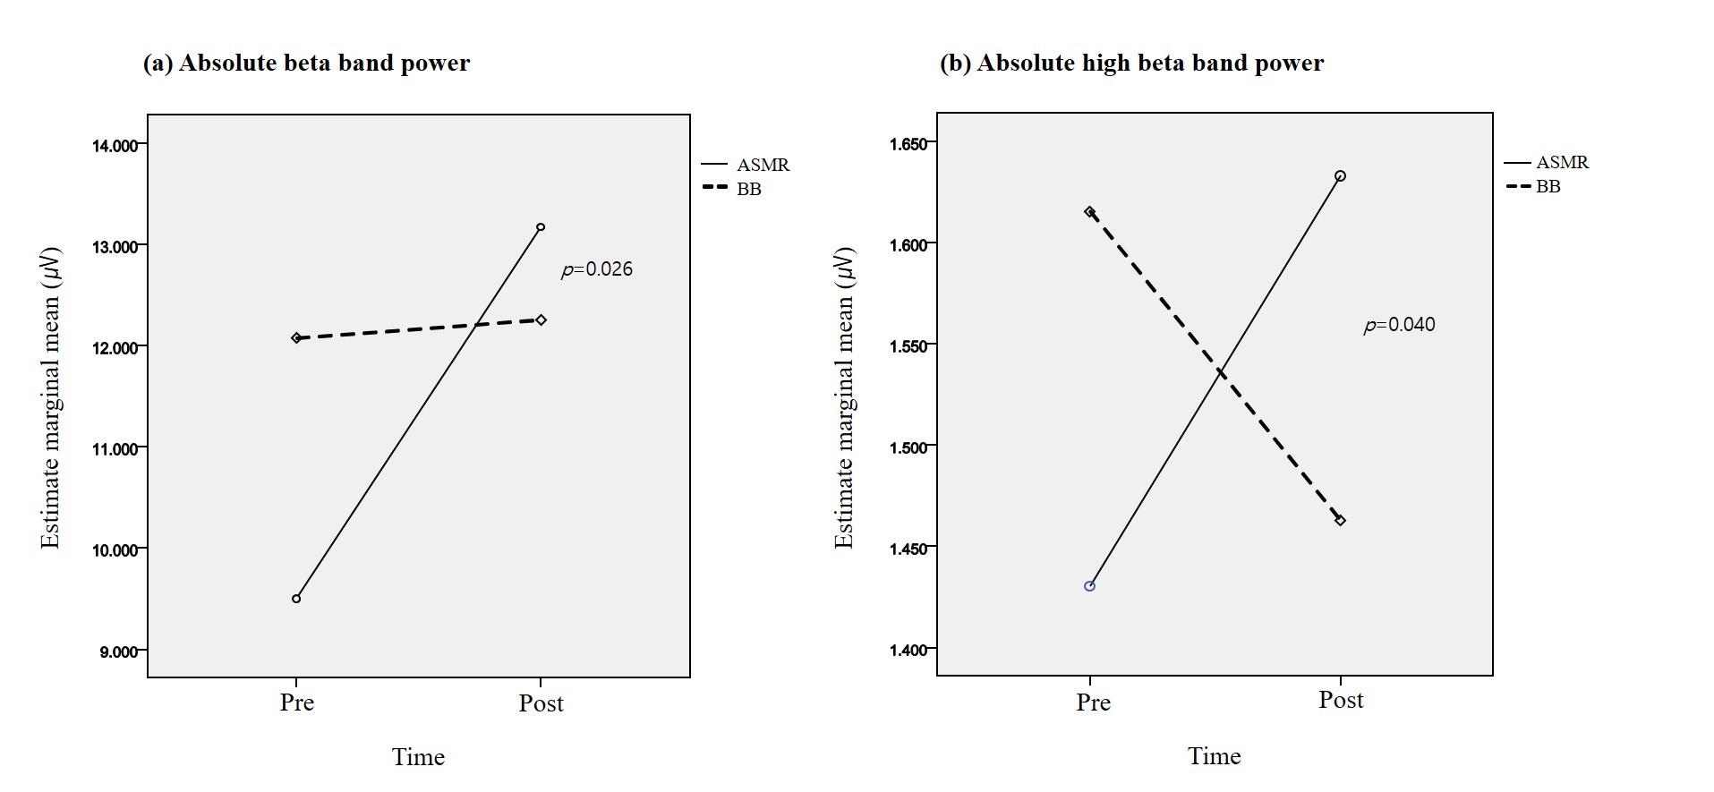
Result
Figure 2. Differences in the changes of absolute power between the ASMR and BB interventions
Group-by-time interaction in absolute beta band power (a) and absolute high beta band power (b).
Notes:
Barratt & Davis found that ASMR affects mood in a positive way and relieves chronic pain
Left Tone 255Hz

Slide 13
Discussion
In both the ASMR and BB groups, subjective stress measured by questionnaires decreased to a similar extent.
Both the ASMR and binaural beats reduced stress levels, particularly in the BDI-II and ISI, the average scores returned to normal.
In the QEEG, the absolute beta and high beta band power in the ASMR group increased
(1) ASMR's characteristics related to tingling sensations can influence the rise of beta waves
Sensorimotor processing, auditory processing, and observation of the tactile input → involve beta modulation
(2) ASMR may be perceived as an annoying stimulus.
Beta waves can be increased in stressful situations.
Beta waves are well known to reflect cortical hyper arousal on quantified EEGs.

Slide 14
Discussion
BB group failed to show entrainment effects.
BB is known to entrain cortical activity at a specific frequency and cross-frequency modulations: in delta, theta, and gamma
In previous studies, most of the experiments that used multiple different frequencies to one subject did not show entrainment effect
It is possible that the entrainment effect was not observed in our study due to interference between the alpha and theta waves.

Slide 15
Discussion
Limitation
Using three different sounds for the ASMR group and BB group
Their brain responses may differ because they heard different sounds
Heterogeneities in the characteristics of people with stress
People with stress may be a heterogeneous group with symptoms such as depression, anxiety, and insomnia
QEEG was not measured while listening to sounds
It is possible that BB had a brain entrainment effect, but it could not be maintained for a long time

Slide 16
Conclusion
Both ASMR and BB are equally effective in reducing stress levels.
Unlike BB, ASMR can lead to an increase in beta and high beta waves associated with cortical arousal.

