Slide 1

『BESETO 2022』
Development of a suicidal risk prediction model and computer application:
A prospective cohort study.
K-COMPASS Korean COhort for the Model Predicting A Suicide and Suicide related behavior
2022. 11. 13.
Yang, Jeong Hun
Seoul National University Hospital
Notes:
연구 한글 제목 확인 요함

Slide 2
Trends of Recent Suicidal Risk Prediction Studies
Suicidal Risk Prediction Model > In-depth clinical assessment
Lack of superiority of accuracy
High consumption of time and manpower
Improving model accuracy and validity
Prospective study of various variables
Risk analysis of suicide-related behaviors (suicide accidents/attempts, etc.) rather than suicide deaths
Suicidal death is an overly rare event, so predictive models are less accurate
Validation of the model built through the train set in the test set

Slide 3
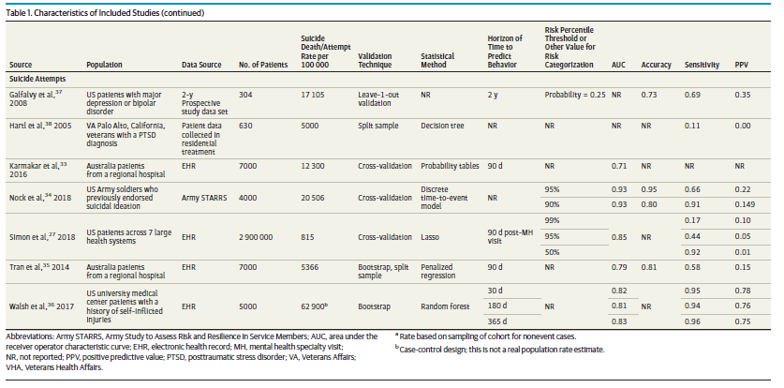
Recent Suicidal Risk Prediction Models for Suicidal Attempt
Global classification accuracy is high, but positive predictive value is low.
Relatively good accuracy compared to suicide death model

Slide 4





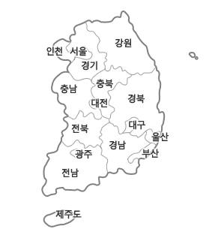
K-COMPASS Korean COhort for the Model Predicting A Suicide and Suicide related behavior
SNUH
KHUH
Jongno
Dongdaemun
GUGH
SUBH
Incheon
Bucheon
Establishment of a network of 8 hospitals and 8 community mental health centers
A prospective cohort study in the high-risk group for suicide 16 years of age or older who have attempted suicide within 1 month or are currently contemplating suicide
Number of study subjects and study period
Train cohort: 2015.11~2019.8, 800 participants
Independent validation cohort: 2019.9~2022.6., 432 participants
Hospital
Community
SUCH
YWMC
Cheonan
Wonju
WKUH
IUBPH
Iksan
Busanjin
KHUH
SNUH
GUGH
YWMC
SUBH
SUCH
IUBPH
WKUH

Slide 5
Construction of Suicide Attempt Risk Prediction Model
Logistic regression model for suicide attempts within 6 months from baseline
Test cohort: Among 800 participants, 452 followed-up until 6 months, and 32 attempted suicide
Independent validation cohort: among 432 in validation cohort, 128 followed-up and 6 attempted suicides
Additional model was constructed only using self-report scales to develop a risk prediction application without professional assessment.

Slide 6
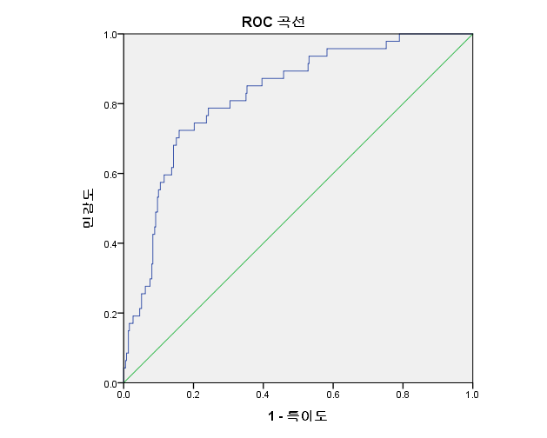
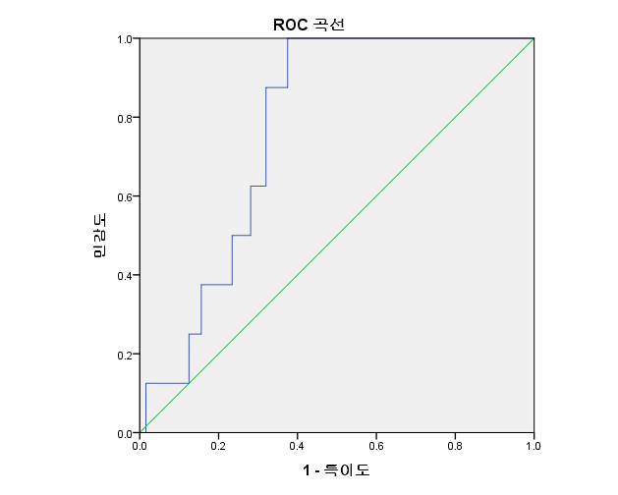
1. Model using both self-report scale + clinician rating scale
Accuracy curves from which the model was validated in an independent validation cohort
Accuracy curve for models built on test cohort
AUROC | Cutoff | Sensitivity | Specificity
0.824 | 17.67% | 0.723 | 0.841
AUROC | Cutoff | Sensitivity | Specificity
0.771 | 17.67% | 1.00 | 0.578

Slide 7
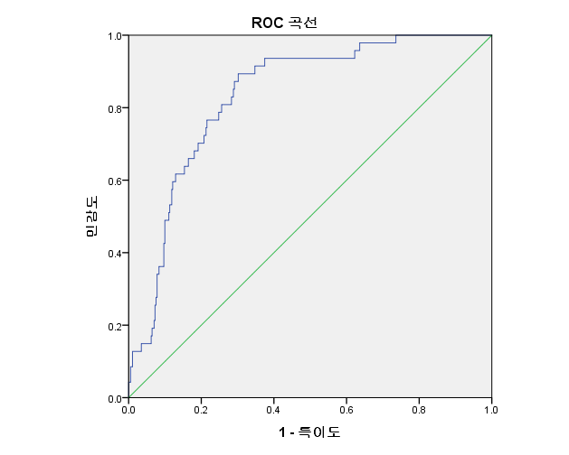
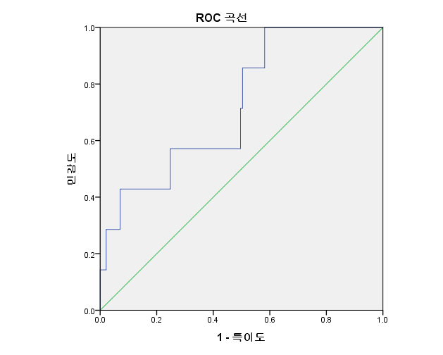
2. Models relying only on self-report scales
Accuracy curve for models built on test cohort
Accuracy curves from which the model was validated in an independent validation cohort
AUROC | Cutoff | Sensitivity | Specificity
0.834 | 9.69% | 0.894 | 0.698
AUROC | Cutoff | Sensitivity | Specificity
0.725 | 9.69% | 0.571 | 0.532

Slide 8
Conclusion
We developed a model to predict the suicidal behavior risk of high-risk groups through a prospective cohort and an application to disseminate the model to the local community.
The accuracy of the model is excellent compared to the latest foreign studies.
The model is more reliable in that an independent cohort was established for validation.
We hope that our model would be widely used in the military or prison where it is difficult to provide mental health services.

Slide 9
Thank you for listening!

