Slide 1
Influence of biogenetic explanations of mental disorders on stigma and help-seeking behavior: A systematic review and meta-analysis
Changhyeon Baek
Seoul Natioanl University Hospital

Slide 2
Introduction
Biogenetic explanation of mental illness
Recent developments in neuroscience → pathophysiological mechanisms underlying psychiatric diseases
Biogenetic explanation of mental disorders : public campaigns and mental health education
Attitude toward mental illness
“medicalization” : over-diagnosis and over-treatment (Conrad, 2007)
vs
Reduce moral and punitive responses to patients by emphasizing that mental illness is unrelated to individual will or personality

Slide 3
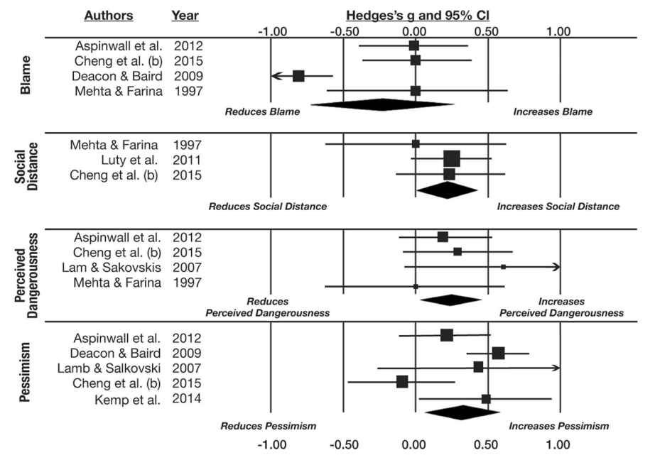
Introduction
Previous studies
Inconsistent ; social distance
Han, 2014 ↑ vs Cheng, 2014 ↓
Meta-analysis (Haslam, 2018)
↑Social distance, Dangerousness, Pessimism
Limitations
Attitude toward help seeking
Different disorder
Target population
Cultural background

Slide 4
In this study
Outcome
Help seeking
Subgroup analysis
Blame
Public
Patient
Biogenetic explanation
Dangerousness
Mood
Psychosis
Pessimism
East
West
Social distance

Slide 5
Method – Study selection
Records identified through database searching
Pubmed(3194), EMbase(13366), Cochrane(982), CINHAL(775), Psyinfo(1794) , Web of Science(3054)
Total (n =23165)
23,165 searched, Excluded duplication → 18,354
221 Screened
84 eligibility
44 included
Records after duplicates removed (n =18354)
Records screened with title/abstract (n =221 )
Records excluded (n = 137)
Full-text articles excluded, with reasons (Cannot find full-text article, Outcomes not relevant,No biogenetic explanation, Suitable data unavailable)
(n = 40)
Full-text articles assessed for eligibility (n = 84)
Studies included in quantitative synthesis (meta-analysis) (n = 44 )

Slide 6
Result

Slide 7
Experimental study
Correlational study
Author | Year | Group | Disorder
JOEL EPSTEIN | 1995 | Public | addiction
Sheila Mehta | 1997 | Public | general mental disorder
Danny C.K. Lam | 2005 | Public | general mental disorder
Danny C.K. Lam | 2006 | Patient | panic
Han DY | 2006 | Public | depression
Jo C. Phelan | 2006 | Public | schizophrenia, depression
Laura Bennett | 2008 | Public | schizophrenia
Michele A.Crisafulli | 2008 | Public | anorexia nervosa
Brett J. Deacon | 2009 | Public | depression
Laura C. Rusch | 2009 | Public | depression
Laura C. Rusch | 2010 | Patient | depression
Bernice A. Pescosolido | 2010 | Public | schizophrenia
Jason Luty | 2011 | Public | depression
Eva Lüllmann, Tania M. Lincoln | 2011 | Patient | schizophrenia
Zhen Hadassah Cheng | 2014 | Public | depression
Matthew S. Lebowitz, Woo-kyoung Ahn | 2014 | Patient | anxiety
Han DY | 2014 | Public | depression
Francois B. Botha | 2015 | Public | depression
Lee, A. A, BRETT J. DEACON | 2016 | Patient | depression, anxiety
Kerry A Howard | 2018 | Public | depression
Ryan Thibodeau | 2019 | Public | schizophrenia
Yasutaka Ojio | 2019 | public | general mental disorder
Caleigh Cassidy | 2020 | public | bipolar
CA Schofield | 2020 | public | anxiety
Author | Year | Group | Disorder
JACK K. MARTIN | 2000 | public | general mental disorder
JASON SCHNITTKER | 2000 | public | general mental disorder
Sarah Wrigley | 2005 | public | schizophrenia, depression
B. BAG | 2005 | public | schizophrenia
Jo C. Phelan | 2005 | public | general mental disorder
JTB Veer | 2006 | public | general mental disorder
Benjamin W. Van Voorhees | 2006 | Patient | depression
Snadra Dietrich | 2006 | public | schizophrenia, depression
Bettina Meiser | 2007 | public | biopolar
Boon-Ooi Lee | 2007 | public | schizophrenia, depression, anxiety
Syed Nabeel Zafar | 2008 | public | schizophrenia
Michelle Kermode | 2009 | public | schizophrenia, depression
Steven Pirutinsky | 2010 | public | obssession
Nicola J Reavley | 2014 | public | schizophrenia, depression, social phobia, PTSD
G. Schomerus | 2014 | public | schizophrenia, depresion, alcohol
Nell Ellison | 2015 | public | biopolar
Katrina Scior | 2016 | public | schizophrenia, mental retardation
Matthew A. Andersson | 2018 | public | schizophrenia, depresion, alcohol
N. Schnyder | 2018 | public | schizophrenia, depression
Subin Park | 2018 | public | bipolar, depression

Slide 8
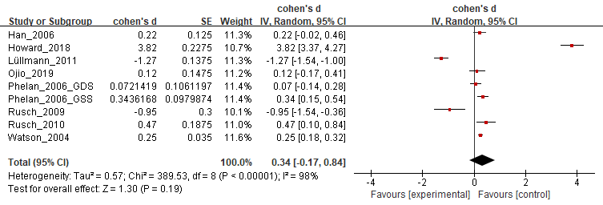
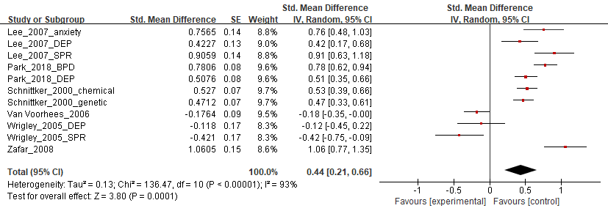
Result 1 - help seeking
Experimental
Correlational
Notes:
Experimental study에서는 유의미한 결과를 보이지 않았으나 (증가시키는 방향성을 보임)
Correlational study에서는 유의미하게 help seeking behavior를 increase
특히, 동서양을 비교했을 때, 동양에서 help seeking behavior가 유의미하게 increase

Slide 9
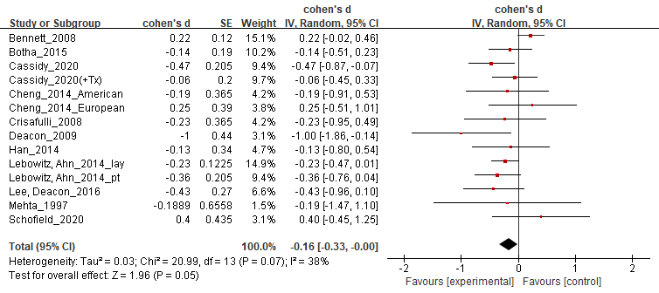
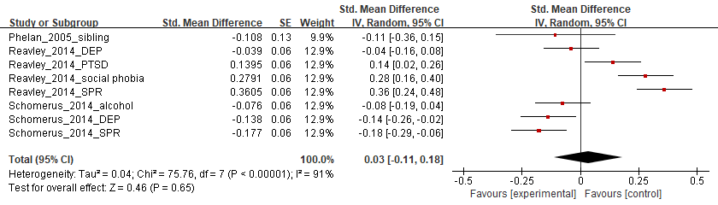
Result 2 - blame
Experimental
Correlational
Notes:
Experimental study에서는 유의미하게 blame을 decrease
Correlational study에서는 유의미한 결과가 없었음

Slide 10
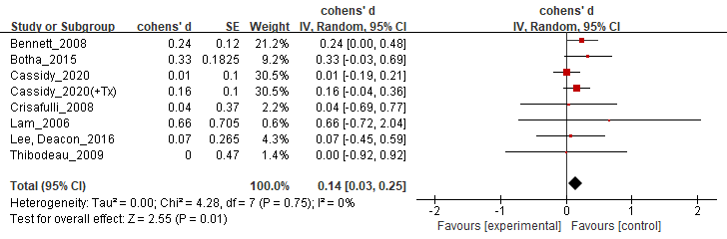
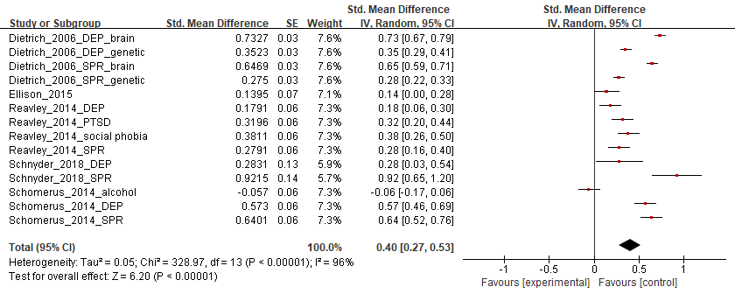
Result 3 - dangerousness
Experimental
Correlational
Notes:
Experimental study에서 유의미하게 dangerousness을 increase
Correlational study에서 유의미하게 dangerousness을 increase

Slide 11
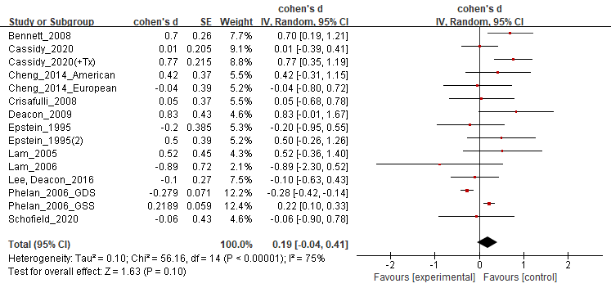
Result 4 - pessimism
Experimental
Correlational
(-)
Notes:
Experimental study에서 증가시키는 방향성을 보였으나 유의한 수준은 아니었음

Slide 12
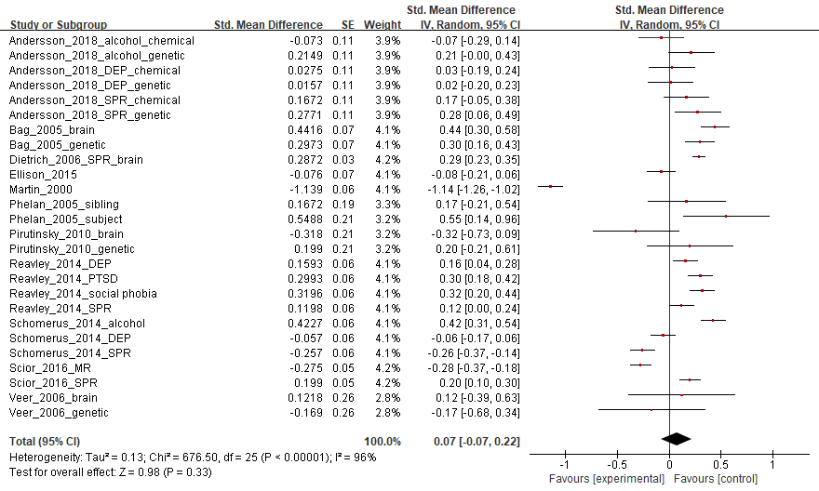
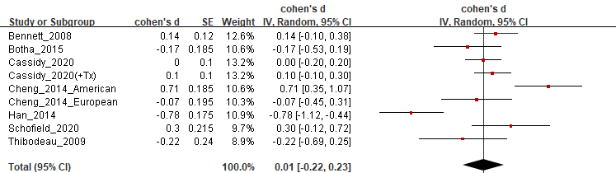
Result 5 - social distance
Experimental
Correlational
Notes:
Experimental, correlational study 모두에서 social distanc에는 유의한 영향을 주지 않았으나
Correlation study에서는 증가시키는 방향성을 보임

Slide 13
Conclusion
 | Experimental |  | Correlational
Help seeking |  | Public |  | East
 |  | Patient (-) |  | West
Blame |  | Public | (-)
 |  | Patient
Dangerousness |  | Public
 |  | Patient
Pessimism |  | Public | (-)
 |  | Patient (-)
Social distance | (-) |  | (-)
Notes:
동양 – 내인적, 개인문제 가족문제 스스로 해결해야할 문제 (이전 문헌 근거하여 설명)
이런 explanation 전략이 도움될 수
환자군보다는 대중에서 높이는 경향
일반인 질병교육시 강조할 필요가
+ blame(같은 맥락에서)
다음
Danger, pessimism
Pulbic, pt. 따로 설명
일반인, 환자군 대상 설명시 주의
에후에 대해 적절한 정보를 반드시 포함

