Slide 1
Financial Performance
Dashboard
DESIGN BRIEF
The pages we will build in Power BI, the question each chart answers, and the colors that hold it together.
EGX listed companies · Quarterly statements · Sample: Juhayna (JUFO)
Notes:
This deck is the agreed design before we build in Power BI. Every page and chart is here with the question it answers, so we build only what serves a question.

Slide 2
Six pages, six questions
THE DASHBOARD
# | Page | The question it answers | Data from
01 | Overview | How is the company performing financially? | Executive summary
02 | Profit & Loss | Is the company growing profitably? | Income statement
03 | Balance Sheet | What does it own, and how is it funded? | Balance sheet
04 | Liquidity & Leverage | Can it meet its obligations? | Balance sheet + P&L
05 | Working Capital | How efficiently does it use operating assets? | Balance sheet + P&L
06 | Compare Companies | How does it stack up against peers? | All statements
Financial Performance Dashboard · Design brief · 2
Notes:
Each page answers exactly one business question. The page title in Power BI is the page name, and the subtitle is the question, so a reader always knows why the page exists.

Slide 3
One meaning per color, on every page
COLOR SYSTEM
Deep teal
Teal
Amber
Purple
#1D4A55
#3A9A9A
#D9772B
#7A5AA6
Revenue, assets, subtotals, selected state
EBITDA, equity, second series
Costs, net income, liabilities
Operating expenses (OPEX)
Brick red
Green
Gray
Sidebar
#B6452C
#2E7D5B
#AEBBC0
#12303A
Debt and warnings, always with words
Positive change, always with words
Prior year, other, thresholds
Navigation panel background
Financial Performance Dashboard · Design brief · 3
Notes:
Colors carry meaning, not decoration: teal family = the business growing (revenue, EBITDA, equity); amber = what it costs or owes; red and green only flag good or bad and always sit next to words like "Above 3x: watch". Page background #EEF2F3, cards #FFFFFF, text #13252C, captions #52646C. All are in the EGX_Financials_theme.json file.

Slide 4
Every page reads the same way
PAGE LAYOUT
1
2
3
4
Navigation
Filters
KPI row
Charts
Dark sidebar on the left with the page navigator. Same place on every page.
One row top-right: Company, Year, Yearly or Quarterly, Clear. Synced across pages.
4 to 6 cards: the value, one line of context, a small trend line.
2 to 4 cards. Each title is the question the chart answers.
Titles are questions
Partial years say so
One unit
"Is profit turning into cash?" beats "OCF vs NI".
2026 is labeled 2026 H1, so nobody reads a drop.
EGP billions (bn), ratios as x, margins as %.
Financial Performance Dashboard · Design brief · 4
Notes:
Readers learn the layout once. Navigation left, filters top, headline numbers, then charts that explain them. The three rules below the layout stop the most common misreadings.

Slide 5
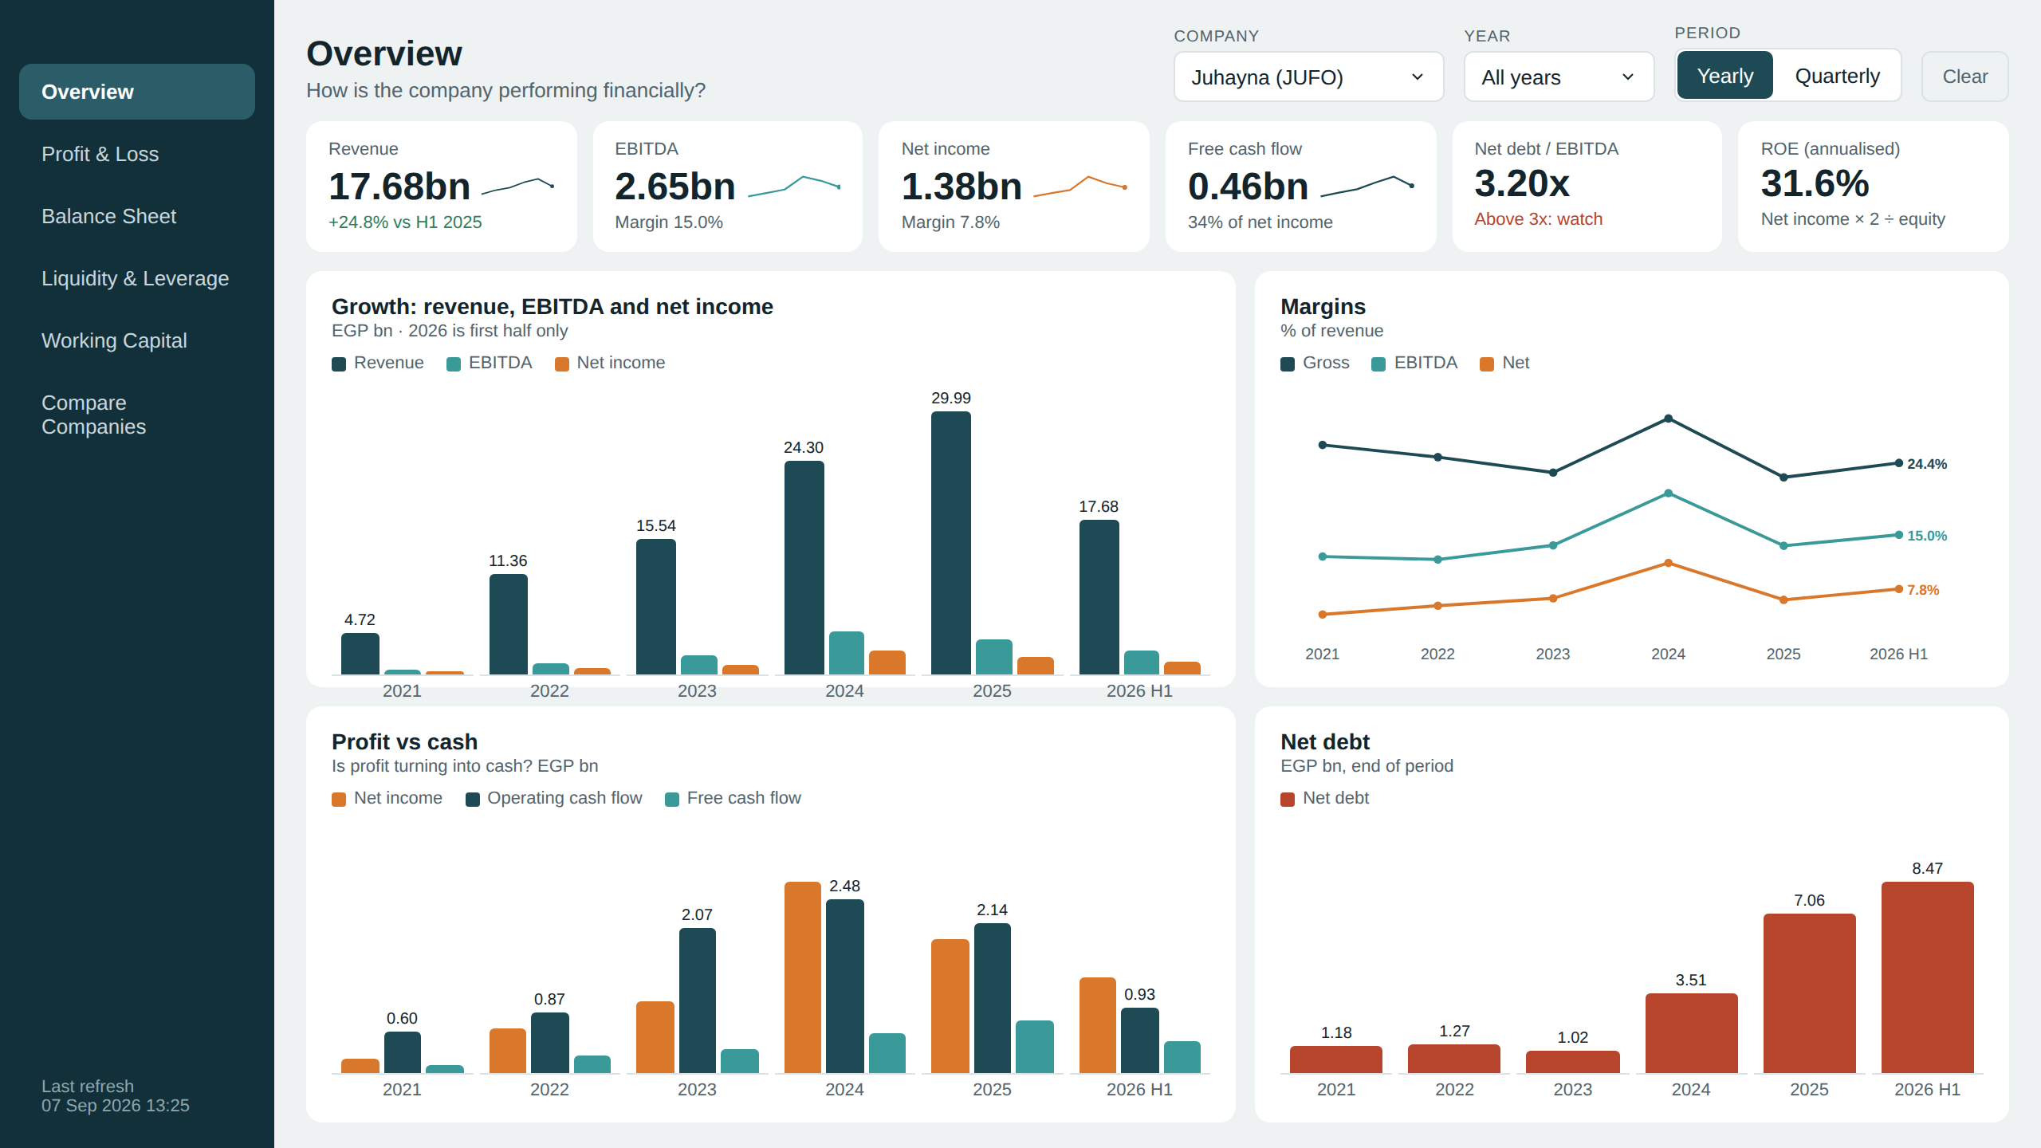
Overview
PAGE 1 OF 6
How is the company performing financially?
The one page an executive reads. Headline numbers first, then four charts that explain growth, profitability, cash and debt.
Financial Performance Dashboard · Design brief · 5
Notes:
Overview: The one page an executive reads. Headline numbers first, then four charts that explain growth, profitability, cash and debt.

Slide 6
Each visual and its job
PAGE 1 · OVERVIEW
Visual | Chart type | Question it answers | Measures
KPI row | Cards | What are the headline numbers right now? | Revenue, EBITDA, Net Income, FCF, Net Debt / EBITDA, ROE
Growth | Clustered column | Is the business growing, and is profit growing with it? | Revenue, EBITDA, Net Income
Margins | Line | Is each pound of revenue becoming more profitable? | Gross, EBITDA and Net margin %
Profit vs cash | Clustered column | Is profit turning into real cash? | Net Income, Operating Cash Flow, FCF
Net debt | Column | Is the company borrowing more over time? | Net Debt
Financial Performance Dashboard · Design brief · 6
Notes:
Every visual on the Overview page with the question it answers and the DAX measures behind it (names as in Measures.dax).

Slide 7
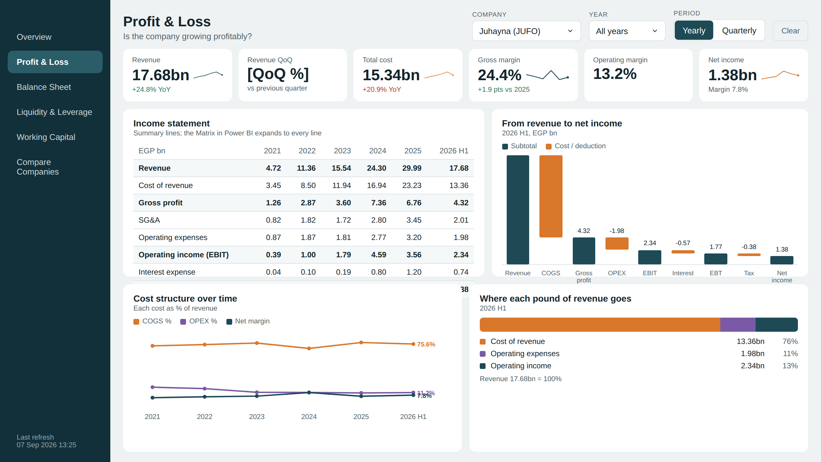
Profit & Loss
PAGE 2 OF 6
Is the company growing profitably?
Follows revenue down to net income and shows which costs grow faster than sales.
Financial Performance Dashboard · Design brief · 7
Notes:
Profit & Loss: Follows revenue down to net income and shows which costs grow faster than sales.

Slide 8
Each visual and its job
PAGE 2 · PROFIT & LOSS
Visual | Chart type | Question it answers | Measures
KPI row | Cards | Are revenue and costs growing, and at what margin? | Revenue, YoY / QoQ %, Total Cost, Margins
Income statement | Matrix | What happened, line by line, period by period? | Financial Term × period, Value
Revenue to net income | Waterfall | Where does revenue go before it becomes profit? | Revenue, COGS, OPEX, Interest, Tax
Cost structure | Line | Are costs growing faster than revenue? | COGS %, OPEX %, Net margin %
Revenue split | 100% bar | Where does each pound of revenue go? | COGS, OPEX, Operating income
Financial Performance Dashboard · Design brief · 8
Notes:
Every visual on the Profit & Loss page with the question it answers and the DAX measures behind it (names as in Measures.dax).

Slide 9
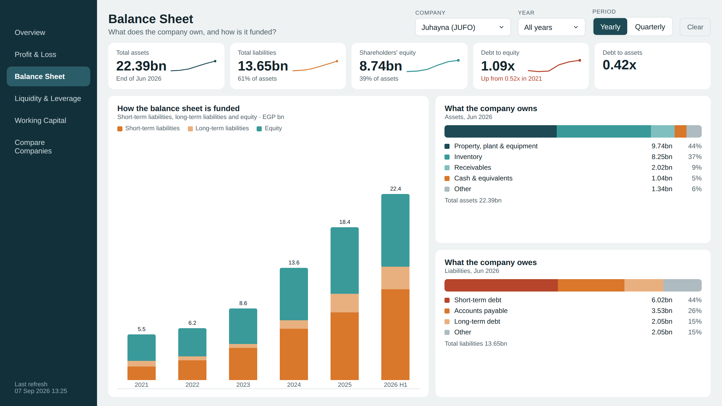
Balance Sheet
PAGE 3 OF 6
What does it own, and how is it funded?
Shows the size of the company and whether growth is paid for with debt or with shareholders’ money.
Financial Performance Dashboard · Design brief · 9
Notes:
Balance Sheet: Shows the size of the company and whether growth is paid for with debt or with shareholders’ money.

Slide 10
Each visual and its job
PAGE 3 · BALANCE SHEET
Visual | Chart type | Question it answers | Measures
KPI row | Cards | How big is the company and how leveraged? | Total Assets, Liabilities, Equity, D/E, D/A
Funding | Stacked column | Is growth funded by debt or by equity? | Short-term liabilities, long-term liabilities, Equity
What it owns | 100% bar | Where is the money invested? | PP&E, Inventory, Receivables, Cash, Other
What it owes | 100% bar | What does it owe, and how soon? | Short-term debt, Payables, Long-term debt, Other
Financial Performance Dashboard · Design brief · 10
Notes:
Every visual on the Balance Sheet page with the question it answers and the DAX measures behind it (names as in Measures.dax).

Slide 11
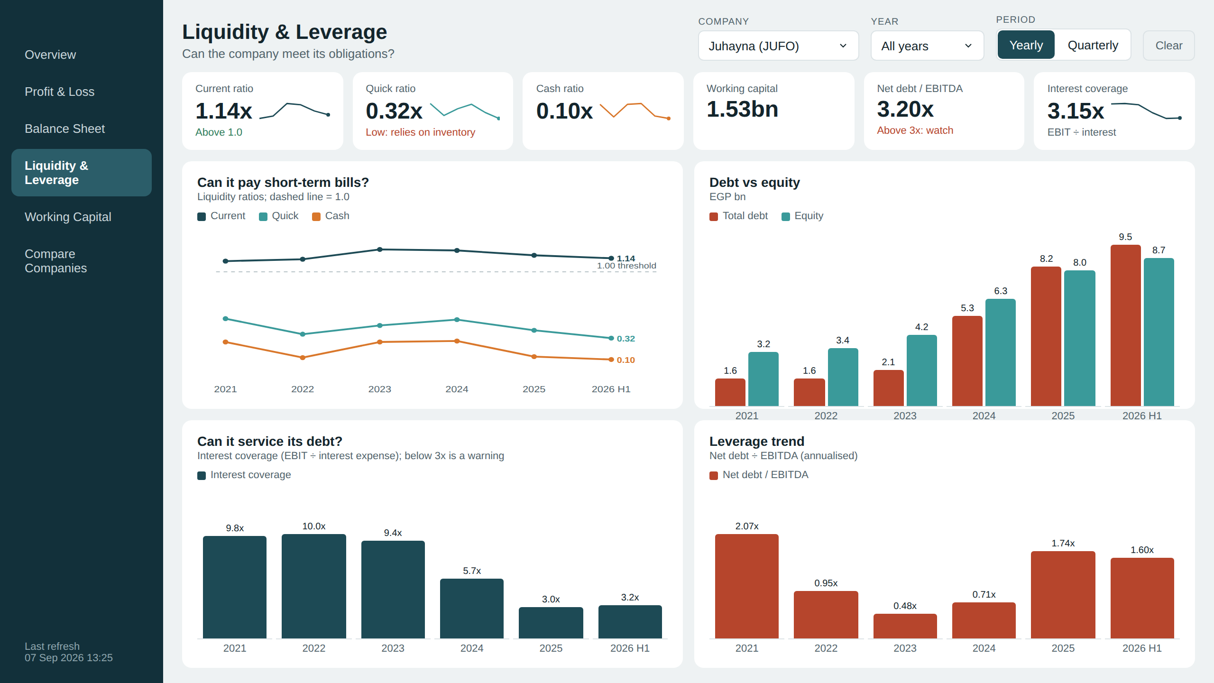
Liquidity & Leverage
PAGE 4 OF 6
Can it meet its obligations?
Short-term: can it pay this year’s bills. Long-term: can it carry and service its debt.
Financial Performance Dashboard · Design brief · 11
Notes:
Liquidity & Leverage: Short-term: can it pay this year’s bills. Long-term: can it carry and service its debt.

Slide 12
Each visual and its job
PAGE 4 · LIQUIDITY & LEVERAGE
Visual | Chart type | Question it answers | Measures
KPI row | Cards | Is any ratio in the danger zone? | Current, Quick, Cash ratio, Net Debt / EBITDA, Coverage
Short-term bills | Line + 1.0 line | Can it pay bills due within a year? | Current, Quick, Cash ratio
Debt vs equity | Clustered column | Is leverage rising? | Total Debt, Total Equity
Debt service | Column | Can profit cover the interest bill? Below 3x is a warning. | Interest Coverage
Leverage trend | Column | How many years of EBITDA would repay net debt? | Net Debt / EBITDA
Financial Performance Dashboard · Design brief · 12
Notes:
Every visual on the Liquidity & Leverage page with the question it answers and the DAX measures behind it (names as in Measures.dax).

Slide 13
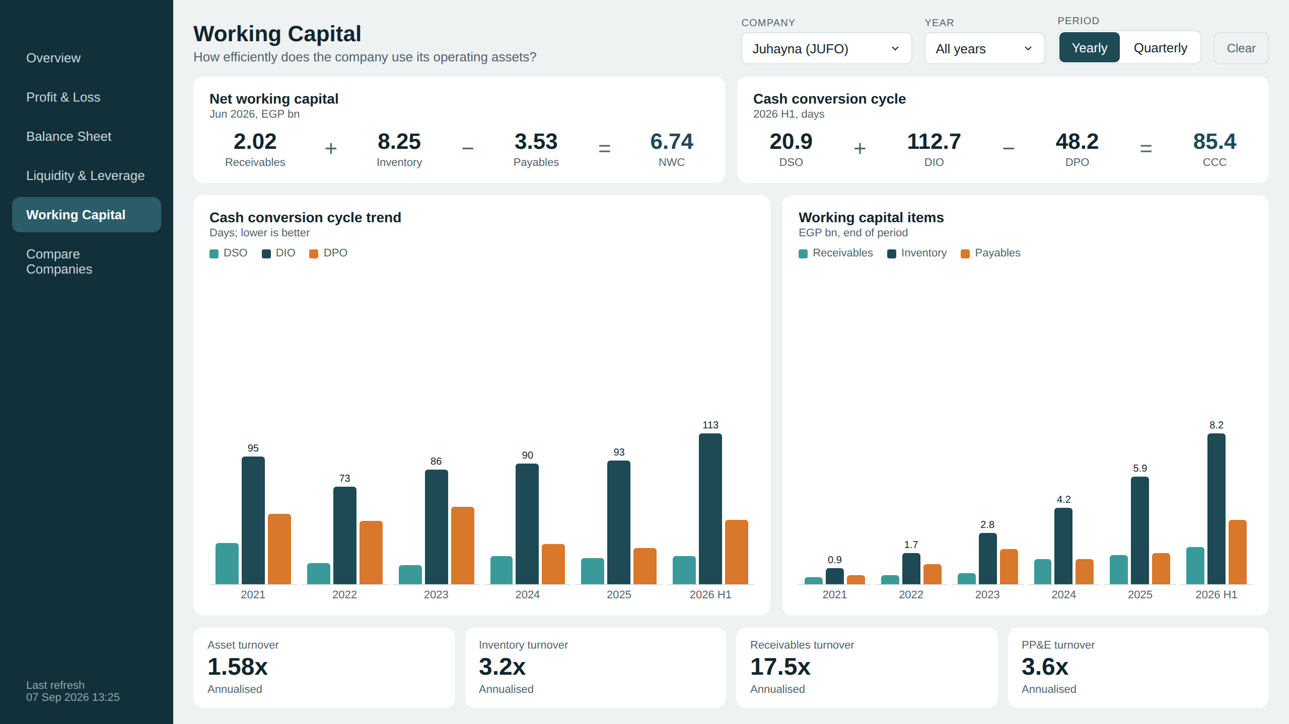
Working Capital
PAGE 5 OF 6
How efficiently does it use operating assets?
Shows how much cash is tied up in running the business and how long it takes to come back.
Financial Performance Dashboard · Design brief · 13
Notes:
Working Capital: Shows how much cash is tied up in running the business and how long it takes to come back.

Slide 14
Each visual and its job
PAGE 5 · WORKING CAPITAL
Visual | Chart type | Question it answers | Measures
Equations | Cards | How much cash is tied up, and for how many days? | AR + Inventory − AP; DSO + DIO − DPO
Cash cycle | Clustered column | Is the cash cycle getting longer? | DSO, DIO, DPO
Working capital items | Clustered column | Which item drives the change? | Receivables, Inventory, Payables
Turnover | Cards | How hard are the assets working? | Asset, Inventory, Receivables, PP&E turnover
Financial Performance Dashboard · Design brief · 14
Notes:
Every visual on the Working Capital page with the question it answers and the DAX measures behind it (names as in Measures.dax).

Slide 15
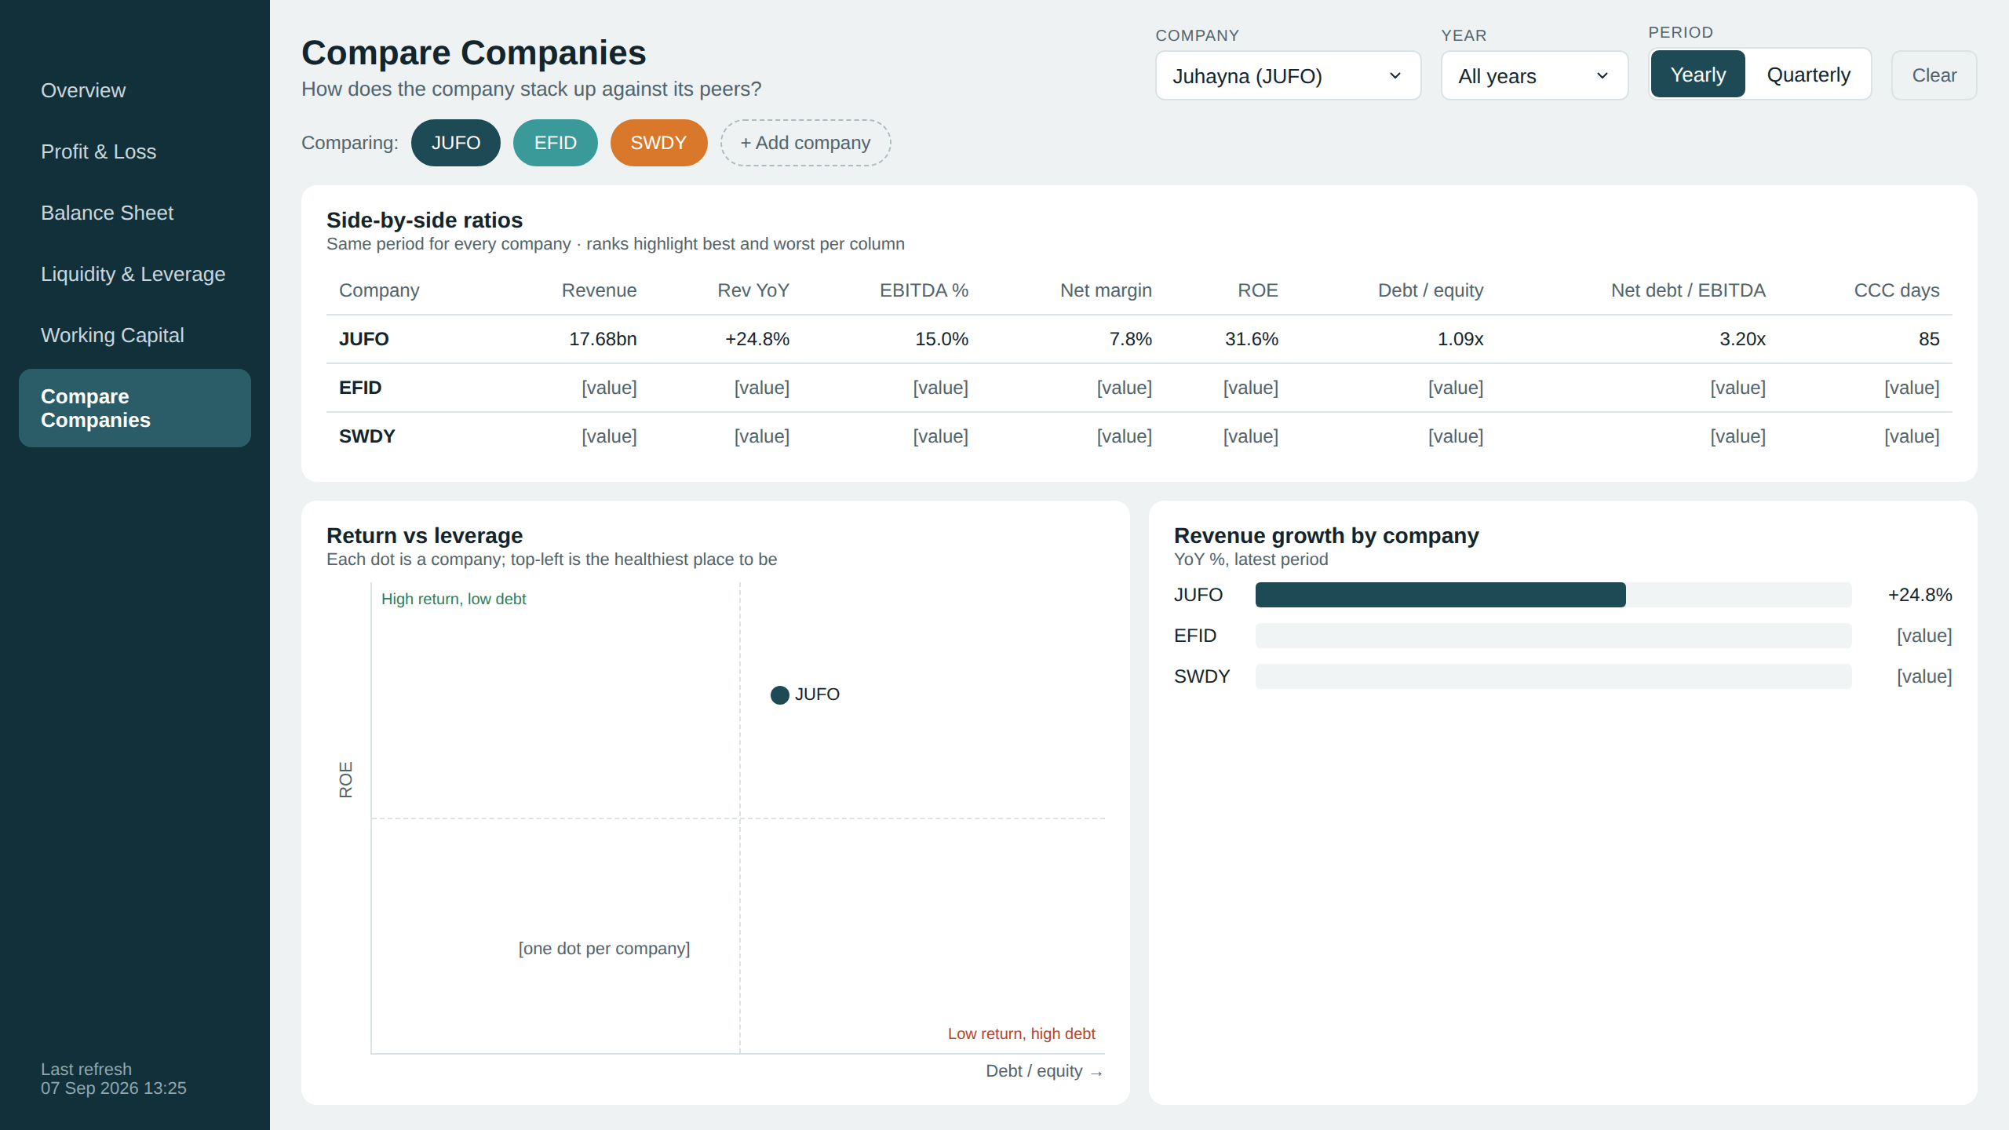
Compare Companies
PAGE 6 OF 6
How does it stack up against peers?
Puts the selected companies side by side on the same ratios for the same period.
Financial Performance Dashboard · Design brief · 15
Notes:
Compare Companies: Puts the selected companies side by side on the same ratios for the same period.

Slide 16
Each visual and its job
PAGE 6 · COMPARE COMPANIES
Visual | Chart type | Question it answers | Measures
Company picker | Slicer chips | Which companies are we comparing? | DimCompany (multi-select)
Ratio table | Table | How does each company rank on the same metrics? | Revenue, YoY, margins, ROE, D/E, CCC
Return vs leverage | Scatter | Who earns high returns without heavy debt? | ROE (y) vs Debt / Equity (x)
Growth ranking | Bar | Who is growing fastest? | Revenue YoY %
Financial Performance Dashboard · Design brief · 16
Notes:
Every visual on the Compare Companies page with the question it answers and the DAX measures behind it (names as in Measures.dax).

Slide 17
From brief to Power BI
NEXT
1
2
3
4
Apply the theme
Set backgrounds
Place visuals
Check numbers
View › Themes › EGX_Financials_theme.json
One 1280×720 image per page
On the white cards, as in these mockups
Assets = Liabilities + Equity, every period
Notes:
The files already exist: the theme JSON, six background images and Measures.dax. The last step catches the most common modelling mistake: summing balance-sheet values across quarters.

