Slide 1
DevOps
Our new Revenue & Time saver

Slide 2
Contents
What is DevOps ?
Benefits of DevOps

Slide 3
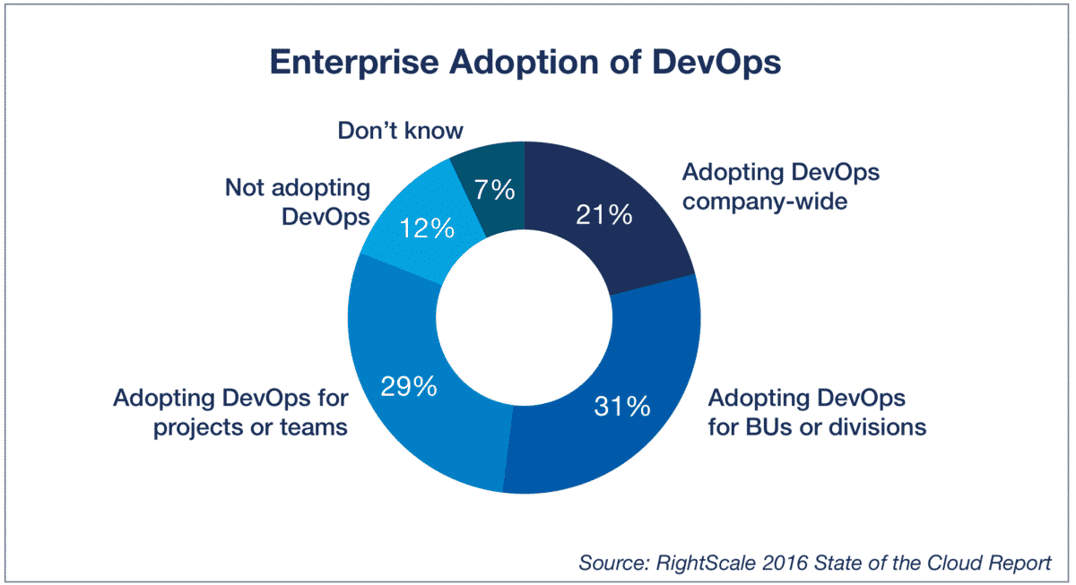
What is DevOps ?
DevOps is the combination of cultural philosophies, practices, and tools that increases an organization’s ability to deliver applications and services at high velocity: evolving and improving products at a faster pace than organizations using traditional software development and infrastructure management processes. This speed enables organizations to better serve their customers and compete more effectively in the market.

Slide 4
Benefits of DevOps
Less bugs in production and less time in testing
Tougher application security
Benefit of automation so, faster deployment
less time for realising new features
Reduced downtime from a deploy-related crash or major bug
Fast recovery to last working version

Slide 5
Thank You!

