Slide 1

IT:U Humanitarian SOS SMS
Foundations and Methods Capstone Project
Bishoy Labib and Greta Toth
Prototype SOS Alert Application

Slide 2

Problem Statement
In areas of natural disasters or human conflict, internet access and smartphone ownership is unlikely
People do have “dumb phones” and telephone network however
Need for fast communication in such crisis zones
People require a safe method to report dangers or needs

Slide 3

Solution Overview
A Python-based app that allows users to submit anonymous SOS messages to a shared online feed accessible by civilians and authorities
      SMS to be sent to central phone number
      timestamped (and location stamped) messages appear in blockchain-like peer-to-peer feed
      users have 50 characters to explain dangers or needs in one message
A GUI interface for ease of use
      mock interface resembles old Nokia devices
A python testing file to check functionality

Slide 4






Key Features
Anonymous SOS submission
Shared feed
Timestamped messages
Coordinates for aid workers or authorities
Simple GUI using Tkinter and a custom-made background graphic
JSON-based local storage (for now)

Slide 5




How It Works
Users press “+” to submit SOS
A character limit (50)
Messages sent to database
Displayed in timeline-style feed, most recent at top

Slide 6
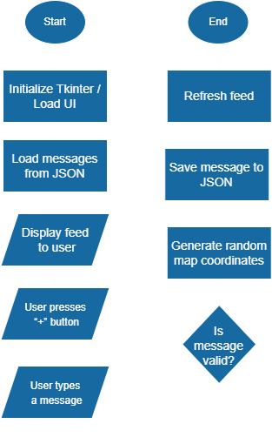
How It Works
(Flowchart)

Slide 7





Current Limitations
No sophisticated telecommunication infrastructure
Local-only feed (no real-time sync)
Placeholder GPS coordinates
Basic UI
No encryption for privacy

Slide 8



Technology Stack
PYTHON 3.X
TKINTER GUI
JSON FILE STORAGE
FIGMA

Slide 9



Future Improvements
Add real geolocation
Cloud backend + API
Send Messages through SMS
Encryption & privacy features
Improved UX/UI

Slide 10
THANK YOU!
Greta & Bishoy

