Slide 1
Gas mentorship
Comprehensive guide about gas
optimization techniques

Slide 2
Content
Introduction
  General overview of gas in ETH
EVM Basics
  Background knowledge about the EVM
Gas optimizations
  In depth review of gas optimizations

Slide 3
Introduction
What is gas?
  Gas is the unit of computation in Ethereum
  Each opcode has a fixed gas cost
  Additionally, some opcodes have an dynamic gas cost on top of the fixed gas cost, e.g.
    SLOAD/SSTORE
    MLOAD/MSTORE

Slide 4
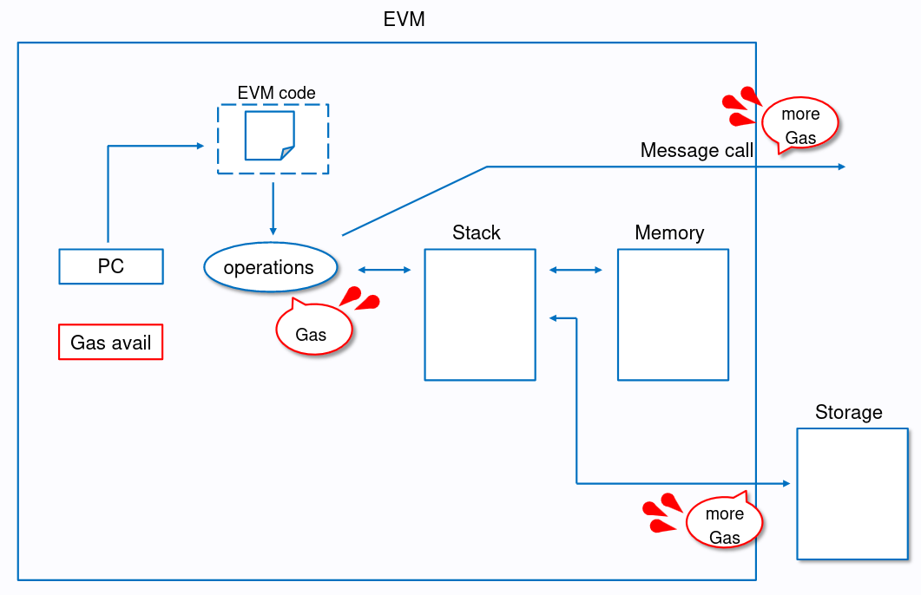

Slide 5
Introduction
Each transaction has an intrinsic cost of 21k gas
The more complex the transaction, the more expensive it is:
  ETH Transfer: 21k gas
  ERC20 Transfer: ~65k gas
  ERC721 Transfer: ~84k gas
  Uniswap V3 Swap: ~184k gas
  Tornado Cash Deposit: ~1M gas

Slide 6
Introduction
How are gas costs calculated?
  Since EIP-1559 the gas price consists of a
    Base fee
    Priority fee
  The fee paid in USD is calculated as follows:
  (gas used x gas price (in gwei) x ether price (in USD)) / 1 billion

Slide 7
EVM Basics
Stack based computer
Deterministic, always the same output for the same input
Creates an execution context when executing a smart contract
  Contains several data regions
  Program counter (PC)
  Gas available
  ...

Slide 8
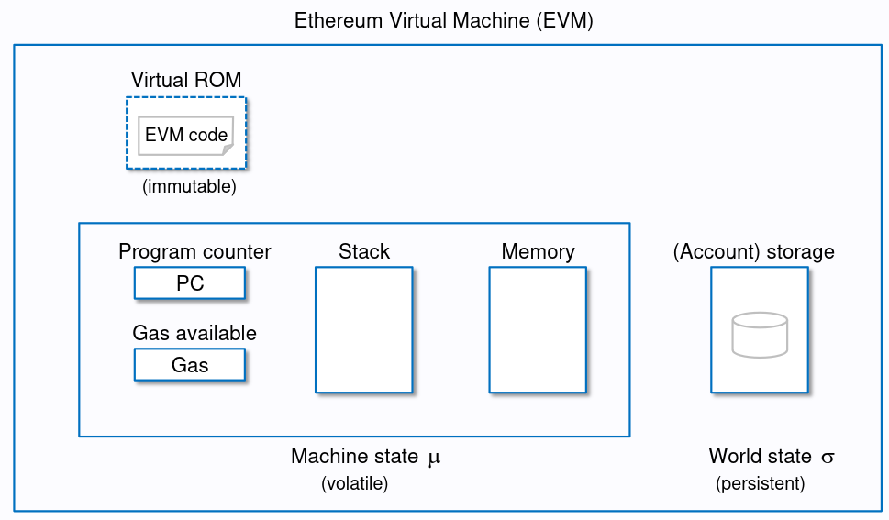

Slide 9
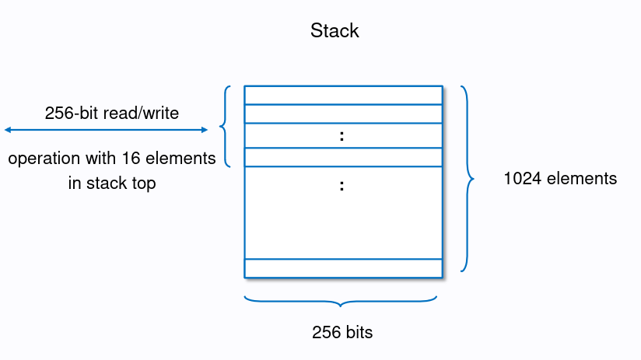
Stack
LIFO data structure
PUSH (3 gas)
POP (2 gas)

Slide 10
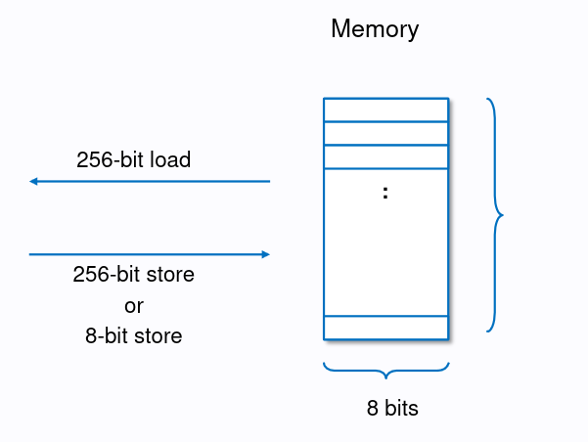
Memory
Byte array
MSTORE: 32 byte / 1 byte
MLOAD: 32 byte

Slide 11
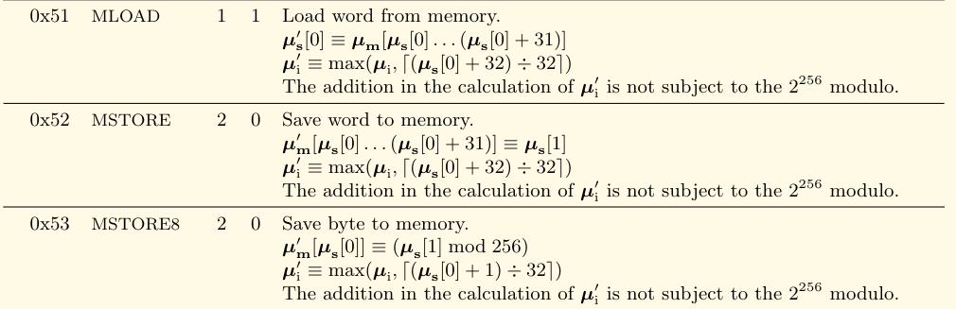
Memory opcodes
Gas cost: 3 (static) + dynamic (memory expansion)

Slide 12

Memory expansion
When an offset is first accessed the memory is expanded in 32 byte chunks
The cost of memory expansion grows quadratically:
(`a` is the size of the memory, G_memory is 3)

Slide 13
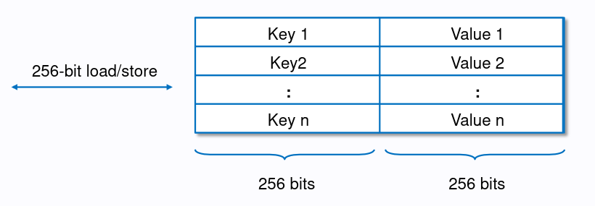
Storage
256 bit key-value store, all values initialized as zero
Multiple variables can be stored in a single slot (storage packing)

Slide 14
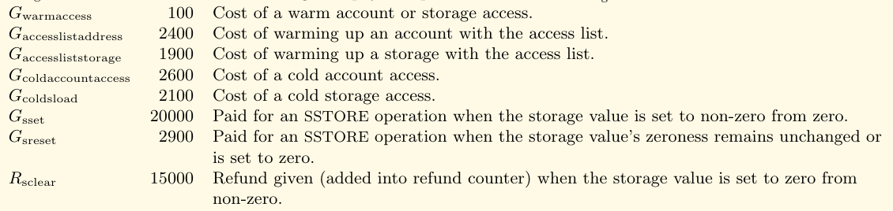
Storage: Gas
Static cost of 100 gas for read (SLOAD) and write (SSTORE)
Dynamic cost related to the state of the storage slot

Slide 15
Storage: Gas
Storage writes
  zero to nonzero: 20k gas + 2.1k gas if first time access
  Nonzero to nonzero: 5k gas
  Nonzero to zero: refund up to 4.8k gas per storage variable
  Zero to zero: 2.2k gas
Storage reads
  Cold: 2.1k gas
  Warm: 100 gas

Slide 16
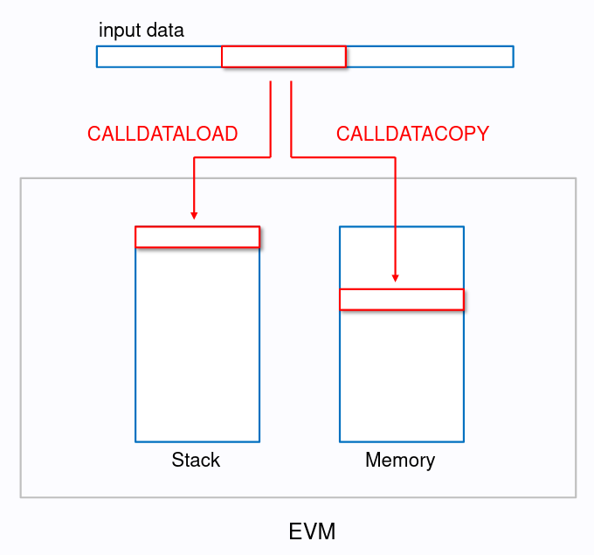
Calldata
Similar to memory, but
read only
Can only be used in
external function calls

Slide 17
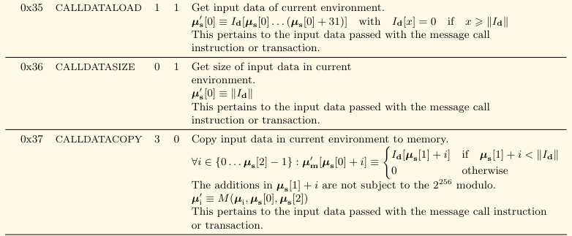
Calldata: Gas
Gas cost: 3 for calldataload/copy, 2 for calldatasize
A byte of calldata costs 4 gas (if its zero) or 16 gas (nonzero)

Slide 18
References
Ethereum EVM illustrated
evm.codes
Ethereum Yellowpaper
Solidity internals

