Slide 1
RETAIL ANALYTICS
PORTFOLIO INSIGHTS
Customer shopping behavior
A behavioral analysis across 3,900 retail transactions
Synthesis of transaction baseline, category dynamics, and loyalty mechanics
Notes:
Introduce the presentation: an empirical look at 3,900 customer transactions exploring product drivers, discount elasticity, and subscription conversion.

Slide 2
TRANSACTION FOUNDATION
3,900 purchases reveal a measurable retail baseline
Dataset scope
Product reach
Average basket
Review rating
3,900
25
$59.76
3.75
Transactions analyzed
Products across 4 categories
Spend per transaction
Average score out of 5
Data schema & structure
Data quality treatment
The underlying repository contains 18 behavioral and transactional columns tracking customer demographics, items purchased, shipping choices, and promotional engagement.
37 review ratings were missing in the source records. To preserve transactional integrity without distorting variances, each was imputed using its respective product-category median.
02
Notes:
Highlight the broad baseline: 3,900 purchases, a stable $59.76 average order value, and clean category-median imputation for the 37 missing ratings.

Slide 3
The analysis combines Python, SQL, and Power BI
Python
PostgreSQL
Power BI
Clean and standardize the transaction data in Python.
Engineer age and purchase-frequency features, then load the dataset into PostgreSQL.
Use SQL to answer business questions and Power BI to make the patterns interactive.
03
Notes:
Explain the workflow: data standardization in Python, feature engineering and loading in PostgreSQL, followed by interactive exploration in Power BI.

Slide 4
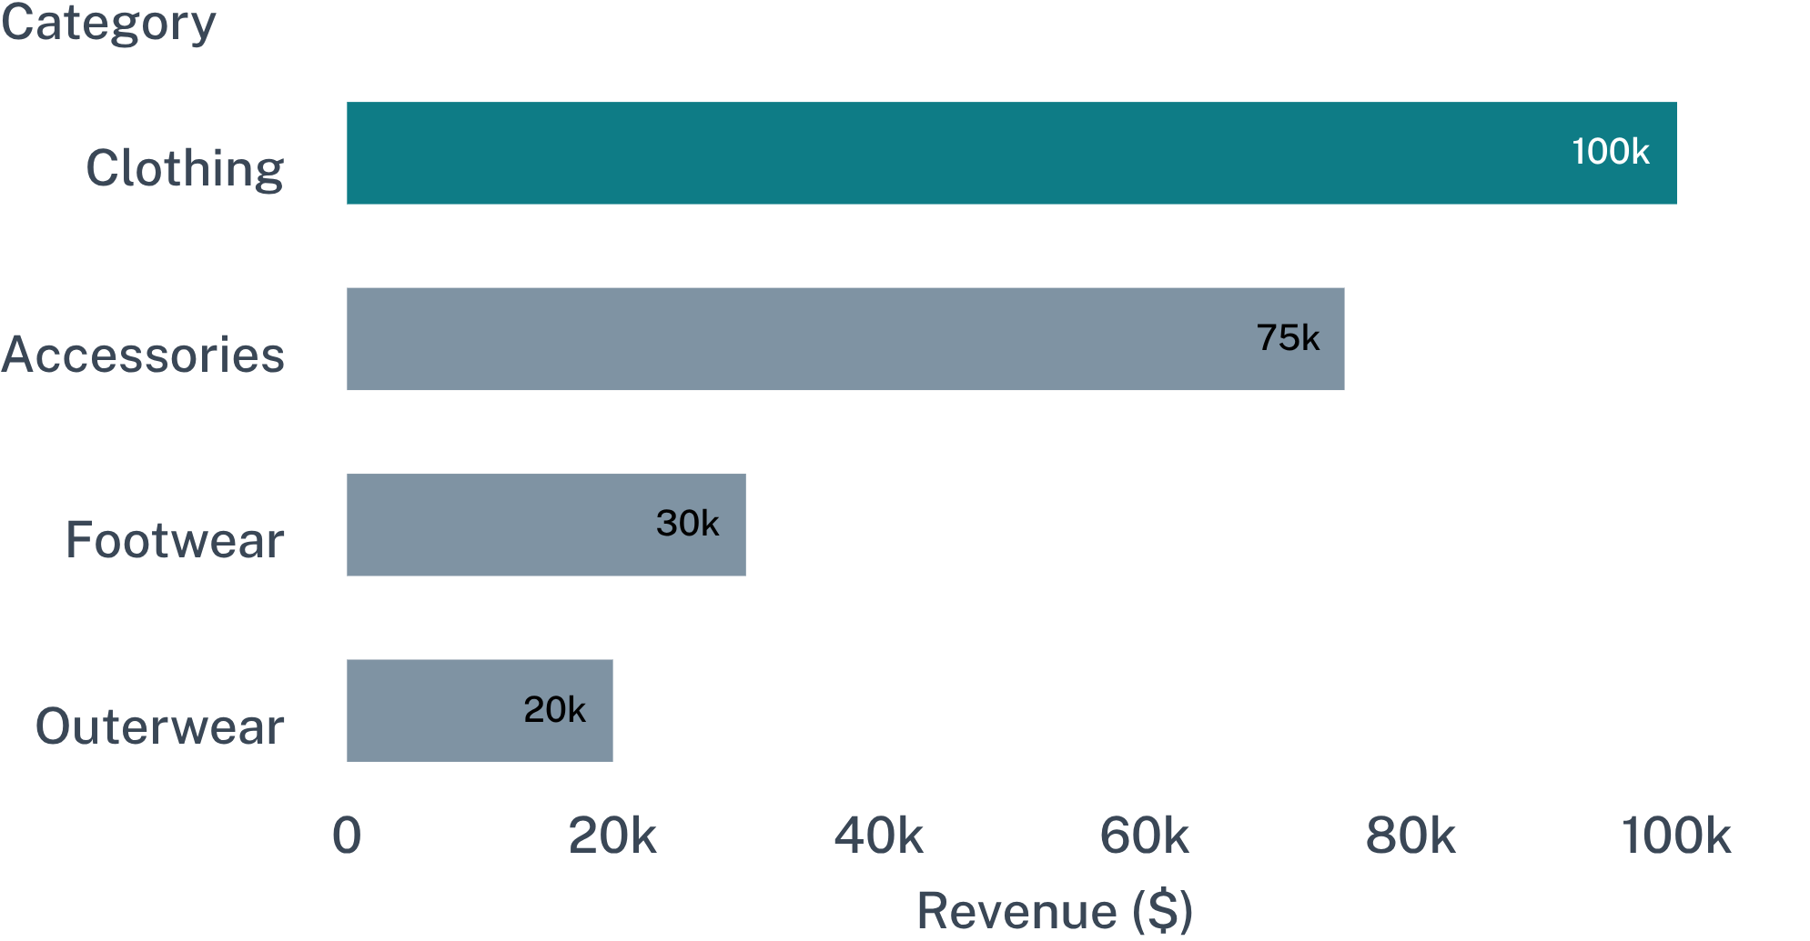
REVENUE CONCENTRATION
Clothing drives the largest revenue pool
GENDER SPLIT
$157,890
Male customer spend (67.7% of total revenue)
$75,191
Female customer spend (32.3% of total revenue)
Category ordering holds across segments: Clothing represents the foundational volume driver, while Accessories offers steady high-margin attachment.
Clothing dominates both gross revenue ($100,000) and sales volume (1,800 units), followed by Accessories ($75,000 / 1,200 units).
04
Notes:
Walk through the category breakdown: Clothing leads at $100K and 1,800 units, with male shoppers accounting for more than double female spend.

Slide 5
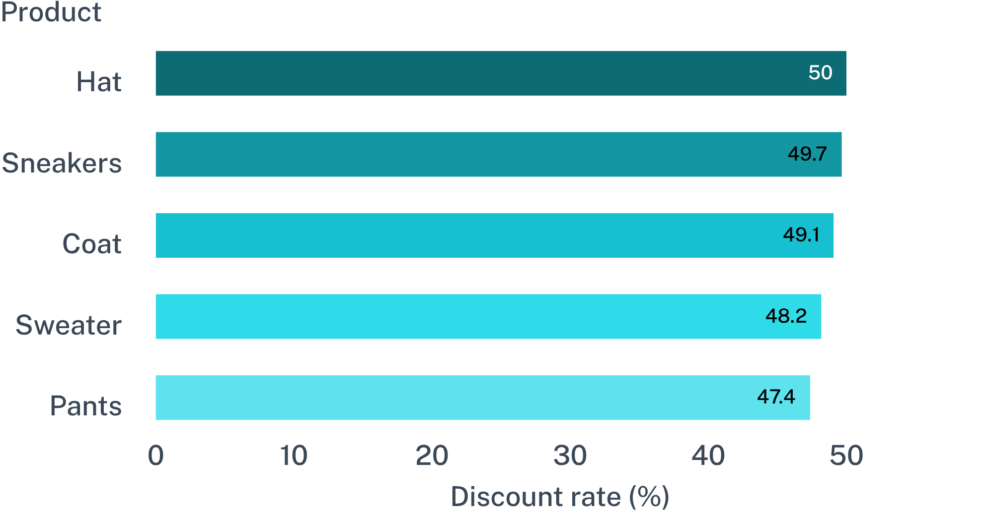
MARGIN & PROMOTIONS
Discounts attract high-value baskets, but some products rely on them
HIGH-VALUE DISCOUNT SEGMENT
839
Customers using discounts while spending above average basket size ($59.76)
Strategic implication
Promotions effectively incentivize premium basket building. However, merchandising must decouple customer acquisition incentives from products showing structural promo dependency.
Five core product lines exhibit discount penetration near 50%, highlighting margin exposure.
05
Notes:
Point out the dual dynamic: 839 customers build above-average baskets with discounts, yet five key staple items hover near 50% promotional dependency.

Slide 6
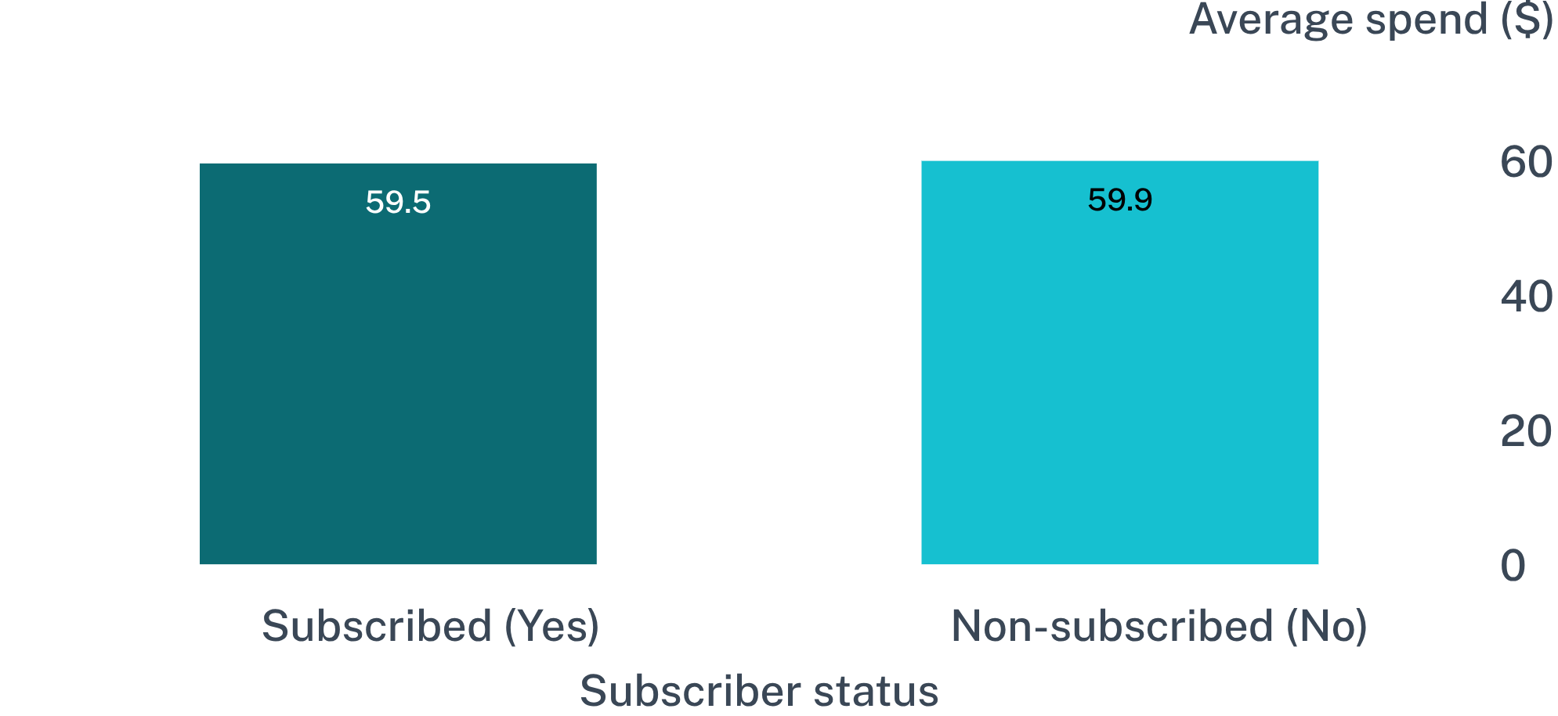
RECURRING REVENUE
Subscription is the clearest growth gap
SUBSCRIPTION PENETRATION
27%
1,053 subscribers vs 2,847 non-subscribers (73%)
Subscribers generated $62,645 in revenue, whereas non-subscribers generated $170,436. The pool represents substantial latent expansion value.
The core opportunity: benefit design
Average basket spend is virtually identical ($59.49 vs $59.87). Growth lies in redesigning membership perks and conversion triggers rather than extracting higher checkout value.
06
Notes:
Emphasize spend parity: subscribers spend $59.49 compared to $59.87 for non-subscribers. The hurdle is conversion and membership benefits, not basket capacity.

Slide 7
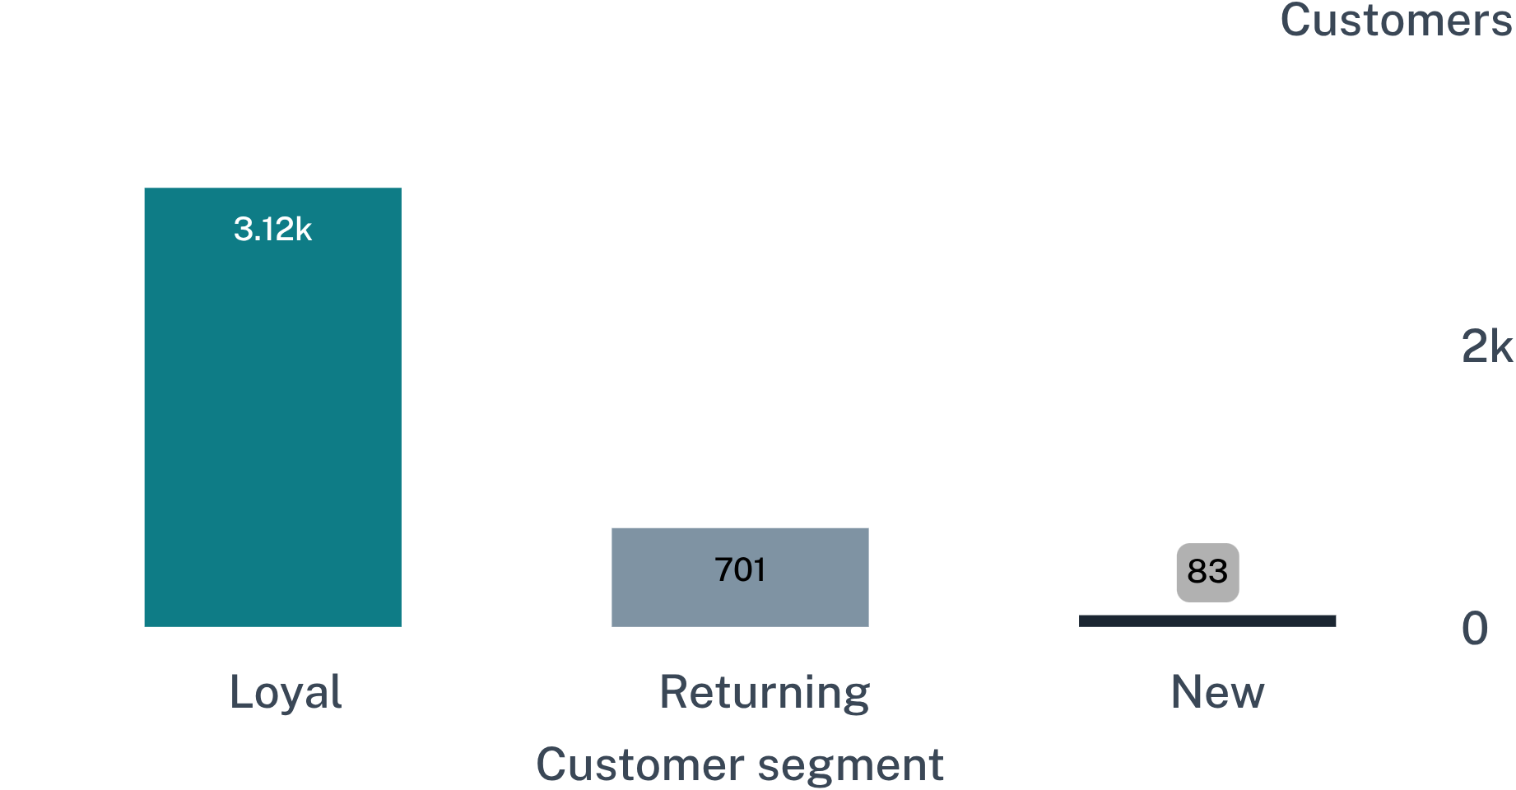
RETENTION MECHANICS
Loyal customers dominate the file, but subscription does not follow
REPEAT BUYER BREAKDOWN (>5 PURCHASES)
2,518 Non-subscribers
Active, proven repeat buyers without membership enrollment.
958 Subscribers
Subscribed repeat shoppers.
Strategic decision
Loyalty behavior and subscription adoption operate as separate funnels. Organic brand affinity is already established; membership requires dedicated value propositions.
Loyal shoppers form 79.9% of all customers (3,116), demonstrating high repeat transaction frequency.
07
Notes:
Point out the stark divergence: 2,518 repeat customers with over five purchases are not subscribed, showing loyalty does not automatically convert into membership.

Slide 8
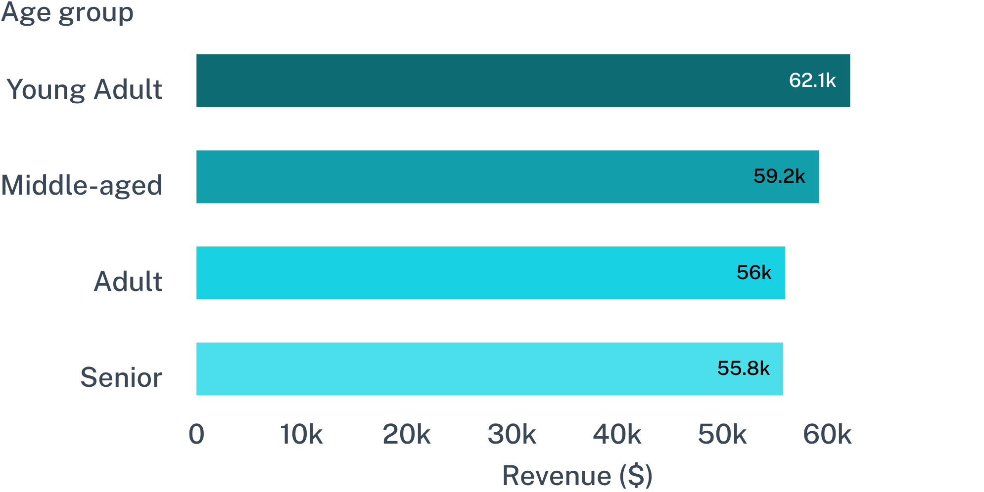
DEMOGRAPHICS & LOGISTICS
Young adults lead revenue contribution
FULFILLMENT PREMIUM
$60.48
Average basket for Express shipping
$58.46
Average basket for Standard shipping
Audience implication
The leading age group is ahead, but the spread is relatively narrow, supporting differentiated rather than exclusive targeting. Express shoppers average $60.48 versus $58.46 for Standard shipping.
Young Adult $62,143; Middle-aged $59,197; Adult $55,978; Senior $55,763. The spread is relatively narrow, supporting differentiated rather than exclusive targeting.
08
Notes:
Summarize the age and fulfillment signals: Young Adults contribute $62K, but all four age brackets sit within a narrow range; Express shoppers generate a clear basket premium.

Slide 9
CATALOG OPTIMIZATION
Product signals point to focused merchandising
Aligning customer satisfaction ratings with volume leaders unlocks higher conversion in cross-category promotions.
CATEGORY | LEADING PRODUCTS
Accessories | Jewelry · Sunglasses · Belt
Clothing | Blouse · Pants · Shirt
Footwear | Sandals · Shoes · Sneakers
Outerwear | Jacket · Coat
Top rated
Consistent ratings
Merchandising action
Gloves (3.86) & Sandals (3.84)
Boots (3.82) & Hat (3.80)
Bundle rated with volume
Highest customer satisfaction across the catalog
Strong positive sentiment despite high promo rate
Pair high-satisfaction items with category anchors
09
Notes:
Guide the merchandising strategy: pair top-rated items like Gloves and Sandals with high-order staples like Blouses, Pants, and Jewelry in campaign bundles.

Slide 10
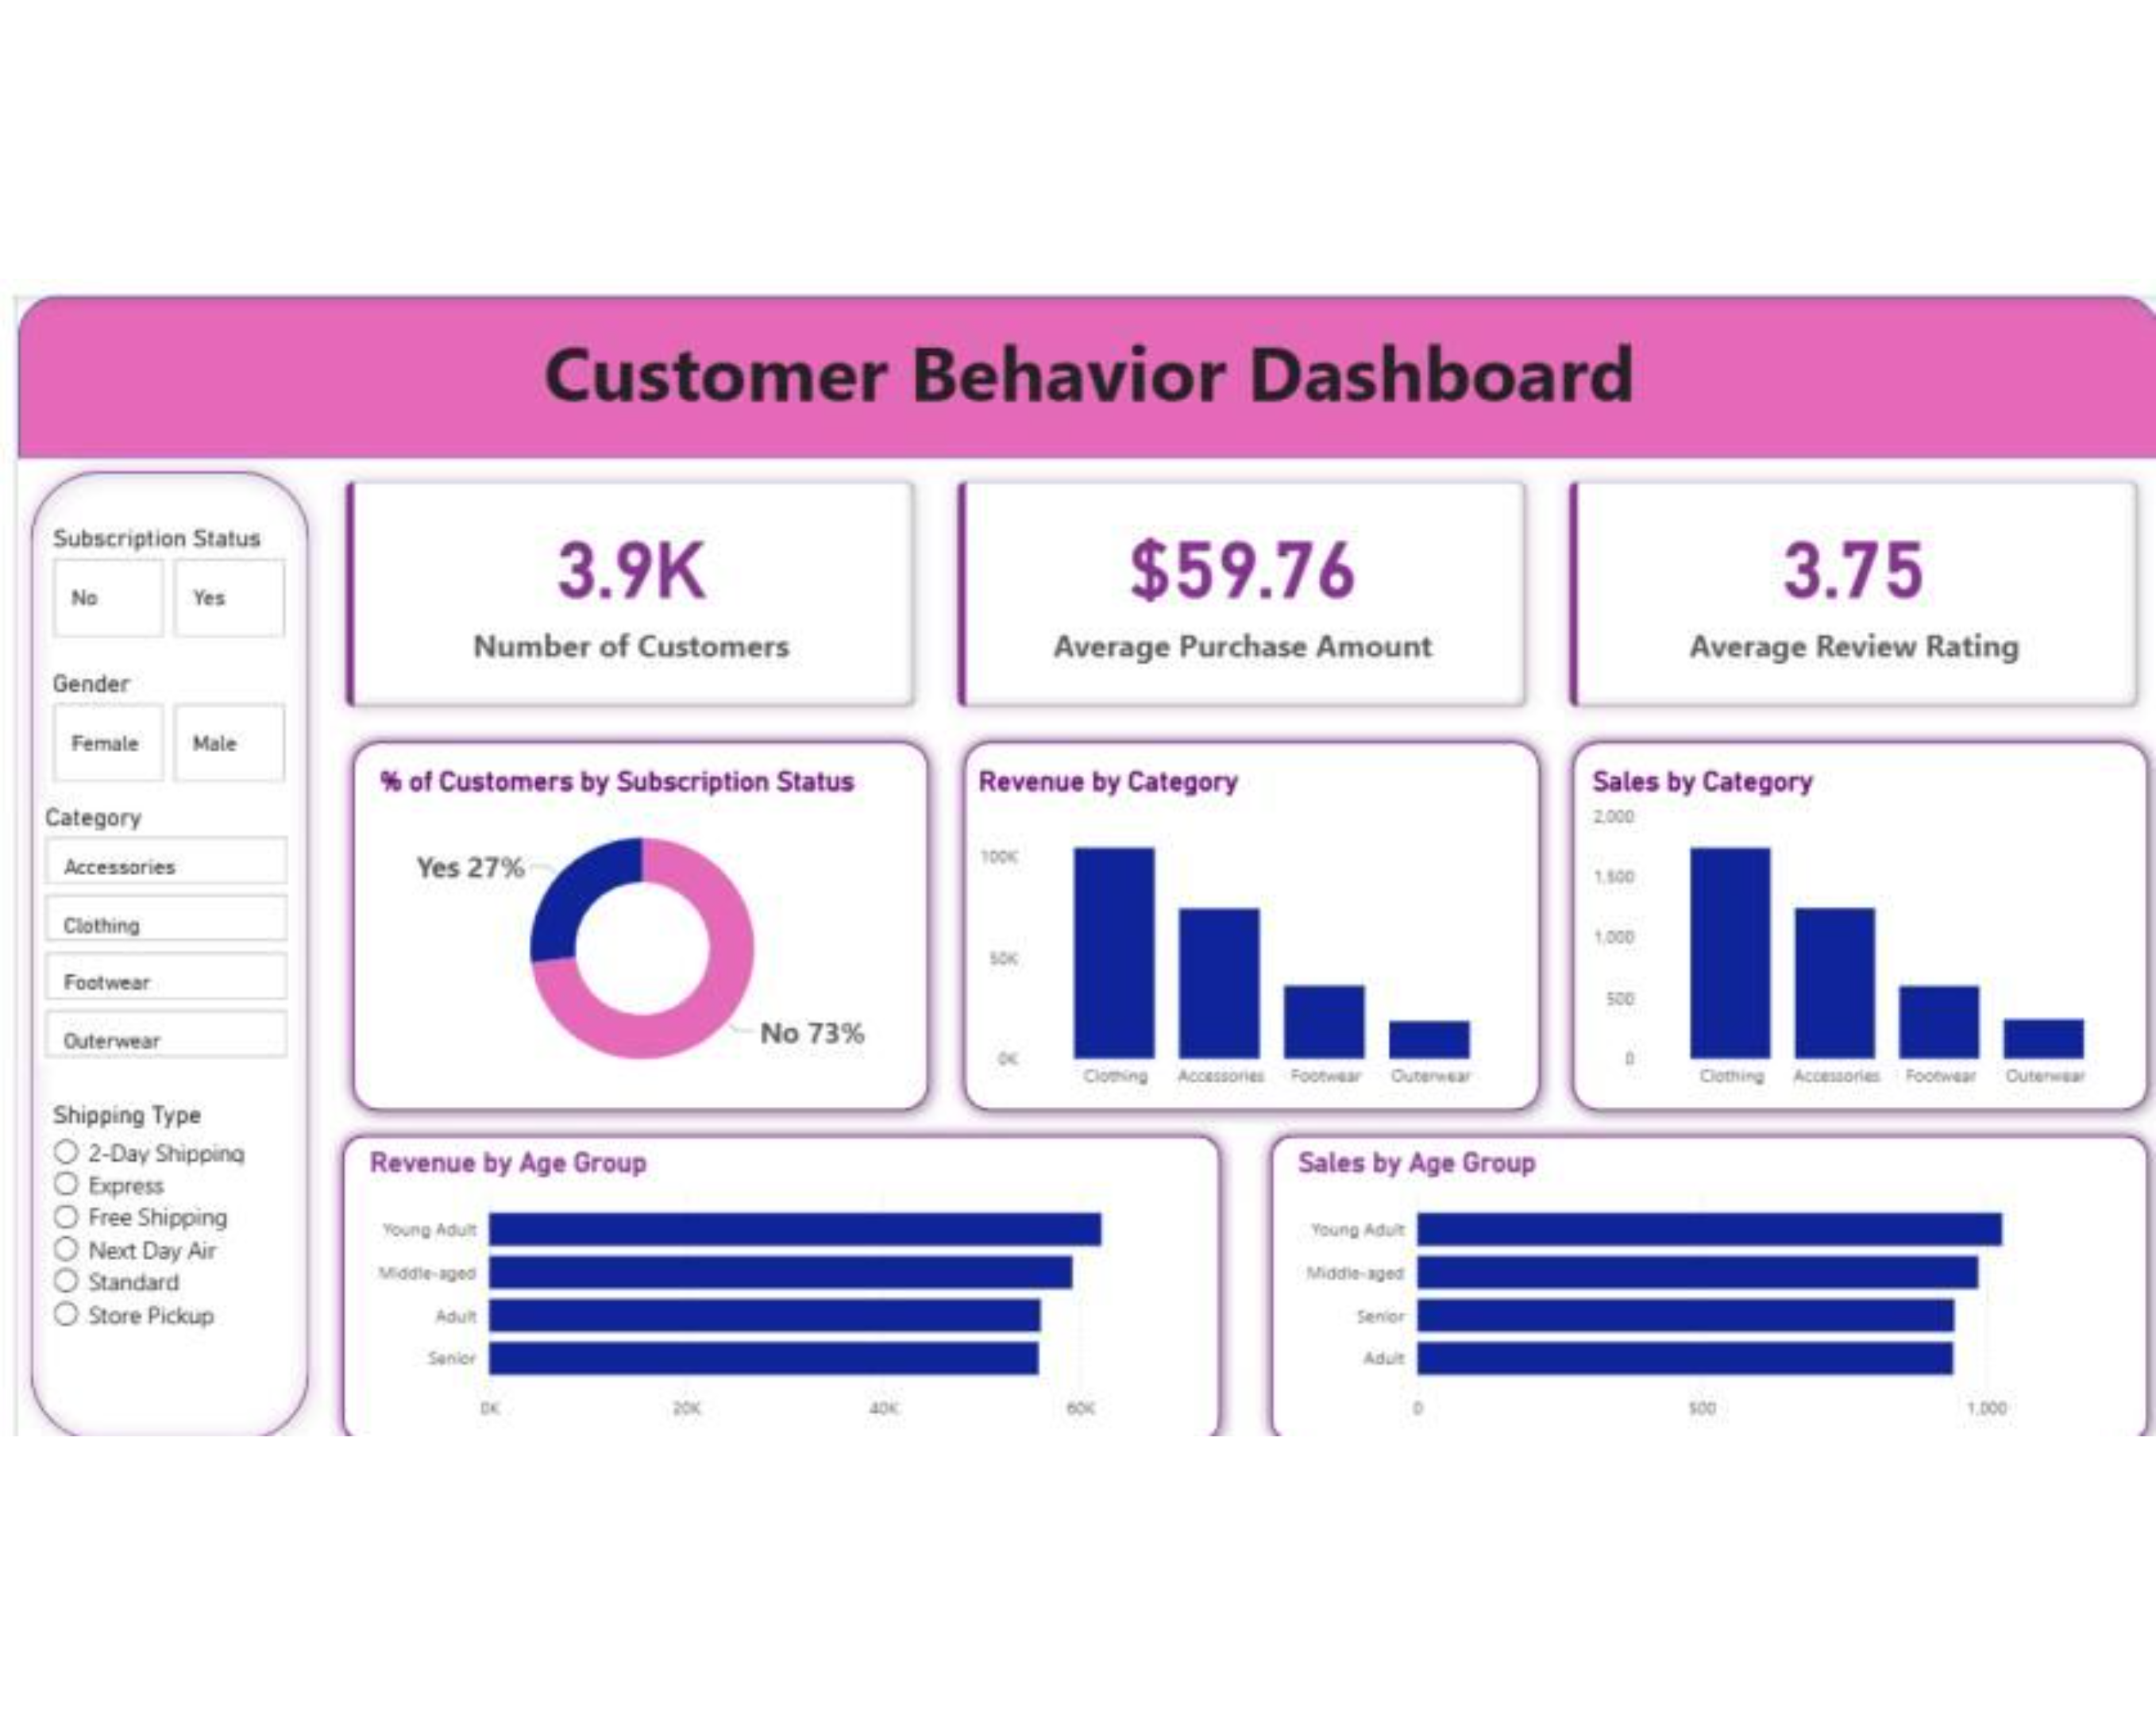
The Power BI dashboard turns analysis into a decision surface
Use filters for subscription status, gender, category, and shipping type to move from the portfolio view to a customer or fulfillment hypothesis.
10

