Slide 1
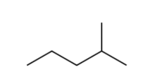

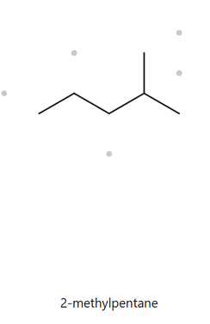
CARD A01
Foundation | Formula: C6H14
1. NUMBERED PARENT
2. NAMING TRAIL
Parent: Longest chain = 5 carbons → pentane
Numbering: L-to-R gives locant 2; R-to-L gives 4. Lower set {2} wins.
Substituents: Methyl at C2 → 2-methyl
3. MY NAME (WRITTEN FIRST)
4. THE ALKANE CHECK
2-methylpentane
Match
Returned: 2-methylpentane
longest chain confirmed
lowest locants
alphabetical order
punctuation
formula counted

Slide 2
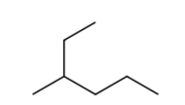
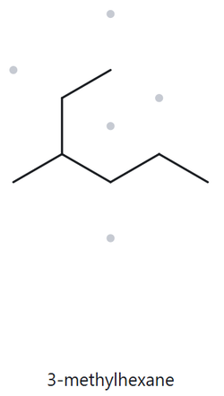
CARD A02
Foundation | Formula: C7H16
1. NUMBERED PARENT
2. NAMING TRAIL
Parent: Bent chain = 6 carbons → hexane
Numbering: Bottom-left to right gives locant 3 (wins over 4).
Substituents: Methyl at C3 → 3-methyl
3. MY NAME (WRITTEN FIRST)
4. THE ALKANE CHECK
3-methylhexane
Match
Returned: 3-methylhexane
longest chain confirmed
lowest locants
alphabetical order
punctuation
formula counted

Slide 3
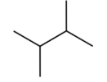
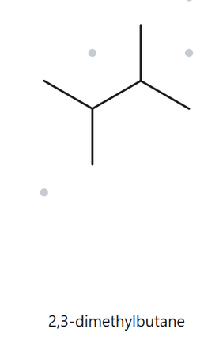
CARD A03
Foundation | Formula: C6H14
1. NUMBERED PARENT
2. NAMING TRAIL
Parent: Longest chain = 4 carbons → butane
Numbering: Symmetrical set {2,3} from either end.
Substituents: Methyls at C2, C3 → 2,3-dimethyl
3. MY NAME (WRITTEN FIRST)
4. THE ALKANE CHECK
2,3-dimethylbutane
Match
Returned: 2,3-dimethylbutane
longest chain confirmed
lowest locants
alphabetical order
punctuation
formula counted

Slide 4
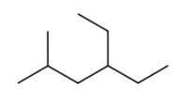
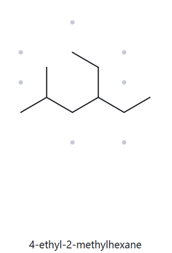
CARD A04
Developing | Formula: C9H20
1. NUMBERED PARENT
2. NAMING TRAIL
Parent: Longest chain = 7 carbons → heptane
Numbering: L-to-R gives {3,4}; R-to-L gives {4,5}. {3,4} wins.
Substituents: Ethyl (C4), Methyl (C2) → ethyl cited first
3. MY NAME (WRITTEN FIRST)
4. THE ALKANE CHECK
4-ethyl-2-methylhexane
Match
Returned: 4-ethyl-2-methylhexane
longest chain confirmed
lowest locants
alphabetical order
punctuation
formula counted

Slide 5

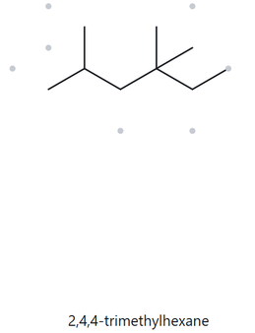
CARD A05
Developing | Formula: C8H18
1. NUMBERED PARENT
2. NAMING TRAIL
Parent: Longest chain = 5 carbons → pentane
Numbering: {2,2,4} vs {2,4,4}. {2,2,4} wins at 2nd locant (2 < 4).
Substituents: Methyls at C2, C2, C4 → 2,2,4-trimethyl
3. MY NAME (WRITTEN FIRST)
4. THE ALKANE CHECK
2,2,4-trimethylpentane
Match
Returned: 2,2,4-trimethylpentane
longest chain confirmed
lowest locants
alphabetical order
punctuation
formula counted

Slide 6
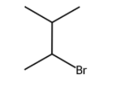
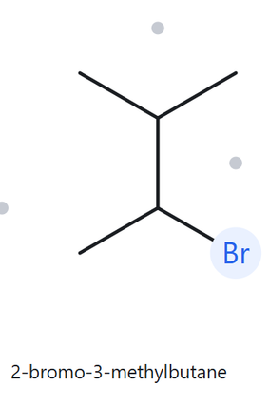
CARD A06
Developing | Formula: C6H13Br
1. NUMBERED PARENT
2. NAMING TRAIL
Parent: Longest chain = 5 carbons → pentane
Numbering: Locant tie {2,3}. Alphabetical tie-break: bromo gets C2.
Substituents: 2-bromo, 3-methyl
3. MY NAME (WRITTEN FIRST)
4. THE ALKANE CHECK
2-bromo-3-methylbutane
Match
Returned: 2-bromo-3-methylbutane
longest chain confirmed
lowest locants
alphabetical order
punctuation
formula counted

Slide 7

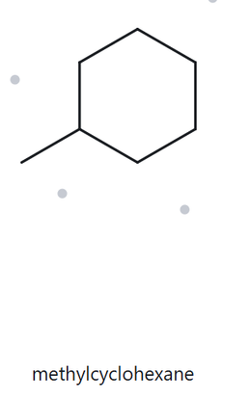
CARD A07
Developing | Formula: C7H14
1. NUMBERED PARENT
2. NAMING TRAIL
Parent: 6-membered ring → cyclohexane
Numbering: Monosubstituted ring; locant 1 is omitted.
Substituents: Methyl group
3. MY NAME (WRITTEN FIRST)
4. THE ALKANE CHECK
methylcyclohexane
Match
Returned: methylcyclohexane
longest chain confirmed
lowest locants
alphabetical order
punctuation
formula counted

Slide 8

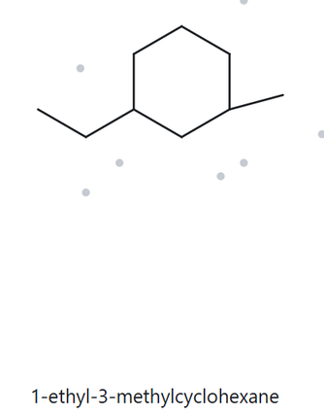
CARD A08
Challenge | Formula: C9H18
1. NUMBERED PARENT
2. NAMING TRAIL
Parent: 6-membered ring → cyclohexane
Numbering: 1,3-tie broken alphabetically: ethyl gets C1.
Substituents: 1-ethyl, 3-methyl
3. MY NAME (WRITTEN FIRST)
4. THE ALKANE CHECK
1-ethyl-3-methylcyclohexane
Match
Returned: 1-ethyl-3-methylcyclohexane
longest chain confirmed
lowest locants
alphabetical order
punctuation
formula counted

Slide 9
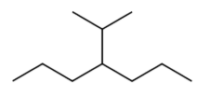
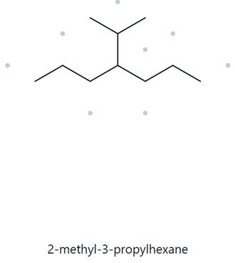
CARD A09
Challenge | Formula: C10H22
1. NUMBERED PARENT
2. NAMING TRAIL
Parent: Longest chain = 7 carbons → heptane
Numbering: Locant 4 from either direction.
Substituents: Isopropyl group at C4
3. MY NAME (WRITTEN FIRST)
4. THE ALKANE CHECK
4-isopropylheptane
Match
Returned: 4-(1-methylethyl)heptane (Equivalent form)
longest chain confirmed
lowest locants
alphabetical order
punctuation
formula counted

Slide 10

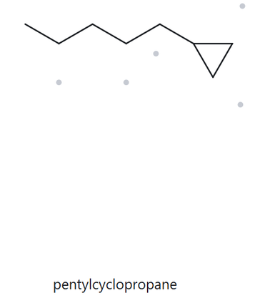
CARD A10
Challenge | Formula: C8H16
1. NUMBERED PARENT
2. NAMING TRAIL
Parent: 3-membered ring is parent → cyclopropane
Numbering: Monosubstituted ring (locant unnecessary).
Substituents: 5-carbon chain → pentyl
3. MY NAME (WRITTEN FIRST)
4. THE ALKANE CHECK
pentylcyclopropane
Match
Returned: pentylcyclopropane
longest chain confirmed
lowest locants
alphabetical order
punctuation
formula counted

Slide 11
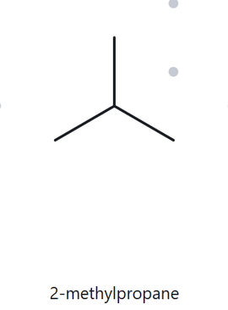
CARD B01
NAME → STRUCTURE
Foundation | Given: 2-methylpropane
1. NAME DECODED
2. BOND-LINE STRUCTURE
Parent: propane (3-carbon chain)
Substituents: methyl at C2
Expected Formula: C4H10 (CnH2n+2)
3. FORMULA CHECK
4. BACK-CHECK
Counted: C4H10
Rule Check: C4H2(4)+2 = C4H10
Same as Given
Returned: 2-methylpropane
parent length matches
substituent positions match
formula agrees
back-check recorded

Slide 12
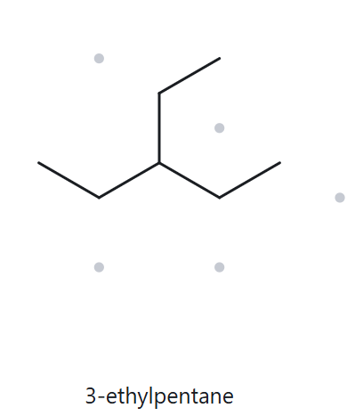
CARD B02
NAME → STRUCTURE
Foundation | Given: 3-ethylpentane
1. NAME DECODED
2. BOND-LINE STRUCTURE
Parent: pentane (5-carbon chain)
Substituents: ethyl at C3
Expected Formula: C7H16 (CnH2n+2)
3. FORMULA CHECK
4. BACK-CHECK
Counted: C7H16
Rule Check: C7H2(7)+2 = C7H16
Same as Given
Returned: 3-ethylpentane
parent length matches
substituent positions match
formula agrees
back-check recorded

Slide 13
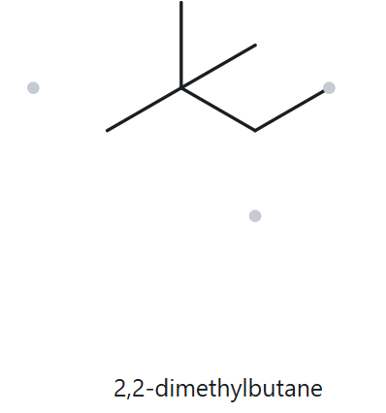
CARD B03
NAME → STRUCTURE
Foundation | Given: 2,2-dimethylbutane
1. NAME DECODED
2. BOND-LINE STRUCTURE
Parent: butane (4-carbon chain)
Substituents: two methyls at C2
Expected Formula: C6H14 (CnH2n+2)
3. FORMULA CHECK
4. BACK-CHECK
Counted: C6H14
Rule Check: C6H2(6)+2 = C6H14
Same as Given
Returned: 2,2-dimethylbutane
parent length matches
substituent positions match
formula agrees
back-check recorded

Slide 14
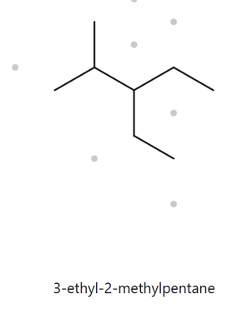
CARD B04
NAME → STRUCTURE
Developing | Given: 3-ethyl-2-methylpentane
1. NAME DECODED
2. BOND-LINE STRUCTURE
Parent: pentane (5-carbon chain)
Substituents: methyl at C2, ethyl at C3
Expected Formula: C8H18 (CnH2n+2)
3. FORMULA CHECK
4. BACK-CHECK
Counted: C8H18
Rule Check: C8H2(8)+2 = C8H18
Same as Given
Returned: 3-ethyl-2-methylpentane
parent length matches
substituent positions match
formula agrees
back-check recorded

Slide 15
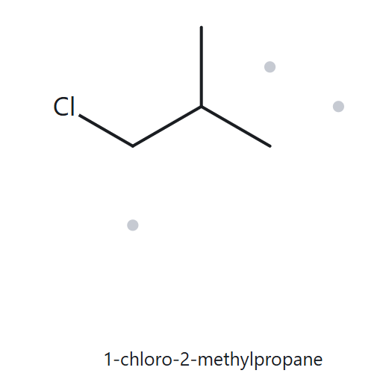
CARD B05
NAME → STRUCTURE
Developing | Given: 1-chloro-2-methylpropane
1. NAME DECODED
2. BOND-LINE STRUCTURE
Parent: propane (3-carbon chain)
Substituents: chloro at C1, methyl at C2
Expected Formula: C4H9Cl (1 H replaced by Cl)
3. FORMULA CHECK
4. BACK-CHECK
Counted: C4H9Cl
Rule Check: C4H10 - 1H + 1Cl = C4H9Cl
Same as Given
Returned: 1-chloro-2-methylpropane
parent length matches
substituent positions match
formula agrees
back-check recorded

Slide 16
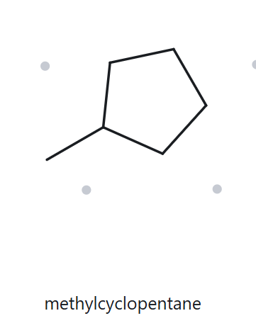
CARD B06
NAME → STRUCTURE
Developing | Given: 1,2-dimethylcyclopentane
1. NAME DECODED
2. BOND-LINE STRUCTURE
Parent: cyclopentane (5-carbon ring)
Substituents: methyls at C1, C2
Expected Formula: C7H14 (CnH2n for 1 ring)
3. FORMULA CHECK
4. BACK-CHECK
Counted: C7H14
Rule Check: C7H2(7) = C7H14
Same as Given
Returned: 1,2-dimethylcyclopentane
parent length matches
substituent positions match
formula agrees
back-check recorded

Slide 17
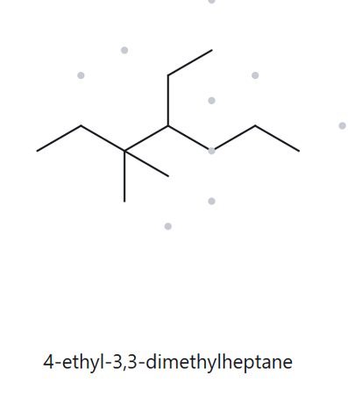
CARD B07
NAME → STRUCTURE
Developing | Given: 4-ethyl-3,3-dimethylheptane
1. NAME DECODED
2. BOND-LINE STRUCTURE
Parent: heptane (7-carbon chain)
Substituents: methyls at C3, C3; ethyl at C4
Expected Formula: C11H24 (CnH2n+2)
3. FORMULA CHECK
4. BACK-CHECK
Counted: C11H24
Rule Check: C11H2(11)+2 = C11H24
Same as Given
Returned: 4-ethyl-3,3-dimethylheptane
parent length matches
substituent positions match
formula agrees
back-check recorded

Slide 18
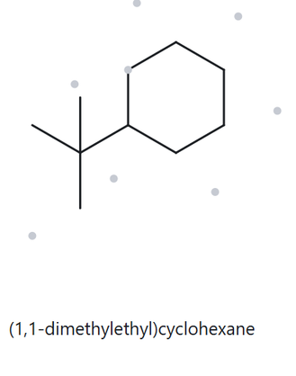
CARD B08
NAME → STRUCTURE
Challenge | Given: tert-butylcyclohexane
1. NAME DECODED
2. BOND-LINE STRUCTURE
Insert b08_lastname.png
Parent: cyclohexane (6-carbon ring)
Substituents: tert-butyl group
Expected Formula: C10H20 (CnH2n for 1 ring)
3. FORMULA CHECK
4. BACK-CHECK
Counted: C10H20
Rule Check: C10H2(10) = C10H20
Equivalent Form
Returned: (1,1-dimethylethyl)cyclohexane
parent length matches
substituent positions match
formula agrees
back-check recorded

Slide 19
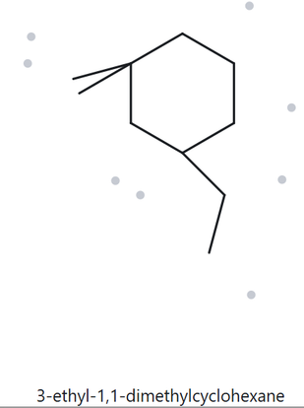
CARD B09
NAME → STRUCTURE
Challenge | Given: 3-ethyl-1,1-dimethylcyclohexane
1. NAME DECODED
2. BOND-LINE STRUCTURE
Parent: cyclohexane (6-carbon ring)
Substituents: methyls at C1, C1; ethyl at C3
Expected Formula: C10H20 (CnH2n for 1 ring)
3. FORMULA CHECK
4. BACK-CHECK
Counted: C10H20
Rule Check: C10H2(10) = C10H20
Same as Given
Returned: 3-ethyl-1,1-dimethylcyclohexane
parent length matches
substituent positions match
formula agrees
back-check recorded

Slide 20
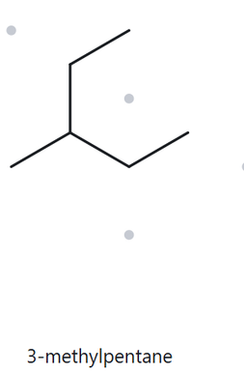
CARD B10
NAME → STRUCTURE (RULE-TESTING CASE)
Challenge | Given: 2-ethylbutane (Incorrect)
1. NAME DECODED
2. BOND-LINE STRUCTURE
Given Name: 2-ethylbutane (breaks rules)
Drawn Parent: butane chain with C2 ethyl
Expected Formula: C6H14 (CnH2n+2)
3. FORMULA CHECK
4. BACK-CHECK & RULE ERROR
Counted: C6H14
Rule Check: C6H2(6)+2 = C6H14
Mismatch Discovered
Returned: 3-methylpentane
Rule Broken: Missed longest chain. Ethyl on C2 extends parent to 5 carbons (pentane).
parent length corrected
substituent positions match
formula agrees
rule error documented

