Slide 1
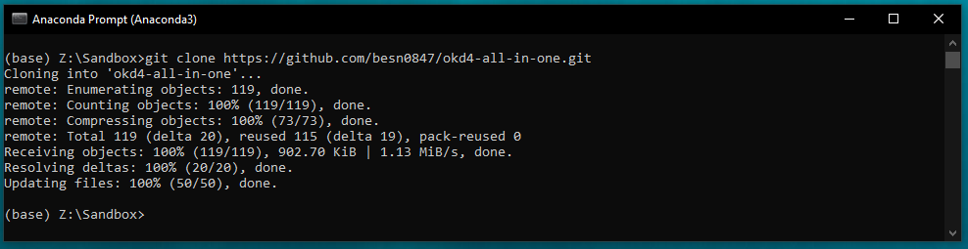
Step 1 : Clone the git repo for All-In-One
> git clone https://github.com/besn0847/okd4-all-in-one.git

Slide 2
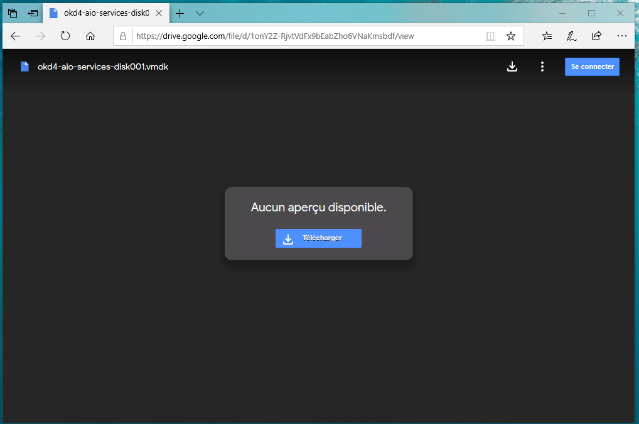
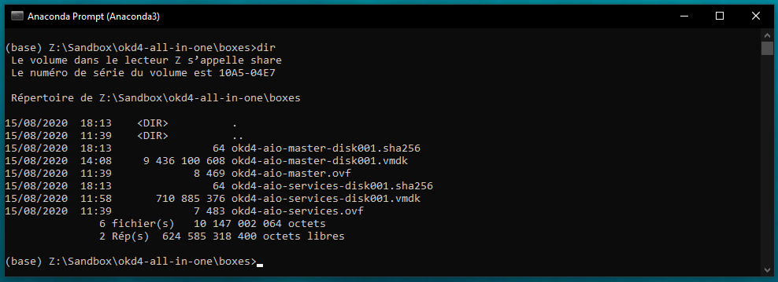
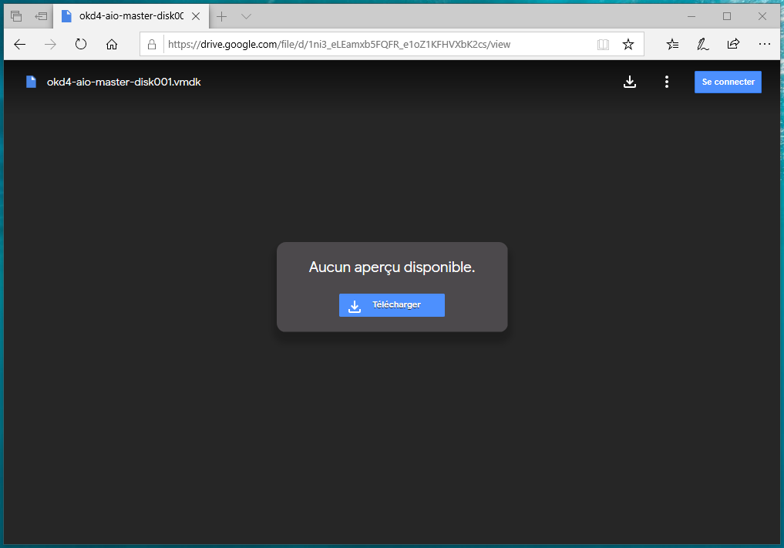
Step 2 : Download the 2 VMDKs
okd4-aio-services-disk001.vmdk (0.7 GB) :
https://drive.google.com/file/d/1onY2Z-RjvtVdFx9bEabZho6VNaKmsbdf/view
okd4-aio-master-disk001.vmdk (8.8 GB) :
https://drive.google.com/file/d/1ni3_eLEamxb5FQFR_e1oZ1KFHVXbK2cs/view
SHA256 Checksums :
okd4-aio-services-disk001.vmdk :
A3ECB4DC431DB3D6F26C3C0CA3A485096B3D0DE97BDA5C5C84268240D9D7948B
okd4-aio-master-disk001.vmdk :
F910B0AEF95DAE5638B5D6427FE6F67B577FD7439D0720B0CC44FAF6D2D4472F

Slide 3
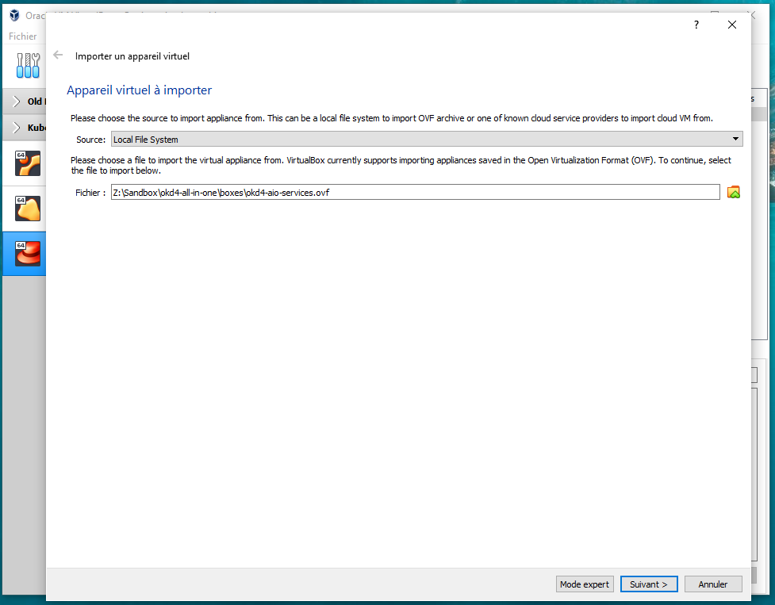
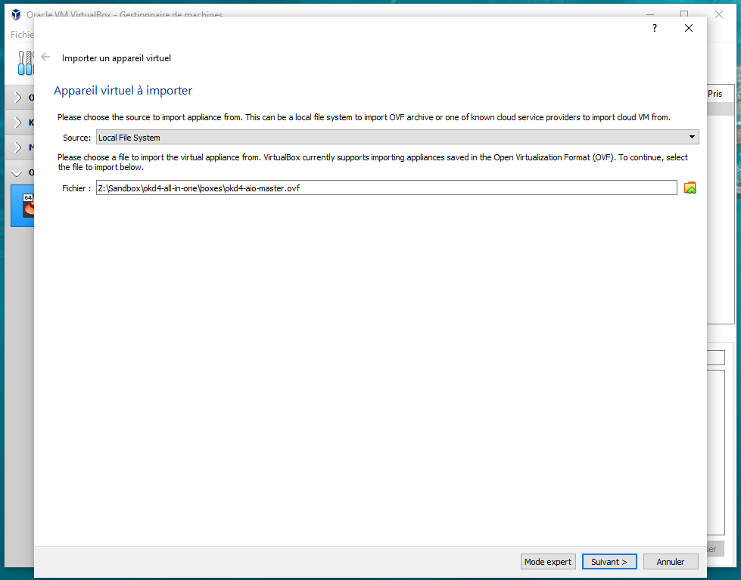
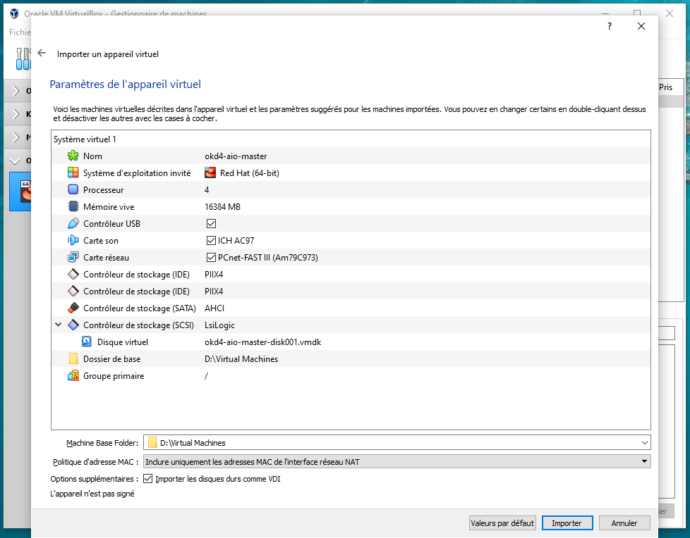
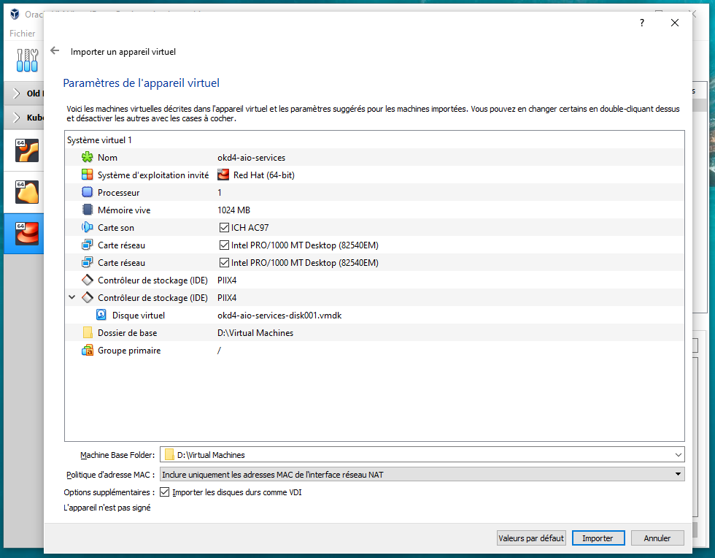
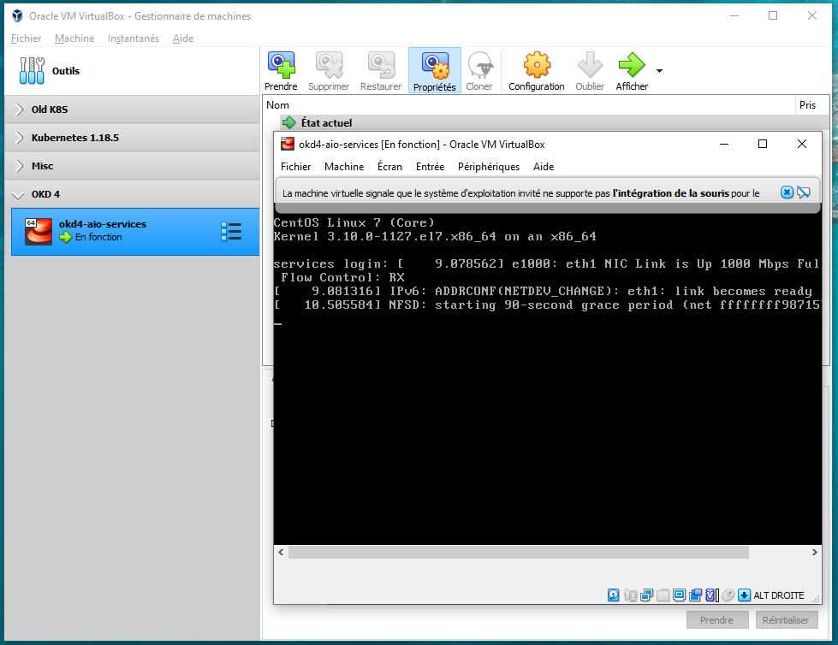
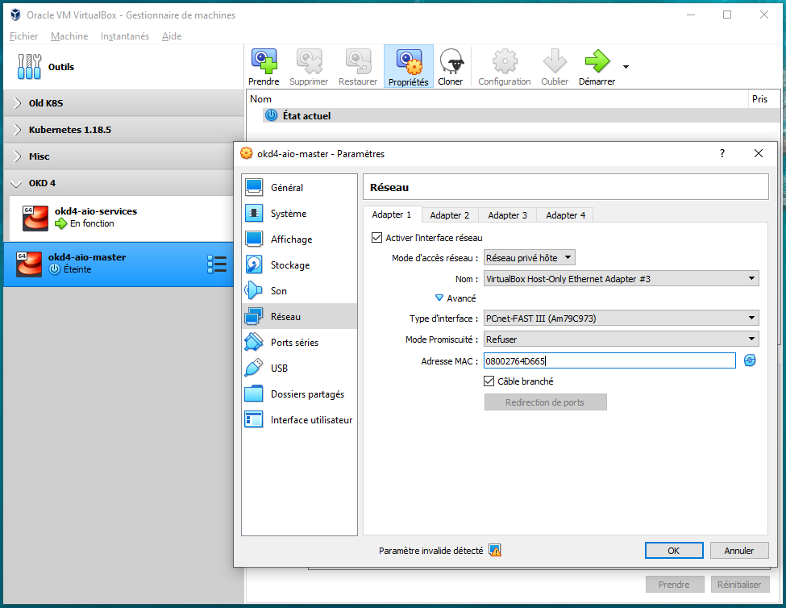
Step 3 : Import the VMs in VirtualBox
!!! Make sure you set the MAC address for the master VM : 08:00:27:64:D6:65

Slide 4
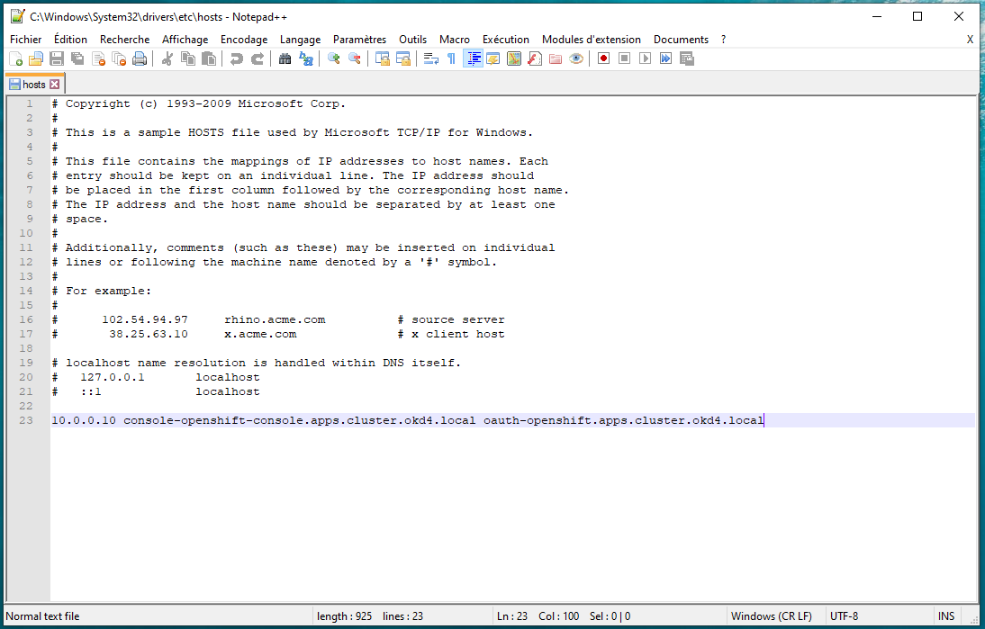
Step 4 : Update your /etc/hosts file

Slide 5
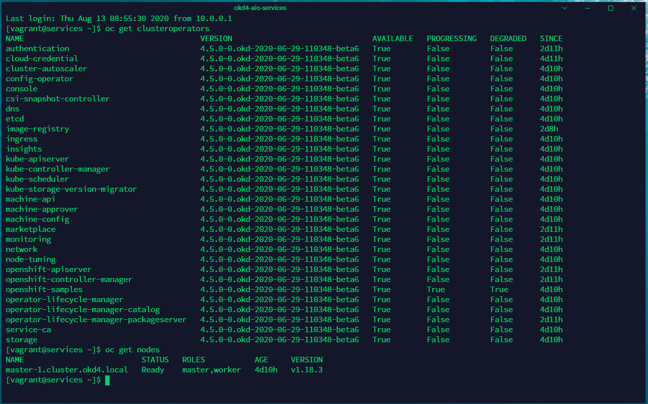
Step 5 : Monitor the start-up process (~10min)
Connect to the Services VM with vagrant + vagrant priv key (id_rsa in the buil d folders)

Slide 6
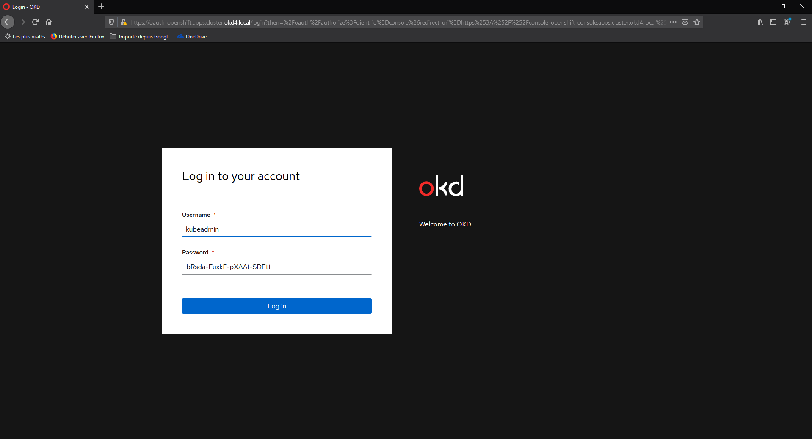
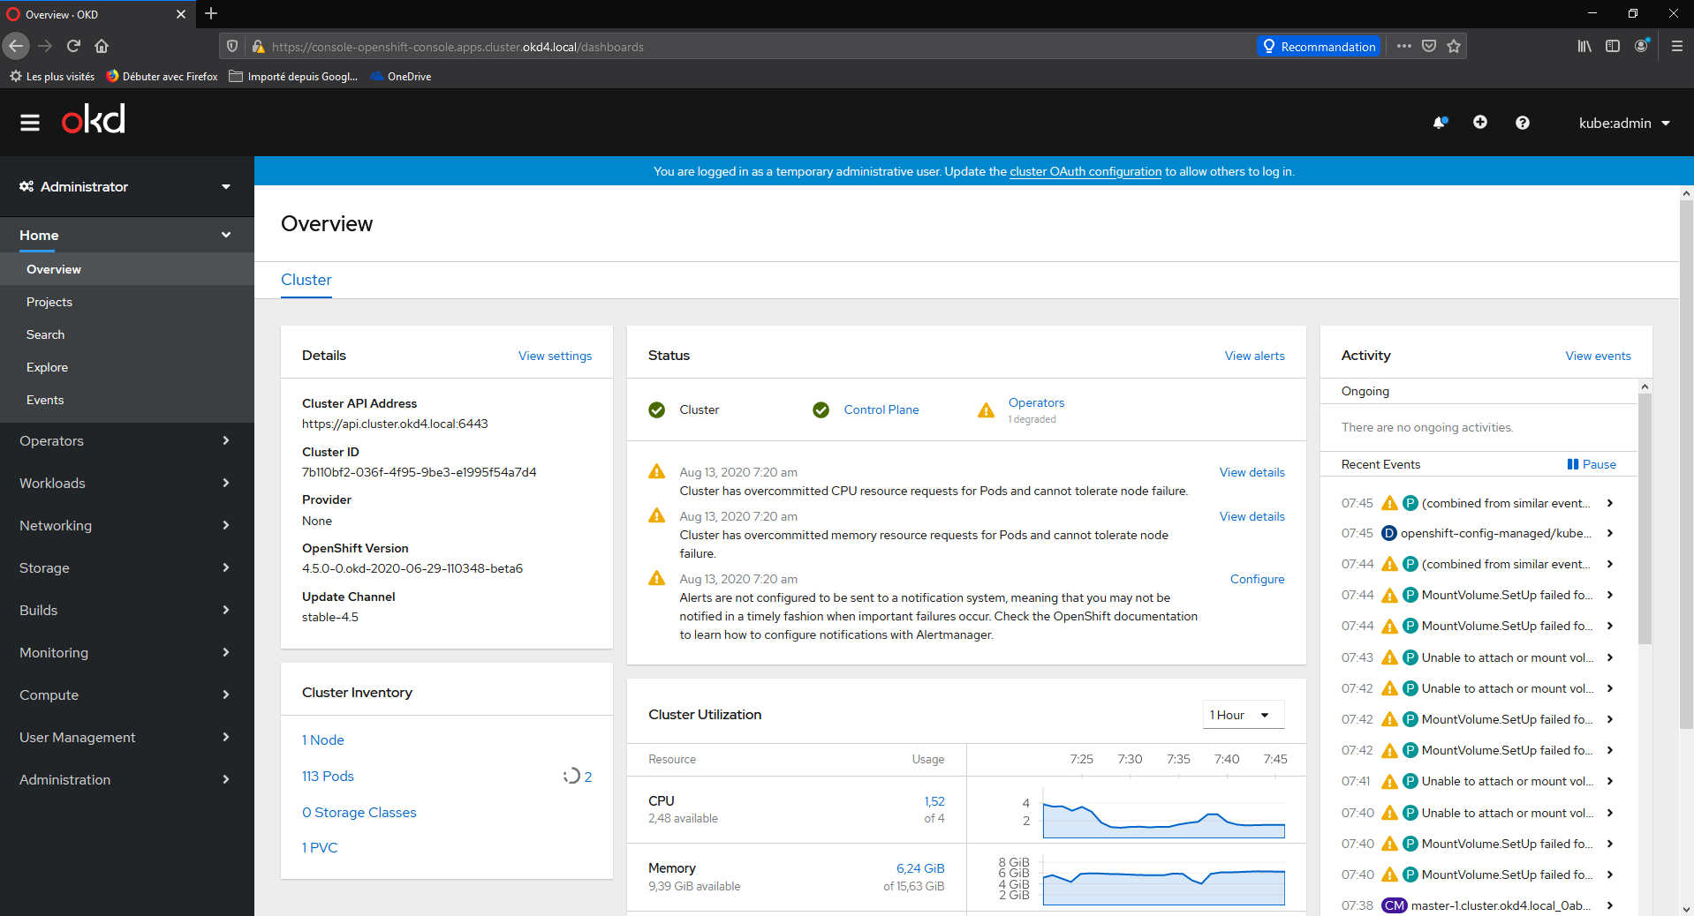
Step 6 : Connect to the OKD console
URL : https://console-openshift-console.apps.cluster.okd4.local/
Login : kubeadmin
Password : bRsda-FuxkE-pXAAt-SDEtt

