Slide 1
ASDC Data Distribution Architecture
Michael M. Little
m.m.little@nasa.gov
Ver 0.4.2
01/26/14

Slide 2
Data Distribution Principles
Principles
ASDC has 3 things: Data, Metadata and Documentation
Metadata describes provenance, authoritative source, derivation
Documentation includes all available descriptive narrative, broken into bite-sized chunks
ASDC has multiple responsibilities
Data Stewardship – to ingest and archive all the data from assigned missions
Data Distribution- to make data available to the whole range of users
Primary, traditional users are the instrument teams, who design the stewardship formatsto meet the requirements of their missions and must stand behind the data
Many other users have no knowledge of the mission, the instruments and means of constructing the data
Data Stewardship can reduce effectiveness of data distribution
All Data access paths rely on the same data files
A Unified Disk Archive with all data accessible from one system
Ensures that the correct version of a file is delivered
Reduces the cost of disk space to make redundant copies
Lower latency than Tape Archive with Disk Cache
Tape Backup ensures stewardship requirements are met
Need to verify integrity of disk files
Minimize duplication within ASDC except for stewardship
Follow ESDIS strategy for DOI’s to trace back to source
Can DOI’s be overlaid on delivery from metadata instead of inserted into original file?
Corollaries
Traditional datasets may require post-processed representations for low-latency applications
Must include traceability to original source data
Need regression testing to verify authenticity
Must be affordable while increasing data re-use

Slide 3
Data Distribution Architecture
Assimilation
Modeling
GMAO
LIS
Modeling
GSFC
Weather
Modeling
NOAA-ESRL
Weather
Modeling
UWisconsin
RSIG
EPA
CESM
NCAR
Wx
Modeling
Northrop-Grumman
Climate
Modeling
GMAO
Climate
Modeling
NCAR
Local File
System Users
-LaRC-
GIS
-DoI, DoAg
DHS-
User Communities
Climate
Modeling
GISS
IDL
MATLAB
Giovanni
MIIC
ESG
REVERB
Value-added
Services
ESRI arc-GIS Server
OPeNDAP
OLTP
SOA
iRODS
ASDCS
Support
BES
BES
ASDC EOSWeb
BES
Allegrograph
Greenstone
FS1
FS3
FS4
FS
FS2
ECS Data
Pool
Ontology
Remote Sensing
Data Products
Documentation
DPO
MISR, MOPPITT, TES, SAGE3
CERES, CALIPSO, Flashflux, ISCCP

Slide 4
ASDC Data Distribution Potential Customer Communities
Institutional Breakdown
Functional Breakdown
NASA GSFC GMAO
Assimilation
Model initialization and verification
Via NCCS
NASA GISS
Model input and verification
Via NCCS
NSF NCAR
Model input and verification
DoD MIT Lincoln Labs (DoD)
NASA ARC NEX
Transfer data to Ames
NASA GSFC Land Information System
Via NCCS
NOAA ESRL/GFDL
NOAA EMC
NOAA NCEP
USN Navy Oceanographer
USN FNMOC
Stennis facility
USAF Weather Agency
EPA EMVL
Community Earth System Model (CESM) (NCAR, NOAA, NASA, DoE, NSF)
NSF University Research
EarthCube
xSEDE
University of London – GERB
British Atmospheric Data Center
UKMet
ECMWF
Assimilation
Weather Modeling
University of Michigan AOSS
University of Wisconsin SSEC
UC Berkeley Earth & Planetary Science
Bill Collins
Northrop Grumman Weather Models
Harris Corporation and FAA
USGS Eros Data Center (LP DAAC)
UMBC – CHMPPR (NSF I/URC)
Modeling Communities
Climate
Weather
Land Processes
Hurricanes
Oceanographic processes
Cryosphere processes
Atmo Chem processes
Air Quality and Pollution
Analysis Communities
Universities
LaRC SD
Instrument Communities
CERES
CALIPSO
SAGE
MISR
LaRC LIDAR
Suborbital Missions
Applications
FEMA
US Army Corps of Engineers
NavOceanO
hifld

Slide 5
Obstacles to Data Access
Data is hard to find
Must have significant prior knowledge to identify which data product contains info needed
Non-NASA data is also parked in a private pasture
Data is hard to use
Bill Collins: Threshold of specialized knowledge makes NASA data hard to use
File formats
Internal file data structures
File size
Data is hard to understand
Voluminous technical documentation
Tech Doc written to a different audience

Slide 6



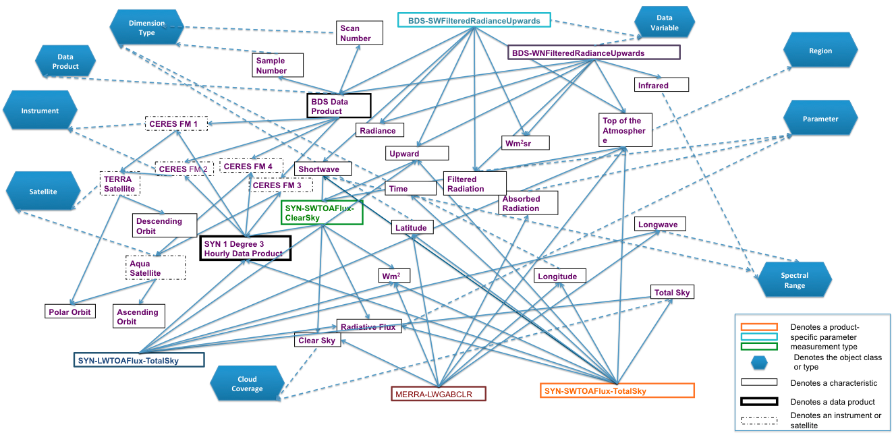
iRODS for Data Access
Assimilation &
Climate Modeling
(Via NCCS)
Climate Modeling
NCCS File System
Client Access
ODISEES
(Ontology)
Semantic Web Tool
iCAT
iCAT
Rules Engine
Rules Engine
iRODS 3.3
iRODS 3.3
Center Firewalls
F
S
F
S
ECS Data Pool
DPO (Data Products On-line)

Slide 7
Performance Testing
Characteristic | Local File System | ftp Data Transfer | iRODS Data Transfer
Latency | 120ms | 400ms | 400ms
Time to copy 9GB file | 2 min | 10 min | 10 min
Time to copy 10 9GB files | 20 min | 40 min | 40 min

Slide 8
ASDC-NCCS Federation Lessons Learned
Planning Federation across computer security domains must engage a significant number of infrastructure managers, including the Office of the local and Agency CIO’s, all the various computer security managers and the local and Agency network managers. Coordinating the infrastructure owners and debugging obstacles was the hard problem. A precision ontology, while not essential, made information sharing across knowledge domains far easier than vague metadata which invariably means different things to different communities A use case to help drive eradication of the obstacles is essential to creating a broadly capable information sharing capability. Identify a local technical expert to leverage all functionality of iRODS Implementation Ensure infrastructure managers have clarity regarding requirements for their respective components needed to support iRODS federation. iRODS redesign between versions 2.x and 3.x preclude multi-generational federations. Operations and Maintenance Monitor/Evaluate Connectivity to detect unannounced infrastructure changes

Slide 9
ASDC-NCCS Federation Future Work
Develop iRODS microservices to interface ASDC access tools and clients to NCCS data, including ODISEES client. Identify other potential collaborators in sharing ASDC data via iRODS Convert ODISEES ontology interface from batch upload to dynamic link to Allegrograph rdf-triple database, Testing of Registered vs. Ingested data products to determine scaling factors.
ASDC-NCCS Federation Future Work
Develop iRODS microservices to interface ASDC access tools and clients to NCCS data, including ODISEES client. Identify other potential collaborators in sharing ASDC data via iRODS Convert ODISEES ontology interface from batch upload to dynamic link to Allegrograph rdf-triple database, Testing of Registered vs. Ingested data products to determine scaling factors.

