Slide 1
PSLab sensor driver using Python

Slide 2
Presentation Outline
Brief introduction to the PSLab and its instruments
Demonstration sensor implementation in Python
  Overview of the TCD1304 Linear CCD
  Coding the clock drivers
  Coding the analog signal capture

Slide 3



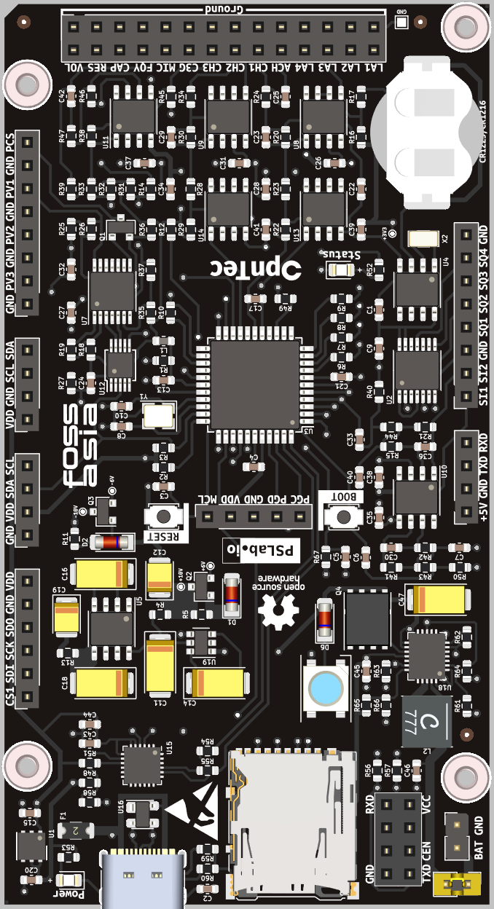


PSLab Instruments
Analog in
Digital in
Oscilloscope
Logic analyzer
Multimeter
Digital out
Analog out
PWM generator
Waveform generator
Power source

Slide 4
Combining instruments
Oscilloscope
Thermometer
Barometer
Hygrometer
Air quality sensor
Accelerometer
Magnetometer
Distance sensor
Luxmeter
Multimeter
Logic analyzer
PWM generator
Power source

Slide 5
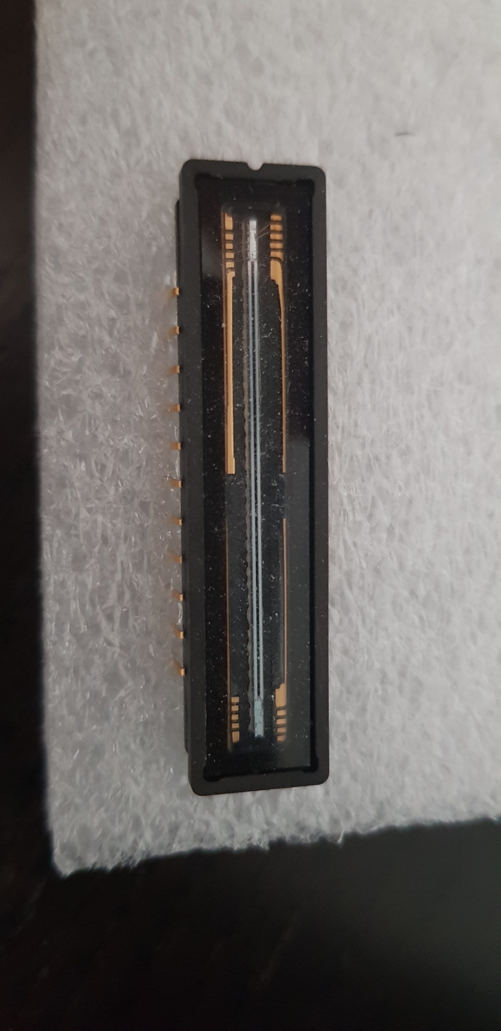
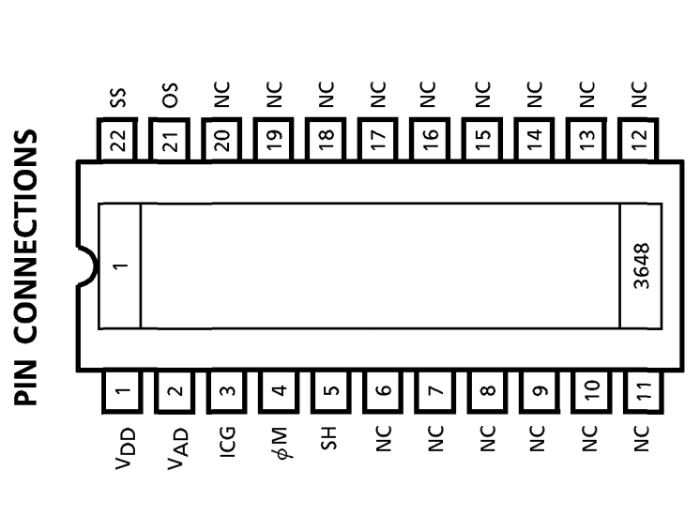
Example sensor: TCD1304 Linear CCD
3648 pixels + 46 “dummy pixels”
Driven by three clock lines:
  Master, ΦM (800 kHz – 4 MHz)
  Integration clear gate, ICG (max Φ_{M} / 4 / 3696)
  Shift gate, SH (max 100 kHz)
Outputs an analog signal:
  Data rate 200 kHz – 1 MHz (1 px / Φ_{M} / 4)
  0.6 V (saturated) - 2.5 V (unexposed)

Slide 6
Implementation demonstration: TCD1304
PWM generator
Final instrument uses
  PWM generator to drive clocks
  Oscilloscope to capture output
Logic analyzer is helpful during development
Oscilloscope
Logic analyzer

Slide 7
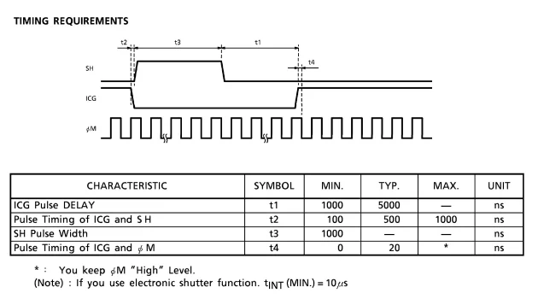
TCD1304: Clock drivers

Slide 8
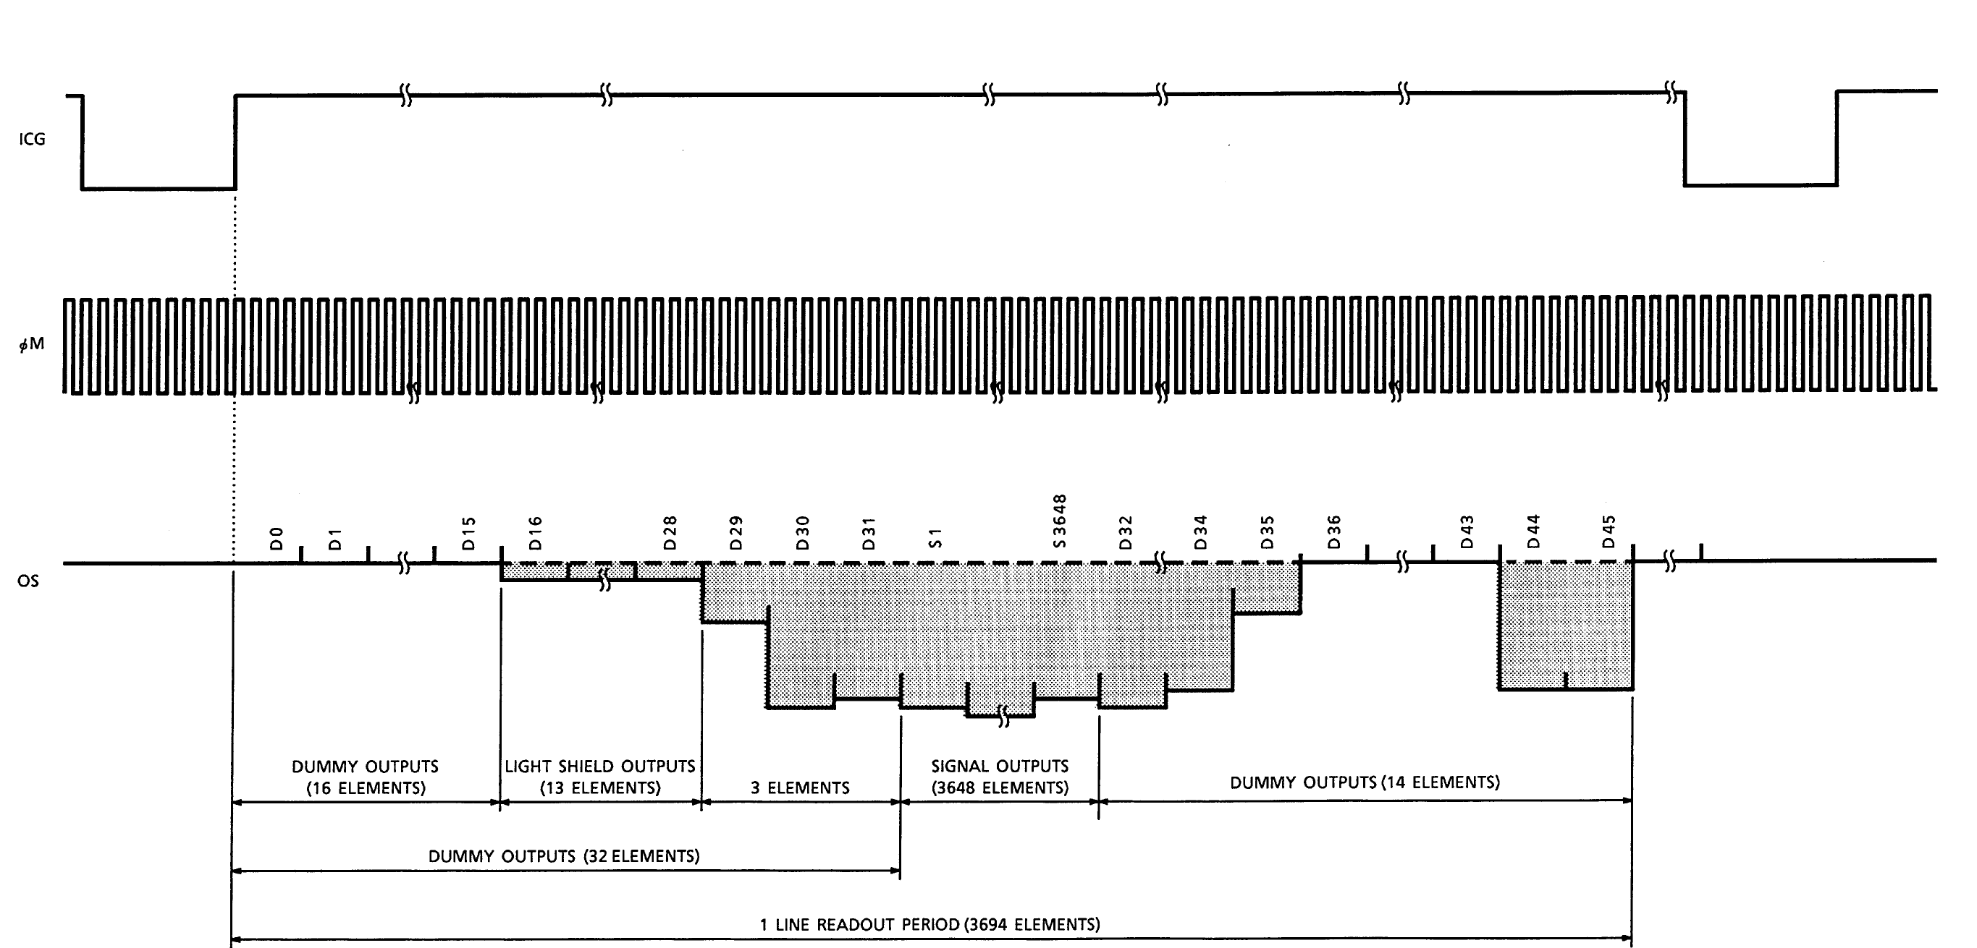
TCD1304: Reading output

