Slide 1
Steps so far on analog snow mapping with Reanalysis and ICESat-2

Slide 2
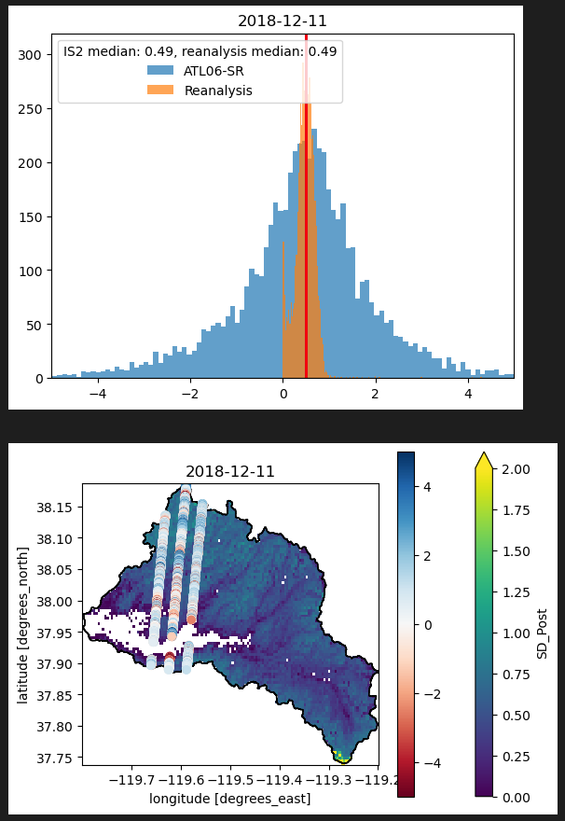
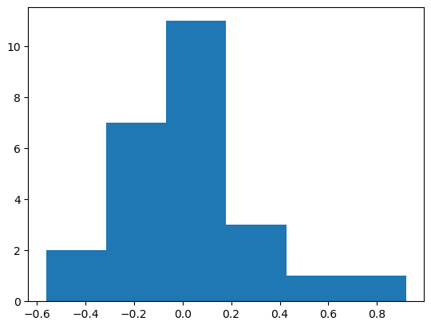
In Tuolumne basin, used ATL06-SR data from Masters work to compare to SWE Reanalysis on the same day
Median MAE is 0.03 m (one mae per acquisition date) for all snow-on dates
Used reanalysis fSCA to exclude reanalysis grid cells and icesat-2 points that overlapped areas with <0.1 fsca
Generally matched well, except for acquisition dates that had very few icesat2 points, or where points were all at very low elevations around Hetch Hetchy.
Downloaded SWE and SD reanalysis files manually from https://search.earthdata.nasa.gov/ and stitched them together.
Notebook: compare_is2_reanalysis.ipynb
Example comparison of snow-on ICESat-2 and reanalysis
Histogram of MAEs for all acquisition dates

