Slide 1
Sept 18 Update for Jessica

Slide 2
CDEC Additions
Metloom contribution to GitHub
(2) Comparisons of kmeans clustering at western US scale and zoomed in to Sierras

Slide 3
SWE Reanalysis EOF
EOF plots, for CO run only:
Compare variance explained plots
Compare the first 4 EOFs
Compare the first 4 PCs? Would need to figure out how to plot the PCs for the Reanalysis data.
Ask about scale of signal: 0.16 vs. 0.002 are magnitudes different…It’s not a result of running it only on CO, could it be based on the granularity of the data? Need help interpreting.

Slide 4


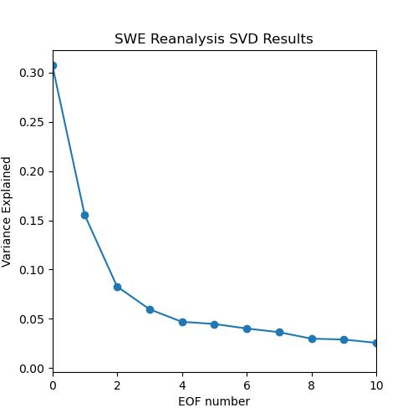
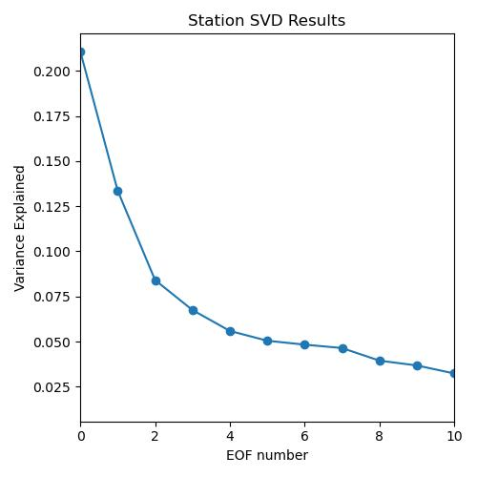

Slide 5
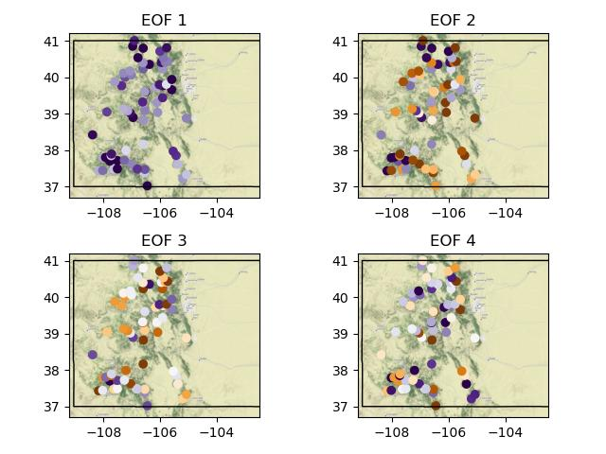


Slide 6
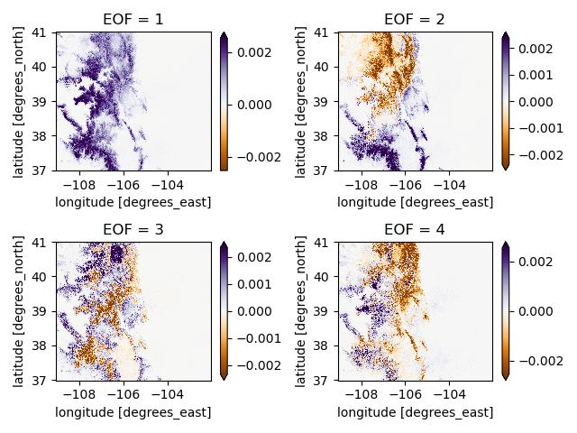

Slide 7
SWE Reanalysis Clusters
Figure out how to run this for CO reanalysis data
Plots to compare:
Colorado clusters for 6 and 7 clusters?
Draw rough cluster boundaries like I did for my Quals
Should I try to identify names of ridgelines/terrain features? Or just discuss when I talk to Jessica.

