Slide 1

GIVE YOUR APPLICATION AUTO-DEPLOY SUPERPOWERS
Presented by BESSONG ATABE JUNIOR

Slide 2
Explain the fundamentals and benefits of CI/CD to achieve, build, and deploy automation for cloud-based software products.
• Reduce technical debt: we may not be able to eliminate technical debt, but a CI/CD pipeline will help reduce it as much as possible. Thus, reducing cost and protecting revenue. • Faster Time to Market: CI/CD will expedite value delivery. Hence, we can onboard more clients and projects without compromising quality. This will increase our revenue and improve our market grip.
• Automated testing will ensure and enforce code quality and security thus reducing cost, protecting revenue, and increasing revenue.
• Catching vulnerabilities early will protect the company from embarrassing conditions, thus, protecting revenue and avoiding unnecessary expenses.

Slide 3
Explain the fundamentals and benefits of CI/CD to achieve, build, and deploy automation for cloud-based software products (Suite).
• Continuous monitoring will help to reduce the Mean Time to Resolution of issues. Happier clients translate to repeat clients and more revenue for the company.
• Adopting CI/CD practices will also help bring otherwise siloed members of staff together. The more collaborative the team can be, the better the products that they will produce.
• This translates to a good working condition which would help to attract the best talents in the industry. Thus, improving the quality of the team and the products that they develop.
• Automated clean-up would help to leverage the available and relatively unlimited cloud computing resources, thus reducing cost, avoiding cost, and improving revenue.

Slide 4
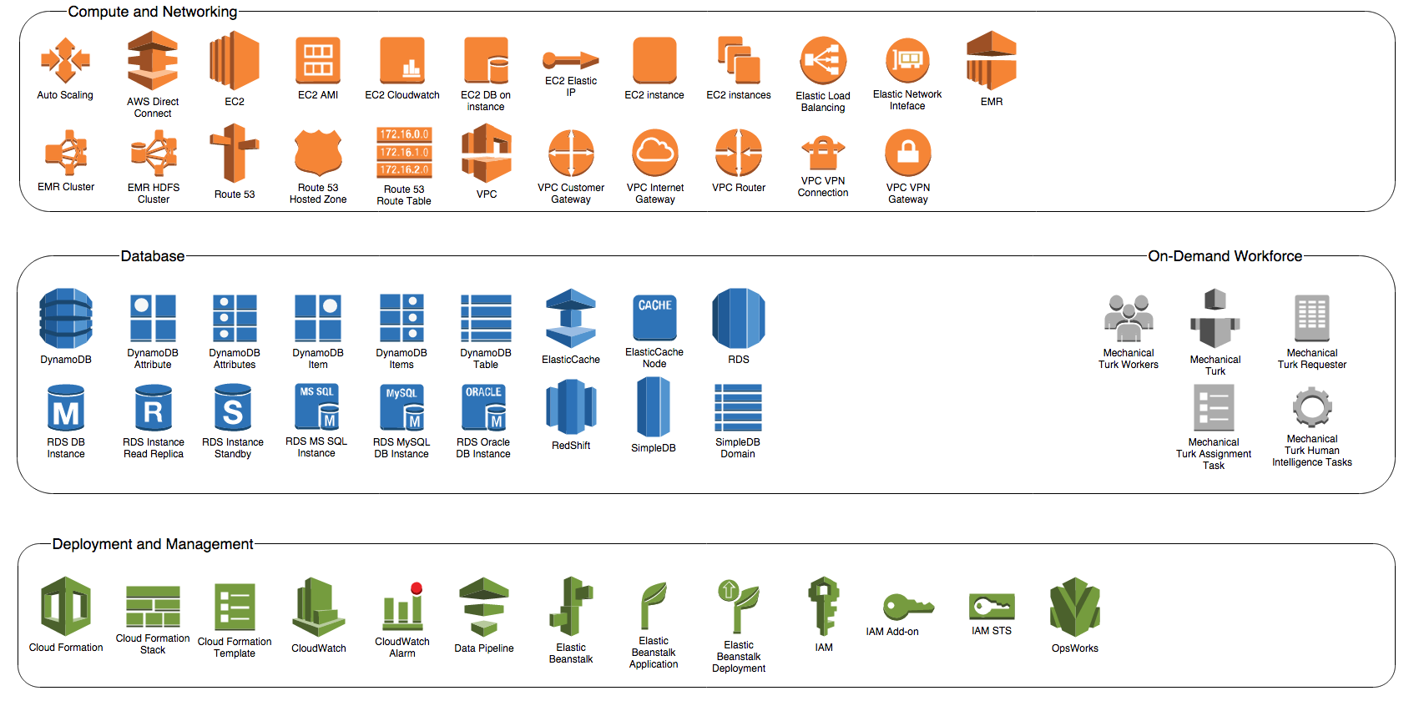
Conclusion
Cloud DevOps is the Future.

