Slide 1
Importance of Data Quality
Evidence Base – Draft (June 2021)

Slide 2
Using this evidence
These slides collect evidence to help you in making the case for data quality initiatives within a public sector department, or team.
This document will be updated regularly.

Slide 3
Using this evidence
Choose appropriate evidence depending on your need. The evidence can support a range of activities aimed at influencing data quality and related activities, from an informal conversation with a senior manager to drafting a business case.
Evidence categories:
Strategic direction and public commitments
Operational effectiveness
Value for money and cost savings
Legislation and regulation
Reputational risk
Note: sources are included for information, these are not endorsements by DQHub

Slide 4
Strategic Direction & Public Commitments
This section includes evidence of the importance of data quality to the work of the UK public sector. It covers both the benefits of good quality, and the risks of poor quality.
Evidence sources:
The National Data Strategy
The Public Accounts Committee
The Government Data Quality Framework

Slide 5
Strategic Direction & Public Commitments – National Data Strategy
Vision and direction for the future: The NDS sets the tone at government level of the importance of data quality and trusted sources of data. Provides the Civil Service with the vision on the future of data in the UK and the direction, in particular through the pillars (data quality is one of them). National Data Strategy [Summary]- GOV.UK (www.gov.uk)
Government is committed to improve data quality: The NDS highlights the government's commitment to improving data quality as part of Mission 3 ‘Transforming government’s use of data to drive efficiency and improve public services’, and as part of the foundations necessary to achieve the Missions. National Data Strategy [4.2] - GOV.UK (www.gov.uk)
Encourages data conversation and application of best practice
Appraising if data is fit for purpose
Considering best practices
Identifying improvement initiatives

Slide 6
Strategic Direction & Public Commitments – National Data Strategy (cont)
Provide specific actions to use as anchor points: Annex A lists specific actions that are already taking place across government- so you could look to link your future project into them, or identify where potential gaps are. One of the actions is the commitment to launch a programme of work to tackle the cultural and coordination barriers to good quality data. National Data Strategy [Annexe A]- GOV.UK (www.gov.uk)
Placeholder for government response to NDS consultation [to add once publication is out at the beginning of April]

Slide 7
Strategic Direction & Public Commitments - Public Accounts Committee
2018 Public Account Committee Report – (link)
Data quality is key for accountability, evaluation, transparency, and fairness.
The report describes poor quality data as "the perennial bugbear" of the Committee. (Page 18) It contains a number of compelling statements about data quality
-Departments collect data as an afterthought, without understanding outcomes and strategies
-Collecting the right information consistently is vital
-Basic assets aren’t recorded
-Partners assume that government data is accurate, leading to failures
Public Accounts Committee – Challenges in using data across government (link)
This report contains a wealth of findings across many aspects of data management and use.
- Data has not been treated as an asset, and how it has become normal to ‘work around’ poor-quality, disorganised data.(P3, Summary)
Poor quality leads to failures in service provision and good decision making (P3, Summary)
Improving the use of data is important but difficult (P3, Summary)
- Quality data for monitoring outcomes is often an afterthought (P6, point 5)

Slide 8
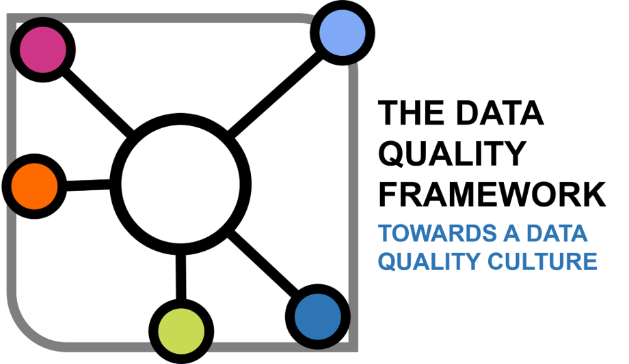
Strategic Direction & Public Commitments - The Government Data Quality Framework
Published with Ministerial approval on GOV.UK – (link)
The framework provides a structured approach to understanding, documenting and improving the quality of government’s data.
It draws on international best practice in quality management and translates this into the context of government data.
The framework defines five data quality principles that aid
the creation of a strong data quality culture:
Commit to data quality
Know your users and their needs
Assess quality throughout the data lifecycle
Communicate data quality clearly and effectively
Anticipate changes affecting data quality

Slide 9
Operational Effectiveness
This section contains evidence relating to operational effectiveness. This can cover delivery of services, policy or decision-making. See also the examples in the Public Accounts Committee reports.
This section includes:
Home Office
NHS

Slide 10
Operational effectiveness – Home Office
A successful example of work on data quality at the Home Office is the work to improve the quality of data sitting on the Police National Database – the development of the database being a core requirement of the Bichard Inquiry (2004) following the Soham tragedy.
There are some key learning points from the experience:
Articulating the why – a single message will not resonate with all. It is important to understand what the “hook” might be for people across a variety of business areas and nuance your message to suit.

Slide 11
Operational effectiveness – Home Office (cont’d)
… more learning points
More than just a number – you need to be able to tell a story. Providing an assessment of data quality in a dashboard format is enormously helpful, but there is also a need to provide context and meaning.
Focus on what matters – don’t be tempted to address all your data quality concerns in one go! You need to engage with the business and its senior leaders to identify what data matters the most, therefore what data has the greatest value. Not all data has an equal value or carries an equal risk, by focusing on core data you are more likely to engage operational leaders.
Return on investment - you cannot realise the full benefit of any investment in technology or innovation until you understand the quality and value of your data.
{Impact of the work done to follow}

Slide 12
Operational effectiveness - NHS
NHS Digital is mandated to collect clinical and administrative data from frontline NHS organisations to support a range of centralised activities including national publications, service planning, performance management and payment.
To meet its statutory obligations under the Health & Social Act 2012, NHS Digital developed the Data Quality Maturity Index (DQMI) to provide a standardise method of reviewing and reporting on the quality of the data it collects and stores on behalf of the NHS.
The DQMI was implemented across eight national data flows submitted by 500+ organisations and the results published monthly to support local quality assurance initiatives. To further drive data quality improvement at a local level, the DQMI was incorporated into key NHS contractual and performance frameworks to utilise established levers and incentives.
The greatest impact on data quality was observed where the incentive carried a financial component. Although availability of this type of incentive was limited, evidence showed that the improvement gains were maintained after the incentive ended.

Slide 13
Value for money & cost savings
This section contains evidence relating to value for money and cost savings. This is traditionally hard to capture as many data quality savings are cost avoidance.
This section includes:
Types of cost savings
Key facts
Examples

Slide 14
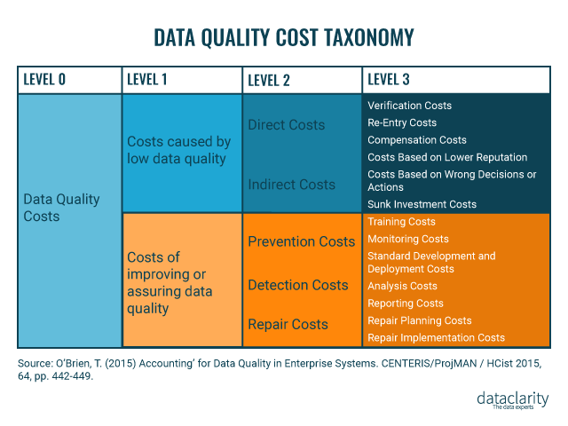
Costs related to poor quality data
Costs are not only monetary ones.
They also include:
Actual costs caused by low-quality data (re-entry costs, reputational costs, decisional costs, etc.)
Costs of assessment and inspection of data to verify data is of good quality (training costs, monitoring costs, etc.)
Costs to improve data quality (IT costs, data cleansing costs, etc.)
Useful resources here and here

Slide 15
Value for money & cost savings – Key Facts
Poor quality costs money to government and society.
Public sector organisations don’t measure costs in terms of lost revenue, but we can learn a lot from studies of the private sector:
DAMA Data Management Book of Knowledge – “Estimates differ, but experts think organisations spend between 10-30% of revenue on handling data quality issues”
In 2016 IBM found that bad data cost the US 3.1 trillion per year (covered here)
“A study by Gartner has found that most organizations surveyed estimate they lose $14.2 million dollars annually.” (covered here)
Experian carried out a global survey about the impacts of poor data quality (report here, see page 18) which estimates “75% of businesses waste an average of 14% of revenue on bad data quality”
MIT Sloan estimated the cost of bad data to be 15% to 25% of revenue for most companies (covered here)

Slide 16
Cost avoidance/savings examples
Data quality supports reducing costs and achieving value for money.
Transforming rehabilitation (Policy development) – Ministry of Justice (MoJ) replaced probation trusts with Community Rehabilitation Companies (CRCs) working under contract. However, CRC contracts were terminated 14 months early after multiple CRCs failed. This was likely due to a lack of data and evaluation lacked understanding of what worked in probation trusts and what the costs were. This example shows potential consequences of the lack of quality data from appropriate sources to support decisions about how to do things differently in the future.
Challenges in using data across government NAO Report

Slide 17
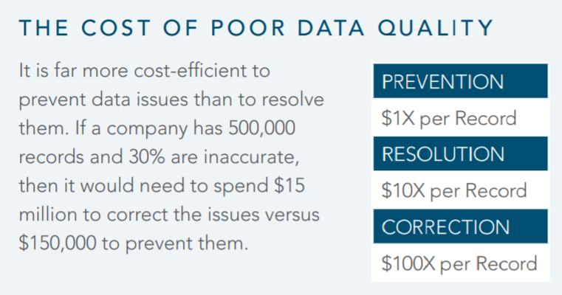
Value for money & cost savings
Dun & Bradstreet has documented key factors in data quality and return on investment

Slide 18
Legislation & Regulation
This section includes evidence from legislation and regulation relating to data. Depending on the type of data you hold and the field in which your organisation works, there may be other regulatory controls that apply.

Slide 19
Legislation - GDPR
Data quality is a requirement of the GDPR.
The key requirements of GDPR’s Article 5 involve appropriate usage, accuracy and data security.
It mandates that personal data should be “accurate and, where necessary, kept up to date; every reasonable step must be taken to ensure that personal data that are inaccurate, having regard to the purposes for which they are processed, are erased or rectified without delay.”
The Information Commissioner’s Office (ICO) gives specific advice about managing accuracy of data here
The ICO provides specific advice on managing data quality here. It covers the importance of regular data quality reviews, staff awareness of quality issues, responsibilities and processes, and “weeding” of personal data.

Slide 20
Legislation – GDPR
Accuracy is an important aspect of GDPR Compliance.
The Information Commissioner's Office regularly deals with over 2300 complaints about the accuracy of personal data each year.
[ICO Annual Report 2019-20]

Slide 21
Reputational Risk
This section contains evidence relating to reputational risk. This is a broad category and many high-profile examples exist in the public domain. See also the examples in the Public Accounts Committee reports.
This section includes:
Incomplete data from Windrush Immigrants
Global CEO Outlook

Slide 22
Reputational Risk
Windrush – data about individuals’ status was not adequate to identify those without rights to live in the UK. NAO Report.
84% of CEOs are concerned about the quality of the data they’re basing decisions on, according to KPMG’s “2016 Global CEO Outlook.” Source here.
Notes:
Might want to introduce something around the relationship with data and digital.. And that many government services are moving online (as a way of delivering effective and efficient services), and this is only possible with underlying data of high quality.

Slide 23
Preparing a business case
There is no single way to prepare a business case, use what works best in your organisation.
This section contains links to advice on preparing data-focused business cases:
DAMA the Data Management Association
Project Business Case (gov.uk)
Gartner guidance

Slide 24
Business Cases for Data Initiatives
DAMA identifies three types of data initiatives that may require business cases: improving a business process; solving a problem; and preparing the ground for the future.
Business cases should:
link data needs with organisational objectives
involve relevant people from the start
use appropriate language, without jargon
learn from previous successful business cases for data initiatives
Remember to include the cost of poor data quality in your cost assessments
If you are a DAMA member, you can find full guidance here.

Slide 25
Guidance on preparing a business case
Successfully selling the case for data quality
Guide to developing the Project Business Case (publishing.service.gov.uk)
Gartner’s guide on how to create a business case for data quality improvement create a business case for data quality improvements

Slide 26
Email us at DQHub@ons.gov.uk with questions and feedback Find out more on GOV.UK
Notes:
“This could be you”

