Slide 1
Building a Python Package for Reproducible Statistical Outputs
David Foster
Best Practice and Impact Division
Notes:
Slides available online
Hope to encourage use

Slide 2
Outline
What is a Package?
Why use Packages?
Motivation
Good Practice Tables (gptables)
What’s next?

Slide 3

What is a Package?
Packages are collections of code (and their metadata) that performs related tasks or an overall high level function
numpy – working with multi-dimensional data
pandas – working with data structures with metadata
A minimal example:
setup.py
examplepackage/
__init__.py example_module.py
Example python package
Example R package
import examplepackage.example_module
from examplepackage.example_module import example_function
Notes:
Structure is flexible within package – can have many sub-packages
Package and sub-package folders (any folder within the package)
Files are “modules”
Objects can be imported from modules

Slide 4
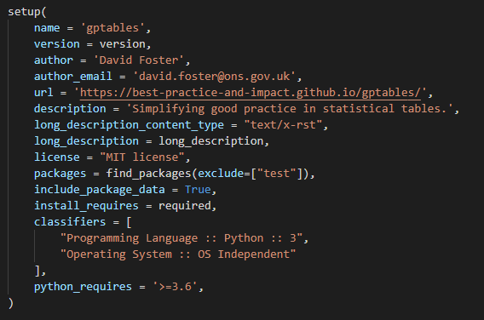
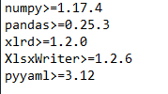
Package Components
__init__.py
This file is used to indicated that neighbouring .py files (modules) are importable
It is executed when that package or sub-package is imported
setup.py
Uses setuptools.setup to provide info for installing and build your package
Notes:
Init often empty, but can be useful
Need one in each package folder and subfolder
contains code that is run when the package or sub-package is imported
Author and maintainer contact details
Dependencies (requirements.txt)
Entry points

Slide 5
Developing a Package
__init__.py makes modules importable
python needs to know where they are located
searches on the PYTHONPATH - sys.path
Installing packages locally
pip install -e example_package_is_in_here/
pip install -e .
Installs in develop mode (creates an .egg-info folder)
Can test your package as you make changes
Uninstall it correctly
pip uninstall examplepackage
Notes:
So you’ve added __init__.py
Can manually add locations to sys.path, but not reproducible!
Points to directory of development package
Demo pip freeze

Slide 6
But why use packages?
Reproducibility
RAP isn’t just for production
A packages purpose could be to reproduce a piece of analysis
Keeps documentation closely associated with the work
N.B. Packages don’t address the whole issue around reproducibility – environments
Reusability
Notes:
I’m an analyst, not a software developer - why should I care?
Important to be able to reproduce statistics
Have done a piece of analysis in your department, want to share with others
By the way, you’ll need versions x of packages y
Also, change this path to point to this file
SML

Slide 7
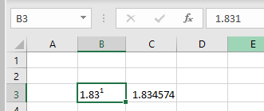
Motivation
Bad statistical tables can be:
Hard to understand
Hard to use – e.g. not machine readable
Incorrect
We recently published guidance on releasing statistic in spreadsheets
Aims to keep tables simple and consistent
Increases machine readability
Notes:
Don’t want to leave anything open to interpretation – it should be easy for users to get the correct message
Multiple index levels
Mixed units types in a table, not indicated
Blank rows/cols
Machines can’t interpret formatting
Manual input can introduce errors
Minimise manual input and don’t allow data to be corrupted by formatting

Slide 8


Motivation
Working on the development of a Reproducible Analytical Pipeline (RAP) for production of statistical tables
Want to generate reproducible and consistent tables
Don’t want to change dramatically from existing format
Want to make it easy to follow our guidance
Packages exist for reading and writing Excel spreadsheets, but:
Some require a rigid, pre-formatted template
Some write and format data on a cell by cell basis
Notes:
End of the pipeline – output over 100 tables
Same occurs for many RAP pipelines
Minimise unnecessary manual input - risk
Users can often depend on output format
Not quite what we want, but we don’t want to reinvent the wheel

Slide 9
Aside: Open Source
“There are very few examples of code that must not be published in the open.”
-- The Government Service Manual
Benefits:
Transparent
Encourages reuse and collaboration
Considerations:
Treat code as you would other documents – always consider its sensitivity
Discuss the project with your peers and management
Notes:
Our work should be open by default and open early on in development
Users can see methodology
Other analysts can reuse your code and could reproduce your results
Don’t release passwords/keys or code that describes a method for preventing disclosure or detecting fraud, or provides insight into a sensitive dataset
Do consider that it will be open for scrutiny, in a good way – promotes good practice
See if your division/department has a group in place already

Slide 10
Ideal Solution
Flexible table design
Makes it easy to format table elements
Keeps formatting consistent across multiple spreadsheets/files
Encourages users to follow good practices
Notes:
Everyone’s tables are slightly different and change over time
Want to support formatting that doesn’t break guidance – and requires no manual input
And across multiple uses (reproducible)

Slide 11

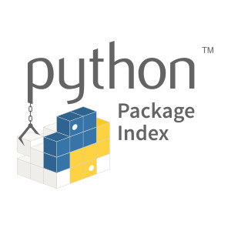

Enter Good Practice Tables (gptables)
Open source python package
Source code on our GitHub
Installable from PyPI (pip install gptables)
Supports use in R (using {reticulate})
Built upon the XlsxWriter package
Writes data to Excel and applies formatting
gptables uses this to write and format cell by cell
Notes:
Many RAP projects use R – no sense in writing it twice
Parrallel with pandas <- numpy
Most of the hard work was already done
We made a high level grouping of table features
Still possible to follow bad practice, but we’ve made it easy to avoid

Slide 12
gptables Structure
setup.py
README.rst
requirements.txt
CONTRIBUTING.md
LICENSE
VERSION
docs/
gptables/
__init__.py
core/
__init__.py
gptable.py
theme.py
wrappers.py
api.py
examples/
test/
Installable
Dependencies
Documentation (sphinx)
Unit testing
Notes:
Package applied many RAP principles
Import useful classes at top level using __init__.py

Slide 13
Good Practice Table Design
Title
Subtitle(s)
Scope
Units
Column Headings
Index level 1
Index level 2
Index level 3
Data
(Source)
(Legend)
(Annotations)
(Notes)
Supplied as a pandas.DataFrame
Mapped individually
Notes:
Most metadata in first, left hand column
No empty rows or columns
One table per sheet/tab

Slide 14
Aside: Objects in Python
Classes - just a way of grouping data (attributes) and related functions (methods)
This is association is useful when working with data and metadata
class Car:
def __init__(make, model, max_speed):
self.make = make
self.model = model
self.max_speed = max_speed
def drive(self):
if self.max_speed > 70:
print("VROOOOOM!")
else:
print("brum brum")
Notes:
Attributes are essentially variables associated with the class instance
Methods are functions that can use and modify attributes belonging to an instance of the class
“self“ allows an instance of the class to access its own attributes and methods

Slide 15

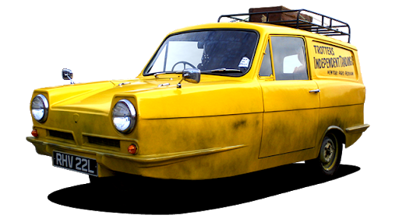

Aside: Objects in Python
An instance of a class is an object
>>> my_car = Car(
make = “Reliant Robin”,
model = “Mk1”,
max_speed = 150
)
>>> my_car.drive()
VROOOOOM!
Car
my_car
Notes:
Class alone is like a generic blueprint or concept - not really useable
must create instances that can be driven
Consider pandas as a more relevant example

Slide 16


gptables Inner Workings
GPWorkbook class
Subclass of xlsxwriter.Workbook
Represents a single file (one or more worksheets)
Stores an associated Theme object – consistent throughout tables
GPWorksheet class
Subclass of xlsxwriter.Worksheet
Represents a single sheet/tab
Contains a methods for writing a GPTable object to a sheet
Notes:
Subclass inherits the attributes and methods from superclass
Stores output filename, worksheets and methods for writing to Excel
Allows you to write data for individual sheet, using Workbook’s Theme

Slide 17
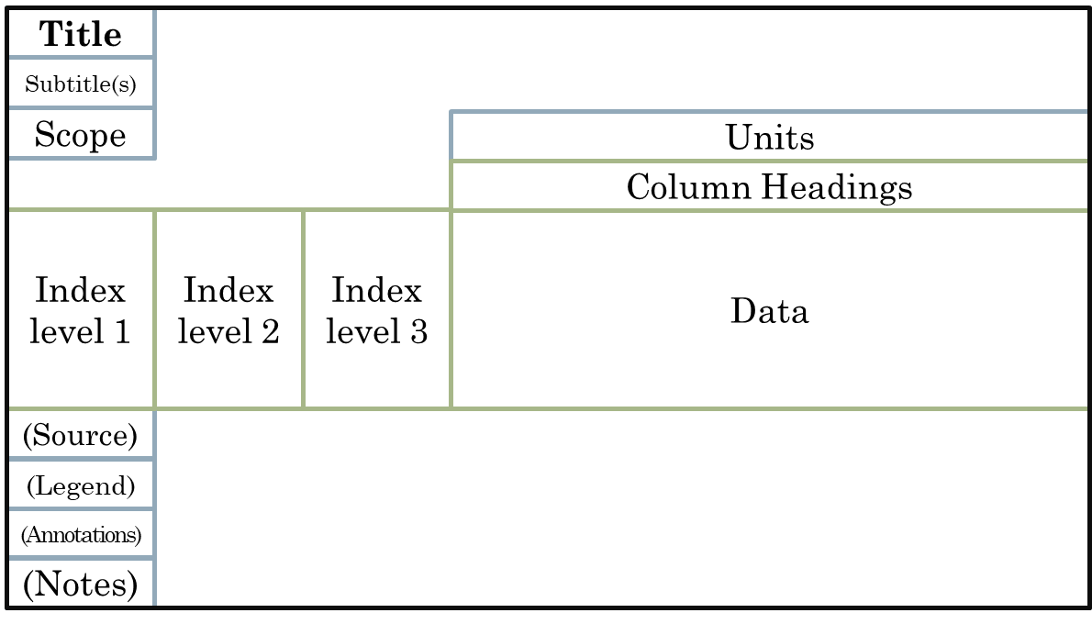


gptables API
GPTable class
Represents a single table (one table per sheet)
Contains the pandas.DataFrame object containing data
Other attributes including title, subtitles etc
Some table specific additional formatting
Theme class
Stores formatting for each GPTable element
Configures using YAML file
Also defines flag for representing missing values and ordering footer elements
API functions
produce_workbook() – returns GPWorkbook object
write_workbook() – saves the Excel file
Notes:
Application programming interface – the users point of contact
produce_workbook allows further modifications
any features from xlsxwriter

Slide 18
Using gptables
Map data to table elements as a GPTable
Design Theme formatting (optional)
You write_workbook() to win
Notes:
Demo in spyder using iris example, also showing object returned from produce_workbook()

Slide 19
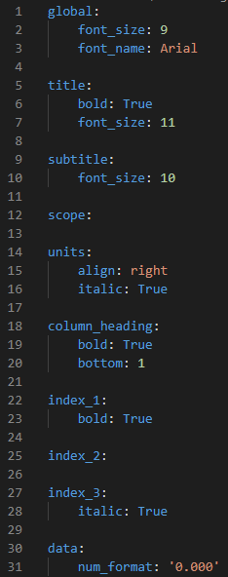
Theme object configuration
YAML config components:
global – default formatting for all elements
Element-wise formatting
Also footer_order and missing_value
Support all formatting using all xlsxwriter.Format properties
Notes:
gptheme – default

Slide 20

What’s next?
Open source packages are often iterative – require maintenance
Fix bugs ((((((()))))))
Cover pages
Automatic column widths

Slide 21

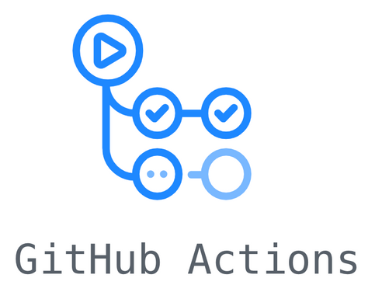


Aside: Continuous Integration
Automated building, testing and deployment
Available on the ONS network
Jenkins
Many freely available online
GitHub Actions
Travis (used in gptables repo)
CircleCI
Notes:
Can be used to run tests, check coverage and even deploy

Slide 22
Take Home
Packaging code is simple and can improve reproducibility in analysis
Open source whenever possible
Classes aren’t so scary – use them when it makes sense

