Slide 1
Coding in Analysis and Research Survey (CARS)
David Mais & George Pickering
Best Practice and Impact division, ONS
Notes:
[DAVID]
David Mais and George Pickering from the Best Practice and Impact Division.
Going to talk to you today about the Coding in Analysis and Research Survey (CARS) which we undertook last year and have now finished analysing.
Results and insights we have drawn will be particularly useful for this network.

Slide 2
Outline
What is CARS?
How did we analyse the data?
What did we find out?
Demonstration of our interactive dashboard
Discussion on how the RAP champions could use the results
CARS wave 2
Notes:
[DAVID]
This is an outline of what we will talk about during the session.
Talk through points in slide.
What is CARS?
How did we analyse the data? (7 mins)
What did we find out?
Demonstration of our interactive dashboard (10 mins)
Discussion on how we can use the results
CARS wave 2 (10 mins)
1-11 and 20-22 for me and then 12-19 for George

Slide 3
What is CARS?
Survey launched in September last year
Developed to understand how analysts and researchers use coding across government
1,051 responses to the survey created a large dataset to analyse
Notes:
[DAVID]

Slide 4
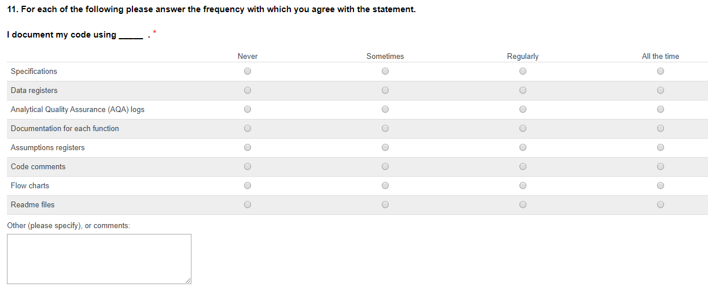
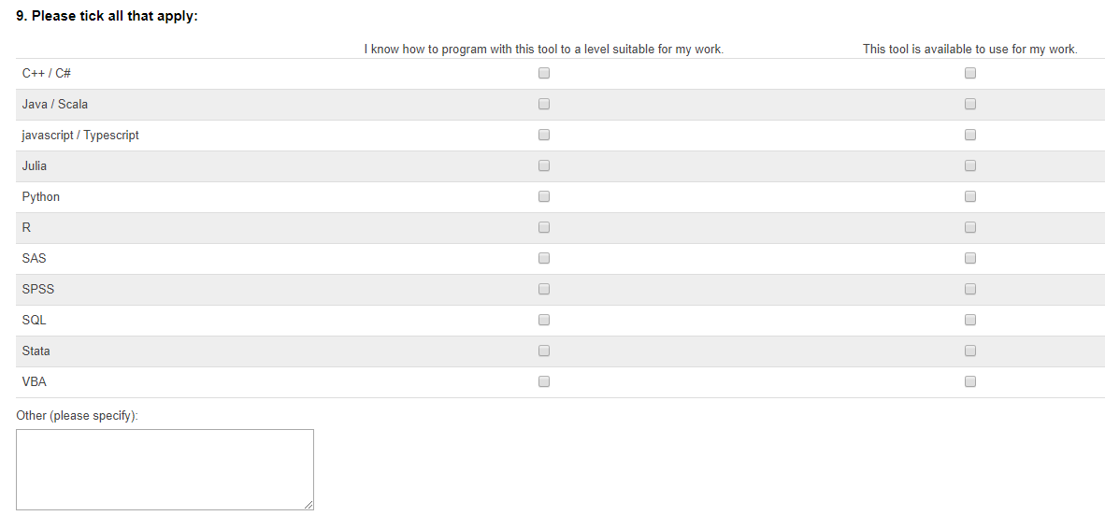
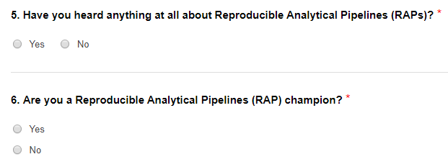
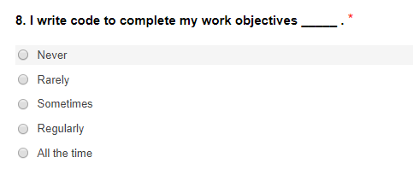
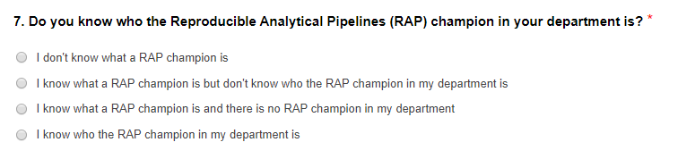
Example questions
Notes:
[DAVID]
These are some examples of some of the questions we asked respondents.
Questions on whether respondents have heard of RAP, awareness of RAP champions, how often they write code, what type of coding tools they know how to use and what tools they have available to them and also questions on the approach respondent takes to documenting code.

Slide 5
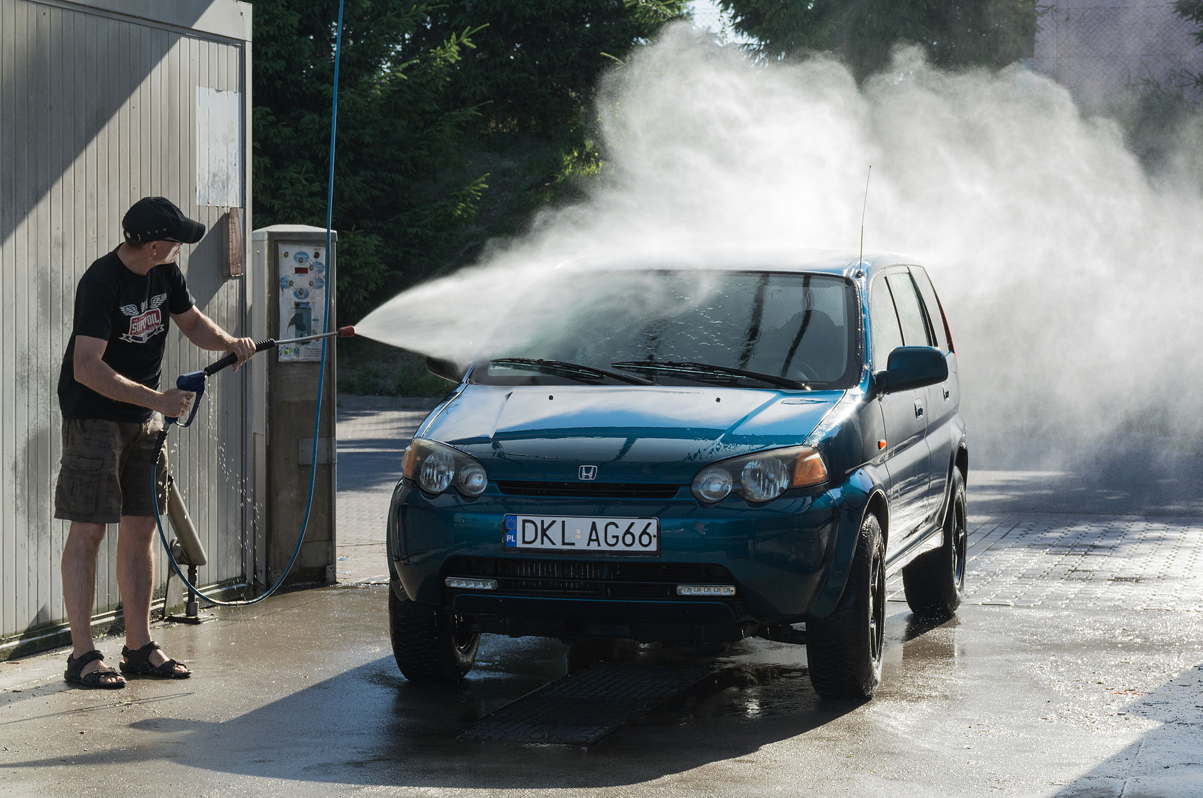
CARS Data Cleaning
Notes:
[DAVID]
Will now talk through how we analysed the data.
Before analysing we undertook a large amount of data cleaning on the raw survey data.

Slide 6
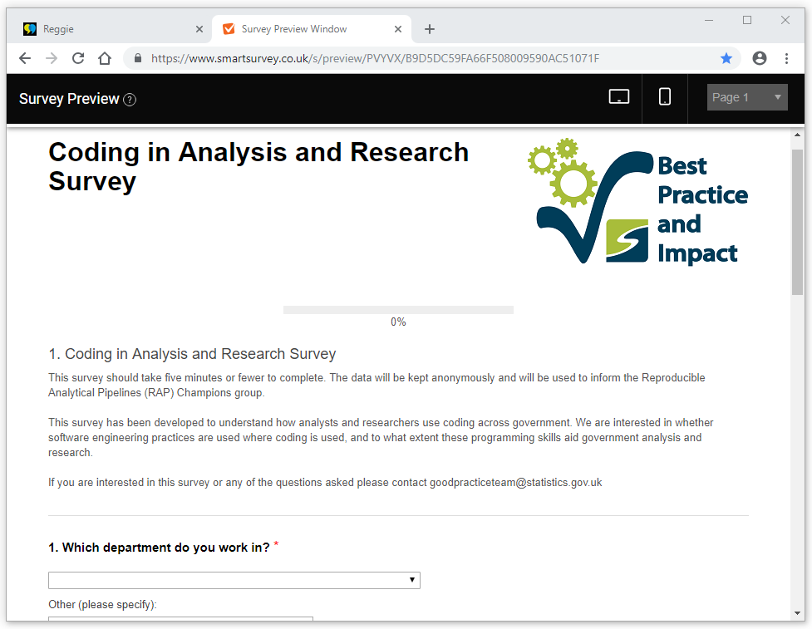


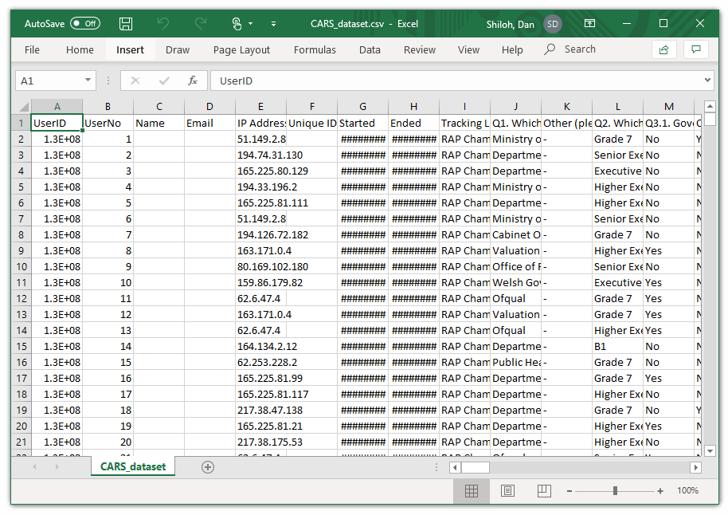
The data
Notes:
[DAVID]
CARS was administered using Smart Survey and the data was downloaded into Excel.
Used R studio to do the data cleaning.

Slide 7






Outcomes
91 variables renamed
118 new variables created:
Missing values imputed where possible
Responses tested for consistency
“Other” responses categorised
The CARS dataset is ready for
analysis
%
Notes:
[DAVID]
As part of the data cleaning, we renamed a lot of the variables as well as creating new variables for analysis. We imputed missing values where we could to make sure the data was complete as possible.
Cleaned version of the dataset was used for the analysis.

Slide 8

Stakeholder Engagement – Why?
Notes:
[DAVID]
Lots of data to work with from the survey, the cleaned dataset contained over 100 variables with over 1000 observations, despite only 15 questions
As a result, there was a need to focus our analysis
Best way to do this is was to interact with our stakeholders and find out what they wanted to learn from our results.
We used the stakeholder engagement to Identify the issues that mattered the most to them to provide a piece of analysis that would be as useful as possible

Slide 9


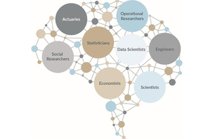
Stakeholder Engagement – Who?
Notes:
[DAVID]
Survey was distributed primarily through the GSS, GSG were most common profession, therefore it would make sense that we engage with statisticians within the GSS
However badged statisticians only made up less than half of the respondents, so there was also a need to engage with GSR and other professions within the wider analysis function.
Given that we had data at the departmental level, we thought that this would be of most interest to those occupying leadership roles for their profession within their department – Heads of Profession.
HoPs interests are quite varied and general so Information would also be useful to those with a more specialised interest in coding – RAP Champions network

Slide 10
Outcomes
14 responses
Mostly from Stats HoPs, RAP Champions and those in data-related positions such as Head of Data Science
Common Themes:
Interest in knowledge and availability of programming tools across the GSS
Coding practices adopted elsewhere e.g. Usage of Git
In general, respondents were much more interested in practices outside of their department
Some appetite for case studies of good practice or challenges faced by other departments, however this is beyond the scope of the survey
Notes:
[DAVID]
14 responses in total (with areas of interest)
These primarily came from Stats HoPs, RAP Champions and those holding data-related positions e.g. Head of Data Science, Head of Data Innovation
Several common themes emerged these conversations: (Use list of slide)
Most interest was in what tools people are using to code and how they are doing so.
Specifically, this referred to the questions relating to the knowledge and availability of programming languages within departments

Slide 11




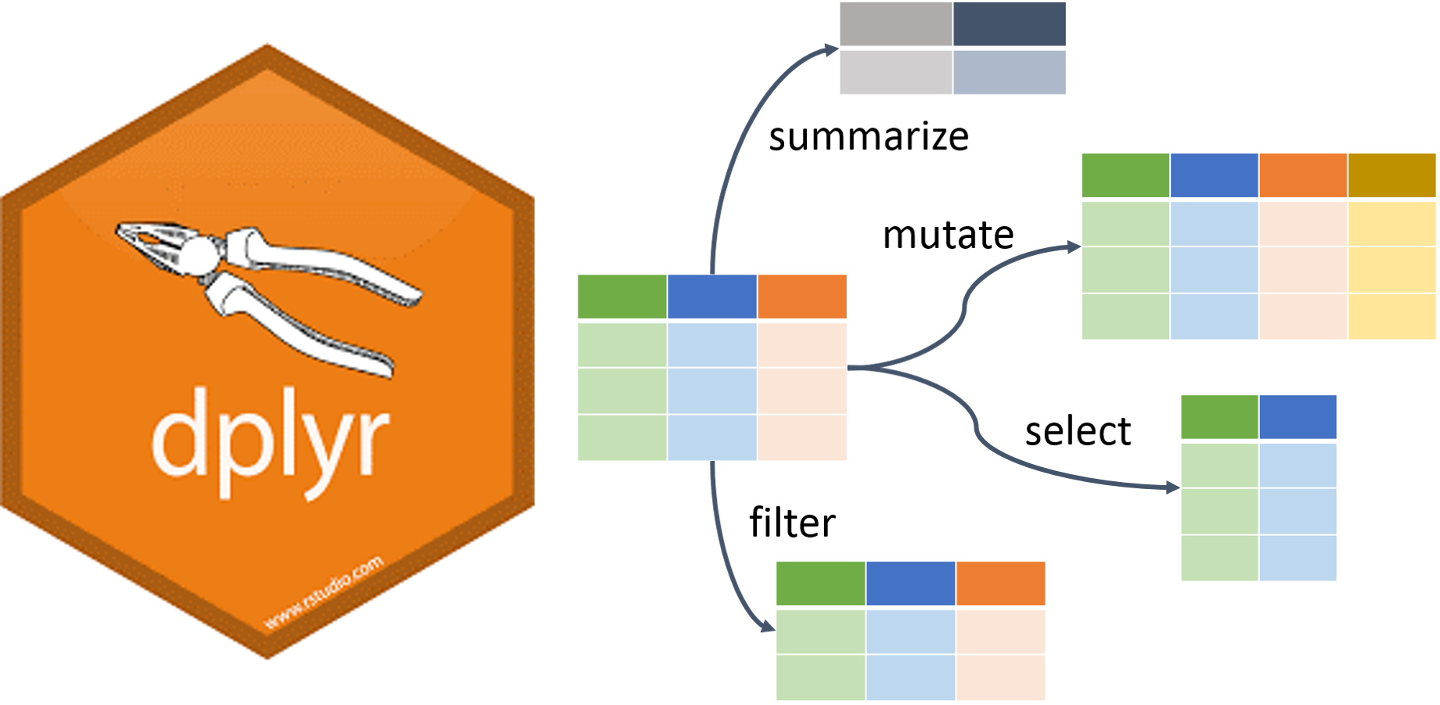



The tools for the job
Version control
Coding environment
Package development
R packages
Notes:
[DAVID]
We used R Studio to undertake the data cleaning and produce a cleaned version of the dataset as well as for undertaking the analysis required to produce an interactive dashboard.
R packages we used included ggplot and dplyr
We used GitLab as our version control tool.
Collaboration on GitLab between the project team using merge requests and code comments.
Pass over to George who will talk through the findings and our interactive dashboard.

Slide 12
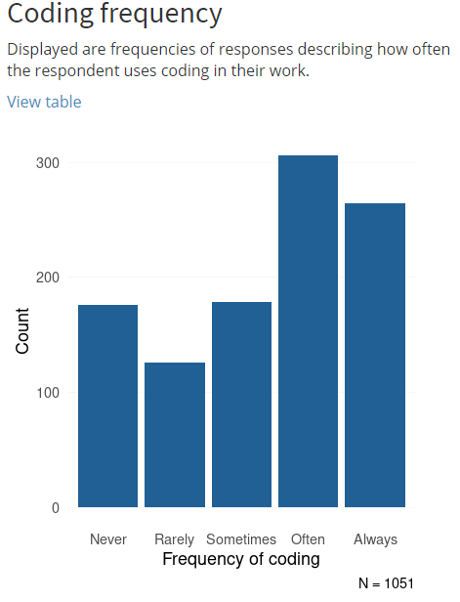
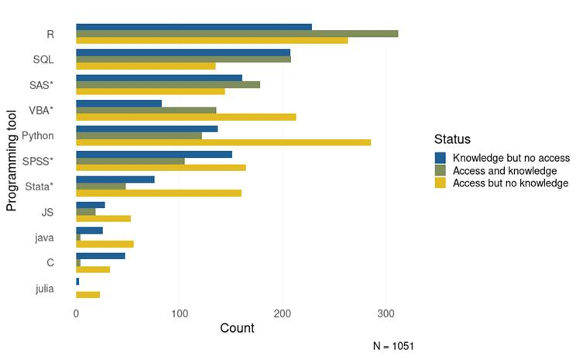
Key findings
Notes:
[GEORGE]
Will now talk through some of the key findings from the survey.
Majority of respondents sampled reported that they use coding in their work at least some of the time (71.3%) – chart on the left.
Open source or free-to-use software appears to be popular. The most used programming languages were R and SQL, at 35.7% and 23.8% of coders in the sample, respectively. However, some proprietary software are still widely used, with SAS and VBA ranked third and fourth for number of users – chart on the right.
The data show gaps in knowledge and access in all programming languages. Many respondents know how to use programmes to which they have no access at work, for example 26.1% of coders in the sample reported that despite a knowledge of R, they could not access it at work – chart on the right.

Slide 13
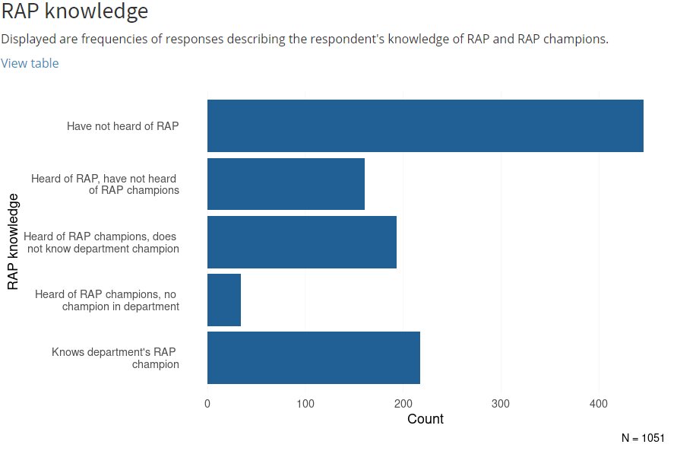
Key findings
Notes:
[GEORGE]
Many respondents had limited knowledge of RAP. Only 57.6% of respondents had heard of Reproducible Analytical Pipelines (RAP). Among those who have, 26.6% had not heard of the RAP champions network. As the survey was heavily promoted by the RAP champions network, the true figures across government might be lower still.

Slide 14
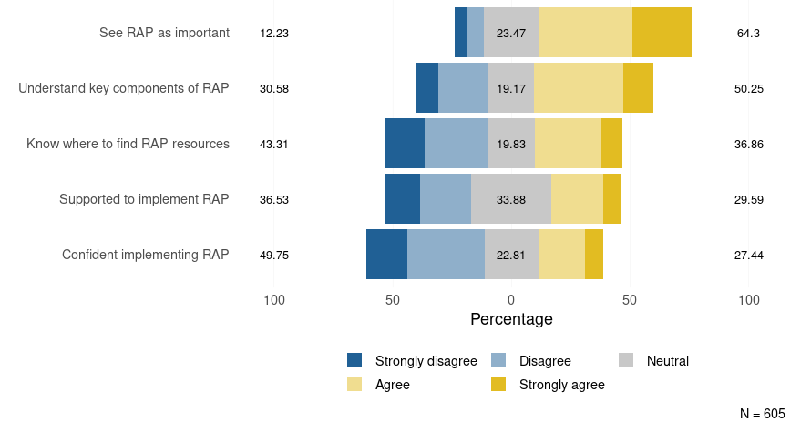
Key findings
Notes:
[GEORGE]
RAP are generally seen as important among those who are aware of it, with 65.3% agreeing or strongly agreeing and only 12.2% disagreeing or strongly disagreeing. However, only a minority reported feeling confident implementing RAP: 25.4% agreed or strongly agreed, whereas 49.8% disagreed or strongly disagreed.

Slide 15
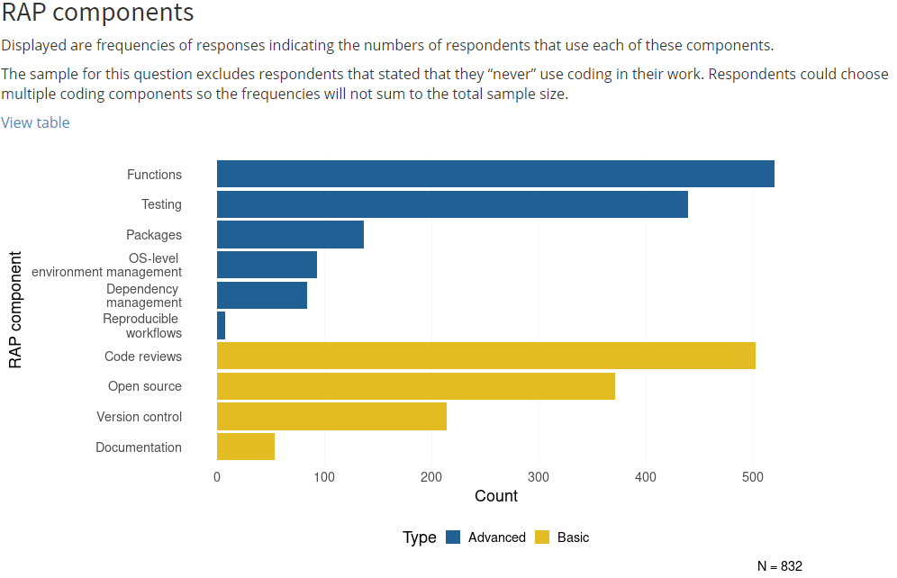
Key findings
Notes:
[GEORGE]
Of the basic components of RAP, the most applied were code reviews and the use of open source software (60.3% and 44.6% of coders, respectively). The least engaged with was documentation - with only 6.4% of coders writing both code comments and readme files.
Of the more advanced components, writing functions and automated quality assurance (QA) or testing were the most engaged with (62.5% and 52.8% of coders, respectively). Reproducible workflows saw the least engagement, at only 0.8% of coders.
These are derived from responses to other questions – outlined in the methodology notes.

Slide 16
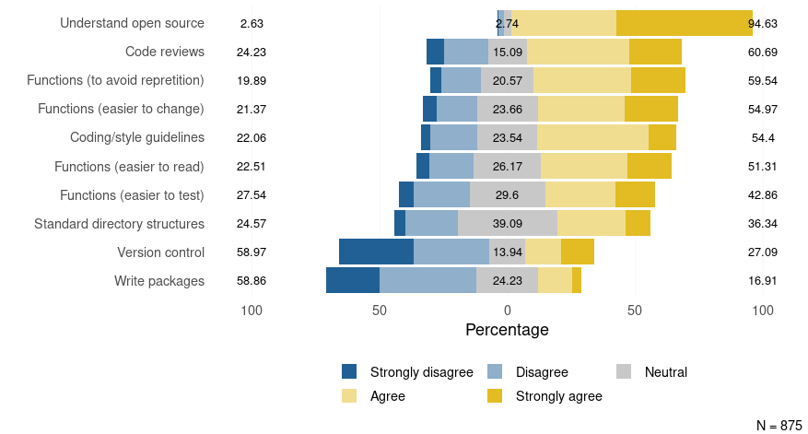
Key findings
Notes:
[GEORGE]
Respondents were asked about a variety of techniques considered to be good practice in coding. Responses showed large variation between these. Some practices such as code reviews, writing functions and commenting code were reported by more than half of coders in the sample. On the other hand, other practices such as writing packages, using tools for reproducible workflows and continuous integration were much less common.

Slide 17
CARS dashboard
R Shiny dashboard produced to display the results
Enables results to be filtered by department, grade and profession
Department level figures are available to view in the dashboard where at least 20 responses have been provided in that department. Further breakdowns by grade and profession are available to view where there are at least 20 responses e.g. ONS G7 results are viewable as there are more than 20 responses
Notes:
[GEORGE]
SDC queries team at ONS advised us on the 20 responses rule.

Slide 18













What department level breakdowns are available to view in the dashboard?
Notes:
[GEORGE]
These are the departments where we had at least 20 responses and have their results viewable in the dashboard.

Slide 19
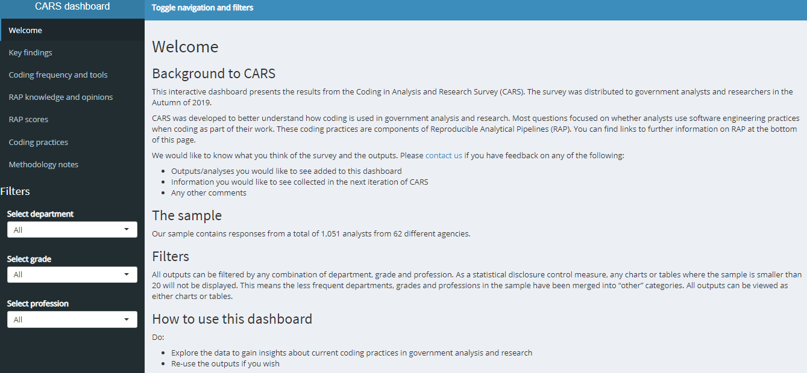
Dashboard demo
https://cars-dashboard-dwzndgiyya-ez.a.run.app/
Notes:
[GEORGE]
George will give a brief demo of the dashboard and how it works.

Slide 20
Discussion
How can this network use the results from this survey?
Notes:
[DAVID]
5 minutes.
Examples of things we could do e.g. action plans for departments on what things they could do to address some of the things flagged in the survey results.
People can get back to us by email with their thoughts on this question – email addresses at the end of the slides.

Slide 21
CARS wave 2
User testing has been completed on the wave 2 survey
Survey will be launched on Thursday 1st October
Please complete the survey and promote it within your departments!
Notes:
[DAVID]
Some changes made to the questions through engagement with stakeholders.
It’s it RAP champions interest to get as many responses in your department.

Slide 22
Any questions?
Notes:
[DAVID]
Time permitting

Slide 23
Contact us
David.Mais@ons.gov.uk
George.Pickering@ons.gov.uk
Notes:
[DAVID]

