Slide 1


‘Nature of Crime’ RAP
Centre for Crime and Justice, ONS
Shannan Child & Greg Rose

Slide 2
Overview of session
Intro to the CSEW
Experiences of RAP
RAP Benefits
Future plans
Questions
Intro to the ‘Nature of Crime’ RAP project
Overview of ‘Crime RAP’ architectures

Slide 3

What is the Crime Survey for England and Wales (CSEW)?
The Crime Survey for England and Wales (CSEW) is a face-to-face victimisation survey.
The CSEW asks approximately 35,000 respondents aged 16 years and over residing in households in England and Wales about their experiences of crime in the 12 months prior to the interview.
Notes:
Usually this is done via F2F interviews but during the Covid-19 period we are conducting a telephone interview.

Slide 4
The ‘Nature of Crime’ RAP project (1)
What?
Over 100 Nature of Crime tables which present annual CSEW data on when incidents happened, information about offenders, the victim's perception of the incident.
Why?
Existing production is repetitive, time-consuming and dependent on passing information between multiple software systems.

Slide 5
The ‘Nature of Crime’ RAP project (2)
Aim
Transform the way we produce our outputs and tables through automation and RAP.
Scope
Allocated 7 research officers split into two coding groups, 2 days a week for 7 months.
Collaborative project with BPI team – initial development of code, mentoring and support.
Technologies
R, Python (why both?) and Git

Slide 6
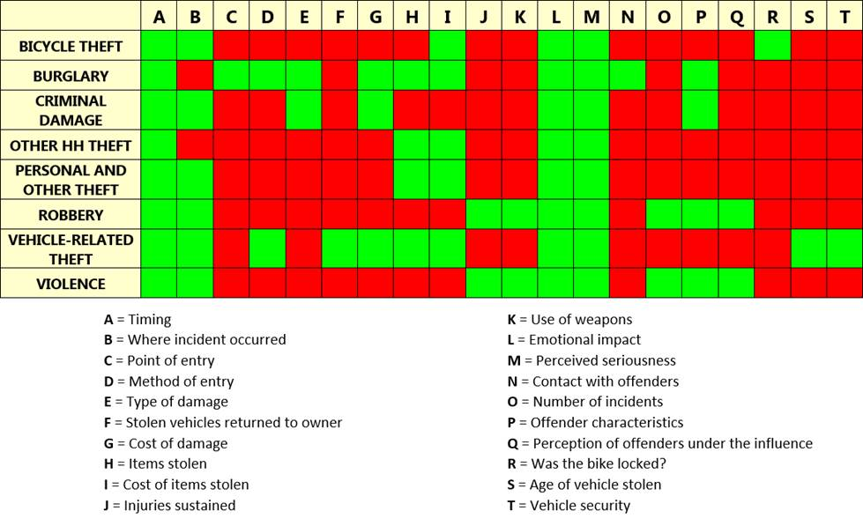
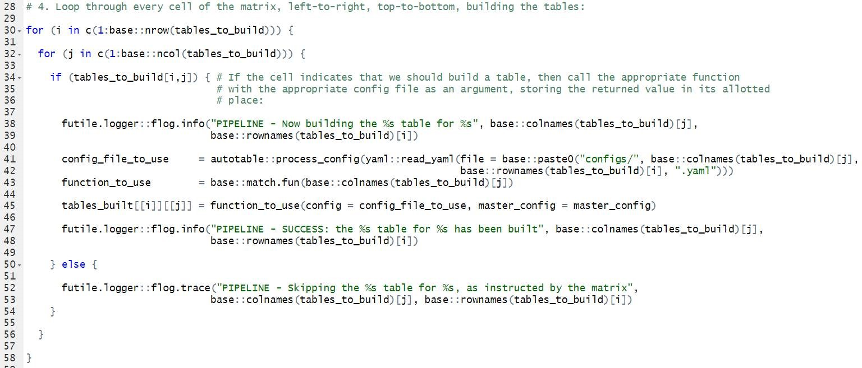
Overview of ‘Crime RAP’ architecture - R
emotional_impact(config = “configs/emotional_impact/VIOLENCE.yaml”).
https://github.com/ONS-centre-for-crime-and-justice/nature-of-crime-r
Notes:
The two pipelines took very different approaches
R
In the Nature of Crime suite, there are 20 different table types¹ and 8 different headline crime types.
We don’t, however, build every table type for every headline crime type. With green meaning “Yes, build this table” and red meaning “No, don’t build this table”, we can summarise which tables we need to build by the following matrix.
We then represent this grid in R as a logical/Boolean matrix (i.e. the value of each cell is either TRUE or FALSE).
In our code, each nature has a corresponding function that takes in a configuration file as its argument. So for example, to build the “Emotional impact” table for Violence you would call emotional_impact(config = “configs/emotional_impact/VIOLENCE.yaml”). The config files allow users to change things about the output (e.g. the title of the table, or the variables used) without fiddling about with the actual code.
Our pipeline then goes through the matrix above cell by cell, left-to-right top-to-bottom, via two for-loops. If the cell is TRUE, the pipeline calls the appropriate nature function with the appropriate config file, building that table. If the cell is FALSE, it just skips over that cell.
The R pipeline uses gptables through reticulate

Slide 7
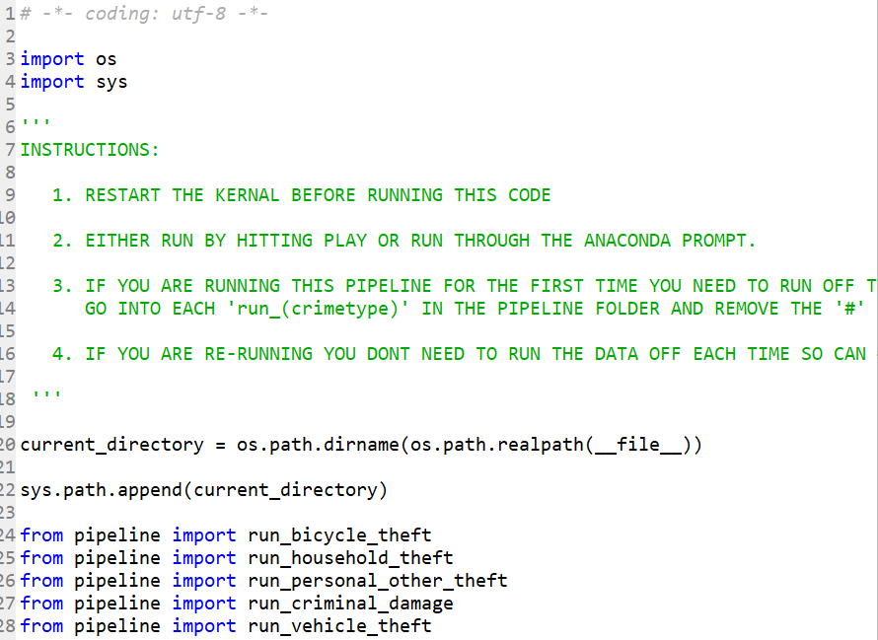
Overview of ‘Crime RAP’ architecture - Python
crime-tables-python
data
Offence tables
gptables
(Crime Theme)
Collate tables into workbook
Final tables
.xlsx output
https://github.com/ONS-centre-for-crime-and-justice/nature-of-crime-python
Notes:
Python
The python pipeline still sticks to the idea that each table will need an individual script to run it, but have tried to implement more efficient and automated methods to create and compile the data tables.
The majority of tables are time-series tables so we initially read in 10 years worth of data so we can apply our functions once rather than looping through the years. We then run the data analysis using functions we have created to calculate, means, median and percentages as required. We also have a significance testing function so instead of the manual calculation we used to use it inputs the correct numbers and automatically calculates the significance. These final datatable are stored as pandas Dataframes.
We then run each of these dataframes through GPTables to format them inline with best practice guidance. This is where our specific Crime Theme is applied which tailors Gptables a bit more towards how we have previously published these tables.
Once the data frames have run through GPTables we output them as XLSX workbooks.

Slide 8

Experiences of RAP - Project management
How?
Was completely unknown!
Iterative
Flexible, short-term milestones
High-level timeline:
Jan- March - BPI scoping and initial development of proof of concepts
March - May – kick off session, pair programming, training
May - July - independent table production with initial QA and cross checks, training
July - Aug – quality assurance and peer review of code on Git, regular publishing tasks
Sep - publication of tables and code

Slide 9
Experiences of RAP - Building capability (1)
Learning RAP
Python and R working groups but also pair programming
Ad-hoc specific sessions to cover issues we were having at the time be that troubleshooting errors or help writing a specific function
Using ‘just in time learning’ to cover some of the fundamental basics of coding (i.e. unit testing and code QA)
Challenges
Moving from thinking about our table production as individuals to a ‘pipeline’ to create a suite of tables.
Using GIT
Automation

Slide 10
Experiences of RAP - Building capability (2)
Outcomes
Identified areas of future development for the pipeline
Have a better understanding of the training needs for wider team
Upskilled analysts in working group who can take this work forward and help bring the other team members up to speed.
Development of core functions for CSEW analysis and desk notes

Slide 11
Benefits of RAP
Improved consistency of formatting across suite of tables
Increased efficiency and significant resource saving
Has improved quality and accuracy of publications
Increased capability of 50% of analysts in team
Has demonstrated that a lot of what we do can be automated

Slide 12

Future plans
Continue to develop and improve code – further testing, documentation
Daily use of coding tools to maintain skills in team – move to ad-hoc analysis
Wider roll out of RAP using code repo functions for table production planned
use on new outputs – e.g. TCSEW,
Support on upcoming releases – possibly 2021 releases
Identify further repetitive processes in existing CSEW statistical value chain
TCSEW processing – some of this already moved to new coding tools (e.g. calibration)
Transformed version of CSEW – explore use of RAP
Upskill rest of Crime team – move from 50% to 100% of analysts
Pair programming internally on RAP projects
Code repo of CSEW functions for analysis and ad-hocs
Notes:
But we need to again secure the resource and time commitment to keep this going.

Slide 13

Questions?

Slide 14
Links
Tables - https://www.ons.gov.uk/releases/natureofcrimetablesyearendingmarch2020
GitHub - https://github.com/ONS-centre-for-crime-and-justice
Nature of RAP - https://gss.civilservice.gov.uk/blog/the-nature-of-rap/
shannan.child@ons.gov.uk
crimestatistics@ons.gov.uk

