Slide 1
RAP and the COVID-19 Press Briefings
Martin Ralphs
Best Practice and Impact division, ONS

Slide 2
COVID-19 Daily Briefings
30th March until 23rd June, seven days a week until 5th June
Watched by 6 - 9 million people on average
More than 20 separate datasets needed to produce slides
Frequent new data or formatting requests
Data feeds were unstable and some changed almost daily
Regular revisions to back series
Some data came onstream during the process and had to be integrated in a matter of hours

Slide 3
Daily process
Most data feeds supplied overnight, except NHS Digital deaths data for the previous day which arrived between 12 – 4pm each day
Change requests from private offices could arrive anytime
Initial cut of slide deck out to stakeholders by 11am
Signoff of slides and clearance of all data feeds by 3pm
Final cut of slides sent to broadcasters and ministerial briefing teams at 3.30pm or ASAP after that
Briefing at 5pm (4.30 pm on Sundays)

Slide 4
Best Practice resource
5-6 extra analysts added to the slide and data pack production and stakeholder liaison team
4 analysts working on RAP development and automation
We worked in shifts so we could cover the 7/7 demand cycle
On average, we worked 60-70 hour weeks while on call

Slide 5

What we wanted to do:
Improve the presentation of the graphs
Improve the transparency of the data sources
Automate production and improve quality assurance

Slide 6
What we weren’t expecting to do
Sort out the data feeds and build new ones from scratch
Sort out clearance for more than 20 different data sources every day
Find and integrate new data in response to stakeholder requests
Build new charts (and sometimes new data) from scratch most days
Notes:
What things looked like in early April. Each slide was a manual product, from data ingest and formatting through to final graph tweaks and signoff. The more slides, the more work.

Slide 7
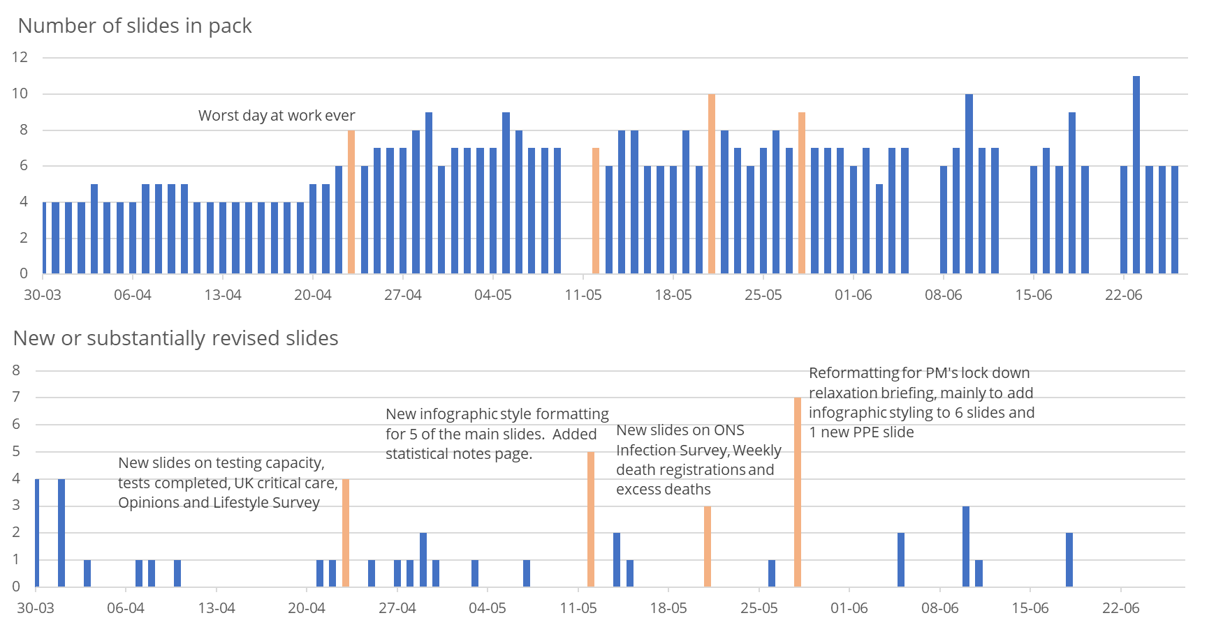
Notes:
Thursday 23rd April was the hardest day we had, with 8 new slides built from scratch.

Slide 8
Things we learned about rapid automation and QA

Slide 9
1. We got our priorities wrong at first
We didn’t understand early on where we should focus the RAP
It took a while to realise this, because everyone was too busy firefighting to discuss and define requirements!
We tried to automate the graphs for rapid production
There were too many new requests and changes each day to make this viable
The focus should have been on the data for building the slides – generating what we needed alongside automated QA
When we DID focus here, things got much, much easier for everyone
but
but
and

Slide 10
2. Design for re-use is a game changer
RAPped inputs would have been incredibly helpful
Most data we used were published outputs. Some were internal sources
Few government sources were easy to ingest. Most were Excel sheets not designed for reuse and needed bespoke tailoring
Integration across UK data sources was a huge challenge
Formatting and file locations changed over time. There was no way to know easily that this had happened
Stable CSV data feeds were so helpful!
PHE’s COVID dashboard with its API was a huge bonus at the end
Notes:
RAPped inputs would mean we would have been able to understand the

Slide 11
3. RAP under pressure can still work
When the briefings started, the requirements and the inputs were very unstable. Only an intensive manual process could meet demand
Close partnerships with our data stakeholders were critical
As things settled down we identified quick wins for automated production and QA
RAP meant we collaborated effectively and could share code and methods quickly and efficiently
RAP meant that we had a documented product to hand over

Slide 12
4. Basic automated QA is great
We brainstormed a small set of standard QA checks:
Diagnostic graphs
Outliers, unusual changes and extreme values
Missingness
Comparisons against last release
Broad credibility checks against the back series
Implemented as markdown reports rendered out to MS Word
Easily generalisable across our data feeds

Slide 13

Where we got to
11 data pipelines for ingest, processing, output and QA for each of the core slides
An R package (“dbpipe”) with automated documentation
Some back end integration with Google Cloud Platform built in Python
Can be spun up again very quickly if the need arises
Drew on data from PHE, NHS, DHSC, devolved administrations, ONS, Department for Transport, CO, Google, Apple and Johns Hopkins University
Hosted on ONS internal Gitlab and Cabinet Office Bitbucket repo but we want to make the code base public.
Documentation is public:
https://github.com/best-practice-and-impact/pipeline_documentation

Slide 14
Bringing out the patterns
Notes:
In the next section we show some before and after slides from some of the earliest press conferences and some of the later ones. This is NOT to say that the analysts who worked on the early slides weren’t working flat out to do their absolute best, but there were only 2 of them each day and the workload was so intense that they barely had time to get the slides out of the door.

Slide 15
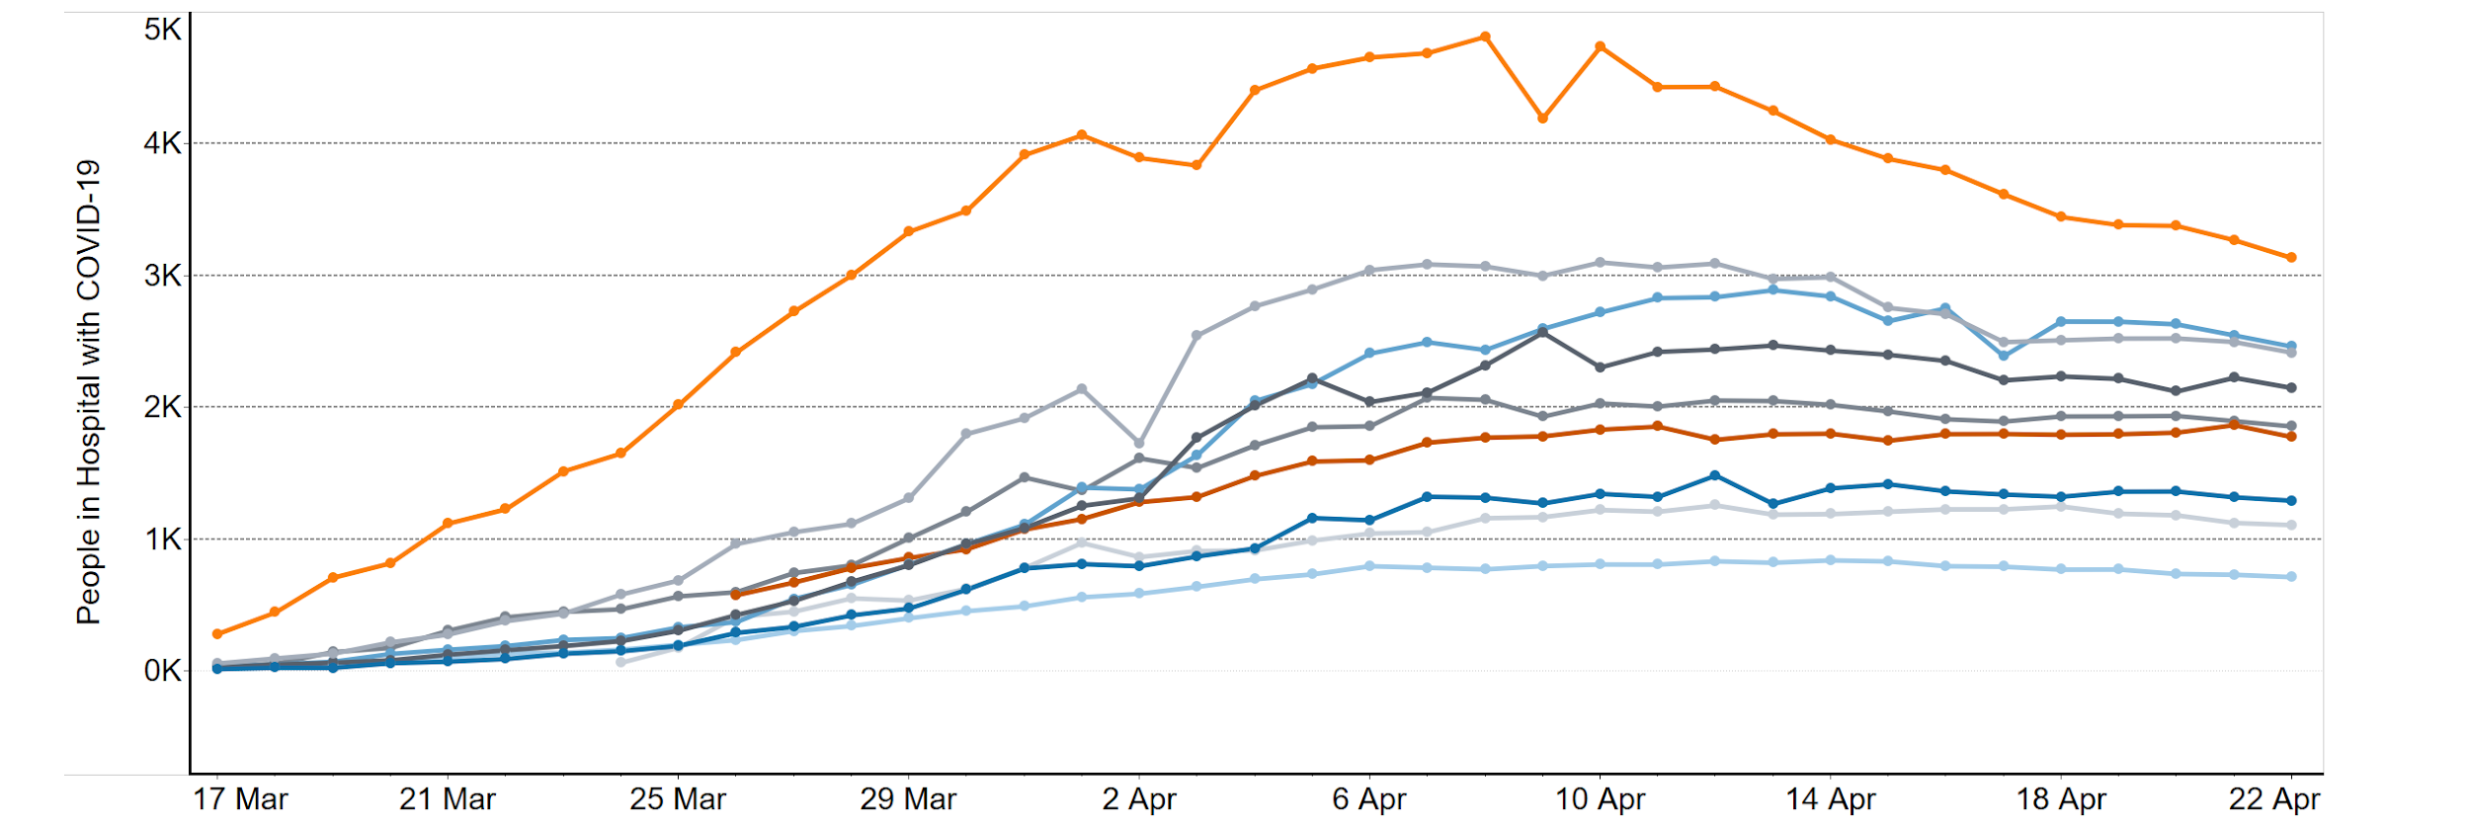
People in Hospital with COVID-19 (Great Britain)
Over the last 24 hours, the number of people in GB hospitals with confirmed COVID-19 has fallen and is 10% lower than one week prior.
London
North West
Midlands
North East & Yorkshire
South East
Scotland
East of England
Wales
South West
Source: NHSE, Welsh Gov., Scottish Gov.

Slide 16
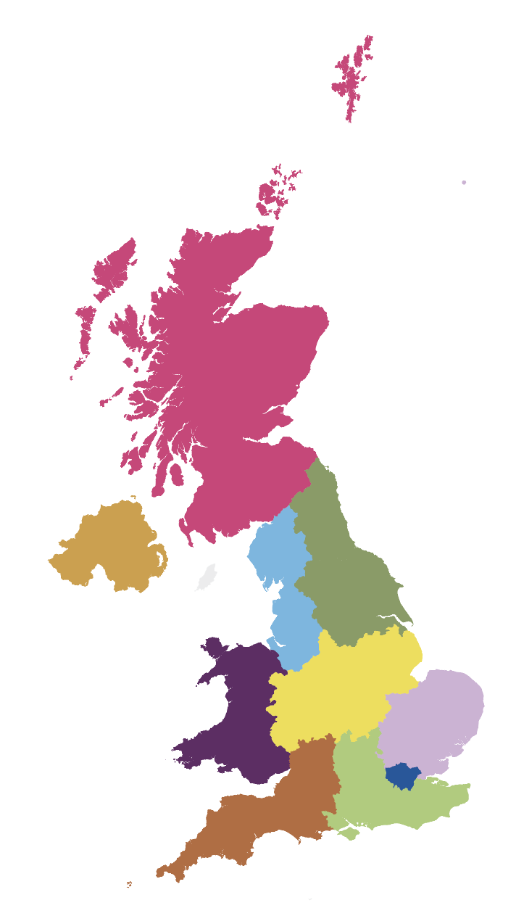
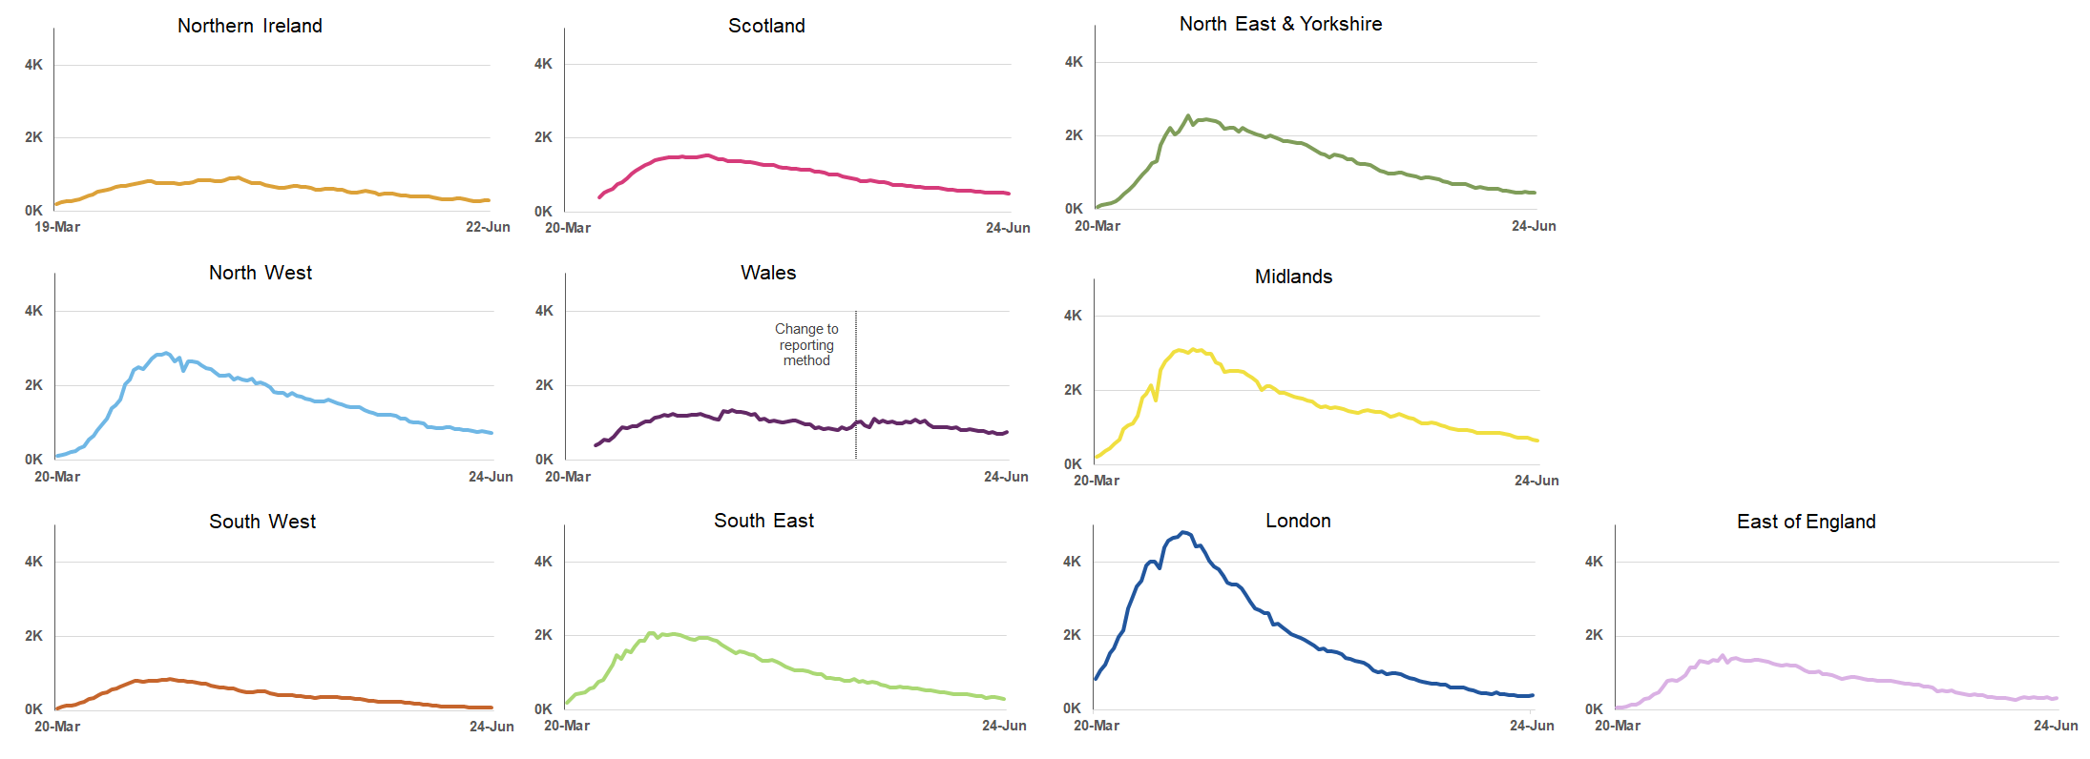
People in Hospital with COVID-19 (UK)
4,186 people are in hospital with COVID-19 in Great Britain, down from 4,837 this time last week.
Source: NHS England and devolved administrations.
Further details on data sources can be found here: https://www.gov.uk/government/collections/slides-and-datasets-to-accompany-coronavirus-press-conferences

Slide 17
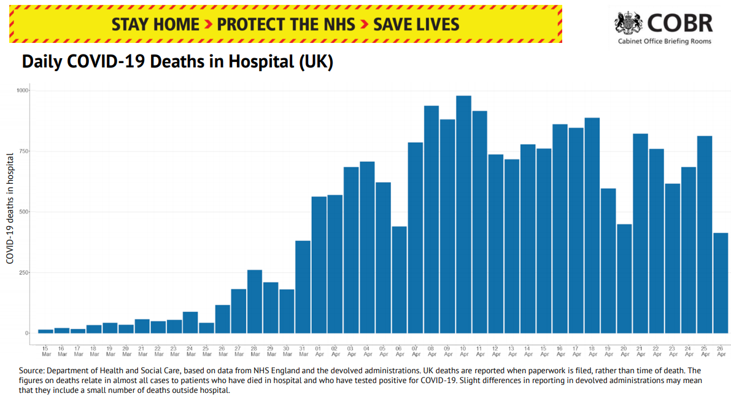
Notes:
Early version of the daily deaths slide, from April 26th 2020

Slide 18

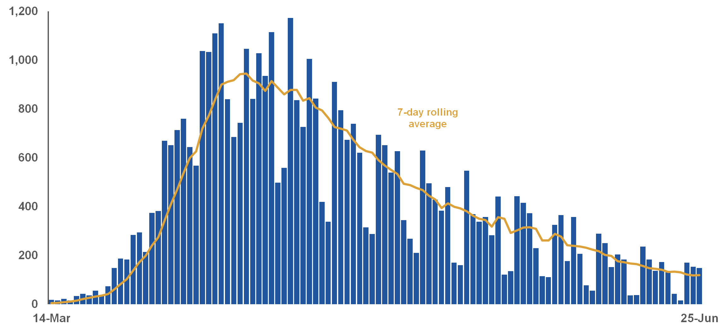
Daily COVID-19 deaths confirmed with a positive test (UK)
The numbers presented here from the Department for Health and Social Care relate to deaths where COVID-19 was confirmed with a positive test.
Daily deaths
On 25 June DHSC reported
149
Daily COVID-19 deaths confirmed with a positive test
43,230
Total COVID-19 deaths confirmed with a positive test
Weekly registered deaths from the Office for National Statistics include cases where COVID-19 is mentioned on the death certificate but was not confirmed with a test. On 12 June, ONS reported 53,009 cumulative registered deaths from COVID-19. This was 11,428 more than the DHSC figure for the same date.
Source: DHSC, sourced from NHSE, PHE, devolved administrations. Further details on data sources can be found here: https://www.gov.uk/government/collections/slides-and-datasets-to-accompany-coronavirus-press-conferences
Notes:
Version from 25th June 2020

Slide 19
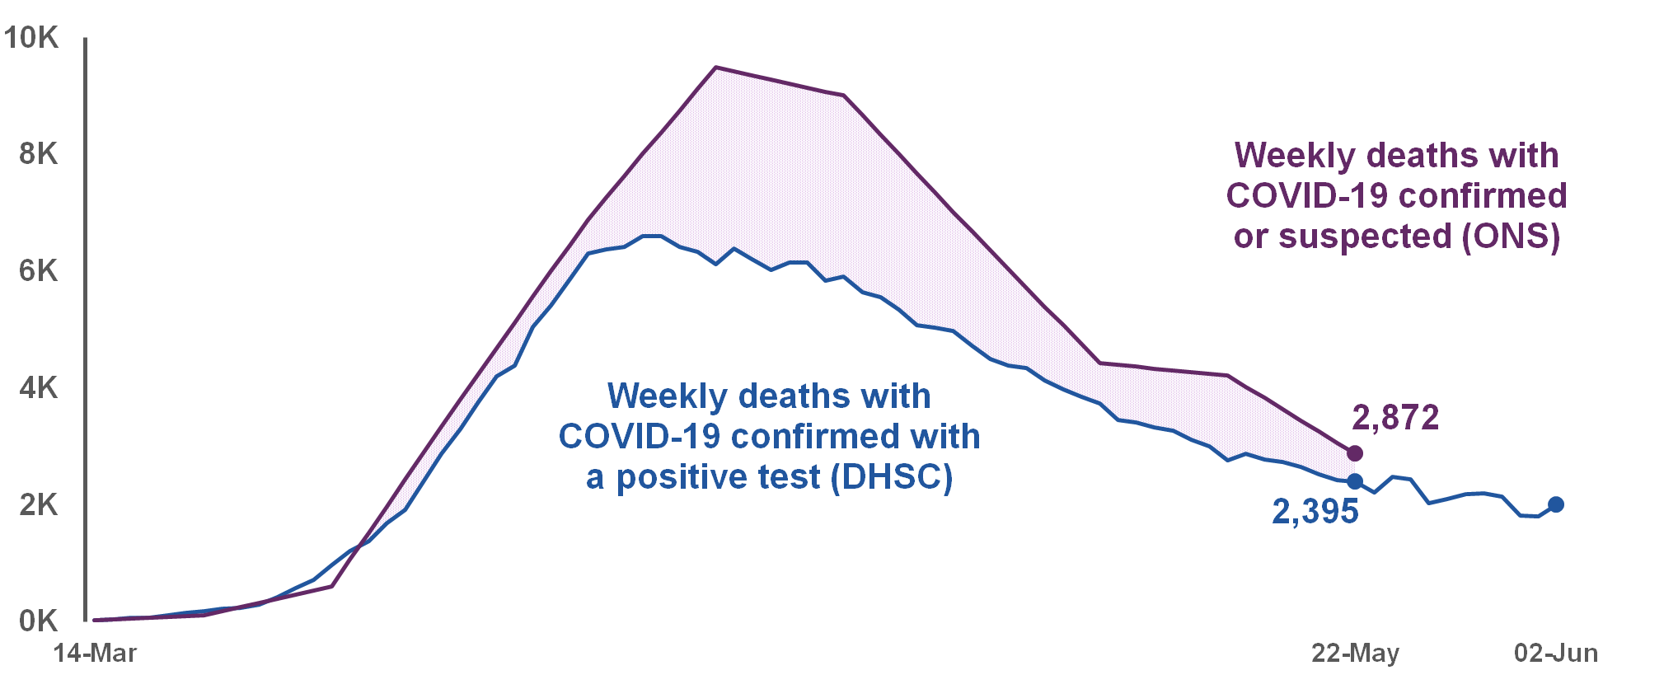
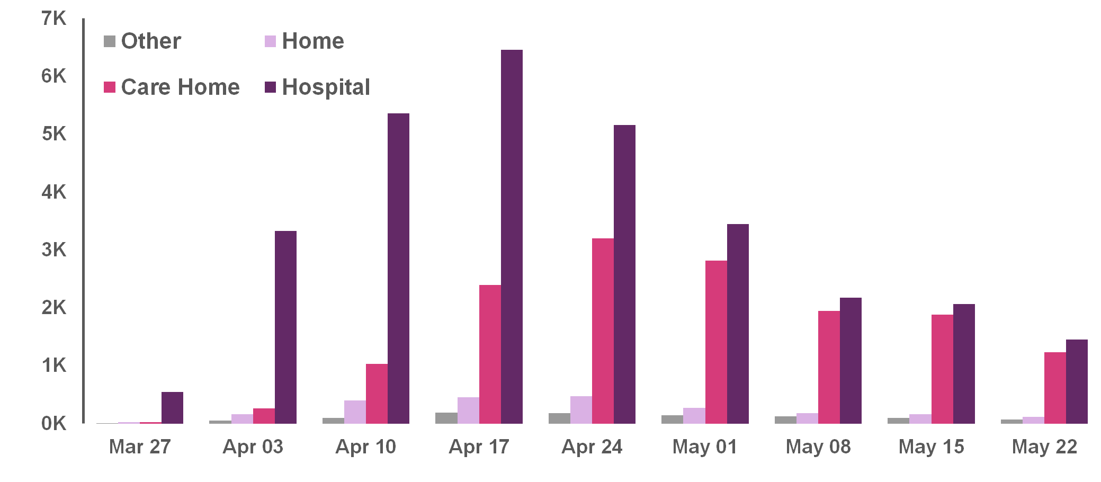
Deaths where COVID-19 was confirmed or suspected
Weekly COVID-19 deaths (UK)
Up to 22 May, the Office for National Statistics reported a total of
48,106
deaths registered in the UK where COVID-19 was mentioned on the death certificate. This includes cases without a positive test and suspected cases.
Up to 22 May, the DHSC reported a total of
36,393
deaths where COVID-19 was confirmed with a positive test.
ONS / NRS / NISRA Weekly deaths by place of occurrence (UK)
Source: DHSC, sourced from NHSE, PHE, devolved administrations. Further details on data sources can be found here: https://www.gov.uk/government/collections/slides-and-datasets-to-accompany-coronavirus-press-conferences
Notes:
Additional data on deaths from 22nd May

Slide 20
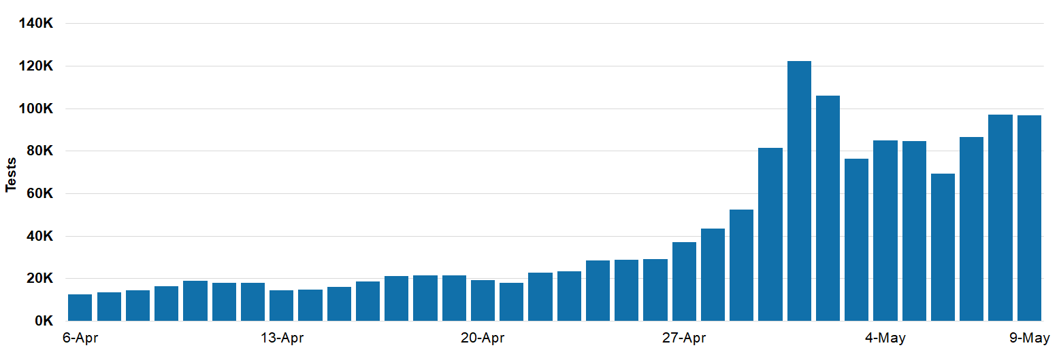
Daily Tests (UK)
As of 9am 9th May, there have been 1,728,443 tests in total. In the 24 hours up to 9am on 9th May, there were 96,878 tests in the UK.
Source: DHSC/NHSX, NHSE, Welsh Gov., Scottish Gov., Northern Ireland Executive. The number of tests includes; (i) tests processed through our labs, and (ii) tests sent to individuals at home or to satellite testing locations. Chart date corresponds to the date tests were reported as of the 24 hours before 9am that day.
Notes:
Daily tests data from 9th May 2020

Slide 21

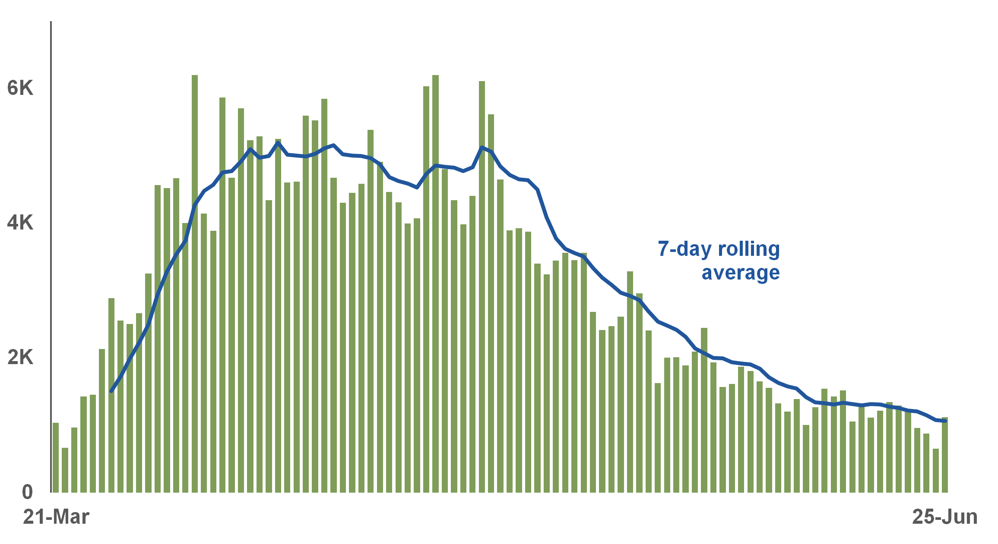

Testing and new cases (UK)
Testing
Includes tests carried out and posted out. Some people are tested more than once.
tests as of 25 June
New confirmed cases
167,023
8,710,292
tests in total
Confirmed cases
Only includes cases tested positive. There are more cases than confirmed here.
1,118
cases confirmed as of 25 June
307,980
cases confirmed in total
Source: NHS England and devolved administrations.
Further details on data sources can be found here: https://www.gov.uk/government/collections/slides-and-datasets-to-accompany-coronavirus-press-conferences
Notes:
Enhanced slide from 25th June

