Slide 1
gptables developing a package for reproducible statistical outputs
David Foster
Best Practice and Impact Division

Slide 2
Outline
Motivation
Good Practice Tables (gptables)
Using gptables
Getting Involved

Slide 3
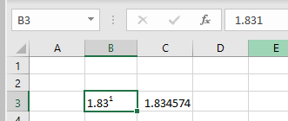
Motivation
Statistical tables can often be:
Hard to interpret
Hard to use for further analysis – e.g. not machine readable
Erroneous
We had recently published guidance on releasing statistic in spreadsheets
Aims to keep tables simple and consistent
Increases machine readability
Notes:
Don’t want to leave anything open to interpretation – it should be easy for users to get the correct message
Multiple index levels
Mixed units types in a table, not indicated
Blank rows/cols
Awkward or inconsistent layout
Machines can’t interpret formatting
Manual input can introduce errors
Minimise manual input and don’t allow data to be corrupted by formatting

Slide 4

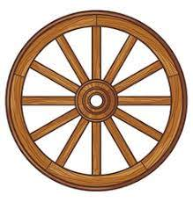
Motivation
Working on the development of a RAP for production of statistical tables
Want to generate reproducible and consistent tables
Don’t want to change dramatically from existing format
Want to make it easy to follow our guidance
Packages exist for reading and writing Excel spreadsheets, but:
Some require a rigid, pre-formatted template
Some write and format data on a cell by cell basis
Notes:
End of the pipeline – output over 100 tables
Same occurs in many RAP pipelines
Minimise unnecessary manual input - risk
Users can often depend on output format
Effortful and not reproducible
Not quite what we want, but we don’t want to reinvent the wheel

Slide 5
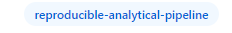
Aside: Open Source
“There are very few examples of code that must not be published in the open.”
-- The Government Service Manual
Benefits:
Transparency
Attribution
Shared value and opportunity from reuse and collaboration
Considerations:
Treat code as you would other documents – always consider its sensitivity
Discuss the prospect with your peers and management
Notes:
Our work should be open by default and open early on in development
Users can see methodology
Other analysts can reuse your code and could reproduce your results
Don’t release passwords/keys or code that describes a method for preventing disclosure or detecting fraud, or provides insight into a sensitive dataset
Do consider that it will be open for scrutiny, in a good way – promotes good practice
See if your division/department has a group in place already

Slide 6
Ideal Solution
Flexible table design
Makes it easy to format table elements
Keeps formatting consistent across multiple spreadsheets/files
Encourages users to follow good practices
Notes:
Everyone’s tables are slightly different and change over time
Want to support formatting that doesn’t break guidance (impact usability) – and requires no manual input
And across multiple uses (reproducible)

Slide 7

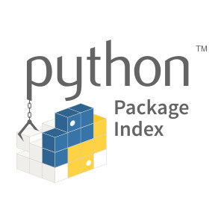

Enter Good Practice Tables (gptables)
Open source python package
Source code on our GitHub
Installable from PyPI (pip install gptables)
Supports use in R (using {reticulate})
Built upon the XlsxWriter package
Writes data to Excel and applies formatting
gptables uses this to write and format cell by cell
Notes:
Many RAP projects use R – no sense in writing it twice
Most of the hard work was already done
We made a high level grouping of table features
Still possible to follow bad practice, but we’ve made it easy to avoid it

Slide 8

gptables Structure
setup.py
README.rst
requirements.txt
CONTRIBUTING.md
LICENSE
VERSION
docs/
gptables/
__init__.py
core/
__init__.py
gptable.py
theme.py
cover.py
wrappers.py
api.py
examples/
test/
Installable
Dependencies recorded
Documentation (sphinx)
Testing
Notes:
Talk used to focus on packaging, but kept this for insight
Package applies many RAP principles

Slide 9
Good Practice Table Design
Title
Subtitle(s)
Scope
Units
Column Headings
Index level 1
Index level 2
Index level 3
Data
(Source)
(Legend)
(Annotations)
(Notes)
Supplied as a pandas.DataFrame
Mapped individually
Notes:
Most metadata in first, left most column
No empty rows or columns
One table per sheet/tab
Limited row index levels
No annotating data directly

Slide 10


gptables Inner Workings
GPWorkbook class
Subclass of xlsxwriter.Workbook
Represents a single file (one or more worksheets)
Stores an associated Theme object – consistent throughout tables
GPWorksheet class
Subclass of xlsxwriter.Worksheet
Represents a single sheet/tab
Contains a methods for writing a GPTable object to a sheet
Notes:
Class alone is like a generic blueprint or concept - not really useable
Object is an instance which can do things
Really useful for relatable “objects”
Subclass inherits the attributes and methods from superclass
Stores output filename, worksheets and methods for writing to Excel
Allows you to write data for individual sheet, using Workbook’s Theme

Slide 11
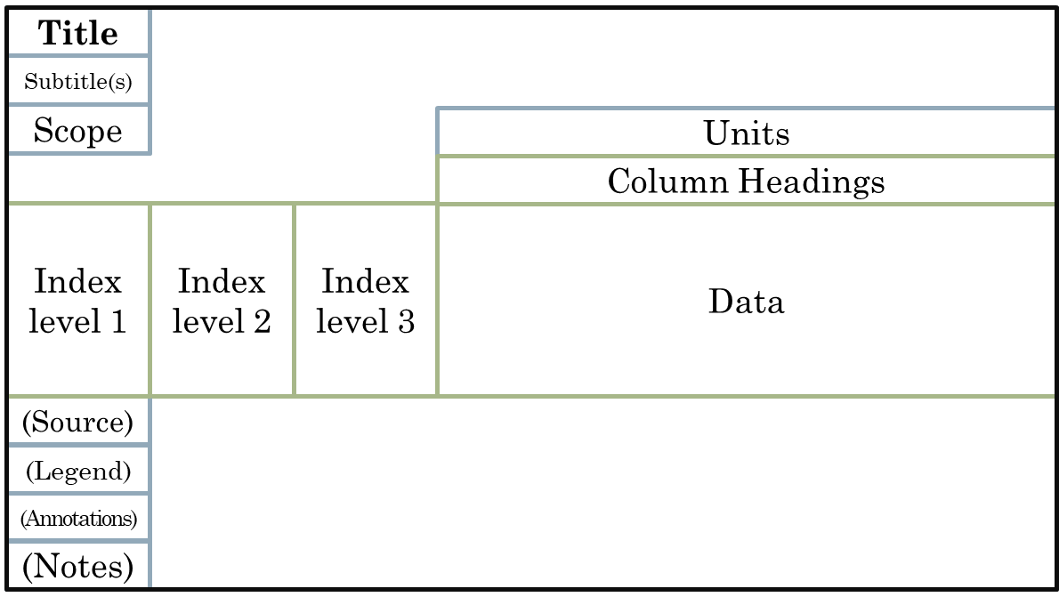

gptables API
GPTable class
Represents a single table (one table per sheet)
Contains the pandas.DataFrame object containing data
Other attributes including title, subtitles etc
Some table specific additional formatting
Theme class
Stores formatting for each GPTable and Cover element
Configured using YAML file
Also defines flag for representing missing values and ordering footer elements
Cover class
Stores information that relates to the whole workbook
Configure table of contents
API functions
produce_workbook() – returns GPWorkbook object
write_workbook() – saves the Excel file
Notes:
Application programming interface – the users point of contact
produce_workbook allows further modifications
any features from xlsxwriter

Slide 12

Latest Features
Open source projects are often iterative – require some maintenance
Fixed bugs (((((((???)))))))
Cover pages
Automatic column widths
Notes:
Working closely with Crime RAP team helped to iron out
Proof of Concept -> usable package
Auto widths is experimental!

Slide 13
Using gptables
Map data to table elements as a GPTable
Design Theme formatting (optional)
Provide information for a Cover page (optional)
write_workbook() to win
Notes:
Demo using penguins
Also able to modify Workbook object from produce_workbook()

Slide 14
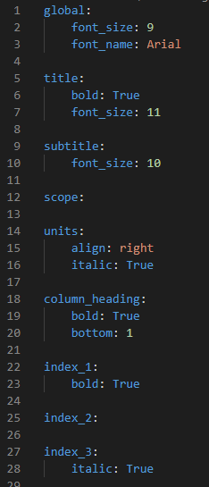
Theme Configuration
YAML config components:
global – default formatting for all elements
Element-wise formatting
Also footer_order and missing_value
Support all formatting using all xlsxwriter.Format properties
Notes:
Example uses gptheme – default

Slide 15
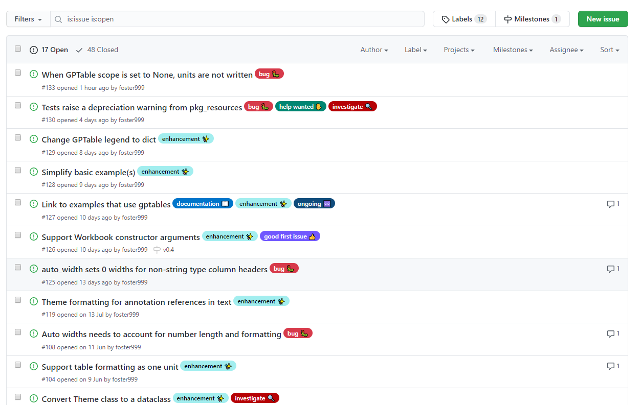
Getting Involved
If you can make use of gptables, please provide any feedback:
Bugs
Additional features that you’d like
GitHub Issues
Any ideas for improving other common RAP processes?
Notes:
Or get in touch directly
Also feel free to contribute – list of desired improvements
Other projects with similar broad usage in RAP?

Slide 16
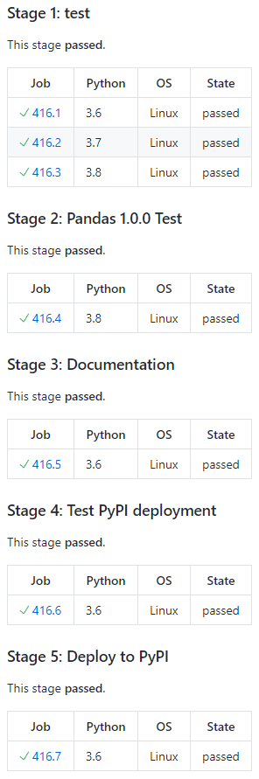




Aside: Continuous Integration
Automated testing and deployment of docs and package
Available on the ONS network
Jenkins
Many freely available online
GitHub Actions
Travis (used in gptables repo)
CircleCI
Notes:
Can be used to run tests, check coverage and deploy

Slide 17
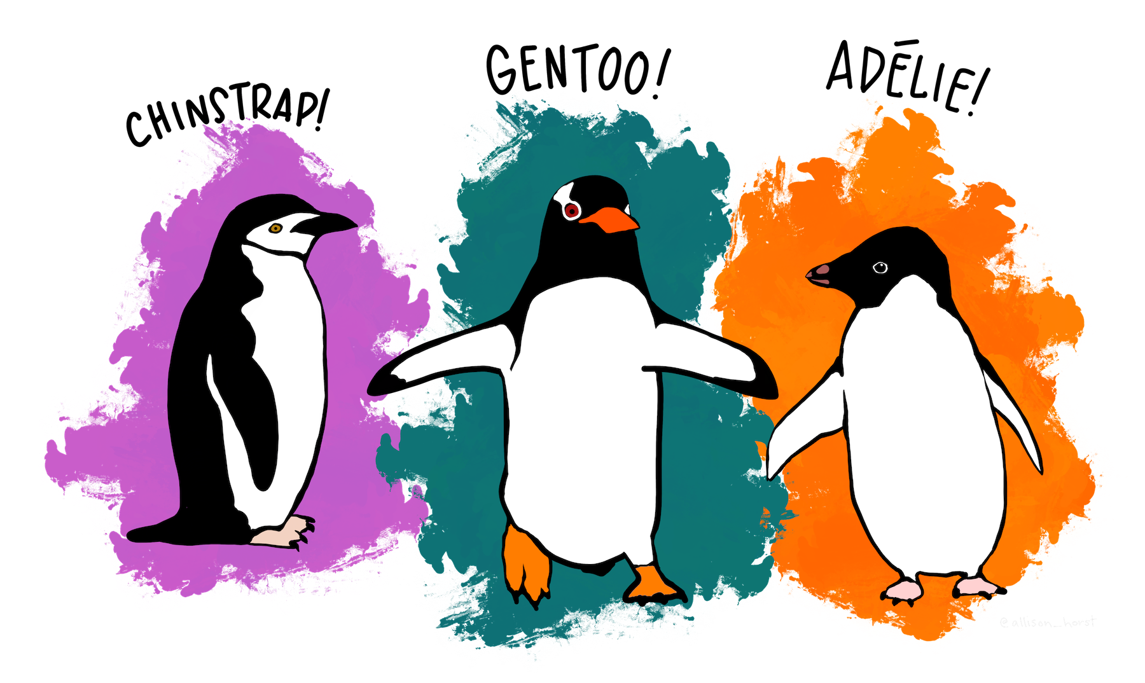
Thank you!
Palmer Penguins dataset

