Slide 1
Rapid RAPping – excess deaths
Seb Fox – Principal Data Scientist (Health Improvement)
Public Health England
14 September 2020

Slide 2
Outline
Context
Show the thing
Technical challenges
RAP implementation

Slide 3
Context
Mid-March: epidemic beginning in UK
Small team arranged
Sharmani Barnard, Senior Statistical Advisor
Sebastian Fox, Principal Data Scientist
Allan Baker, Deputy Head of Population Health Analysis
Paul Burton, Professor of Data Science for Health at Newcastle University and Honorary Consultant in Public Health (Epidemiology and Statistics) to PHE
Peter Goldblatt, Senior advisor University College London Institute of Health Equity and Statistical Advisor to PHE
Justine Fitzpatrick, Head of Population Health Analysis
Task - create robust methodology to understand mortality during the epidemic

Slide 4
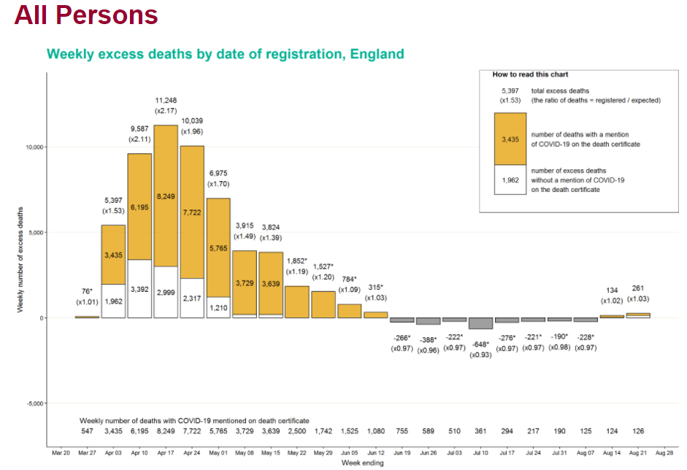
Weekly report
Excess deaths for:
All persons
Age-sex
Ethnicity-sex
Deprivation
Region
Underlying cause of death
Deaths with a mention of specific cause
Place of death
…including registered/expected ratio
Source: https://fingertips.phe.org.uk/static-reports/mortality-surveillance/excess-mortality-in-england-latest.html

Slide 5
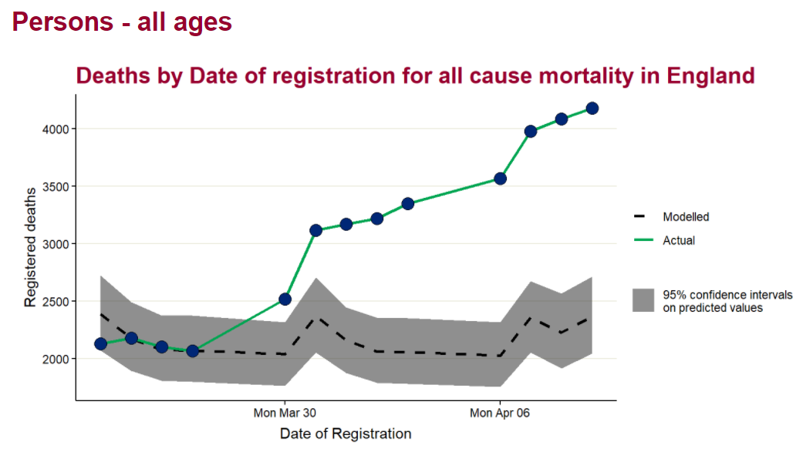
Technical challenges
Rapidly evolving task
Developing the outputs
Data linkage
Business continuity
Publishing
Sharing code securely externally

Slide 6
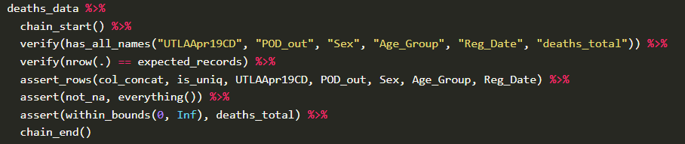
RAP implementation
The report was written in R
assertr - inline checking

Slide 7
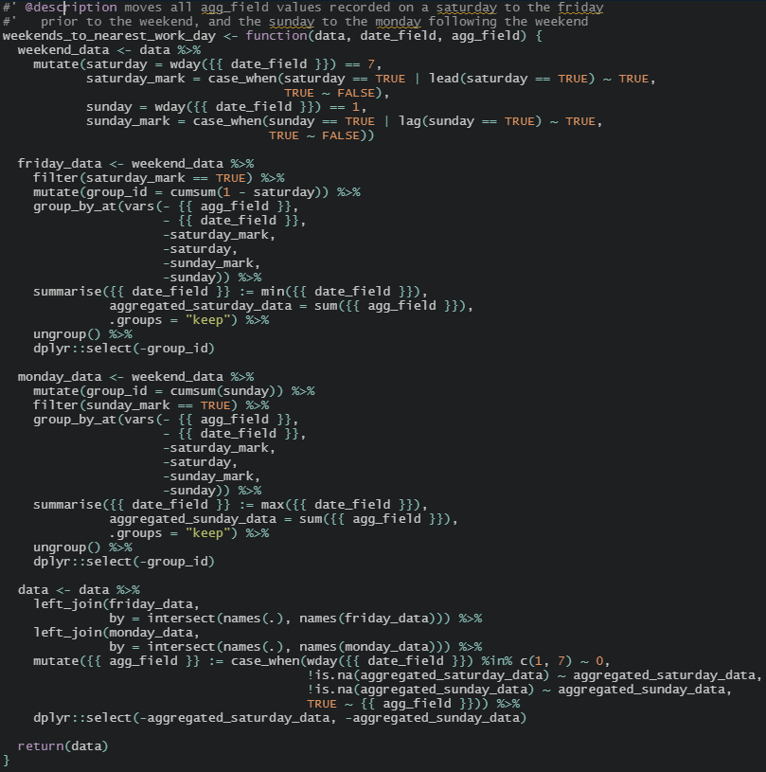
RAP implementation
Functional programming – repeatable parts of code
Documenting code

Slide 8
RAP implementation
Linkage done by separate team with our input

Slide 9
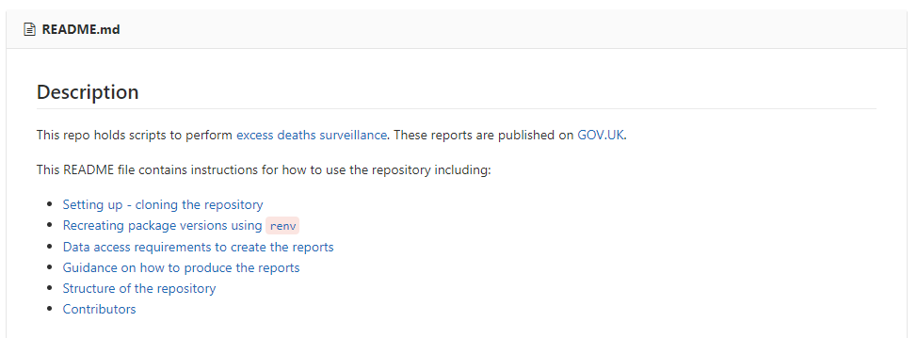
RAP implementation
renv – package management (some excellent slides describing renv from Rstudio 2020)
GitLab (internal) for code development; GitHub for sharing externally
Documentation documentation documentation

Slide 10
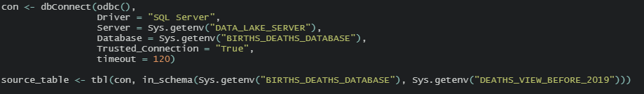
RAP implementation
Environment variables – where security risks exist

Slide 11
Thank you

