Slide 1
AURORA 2.0
Advanced Underground Resource Observation & Remote Analysis
Team: Marauders
Members: Vasudev Sajeev, Disha Hebbar, V Kavyanjali, Sahana Bhagwat

Slide 2
PROBLEM STATEMENT
Adaptive Mining Activity Monitoring using Sentinel-2 Time Series
OBJECTIVE :
Design an intelligent system that automatically detects, quantifies, and monitors excavation activity over time within a legally defined mining area and identifies violations within designated no-go zones, using Sentinel-2 imagery

Slide 3
INPUTS
→ Sentinel-2 Level-2A imagery (multispectral, multi-temporal) covering the Area of Interest (AOI). Data can be accessed through Copernicus browser.
→ Legal Mine Boundary (Polygon) Includes both currently active mining zones and permissible but not yet excavated areas.
→ No-Go Zone Boundary (Polygon) - Areas where mining is strictly prohibited (e.g., forest buffers, water bodies, habitations, eco-sensitive zones). Use of synthetic dummy polygons from within the known mined area of past few years from datasets shared.

Slide 4
DATA SOURCES
SENTINEL-2 SPECIFICATIONS
- Spatial Resolution: 10m
- Temporal Resolution: 5 days
- Bands Used: B2, B4, B8, B11, B12, Scene Classification Layer
(SCL)
- Coverage: 2017-present
- Data Source: Google Earth Engine

Slide 5
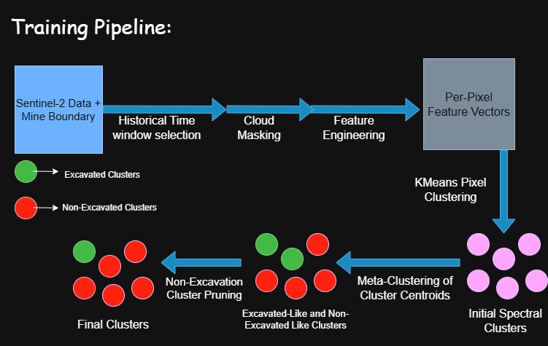

Slide 6
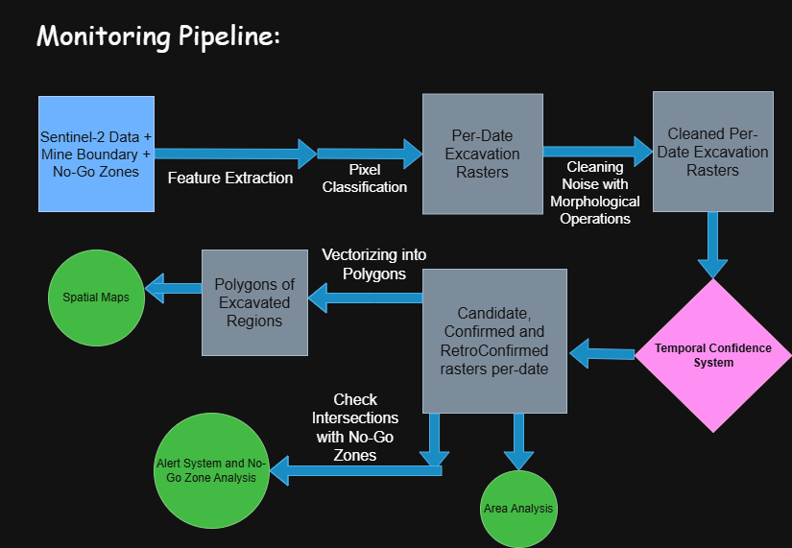

Slide 7
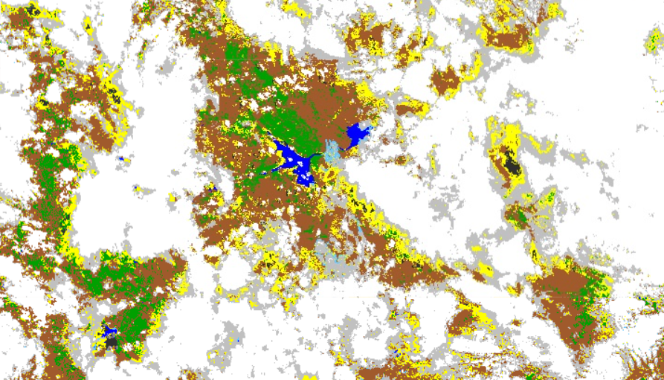
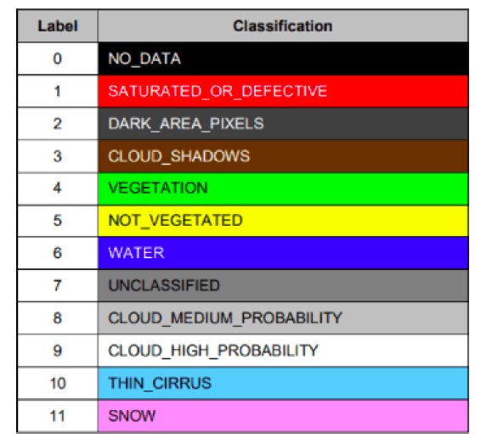
CLOUD MASKING WITH SENTINEL-2 SCL
To ensure reliable spectral-temporal analysis, contaminated pixels were removed using Sentinel-2 Scene Classification Layer before feature extraction. We removed pixels with SCL of 3, 8, 9, 10 and 11.

Slide 8
FEATURE ENGINEERING
SPECTRAL INDICES
- NDVI - Vegetation health
- B11/B12 - Shortwave infrared
- BSI - Bare soil index
- NBR - Normalized burn ratio
- NDMI - Moisture index
TEMPORAL STATISTICS
- Rolling median (60-day)
- NDVI variance
- NBR slope
- Captures persistent excavation patterns
Goal: Extract spectral and temporal features to differentiate permanent excavation from non-excavation and seasonal changes.

Slide 9
CLUSTERING & META-CLUSTERING
Approach: Unsupervised Learning using K-Means Clustering without requirement of excavation data.
Pixels are clustered by spectral-temporal similarity (K = 6).
Cluster centroids are meta-clustered (K = 2) to separate excavation and non-excavation.
We use RobustScaler for scaling before clustering, which is robust against outliers. A small numerical stabilization is applied only during meta-clustering to prevent water/shadow from dominating the meta-clustering.

Slide 10
EXCAVATION SCORE & CLUSTER PRUNING
Excavation Score = 2 * B12 + 1 * BSI - 0.5 * NDVI - 1 * NDMI
Above excavation score assigns excavation likelihood scores to meta-clusters to interpret clusters in a physically meaningful way and identify the meta-cluster corresponding to excavation. The score emphasizes exposed rock and penalizes vegetation and moisture.
We then perform cluster pruning, to suppress non-excavation clusters like bare soil and other weak transient signals.
We identify the strongest excavation cluster per mine using our excavation score. We allow secondary clusters to remain excavated only if they are spectrally similar to the leader cluster.

Slide 11
TEMPORAL CONFIDENCE SYSTEM
Excavation causes permanent spectral change, whereas seasonal changes are temporary. Each pixel accumulates confidence as it remains in an excavation-like state. Temporary reversions reset confidence, while masked observations pause accumulation.
Pixels are confirmed as excavated only after sustained temporal persistence.
Retro-confirmation backdates this confirmed excavation to its first detection. This removes confirmation latency while preserving temporal robustness in spatial and temporal outputs.
Candidate pixels indicate early excavation signals prior to confirmation.
We store these candidate, confirmed and retro-confirmed rasters over time.

Slide 12
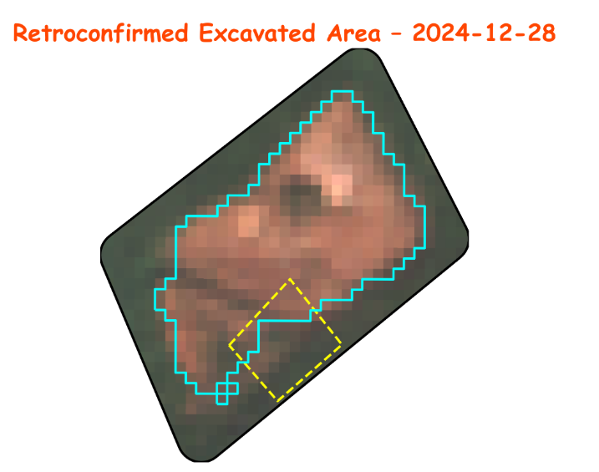
GENERATING OUTPUTS
Spatial Outputs:
  Per-date excavation maps overlaid on satellite imagery
  Legal mine boundaries and no-go zones highlighted
  Blue regions indicate excavated areas, while yellow outlines denote no-go zones.
Temporal Analytics:
  Excavated area vs time
  Excavation growth rate
  Normalized excavation intensity
Alert logs for no-go zones

Slide 13
NO-GO ZONE ANALYSIS
We check for spatial intersection between excavated regions and no-go zones.
We quantify the area of excavation occurring inside no-go zones.
A three-level alert system is used for regulatory monitoring.
Level 1: Early warning triggered when candidate excavation is detected inside no-go zones.
Level 2: Confirmed violation when excavation persists inside no-go zones.
Level 3: Escalation triggered by sustained or expanding excavation within no-go zones.

Slide 14
LIMITATIONS AND FUTURE SCOPE
Limitations:
  Pixel-level analysis at 10 m resolution can introduce uncertainty near mine and no-go zone boundaries
  Temporal confirmation introduces a short delay before excavation is formally confirmed.
  Reliance on optical imagery limits update frequency during prolonged cloud cover.
Future scope:
  Fusion with Sentinel-1 SAR data to improve robustness under cloud cover
  Adaptive parameter selection based on mine-specific data distributions.
  Incorporation of spatial context to improve boundary and region-level understanding.

Slide 15
THANK YOU

