Slide 1
Credit Score Movement Prediction
An End-to-End Machine Learning Project
Subhanjana Banerjee| 13/06/2025

Slide 2
Project Goal: Predicting Credit Score Movement
Objective: Predict whether a customer's credit score will increase, decrease, or remain stable.
Importance: Helps financial institutions in risk assessment, marketing, and retention.
Approach: End-to-end ML pipeline from data to insights.

Slide 3
Generating a Realistic Synthetic Dataset
Reason: Real credit data is sensitive; synthetic simulates real scenarios.
Dataset Size: 25,000 customer records.
Features: Demographics, Financial Behavior, Credit Bureau.
Method: Statistical distributions and domain logic.

Slide 4
Defining the Credit Score Movement Target
Target: target_credit_score_movement ('increase', 'stable', 'decrease')
Logic: Business rule-based score calculation using financial indicators.
Labeling: Thresholds applied to categorize into 3 classes.
Class Distribution shown via pie chart in EDA.

Slide 5
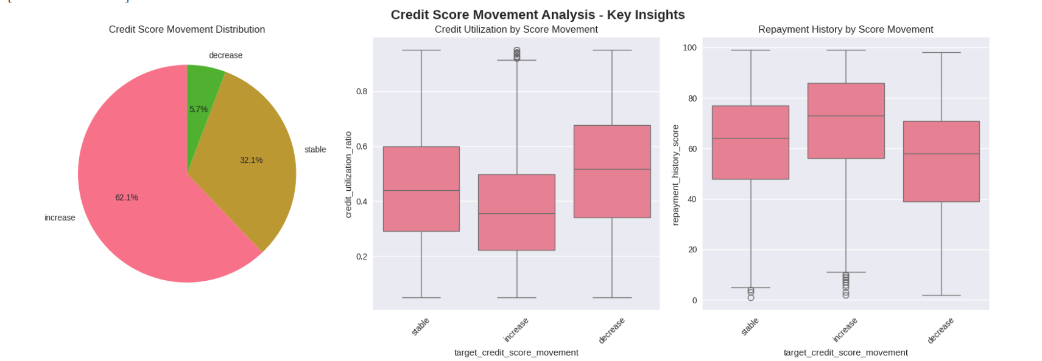
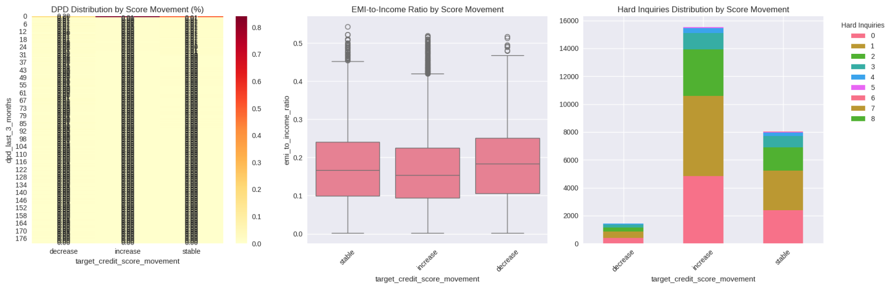

Slide 6
Understanding the Data
Purpose: Identify patterns and feature-target relationships.
Findings:
- Lower utilization → higher scores.
- Good repayment history → increase.
- DPD & hard inquiries → decrease.
Challenge: Imbalanced target classes.

Slide 7
Preparing Data for Modeling
Feature Engineering: New ratios/buckets from existing features.
Encoding: Label Encoding for categorical variables.
Class Imbalance: Handled using SMOTE.
Split: Train-test (80-20) with stratification.
Scaling: StandardScaler applied.

Slide 8
Exploring Different Classification Models
Models: Logistic Regression, Random Forest, XGBoost, LightGBM, KNN, Naive Bayes, Decision Tree, Gradient Boosting.
Mix of linear and ensemble models for performance comparison.
Trained on balanced & scaled datasets.

Slide 9
Evaluating Model Performance
Metrics: Accuracy, F1-Score (weighted), Confusion Matrix.
Top Models: Compared based on F1-Score.
Insights: Tradeoffs in correctly predicting each class.
Visuals: F1 bar chart, Confusion Matrix of best model.

Slide 10
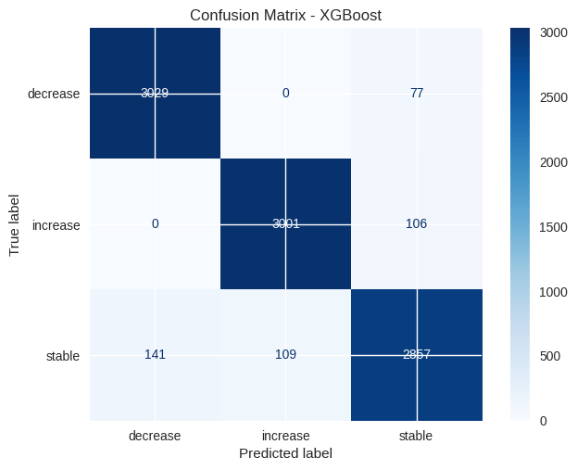
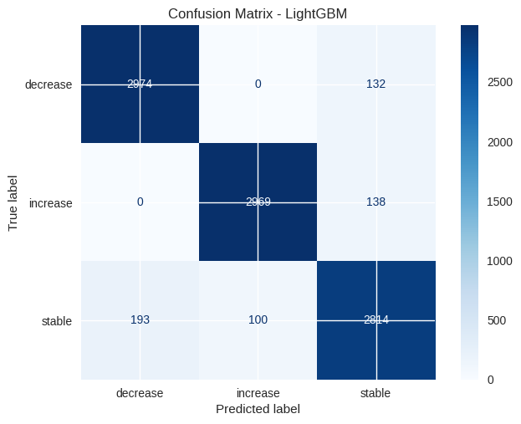

Slide 11
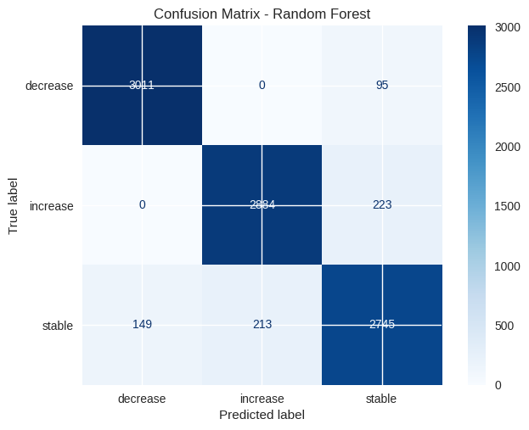


Slide 12
Understanding Model Discriminatory Power (AUC-ROC)
AUC-ROC: Measures ability to separate classes.
Approach: One-vs-Rest for multi-class setting.
Visual: ROC Curves per class.
Best models show strong AUC for 'decrease' class.

Slide 13
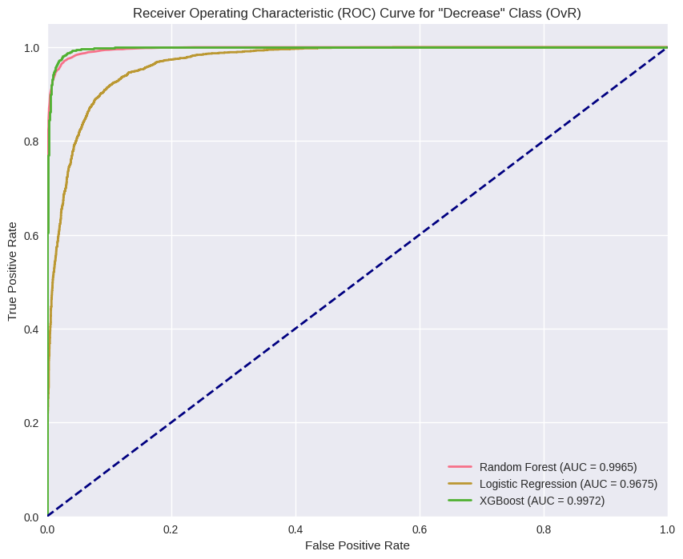

Slide 14
Understanding What Drives Predictions (Feature Importance)
Importance: Transparency & actionable insights.
Method: Tree-based feature importance (XGBoost, RF).
Top Features: Utilization, DPD, EMI burden, etc.
Aligned well with EDA insights.

Slide 15
Translating ML Findings into Business Action
Segmented customers into high-risk & high-opportunity.
High-Risk: Counseling, alerts, EMI adjustment.
Opportunities: Rewards, credit upgrades.
Other Ideas: Credit score simulators, proactive engagement.

Slide 16
Project Summary
Generated realistic synthetic data mimicking credit behavior.
Thorough EDA & visualization of patterns.
Built and evaluated multiple ML models.
Derived business insights from model outputs.

