Slide 1
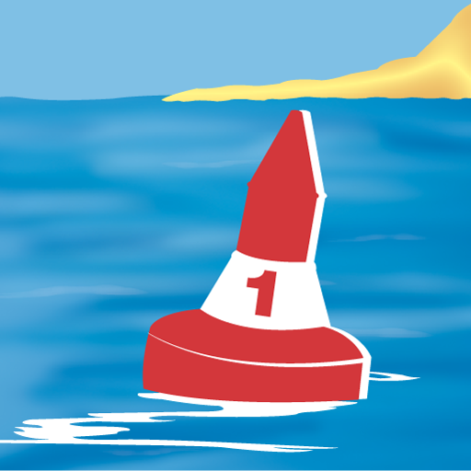
SeaPal
Android App

Slide 2
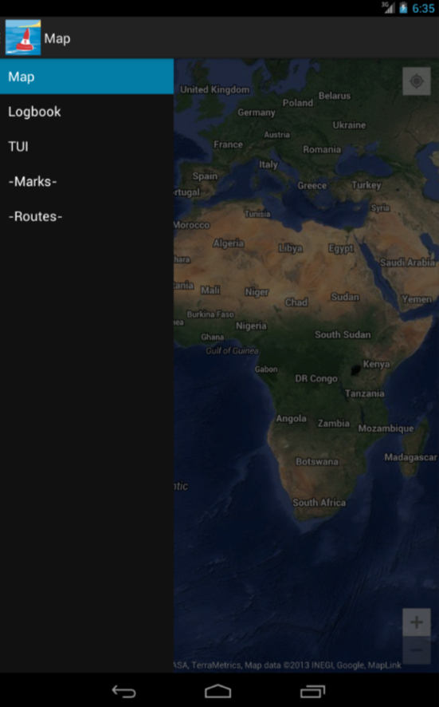
Drawer Navigation
The Drawer Navigation is accessible from every Activity by swiping from the left or the Up-Navigation
Provides navigation to the most important Activities (not complete yet)

Slide 3
Map

Slide 4
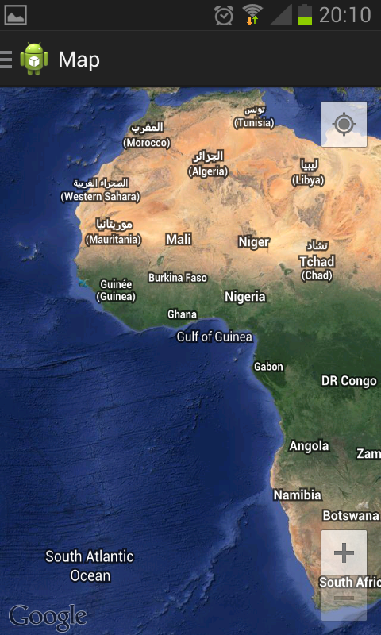

Map
Startup screen of the map
Contains zoom and change to current location
Actionbar with menu on top

Slide 5
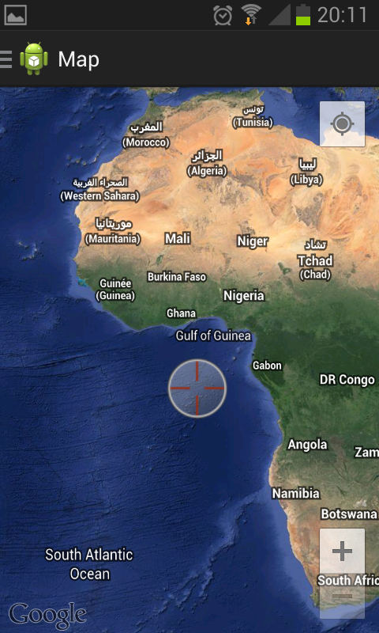
Map
Adding crosshair by longclick on screen

Slide 6
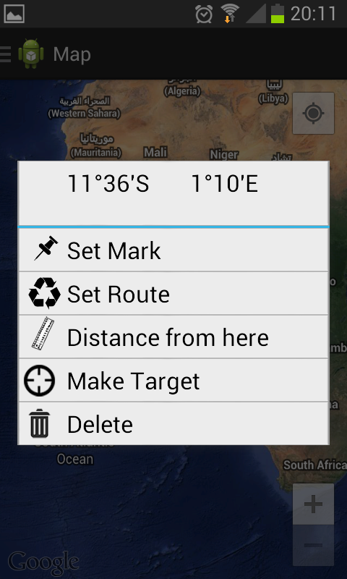
Map
On click on crosshair opens Dialog
Location of crosshair
Standard Seapal operations
(currently operations working: Set Mark, Set Route, Distance from Here and Delete)

Slide 7
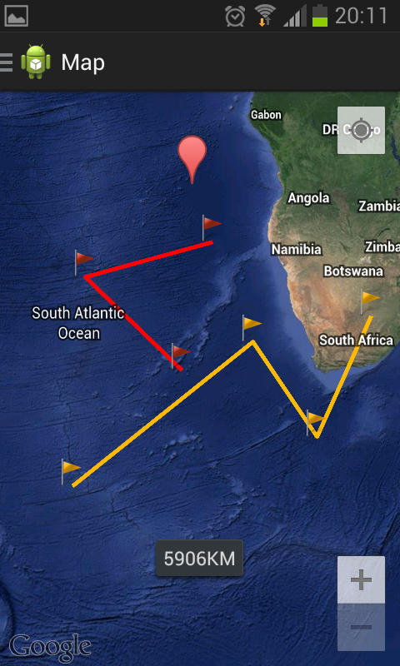
Map
Seapal Operations on the Map
Marker
Red: Set Route
Yellow: Distance from here
Toast showing distance

Slide 8
Logbook
Smarthphone

Slide 9
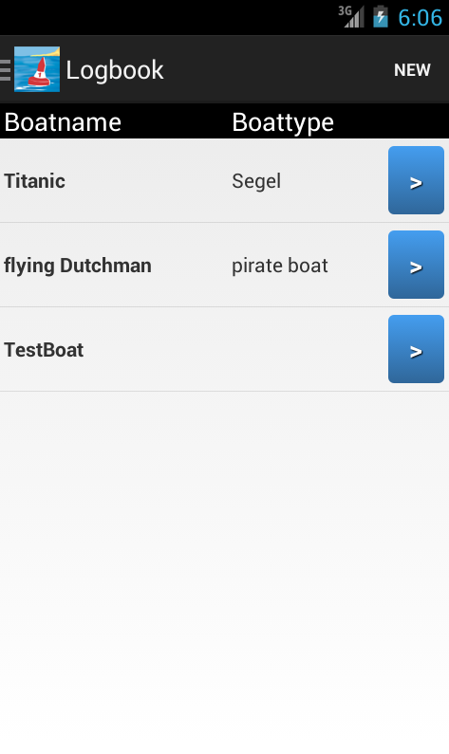
Boat
Portrait
List Fragment
Because of the small Display only “Boatname” and “Boattype are visible

Slide 10
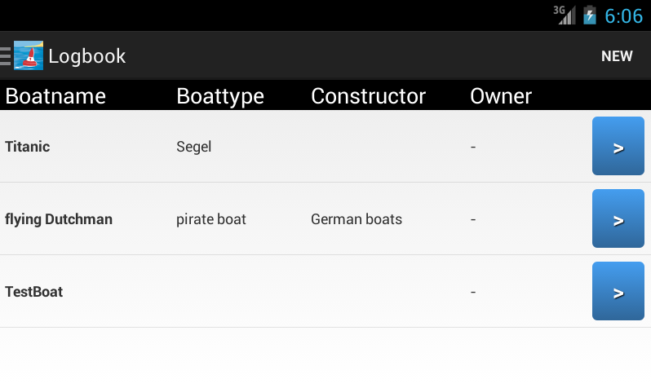
Boat
Landscape
Layout change dynamically
More information about the boats

Slide 11

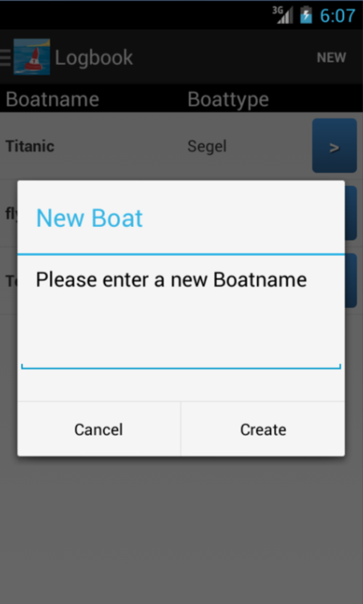
Boat
Press “NEW” to get PopUp Window

Slide 12
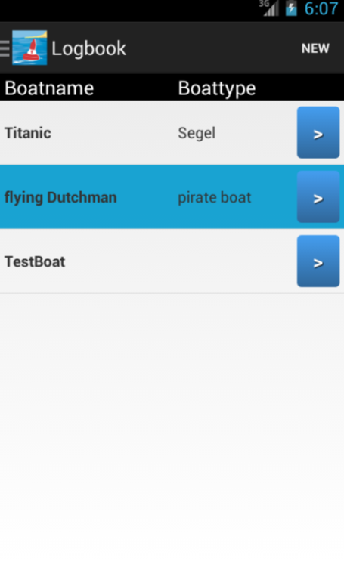
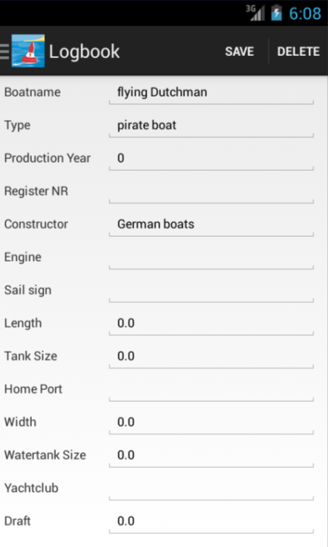
Boat
Click on a ListItem to get boat details
You can edit and delete a boat in the details view

Slide 13

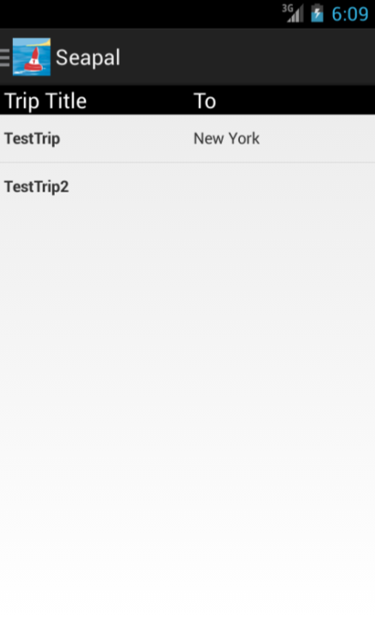
Boat -> Trip
Press this button to start the TripListActivity

Slide 14

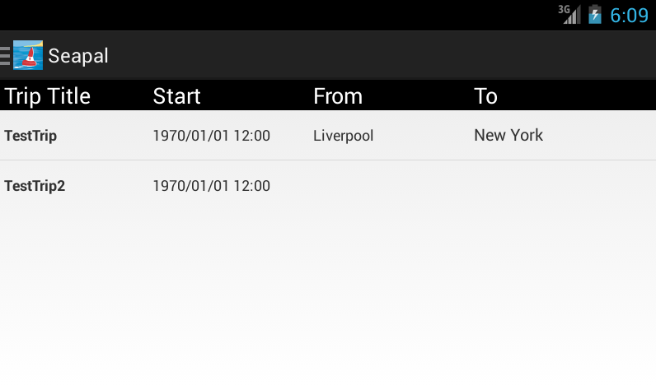
Trip
No Options
Create a Trip with Tracking
Portrait
Landscape

Slide 15
Logbook
Tablet

Slide 16
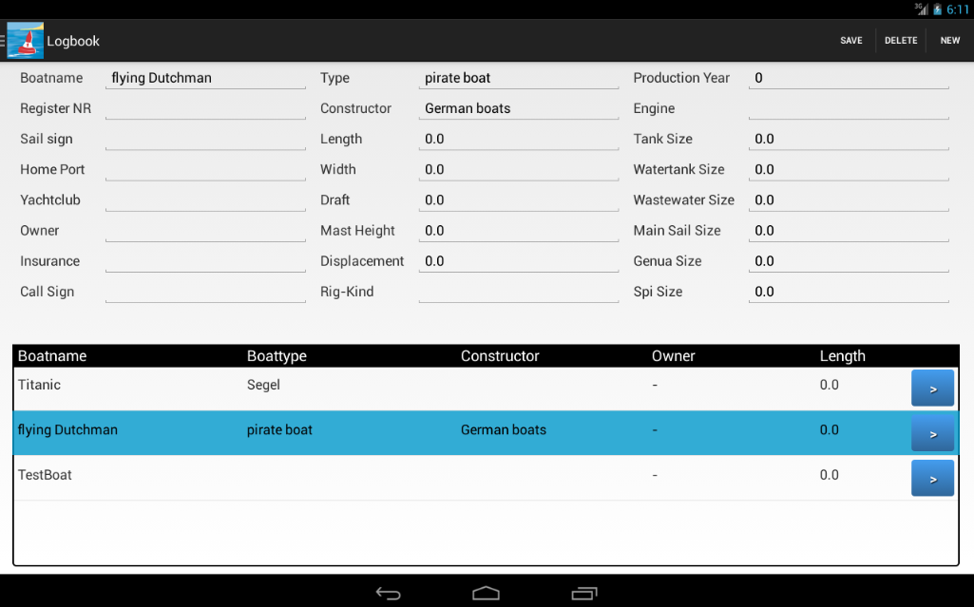
Boat
List + Detail Fragment
“save”, “delete” and “new” Option

Slide 17
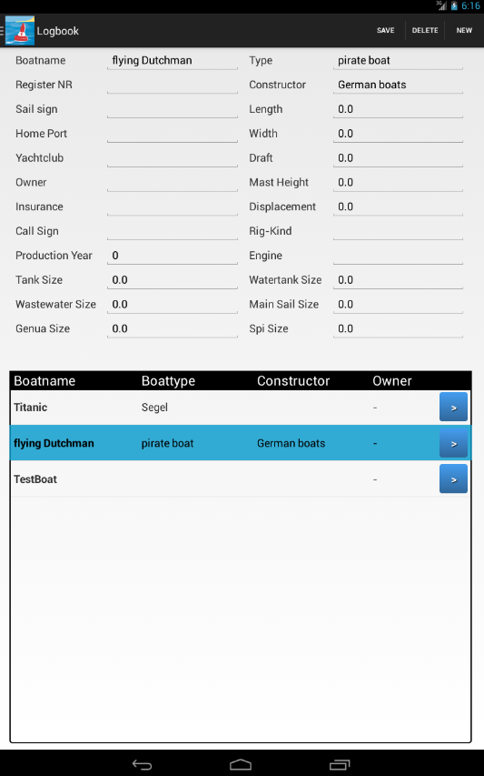
Boat
Tablet-Portrait
Only 2 table columns

Slide 18
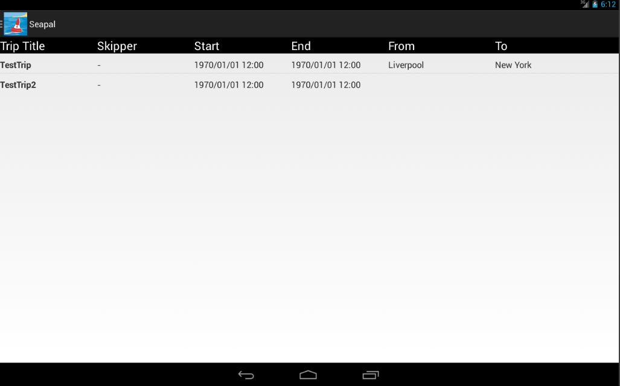
Trip
TripListActivity

Slide 19
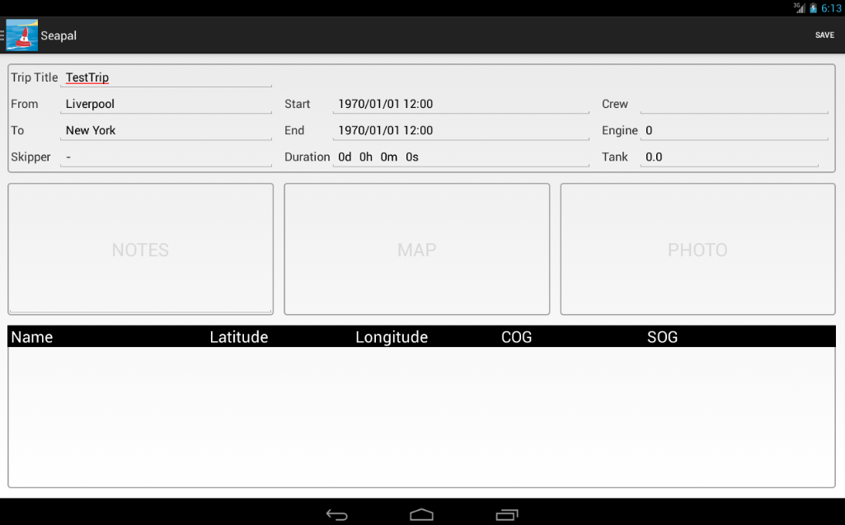
Trip
TripActivity (still now only on tablet)
Edit and save a Trip
Duration will be calculated
ToDo: Show Waypoints in the ListView
Waypoints

Slide 20
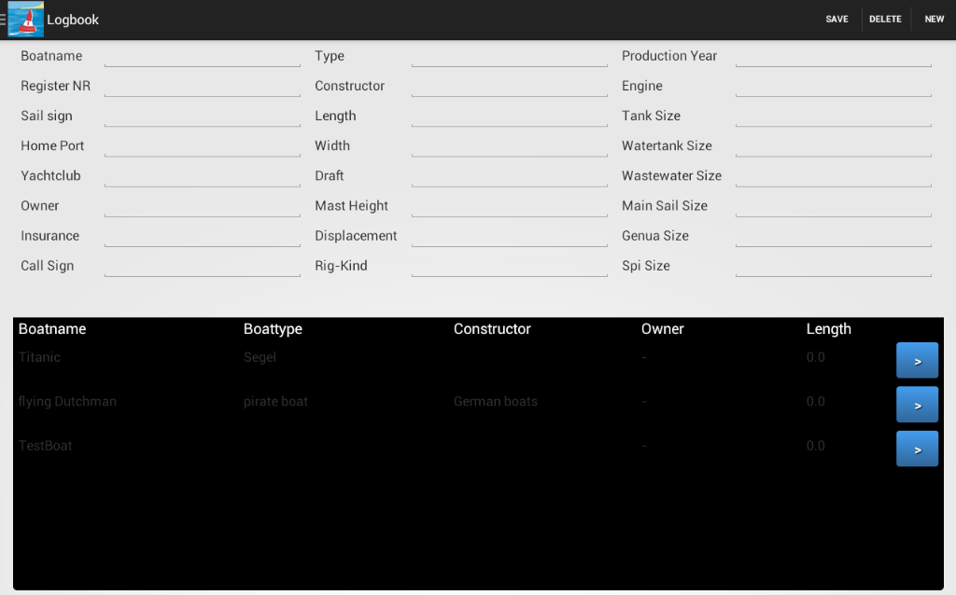
Problems on 4.0.3 Tablets
The BoatListFragment is transparent. So on older Devices the background is black. On Android 4.2.2 tablets the list background appears normal. If you change this background programmatically, you will see a difference to the main layout.

Slide 21
Text UI

Slide 22
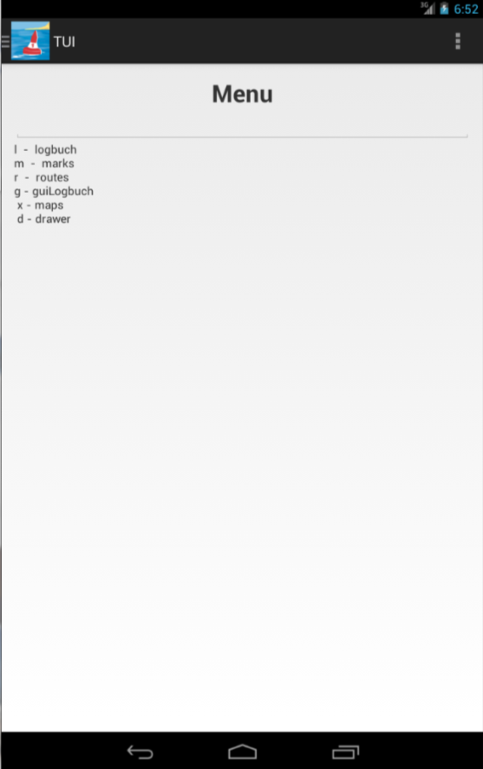
Text UI
For test purposes and to access actions not implemented yet in the GUI
All actions are accessible with the TUI

Slide 23
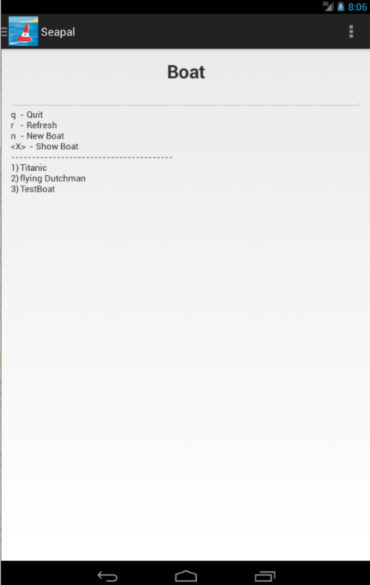
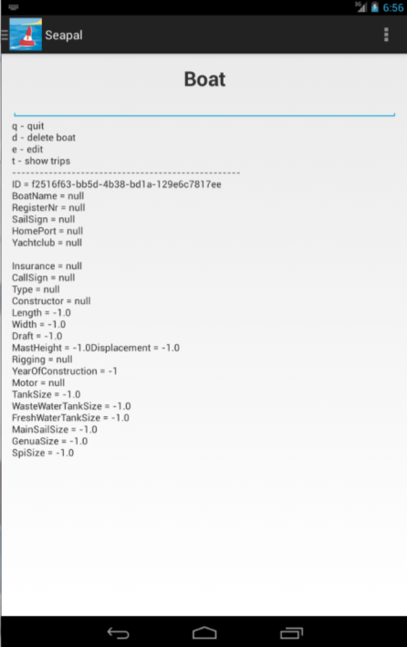
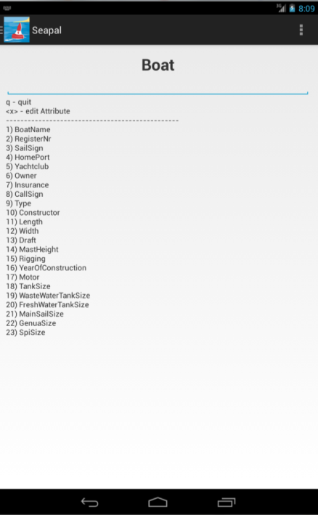
TUI Examples

