Slide 1
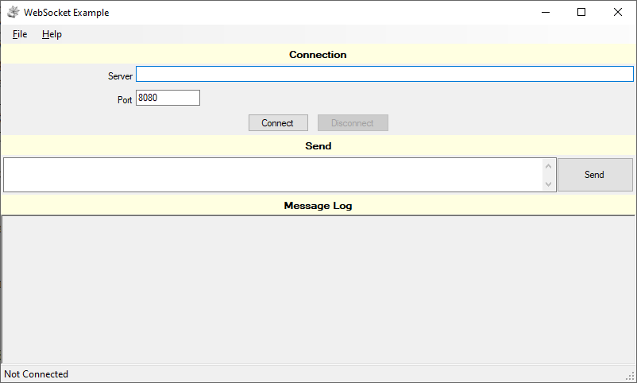
en-US

Slide 2

en-UK

Slide 3
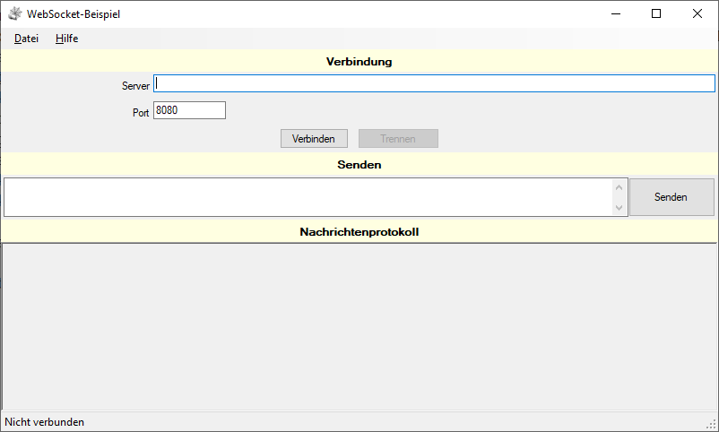
de-DE

Slide 4
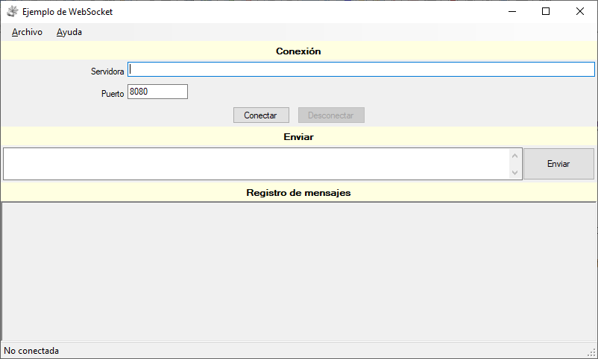
es-MX

Slide 5

lo-LA

Slide 6

th

Slide 7


