Slide 1
Authstronomy
The Science of Web Authentication (and other security stuff)
Daniel Mahinthakumar

Slide 2
Authstronomy
The Science of Web Authentication (and other security stuff)
Coined by Kim Maida (Auth0)
How does cookie-based authentication work?
How does token-based authentication work?
New SPA authorization best practices?!
What are the shortcomings and advantages we need to consider when adding authentication to browser-based applications?
What does all this technical jargon mean?!?!

Slide 3
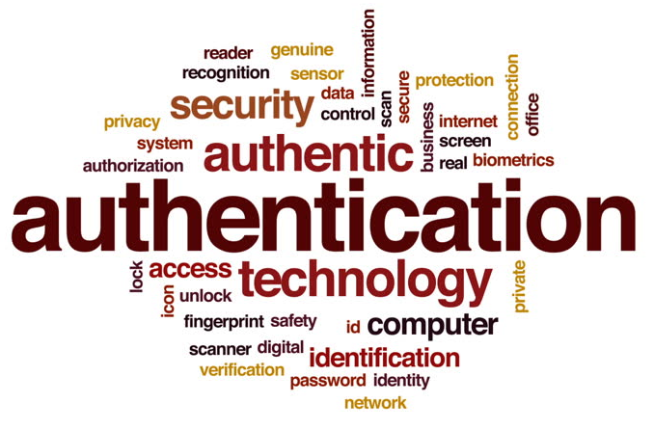
Overview
High level of components involved with web authentication
Web Tokens (JWT)
Web API (.NET Core)
Demo
Future of Web Auth
Questions

Slide 4
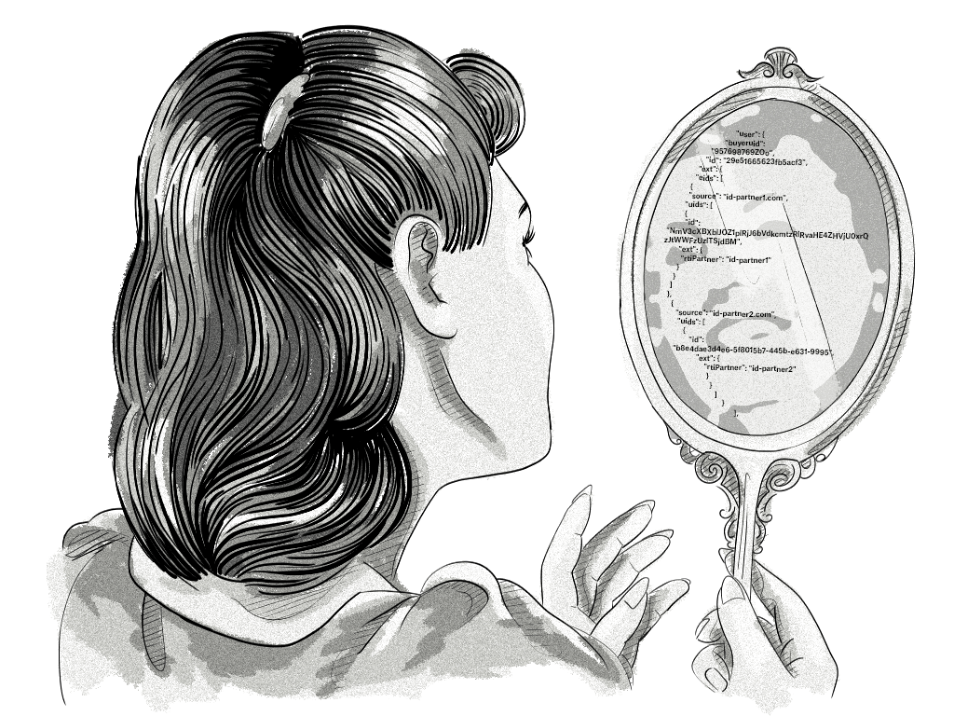
Digital Identity
Set of attributes that define an external agent to an application
Agent could be a person, organization, application, or device
ISO/IEC 24760-1 defines identity as "set of attributes related to an entity"
https://clearcode.cc/blog/adtech-id-solutions/

Slide 5

Authentication
The process of verifying a digital identity
Not the same as identification (act of indicating an identity)
Involves using static attributes to prove identity
Username/Password
Access Card
Biometrics
https://www.forensicmag.com/news/2018/10/contactless-3d-fingerprint-identification

Slide 6
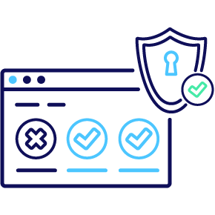
Authorization
Indicates the rights a Digital Identity must have to access a resource
Read/Write Privileges
User vs. Admin
https://www.changehealthcare.com/solutions/clearance-authorization

Slide 7

Who writes these specs?
Internet Engineering Task Force (IETF)
Open Standards Organization
Develops and promotes voluntary internet standards
https://en.wikipedia.org/wiki/Internet_Engineering_Task_Force

Slide 8


Scenario

Slide 9


Scenario
Bugify

Slide 10
Scenario
Needs access to Username/Password
To read emails
Bugify
Needs access to Username/Password
To write bug tickets

Slide 11
Sharing Credentials is BAD!

Slide 12

OAuth (2.0)
Grants third party access to APIs without sharing credentials
Set of endpoints to interact with tokens
Not an authentication protocol, but used for authorization
https://oauth.net/2/

Slide 13

OpenID Connect (OIDC)
Lays on top of OAuth
Used for Authentication
Extends OAuth to specify ID Tokens
https://openid.net/connect/

Slide 14
Tokens
Encoded pieces of data for transferring credentials
ID Token – Provides User Information
Access Tokens – Used for accessing resources (no specific format)

Slide 15
Scenario
Bugify

Slide 16

Scenario
Bugify

Slide 17
Scenario
Bugify

Slide 18

Scenario
Bugify pings Authentication API for Email
Bugify
Email Server prompts user for consent
Signs up for Bugify

Slide 19

Scenario
Bugify would like access to the following:
Bugify would like access to the following:
Read Emails
Read Contacts
Read Tickets
Write Tickets
This does not let Bugify send emails on your behalf
Deny
Accept
Deny
Accept

Slide 20
Scenario
Token Returned
Bugify pings Authentication API for Email
Bugify
User gives consent
Email Server prompts user for consent
Signs up for Bugify

Slide 21
Scopes
Limits what an application can do on behalf of a user
Cannot grand new privileges to user (that they don’t already have)
API is responsible for controlling scopes
Scopes shouldn’t be overloaded with user-specific privileges

Slide 22
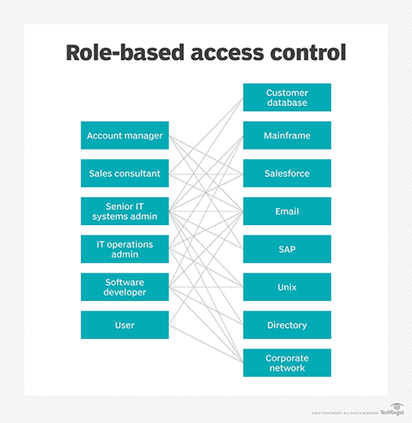
RBAC
Role-based access control
Sets user roles and permissions on an authorization server
https://searchsecurity.techtarget.com/definition/role-based-access-control-RBAC

Slide 23
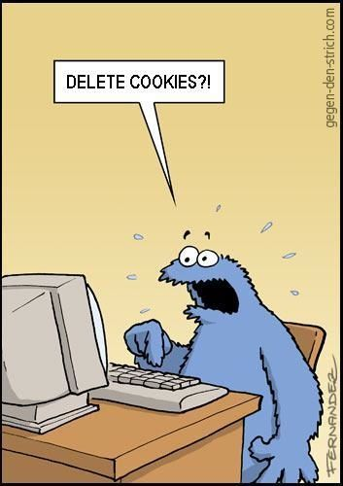
Cookies
Entities passed from a web server to a browser
Stored in cookie.txt (in browser)
Used to persist the state of a user session
Mostly used to track website activity

Slide 24
JWT Tokens

Slide 25
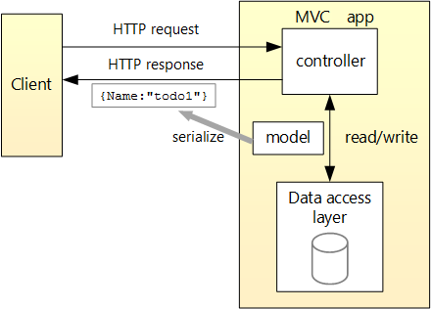
Web API (.NET Core)
Used to support RESTful services using C#
Uses Controllers (ControllerBase) to handle requests
https://docs.microsoft.com/en-us/aspnet/core/tutorials/first-web-api?view=aspnetcore-3.0&tabs=visual-studio

Slide 26
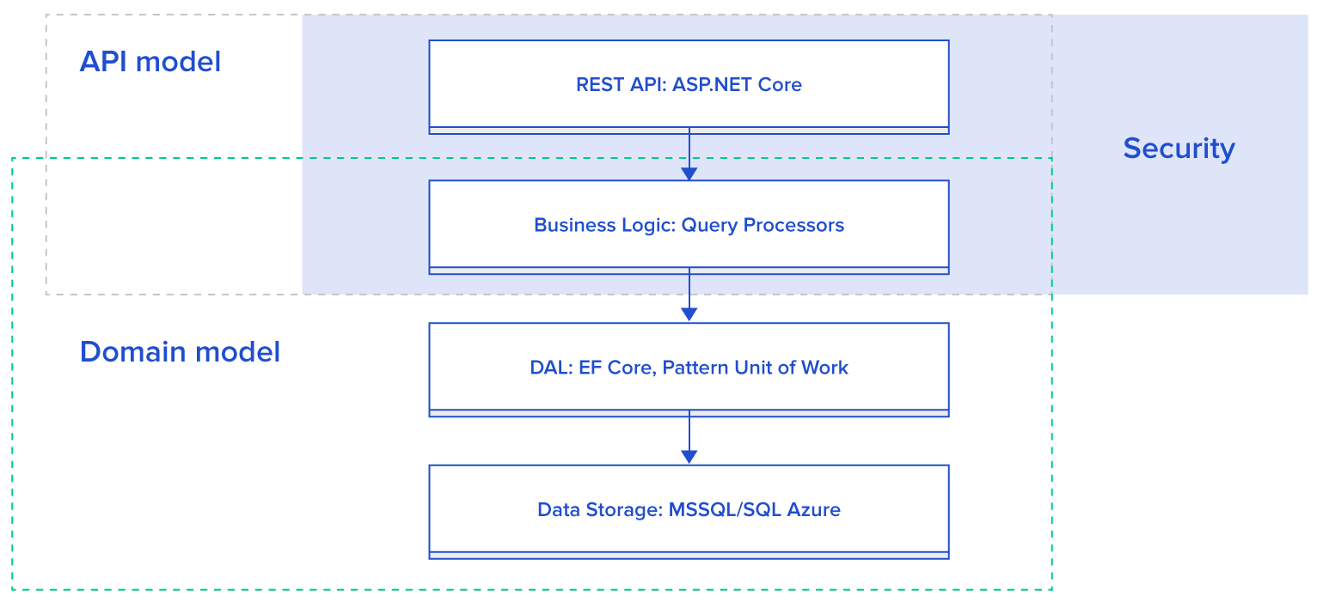
Web API (.NET Core)
https://www.toptal.com/asp-dot-net/asp-net-web-api-tutorial

Slide 27
Demo
.NET Core 2.1 for web services
Angular Frontend
SQLite for managing credentials
Containerized with Docker
Deployed to Heroku

Slide 28
Sources
https://searchsecurity.techtarget.com/definition/role-based-access-control-RBAC
https://community.auth0.com/t/all-things-open-raleigh-nc-usa-october-13-15-2019/31634
https://en.wikipedia.org/wiki/Digital_identity#Authentication
https://jasonwatmore.com/post/2018/08/14/aspnet-core-21-jwt-authentication-tutorial-with-example-api#projectstructure
https://scotch.io/tutorials/the-anatomy-of-a-json-web-token

