Slide 1
Crank
ArcMind Inc.
info@arc-mind.com 
w w w . A r c - M i n d . c o m 
Presenter: Rick Hightower, CTO of ArcMind
Author: Books Professional Struts, Java Tools for Extreme Programming (best seller), Struts Live (#1 download on TSS), etc.
JDJ Editorial Board, IBM DeveloperWorks regular author, JavaLobby Zone leader
Speaker: JavaOne, TheServerSide Symposium, JDJ Edge, SDWest, XP Universe
Rick is the founder of the Crank project
©ArcMind, Inc. “Know The Next” 2004-2007
1
Notes:
1

Slide 2

Crank QuickStart Overview
What is Crank?
Understand how to use Crank
©ArcMind, Inc. “Know The Next” 2004-2008
2
Notes:
2
2

Slide 3


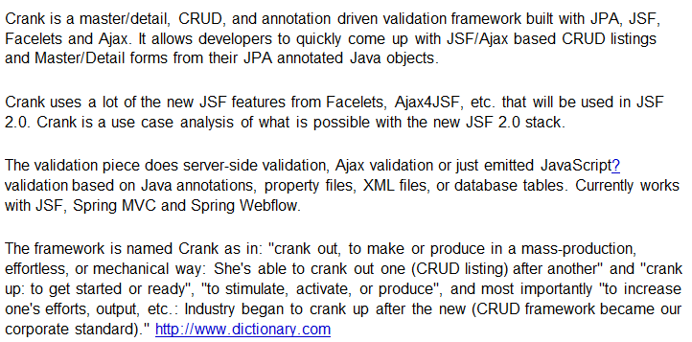
Crank

Slide 4
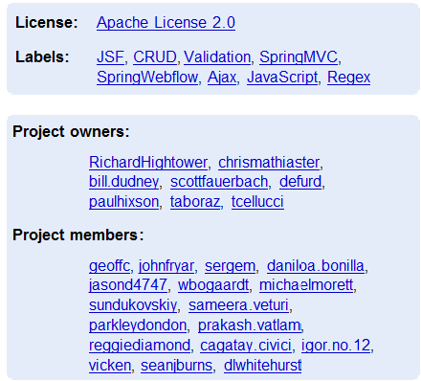
Crank Members
We have members from all over the U.S and the world. One member is South Africa, another hails from Turkey

Slide 5
Crank Introduction
Crank: “Crank the project out”
Idiomatic Java GUI development
POJO Based
GUI support for JPA projects
Allows easy creation of CRUD listings and Master Detail pages to edit JPA based objects
Uses JPA/JavaBean constructs to develop GUI
Currently supports JSF as GUI
Additional Goodies:
Annotation Driven Finder method mix-ins for DAO,
Criteria DSL for DAO,
Annotation Driven Validation framework
©ArcMind, Inc. “Know The Next” 2004-2008
5
Notes:
5

Slide 6
Why Crank?
Use current, common technology stack: Spring, Spring MVC or JSF, and JPA to implement CRUD GUIs quickly
CRUD = Create Read Update and Delete
CRUD has been done before
CRUD is not the interesting part of the application
Make CRUD easier
Allows developers to focus on interesting parts of application
Use annotations from JPA etc. to help build GUI
Map datatypes Date
Map relationships to GUI elements
©ArcMind, Inc. “Know The Next” 2004-2008
6
Notes:
6

Slide 7
Crank has many parts
core
Core crank support
validation
Annotation/meta-data driven validation framework with Ajax bindings
Not tied to JSF or Spring MVC
crud
Support event driven CRUD development, paginators, selectMany support, etc.
Not tied to JSF or Spring MVC
jsf-support
Bind crank-crud to JSF
jsf-validation
Bind crank-validation to JSF
springmvc-validation
Bind crank-validation to Spring mvc
springmvc-crud
planned
test-support
Support for testing in JSF, Spring, Crank environment
Notes:
The above make up the core projects of Crank. Here are the core projects:
crank-core
crank-crud
crank-jsf-support
crank-jsf-validation
crank-springmvc-validation
crank-test-support
crank-validation

Slide 8
Crank examples
blank-project
Blank starter project for creating new crank projects
crank-crud-webapp
Project to show all of crank features (also project we use to test new features)
crank-validation-jsf-webapp
Project to show how to use crank validation with JSF
crank-validation-springmvc-webapp
Project to show how to use crank validation with Spring MVC
todo-example
Simplest crank crud example that implements a simple TODO list

Slide 9
Using Crank
Define Persistence Tier in Java/JPA
Use Facelets/JSF composition components to map persistence tier to GUI
©ArcMind, Inc. “Know The Next” 2004-2008
9
Notes:
9

Slide 10
Overview of Crank Features and Architecture

Slide 11
Crank Block Diagram
Custom JSF pages
Custom Spring MVC pages
Crank Facelets Comp Components
Crank Spring MVC Freemarker templates
Crank JSF Support
Crank SpringMVC Support
Crank Crud Framework (event model)
Java Model Annotated with JPA and Crank Validation
Crank Validation
Framework
Crank Criteria DSL
Crank Repository/DAO
Crank Utilities
Java Persistence API provider

Slide 12
Feature Overview

Slide 13
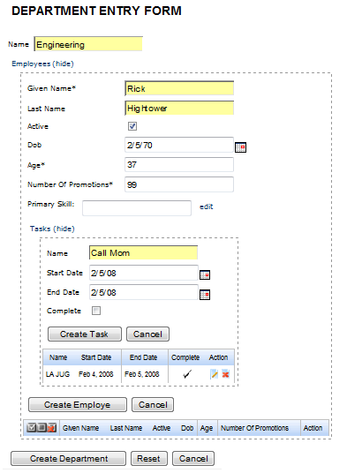
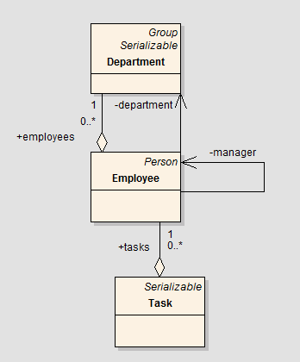
Master Detail Framework

Slide 14
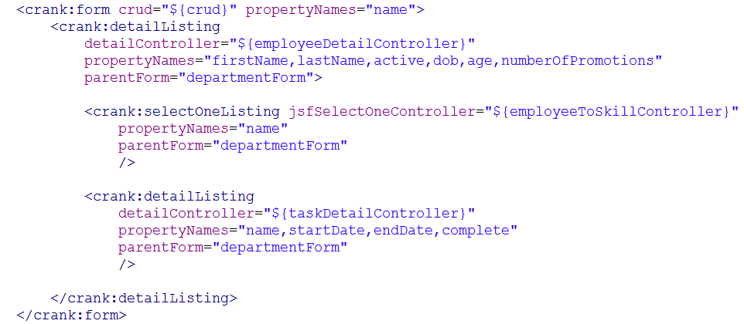
Master Detail Framework

Slide 15
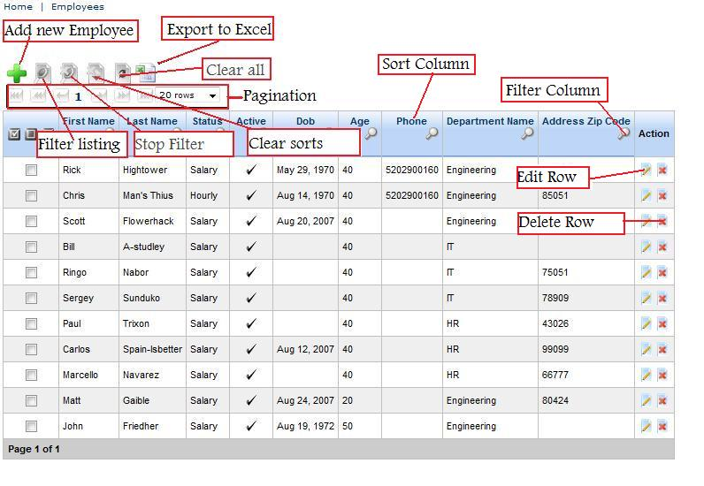
Crud Listing (all columns are filterable and sortable)

Slide 16
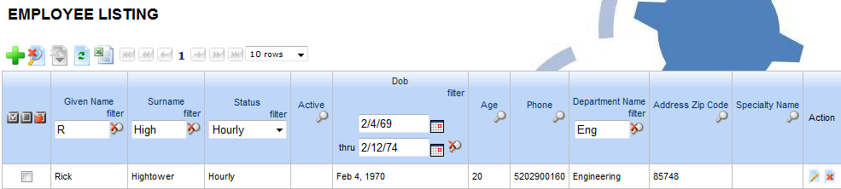
Listing Filters
Strings, Enums, Dates, Number, Related properties (employe.department.name)

Slide 17

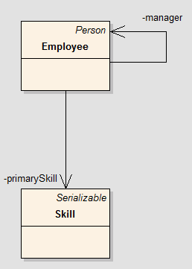
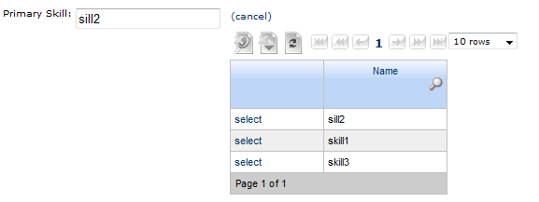
Editing Relationships--Select One Controller

Slide 18
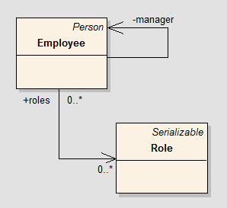
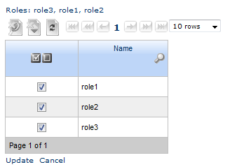
Editing Relationships -- Select Many Controller

Slide 19

Crud framework builds on top of Criteria API
JPA DAOs process Criteria API
Criteria API just POJOs
you can write your own classes that read them
Not tied to JPA; Examples that use SQL to process Criteria API

Slide 20
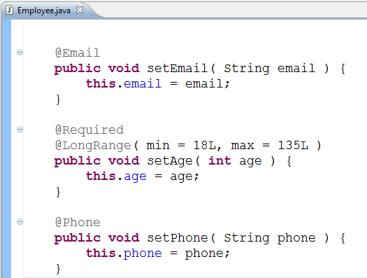
Annotation driven validation
Annotations are read and processed

Slide 21

Validation used by GUI layer

Slide 22
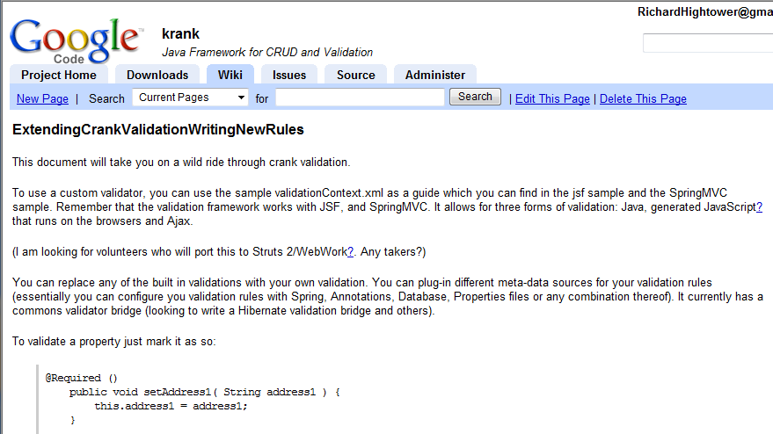
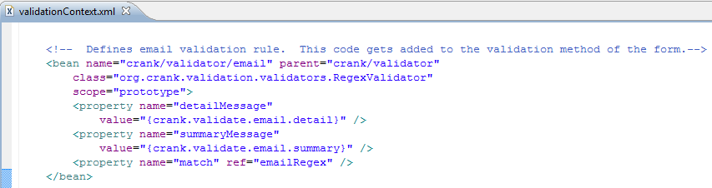
You can customize validation (configured in Spring)

Slide 23
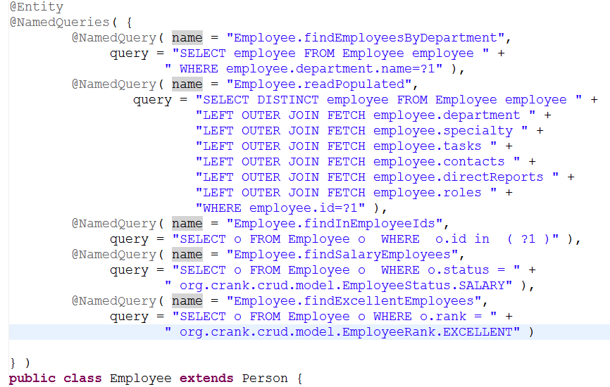
Finder Methods get mixed in

Slide 24
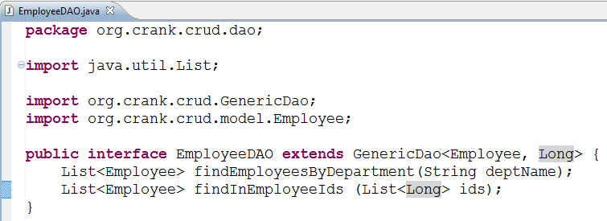
Finder Methods get mixed in

Slide 25
Small History of Crank

Slide 26
Evolution of Crank
1st Web Crud Framework I wrote written with Struts, EJB 2.x and JSP (2001)
Had validation based on property names
Used Jython to generate starter code
Learned about tradeoffs between code gen vs. framework
2nd Web Crud Framework JSF, 2004
Wow, nice and easy; needed many CRUD listings wrote small framework
3rd Web Crud Framework Presto, 2005
4th Web Crud Framework Crank

Slide 27
Presto (Crank’s closest cousin)
Internal project, started as an example on how to combine JSF, Spring and Hibernate (Java 1.4 no annotations; big company)
18 months (3 day contract)
Kept adding features, plan was to OpenSource
Added code generator (Maven 2 plugins); heavy use of Facelets
Now has fulltime support staff, writes documentation and FAQ
Corporate Standard for new Apps (large corporation)
20 to 30 applications launched on Presto, many more expected
Very mature, lots of documentation, etc.
Light on Java 5 features;
Ported to work with iBatis in addition to JPA
Crankification of Presto (possibly); Prestofication of Crank… (possibly)

Slide 28
Crank
Open Source… Presto’s cousin (a rewrite)
Developed while working on applications for Vantage Media
Vantage Media looking for senior Java developers, and is a great place to work
Vantage Media, ArcMind Inc., corporate sponsors
Crank makes heavy use of Annotations, and has support for Enums, etc.
Crank is Ajaxified via Ajax4JSF
Crank makes heavy use of Facelets
Added Criteria API to base filtering and sorting on
Controllers are divorced from JSF and are easier to test
Not as mature as Presto, much more nascent
No more reinventing the wheel

Slide 29
Short term Roadmap (May 2008)
Porting CRUD framework to Spring MVC (started)
Spin-off project started Crank on Struts (Struts 2)
Writing Code generator for reverse engineering database tables into Crank listings (started)
More integration with Seam (done at some level)
As an option, already started and already working
More documentation
Higher code coverage (started)
Website, Public JIRA, Public Confluence (started process)
Currently hosted on google code, WIKI, etc.
Crank 1.0 May 2008

Slide 30
Longer Term Roadmap (Late 2008 and beyond)
Port to JSF 2.0 when it comes out
Port Facelets Composition components to other component frameworks (current uses Ajax4JSF, RichFaces and Tomahawk)
IceFaces
Trinidad
Improve JPA handling via Apache Orchestra
Port to other frontends, Swing, GWT, Flex?
Really driven by needs of members

Slide 31
Getting Started with Crank Worked Example

Slide 32
Getting started with Crank (1 of 2)
Check out crank project
Build Crank
Copy the blank-project from examples
Use Beyond Compare or Araxis (don’t copy .svn folders)
Edit pom.xml file and rename project
Create Eclipse projects or IntelliJ, import project into IDE

Slide 33
Getting started with Crank (2 of 2)
Refactor/Rename CrankCrudExampleApplicationContext
Create JPA enabled Task class
Add entry in new App context for Task
Add persistence.xml entry for Task persistence object
Add form and listing to home.xhtml

Slide 34
Check out crank project
Using subversion, you need to check out crank
We created a tag called good, which is the last known good build
Create a new directory, in the new directory run the following command from the command line:
svn checkout http://krank.googlecode.com/svn/tags/good crank
Notes:
The above checks out the good tag from the svn repository. This will check out all of crank. Once you have it checked out you can build it.

Slide 35
Build Crank
Crank uses maven for builds
Before you can use an example Crank project you need the Crank jar files
The easiest way to get the Crank jar files is to build Crank as follows from the command line:
cd crank
mvn clean install -Dmaven.test.skip=true
Notes:
The above puts you into the directory that svn just created in the last step. Since this is the “good” verified build there is no reason to run the time consuming tests.

Slide 36
Copy the blank-project from examples
Copy the blank-project from examples
Crank ships with a blank-project
The blank-project is everything you need to create your first crank project
JSF, Facelets, Ajax4JSF, Spring and JPA are preconfigured
Copy examples\blank-project (in the crank directory) to a new location
Notes:
If you have Araxis or Beyond Compare, copy the files without the .svn files.

Slide 37
Edit pom.xml file and rename project (1 of 2)
In the new folder, edit the pom.xml file
Change the artifact-id from blank-project to todo-example
<artifactId>todo-example</artifactId>
DO NOT MODIFY THE PARENT artifactId

Slide 38
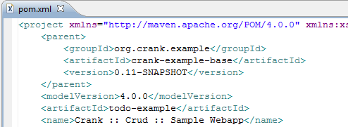
Edit pom.xml file and rename project (2 of 2)
Edit the artifact Id

Slide 39
Create Eclipse projects or IntelliJ
IDE support
To create Eclipse project files run:
mvn eclipse:eclipse
To create InteliJ project files run:
mvn idea:idea
Now import the project into your favorite IDE
Notes:
For more information on the maven Idea plugin go to:
http://maven.apache.org/plugins/maven-idea-plugin/
For Eclipse go to:
http://maven.apache.org/plugins/maven-eclipse-plugin/

Slide 40
Using IDE rename CrankCrudExampleApplicationContext (1 of 2)
Using IDE rename/refactor CrankCrudExampleApplicationContext to org.crank.todo.TodoApplicationContext
Make sure IDE scans xml files when refactoring
Ensure name changes in \src\main\resources\applicationContext.xml

Slide 41
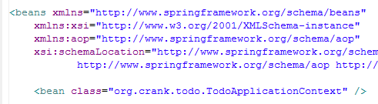
Using IDE rename CrankCrudExampleApplicationContext (2 of 2)
Ensure change in \src\main\resources\applicationContext.xml as follows:

Slide 42
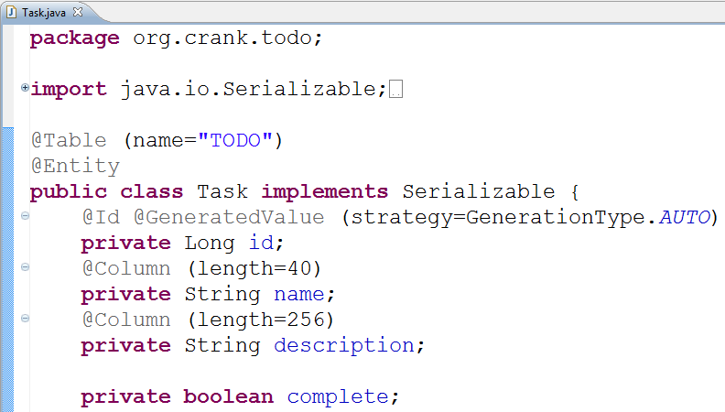
Create JPA enabled Task class
Notes:
The above is just a vanilla JPA class nothing special.

Slide 43
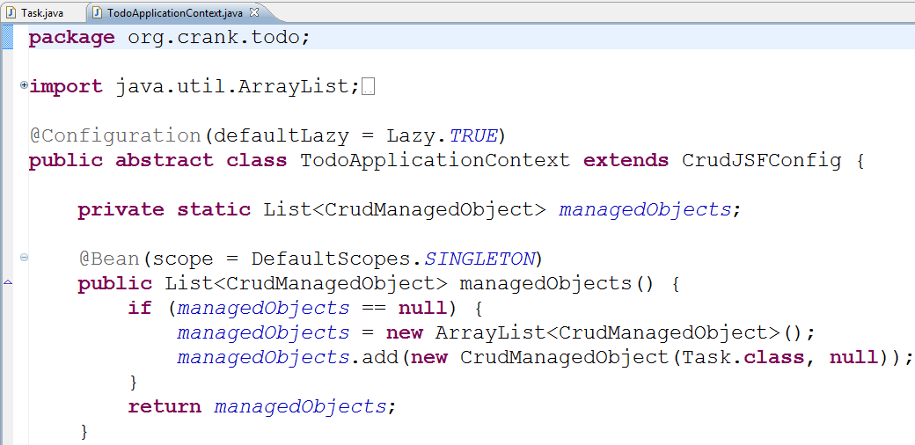
Add entry in new App context for Task
Notes:
You just need to add a new CrudManagedObject to the managedObject list. The base class, CrudJSFConfig will use this to setup everything needed for a Crud listing.

Slide 44
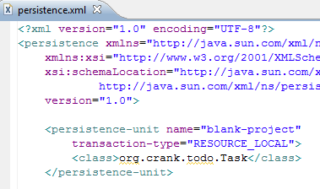
Add persistence.xml entry for Task persistence object
src/resources/META-INF/persistence.xml
Notes:
Strictly speaking, Hibernate will find the Task class without the above entry.
However, OpenJPA will not so to be JPA compliant please follow the rules.

Slide 45
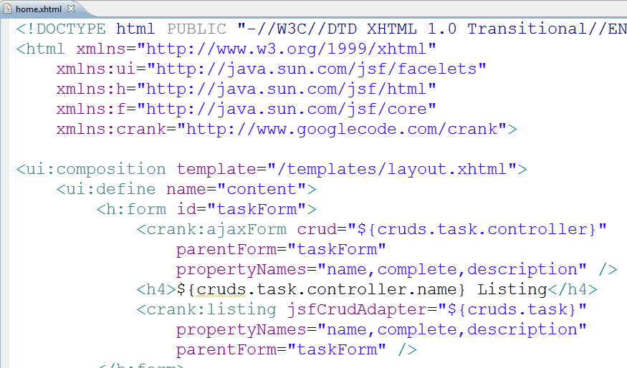
Add form and listing to home.xhtml
Notes:
In order to use the crank facelet taglib you must import it.
There is a tag for ajaxForms and a tag for the listing.

Slide 46
Running the example
To run the example, run mvn jetty:run from the command line:
mvn jetty:run

Slide 47
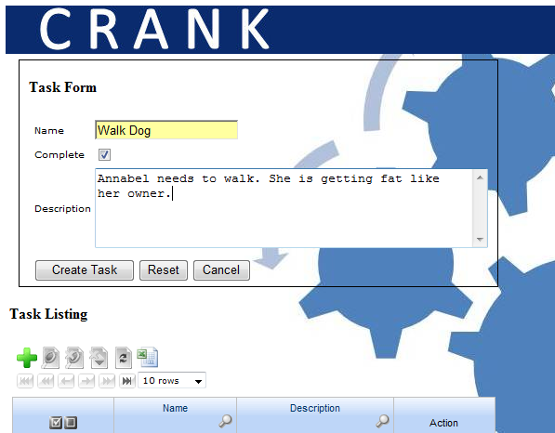
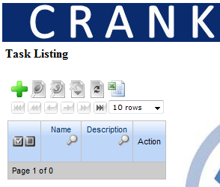
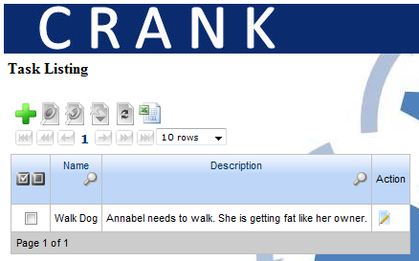
Using Crank Todo App

Slide 48
Where to go from here
Crank home page
http://code.google.com/p/krank/
Crank Crud Design Document
http://code.google.com/p/krank/wiki/CrankCrudDesignDocs
If the instructor has time, go through the design document
Crank Crud Intro
http://code.google.com/p/krank/wiki/CrankCrudIntro
More involved Crank Crud Tutorial
http://code.google.com/p/krank/wiki/CrankCrudTutorial

Slide 49
Validation Framework Design Overview

Slide 50
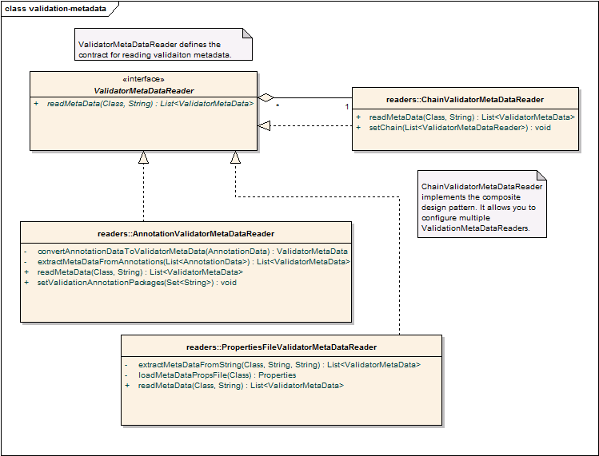
Easy to plugin meta-data sources for Validation

Slide 51
ValidatorMetaDataReader
ValidatorMetaDataReader
extention point for classes that need to read validation meta-data
One implementation reads the meta-data from a properties file
One implementation reads the data from Java 5 Annotation
Another implementation reads from DB

Slide 52
AnnotationValidatorMetaDataReader
Reads validation meta-data from annotations.
Configure base package of the annotatoins
defaults to "org.crank.annotations.validation".
Takes name of the ValidatorMetaData and captilalizes the first letter.
"com.mycompany.annotations", and ValidatorMetaData.name = "required", then look for com.mycompany.annotations.Required
use annotation without polluting your model classes with Crank annotations
Three extensions use this JavaScript, JSF and SpringMVC

Slide 53
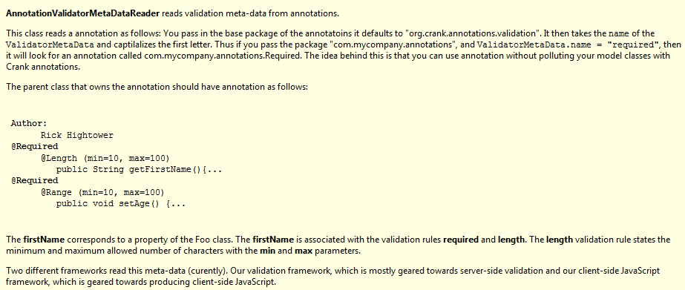
AnnotationValidatorMetaDataReader

Slide 54
PropertiesFileValidatorMetaDataReader
reads validation meta-data from properties files
Class name com.foo.Foo, then the resource name is com.foo.Foo.properties.
Properties file contents
firstName=required; length min=10, max=100
age=required; range min=10, max=100
First name is required, and must be at least 10 characters and no more than 100 characters
Age is required and must be between 10 and 100
Notes:
The firstName corresponds to a property of the Foo class. The firstName is associated with the validation rules required and length. The length validation rule states the minimum and maximum allowed number of characters with the min and max parameters.

Slide 55
ChainValidatorMetaDataReader
Allows you to chain validator readers
you can read validation data from more than one source
you could read validation meta data from properties files, and annotations
last one configured in the chain wins if you have the same type
also merges as long as they are different types (there are overrides rules as well)

Slide 56
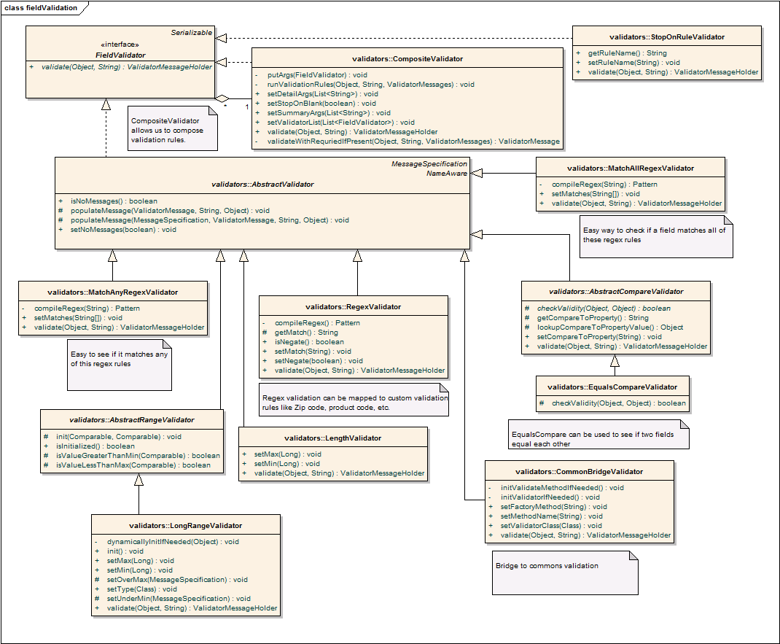
FieldValidators

Slide 57
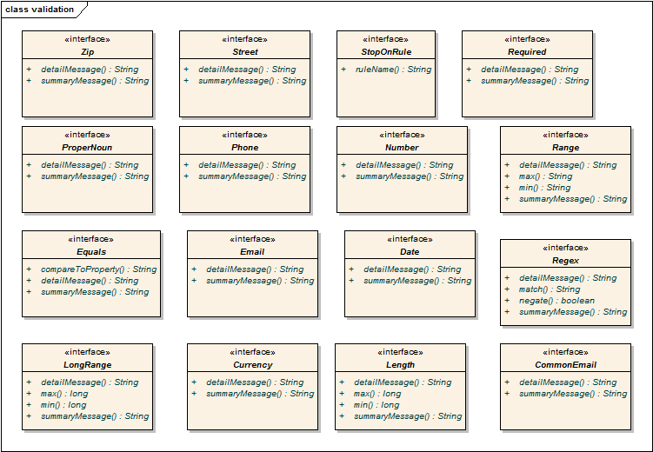
Validation Annotations

Slide 58
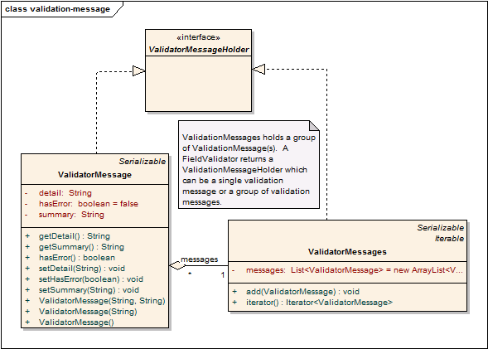
Validation Messages

Slide 59
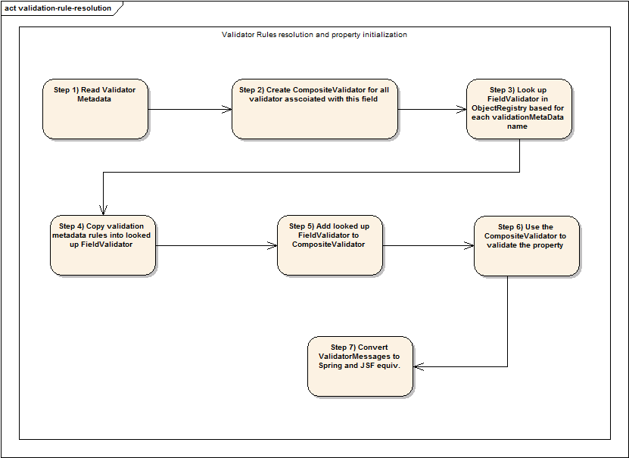
Lookup validation rules

Slide 60
More on validation rules
Design Document (8 pages)
http://code.google.com/p/krank/wiki/CrankValidationDesignDocument
How to configure and extend
http://code.google.com/p/krank/wiki/ExtendingCrankValidationWritingNewRules
Example using JSF and JavaScript
http://krank.googlecode.com/svn/trunk/examples/crank-validation-jsf-webapp/
Example using Spring MVC and JavaScript
http://krank.googlecode.com/svn/trunk/examples/crank-validation-springmvc-webapp/

