Slide 1
Cloud Security Auto-Remediation Architecture
Subtitle: Event-driven security automation system to detect and automatically remediate insecure cloud configurations in real time
Tech stack: Terraform · GitHub Actions · AWS CloudTrail · EventBridge · Lambda
Name: SeokHyun Yoo
Role: Security Automation / Cloud Security
Keywords: CI/CD, IaC, Event-driven Security Automation

Slide 2
Problem Definition
현실 문제
클라우드 환경에서 Security Group 0.0.0.0/0 SSH 오픈은
침해사고의 가장 빈번한 초기 침투 벡터
운영 환경에서:
수동 탐지 → 지연
수동 대응 → 휴먼 에러
야간/비근무 시간 → 대응 공백

Slide 3
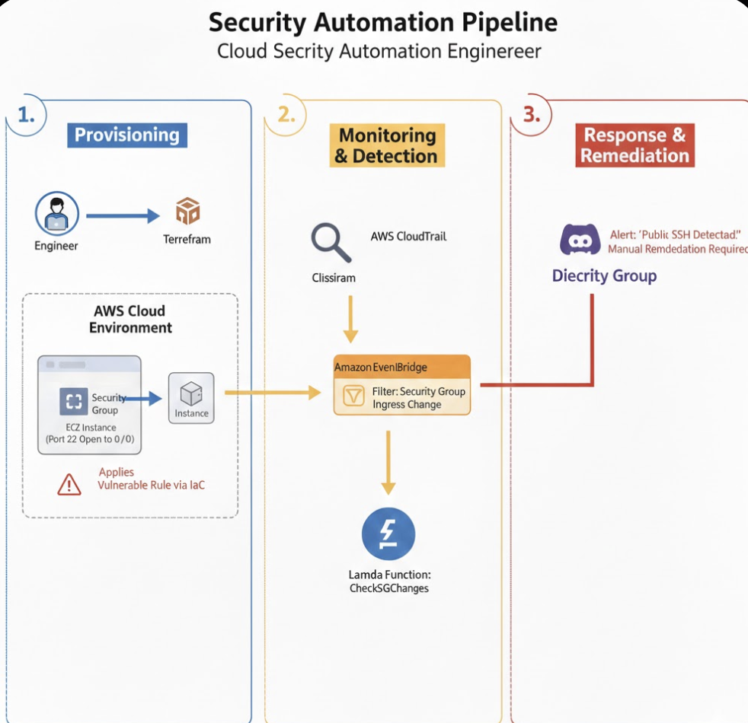
High-Level Architecture

Slide 4
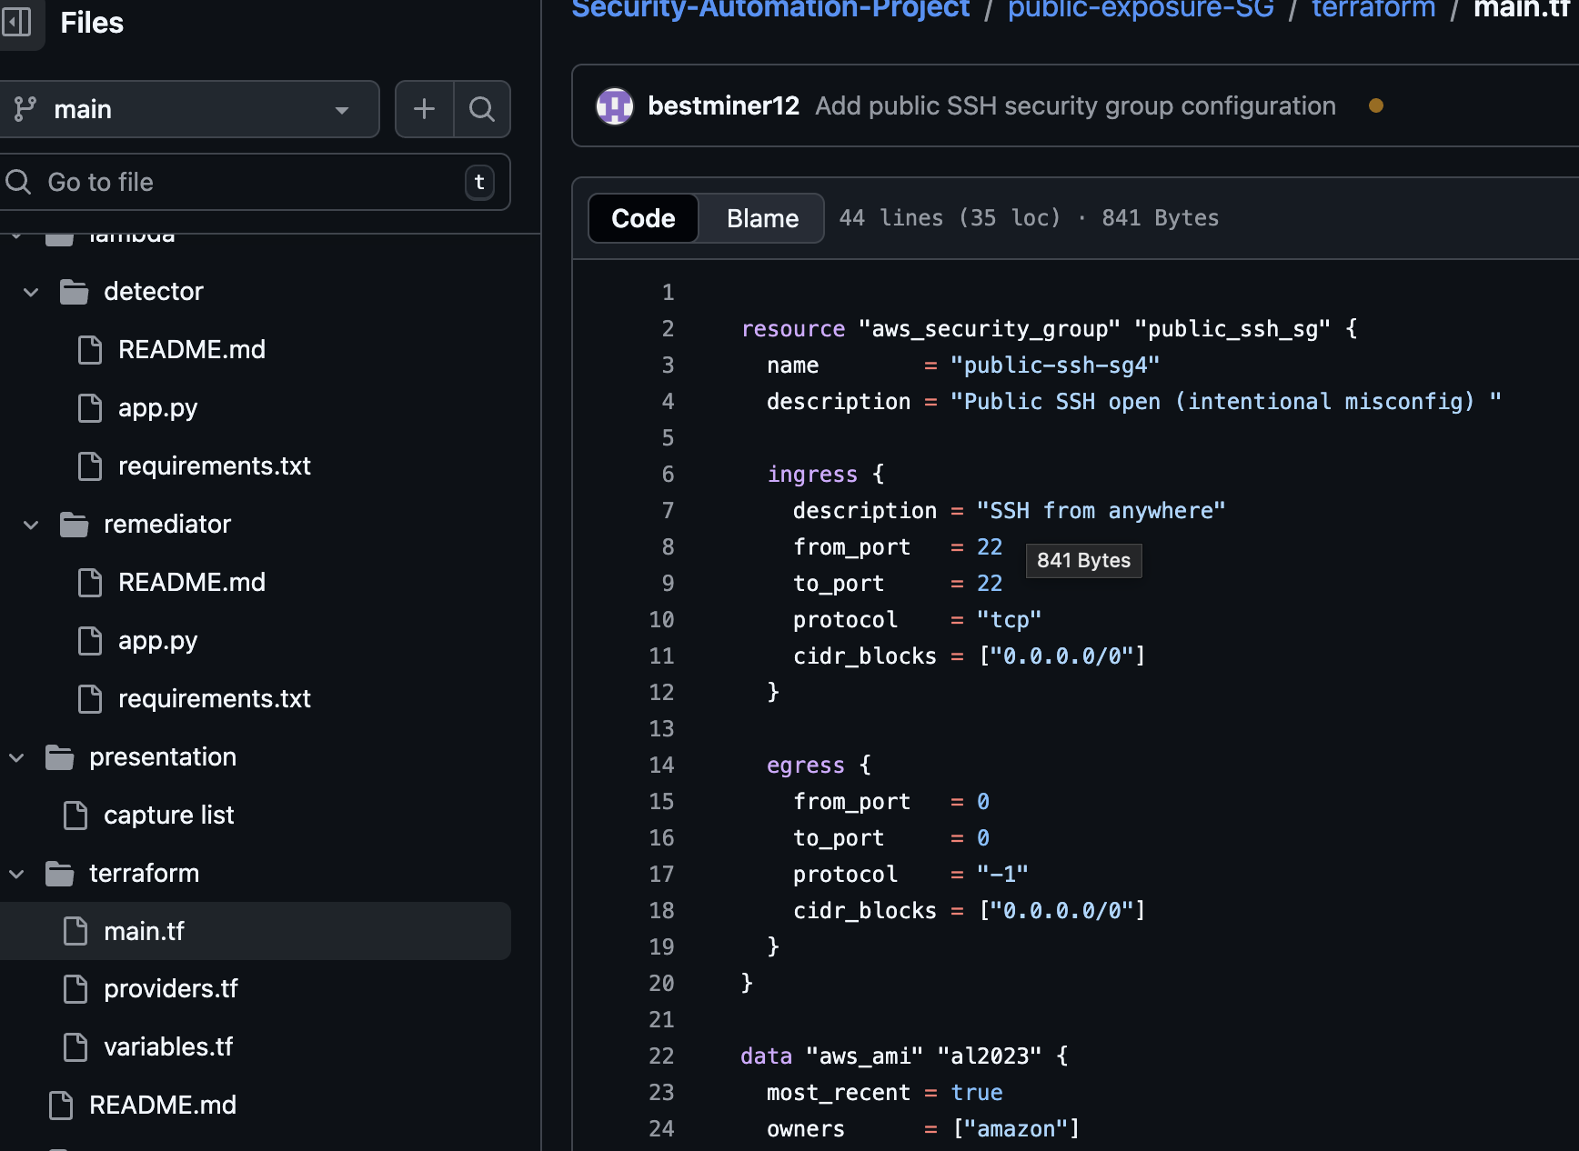
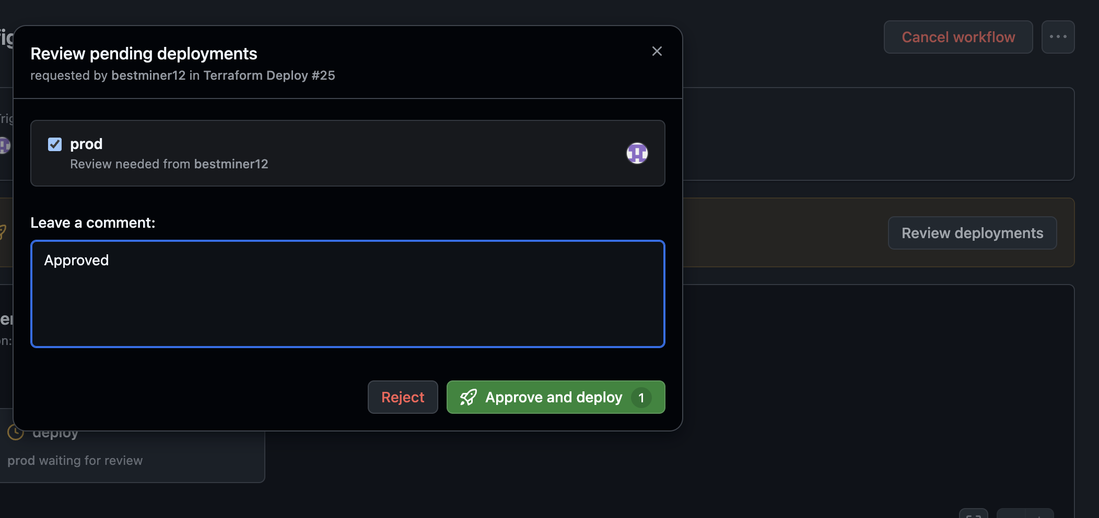
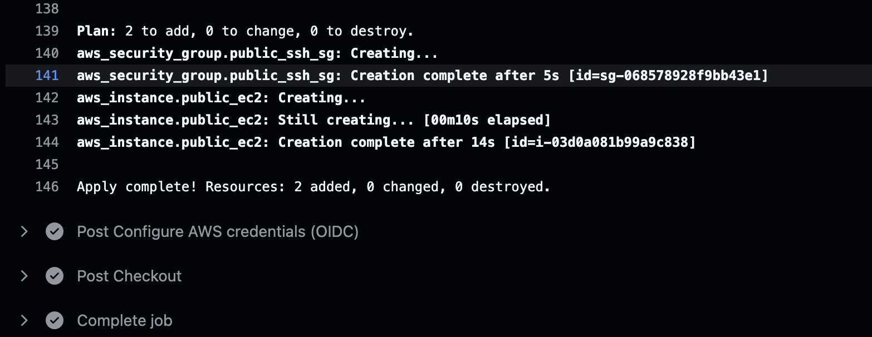
Terraform Apply, CI/CD
Terraform Code
2. Approval-based CD
3. Resource deploy

Slide 5
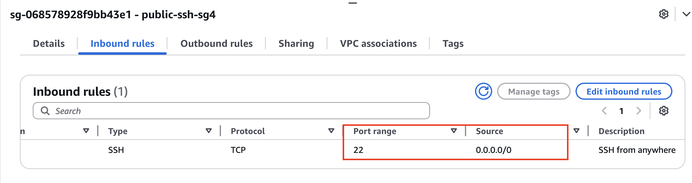
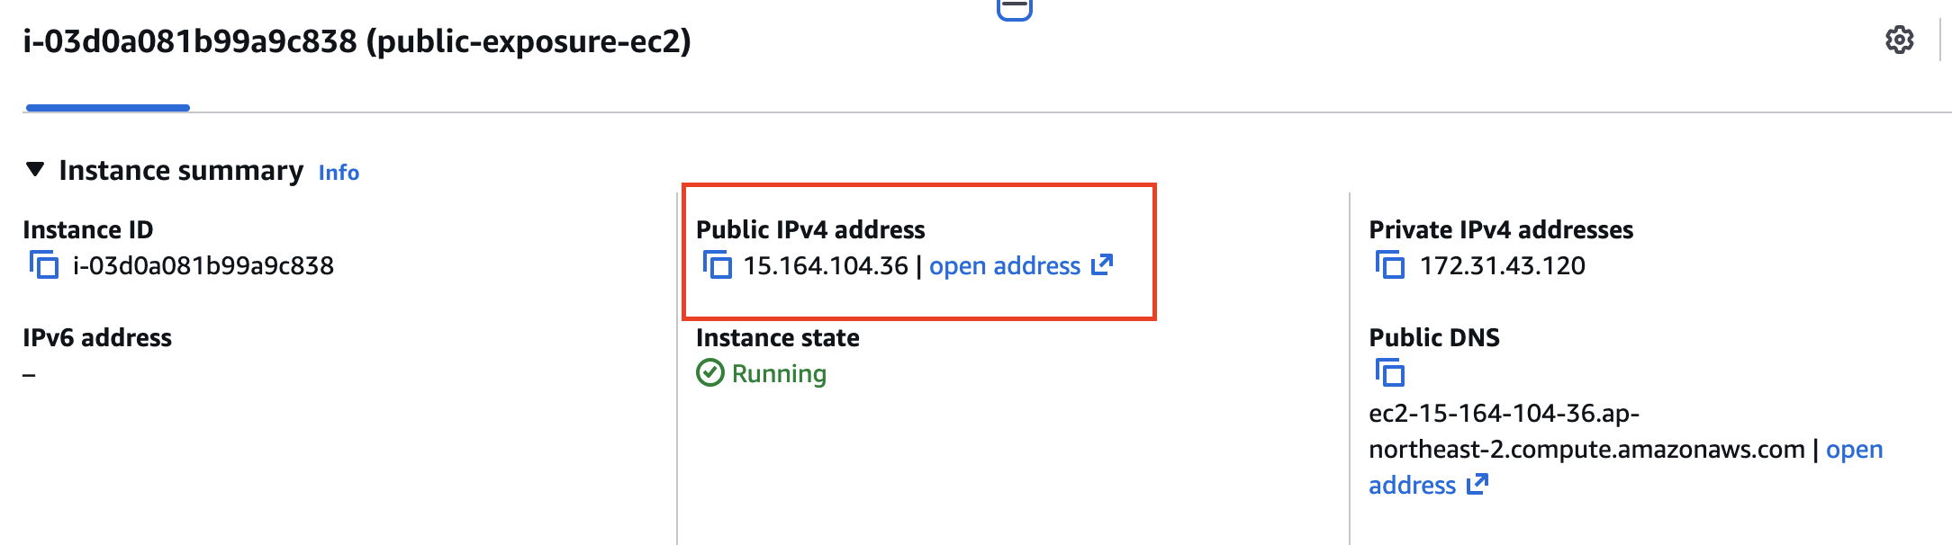
AWS Console Resource check
1. SG opend to any public ssh port
2. EC2 setting public IP

Slide 6
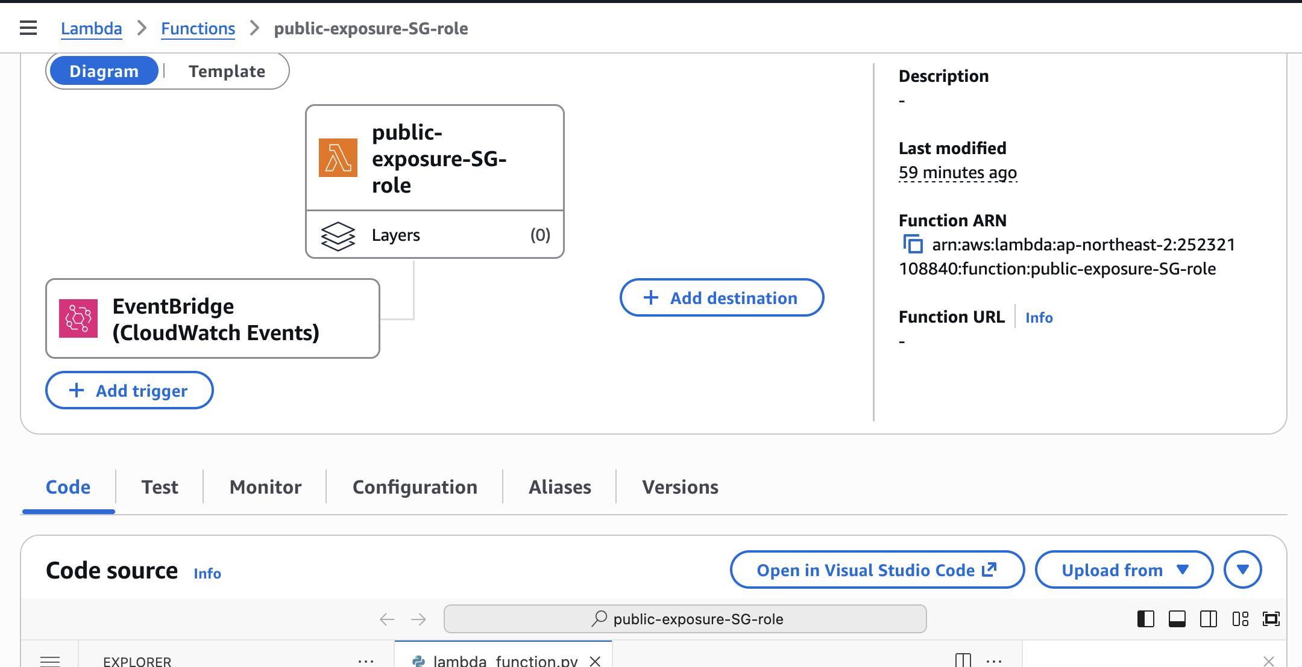
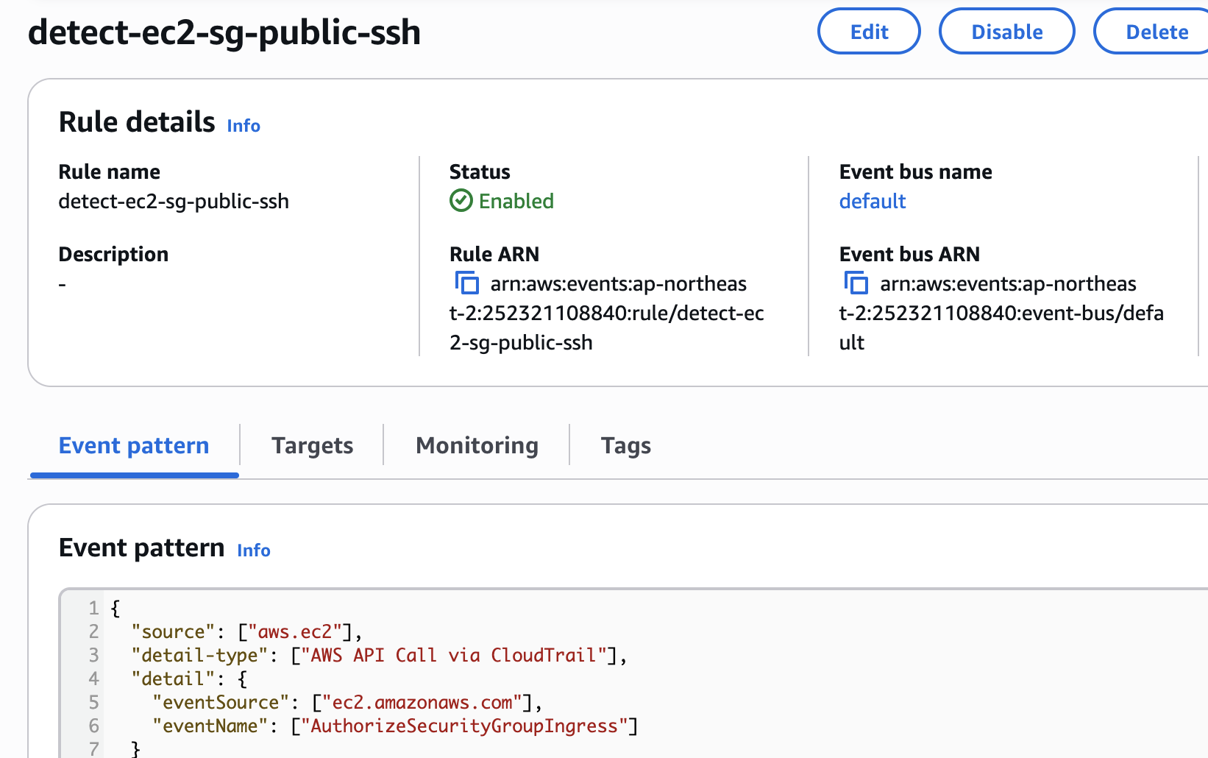
Lamda, Event bridge setting
1. Detecting Lamda setting
2. Event bridge setting

Slide 7
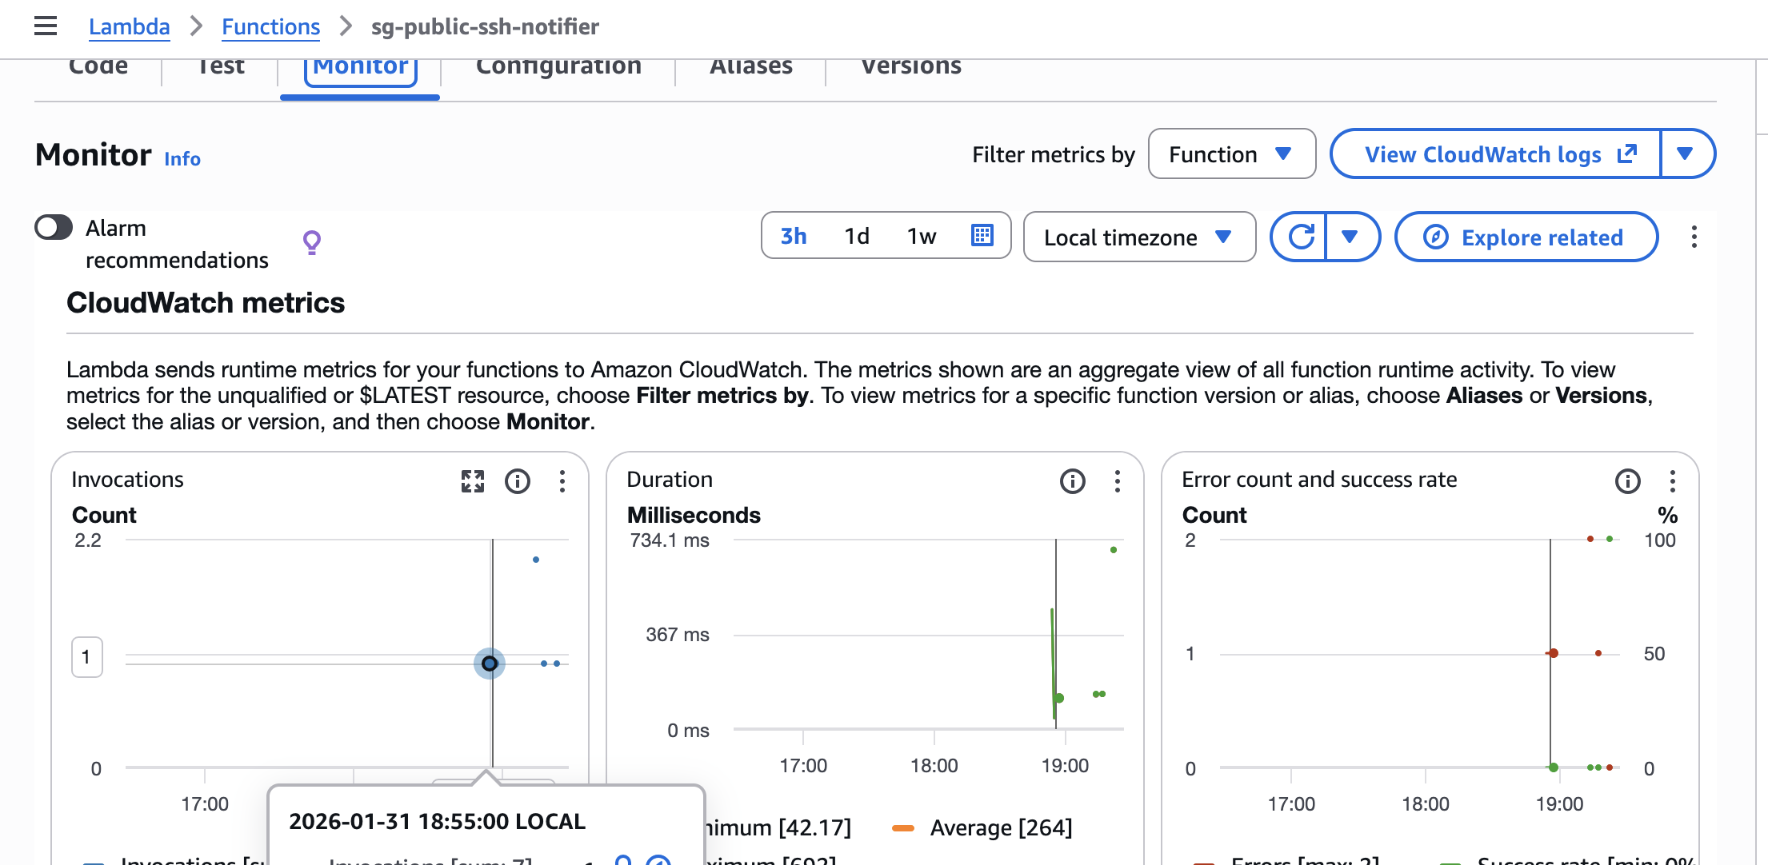
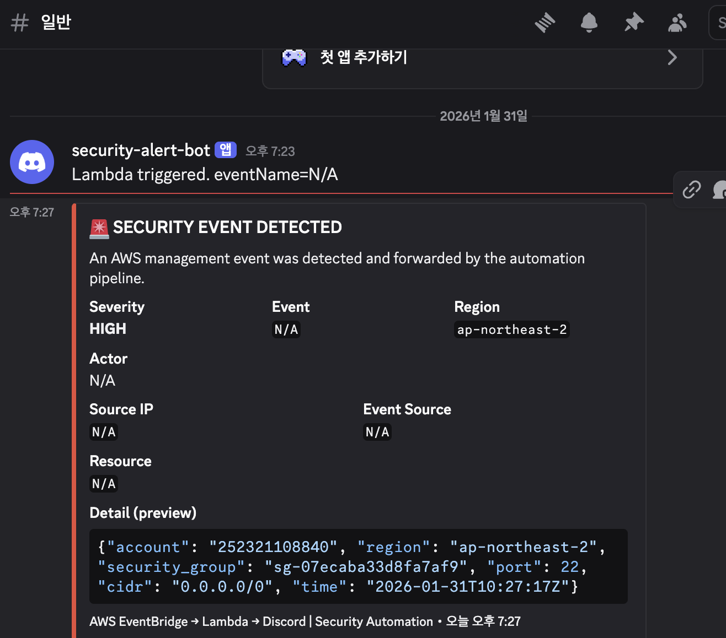
Send alert info to discord
1. Notifier lamda setting
2. Send alert to discord

Slide 8
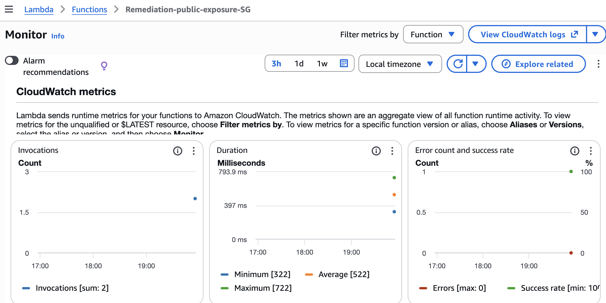
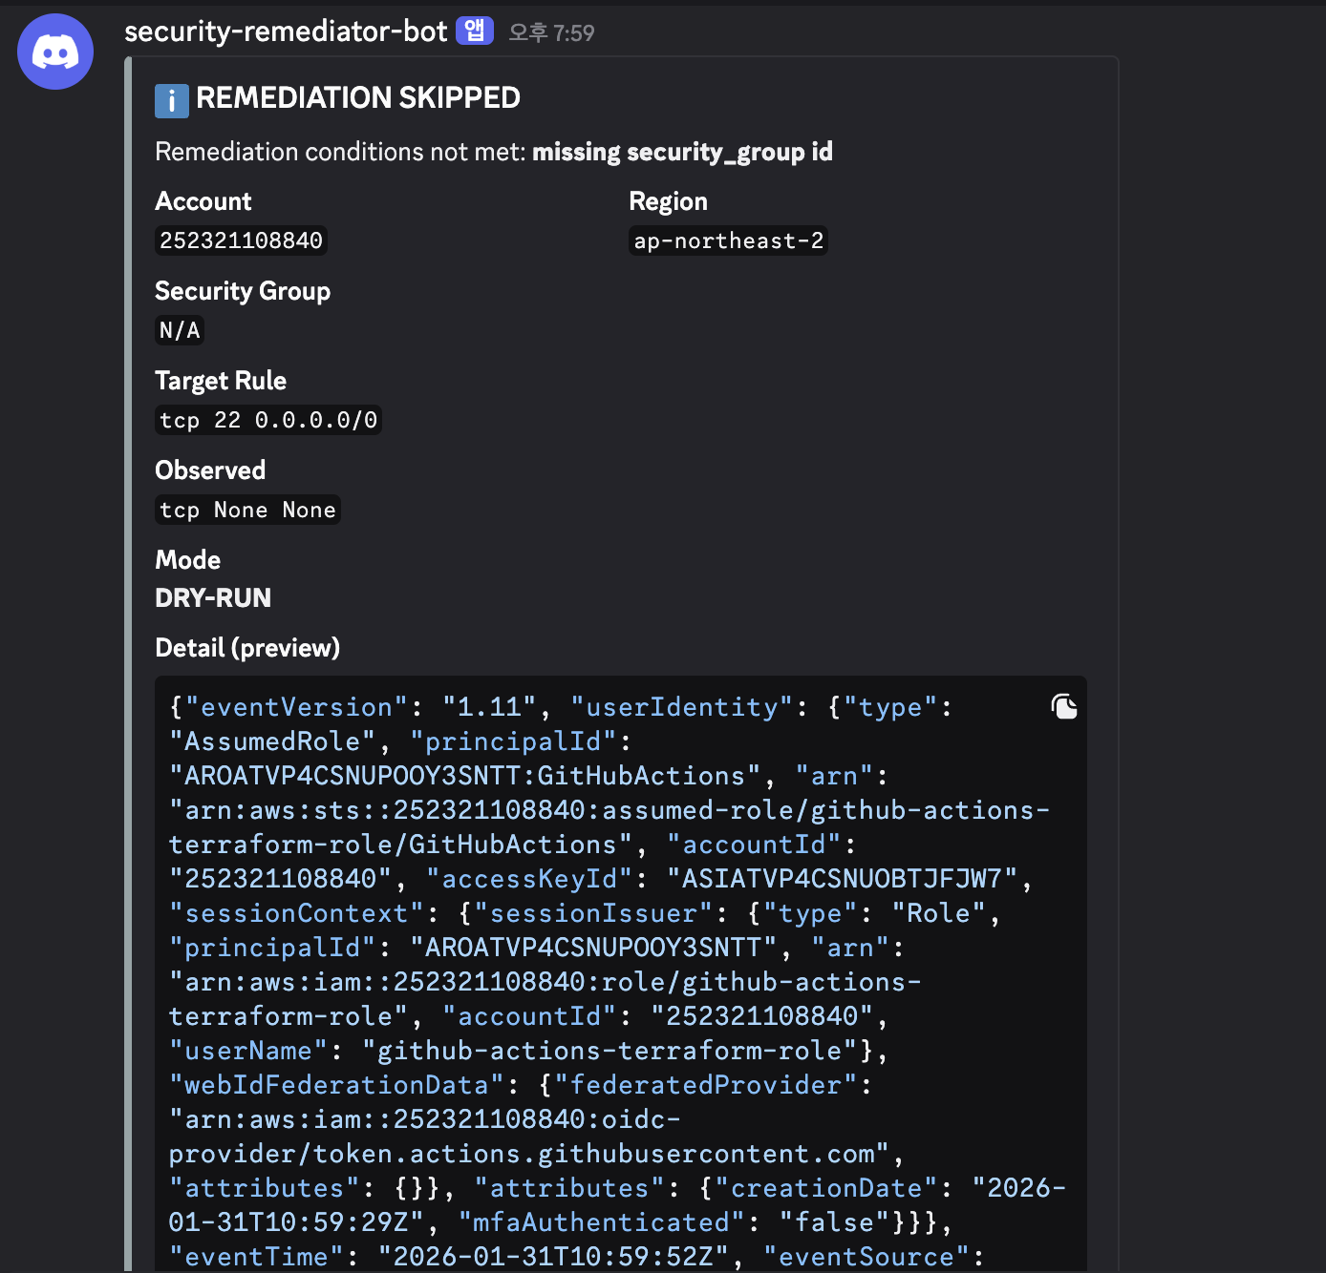
Automated Remediation (Security Group Hardening)
1. Remediation Lambda Configuration
2. Analyst-Driven Remediation Decision

