Slide 1


Progress Presentation
Intelligent assistant for hearing impairers to interact with the society

Slide 2
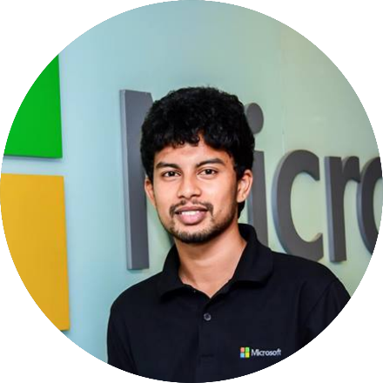
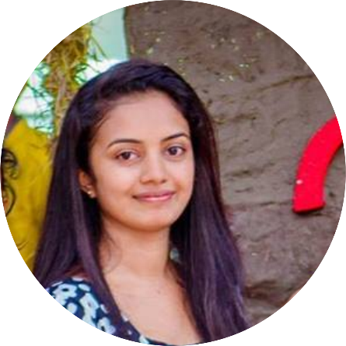
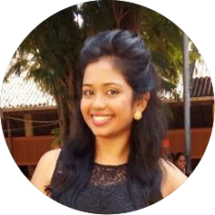
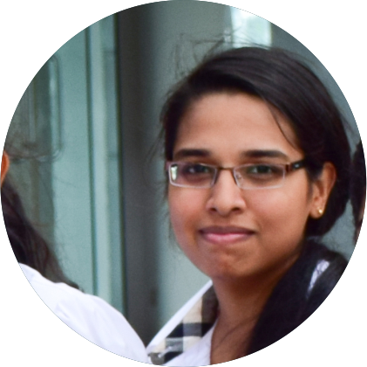
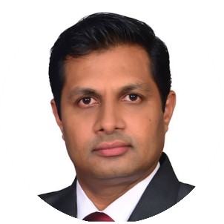
Group Details
Group No - 17-092
IT14029264
IT14114618
IT14106866
IT14076176
S.Y.M. Perera
J.P.C.N. Jayalath
W.S. Tissera
A.M.O.P. Bandara
Supervisor- Prof. Samantha Thelijjagoda

Slide 3
Ultimate Goal
3
Notes:
A Better application to make a bridge to avoid the gap between normal and hearing impairs .

Slide 4

Project Overview
……………………………………………..
2D Model Creation
……………………………..…..
Text Conversion
………………………………...
GIF Compression & Extraction
…………………………………………...
Voice Recognition Module

Slide 5



Project Overview
2D Model Creation
Task | Status
Creating 2D model
Convert created 2D model sign to Text
Offline Messaging
Creating Sticker and GIFs
Learning Signs
Task completed
Work in progress
Waiting Task

Slide 6
Project Overview
Text Conversion
Task | Status
Text to Sign Language using Semantic Analysis
Handling Sinhala & Singlish API
Interaction with Chat application “Sanwadha”
Creating Sticker and GIFs
Task completed
Work in progress
Waiting Task

Slide 7
Project Overview
GIF Compression & Extraction
Task | Status
Sign Language to GIF format conversion
Machine Learning & GZIP compression algorithm
Interaction with Messenger API
Creating Sticker and GIFs
Task completed
Work in progress
Waiting Task

Slide 8
Project Overview
Voice Recognition Module
Task | Status
Speech Recognition
Speaker Recognition
Natural Language Processing
Creating Sticker and GIFs
Task completed
Work in progress
Waiting Task

Slide 9
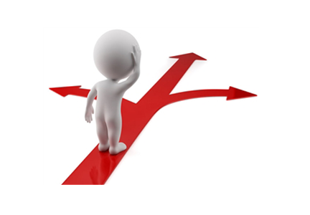
Challenges
Detecting Deaf and Regular user at the Login point.
Save and Retrieve Sinhala data in database.
Merging individual GIFs together as one.
Sinhala Text To Speech : Linguistic problem
Semantic Analysis : Sinhala
2D Model illustration

Slide 10

Business Pitch
How do we earn revenue ?
?
Government funds via special projects (MOH, Ministry of IT, ICTA).
Invest through Independent Software Vendors (ISV) in Private Companies.
Endow through Health Care exhibitions & offering trial accounts.
Digital Marketing (Facebook , Twitter, Linked In).
Give a premium model and then supply additional services.
Forming partnership with companies (Microsoft & Facebook).
Q
IT 14114618 – J.P.C.N. Jayalath

Slide 11


communication
Download
HAPPY
Thank You !!

Slide 12

Thank You !!

