Slide 1


Progress Presentation II
Intelligent Mobile Assistant for Hearing Impairers to Interact with the Society
IT 14106866 – W.Shenali Tissera

Slide 2


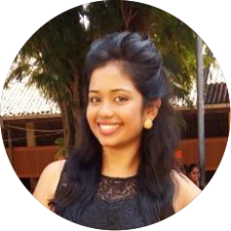

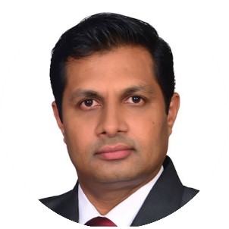
Group Details
Group No - 17-092
IT14029264
IT14114618
IT14106866
IT14076176
S.Y.M. Perera
J.P.C.N. Jayalath
W.S. Tissera
A.M.O.P. Bandara
Supervisor- Prof. Samantha Thelijjagoda
IT 14106866 – W.Shenali Tissera

Slide 3

Overview
Research Problem
Background Study
Objectives
Project Overview
Advancement in functionalities
Technologies
Business Plan
Q&A
IT 14106866 – W.Shenali Tissera

Slide 4

What will go wrong without an Interpreter?
IT 14114618 – J.P.C.N. Jayalath
IT 14106866 – W.Shenali Tissera
Notes:
When we have not an interpreter definitely we are getting trouble. Because we cant understand what our deaf friend try to say us.

Slide 5

Research Problem
Many deaf people feel awkward or become frustrated trying to communicate with ordinary people, especially when no interpreter is available. (SaraEgo1,Communication between deaf and hearing society, 2014)
There’s no way to share emotions and feelings unless they meet each other. (M. Alimohammadi and M. Zahedi, Communication between deaf and hearing children using statistical machine translation, 2015 )
Deaf community discourage to be social. (M. Alimohammadi and M. Zahedi, Communication between deaf and hearing children using statistical machine translation, 2015 )
Deaf people unable to get any support from ordinary people since there isn’t any common communication mode.
?
IT 14106866 – W.Shenali Tissera

Slide 6


Background Study
Discussions & Interviews
Prof. Samantha Thelijjagoda.
Head/Department of Information Systems Engineering(SLIIT)
Rev. Sister Nirmali
Principal - St. Joseph's School For The Deaf, Ragama
Mr. Kasun Jayathunga
Founder & CEO at “Ahanna(Listening) Foundation”
Ms. Rajitha Viduransi
Interpreter for the Deaf, “Ahanna(Listening) Foundation
?
IT 14106866 – W.Shenali Tissera

Slide 7


What we offer….
IT 14106866 – W.Shenali Tissera
Notes:
We offer “Sanwada” as a solution that problem.

Slide 8

Main Objective
To deliver excessive support by enabling hearing impaired people to communicate with others and actively interact with the society.
IT 14106866 – W.Shenali Tissera

Slide 9






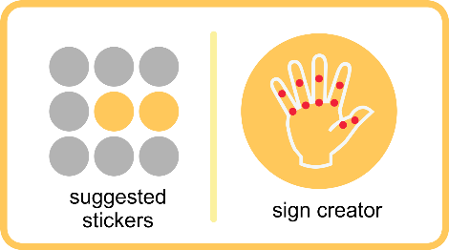
System Diagram
Chatting Procedure
gif
Sign Language
Gif Creation
D-User
User
Facebook Messenger
Text Message
Animated Stickers
2D Model
Text Message
IT 14106866 – W.Shenali Tissera

Slide 10


System Diagram
Voice procedure
Animated Stickers
2D Model
Voice output
User
D - User
Text Message
gif
Gif Creation
Voice input
Text Message
IT 14106866 – W.Shenali Tissera

Slide 11




Project Overview
2D Model Creation
Text Conversion
GIF Compression & Extraction
Voice Recognition Module
IT 14029264 – S.Y.M.Perera

Slide 12
Project Overview
2D Model Creation
Having Senses for each Finger joints with high flexibility. Hearing impaired user can bend or stretch very easily from each sense to create the user’s sign
Text Conversion
GIF
Compression & Extraction
Voice
Recognition
Module
IT 14029264 – S.Y.M.Perera

Slide 13
Project Overview
Text Conversion
Text input by the user is sent to a module which tries to recognize word by word through Semantic Analysis.
2D Model Creation
GIF Compression & Extraction
Voice
Recognition
Module
IT 14029264 – S.Y.M.Perera
13

Slide 14
Project Overview
Voice Recognition Module
Automatic Speech Recognition will recognize the words from the given speech. Spoken words are analyzed by a Spoken Language Understanding. Use of text-to-speech synthesis (TTS) module
2D Model creation
Text Conversion
GIF Compression & Extraction
IT 14029264 – S.Y.M.Perera

Slide 15
Project Overview
GIF Compression & Extraction
GIF files are send through the networks by compressing. The “GZIP Compression Algorithm” is used for the compression & output GIF is deliver under decompression
2D Model creation
Text Conversion
Voice
Recognition
Module
IT 14029264 – S.Y.M.Perera

Slide 16



Project Overview
2D Model Creation
Task completed
Work in progress
Waiting Task
Task | Status
Creating 2D model
Convert created 2D model sign to Text
Offline Messaging
Creating Sticker and GIFs
Learning Signs
IT 14076176 – A.M.O.P.Bandara

Slide 17
Project Overview
Text Conversion
Task completed
Work in progress
Waiting Task
Task | Status
Text to Sign Language using Semantic Analysis
Handling Sinhala API
Interaction with Chat application “Sanwadha”
Creating Sticker and GIFs
IT 14076176 – A.M.O.P.Bandara

Slide 18
Project Overview
GIF Compression & Extraction
Task completed
Work in progress
Waiting Task
Task | Status
Sign Language to GIF format conversion
Machine Learning & GZIP compression algorithm
Interaction with Messenger API
Creating Sticker and GIFs
IT 14076176 – A.M.O.P.Bandara

Slide 19
Project Overview
Voice Recognition Module
Task completed
Work in progress
Waiting Task
Task | Status
Speech Recognition
Speaker Recognition
Natural Language Processing
Creating Sticker and GIFs
IT 14076176 – A.M.O.P.Bandara

Slide 20








Technologies we are using….
Android Studio
Microsoft Azure
SQLite Database
MAYA Autodesk
Adobe Illustrator
Photoshop CC
CorelDraw X7
Rest API
IT 14076176 – A.M.O.P.Bandara

Slide 21

Users & Benefits
IT 14114618 – J.P.C.N. Jayalath

Slide 22

Benefits
Help hearing impaired people to communicate themselves once they are in distance.
Help to link hearing impaired people with ordinary people.
To fully integrate the Hearing impaired individuals in the society.
Avoids too much texting in chatting.
Make message sending effective.
Availability of offline messaging.
IT 14114618 – J.P.C.N. Jayalath

Slide 23

Business Pitch
How do we earn revenue ?
?
Government funds via special projects (MOH, Ministry of IT, ICTA).
Endorse through Health Care exhibitions & offering trial accounts.
- Charge for elementary application – Free
- Charge for Advanced features – Rs.2 per download
Invest through Independent Software Vendors (ISV) in Private Companies.
- “Ahanna Foundation for Deaf” purchase the application for Rs.300,000
Q
IT 14114618 – J.P.C.N. Jayalath
23

Slide 24
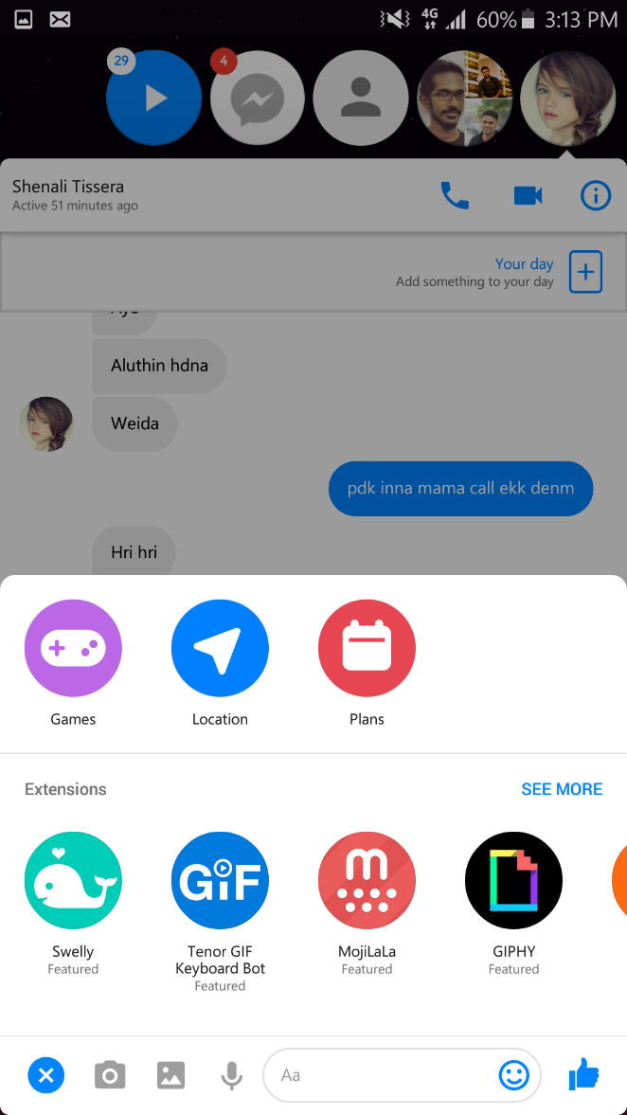


Business Pitch
Facebook Messenger
Digital Marketing
Facebook
Twitter
Linked In
- As a Plugin to the Facebook Messenger
$8.25 per download of Sanwadha Plugin
Q
IT 14114618 – J.P.C.N. Jayalath
24

Slide 25

Business Pitch
Give a premium model and then supply additional services.
Forming partnership with companies
Microsoft
Through Advertisements
Google AdSense
Basic Suite
Plus Suite
Prime Suite
?
Basic chat with Animated Stickers
Basic Suite with Learning Sign language
Plus Suite with Voice Segment
Q
IT 14114618 – J.P.C.N. Jayalath
25

Slide 26


communication
Download
HAPPY
Thank You !!

Slide 27

Thank You !!

Slide 28
Q & A

