Slide 1
計算機結構
(控制單元的設計)
陳鍾誠 於金門大學

Slide 2
第 8 章
Combinational Logic Applications
Computer Organization and Design Fundamental
書籍作者：David Tarnoff
投影片製作者：陳鍾誠

Slide 3
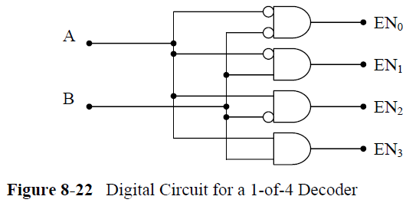
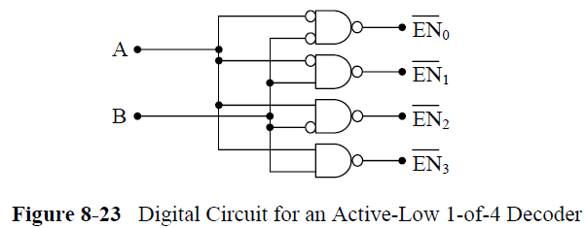
2 對 4 解碼器
Active High 版
Active Low 版

Slide 4
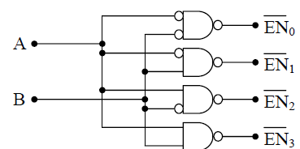
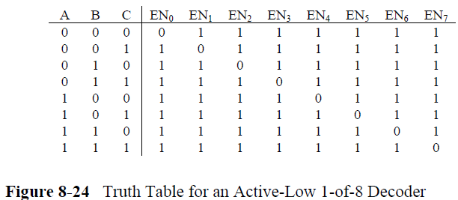
2 對 4 解碼器

Slide 5
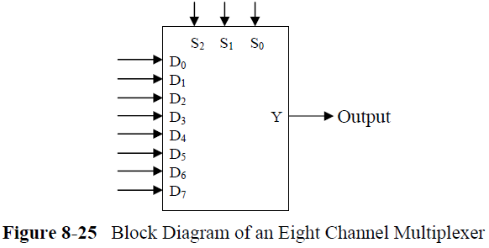
8.5 Multiplexers (多工器)

Slide 6
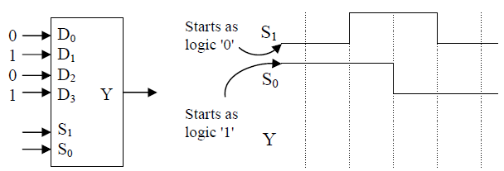
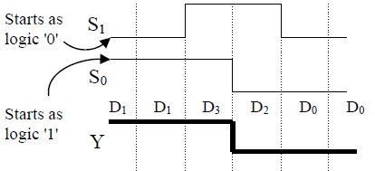
多工器 -- 計算輸出

Slide 7
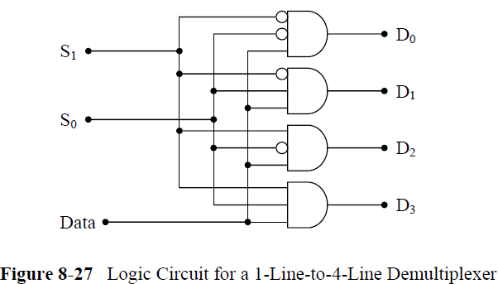
8.6 Demultiplexers (解多工器)

Slide 8
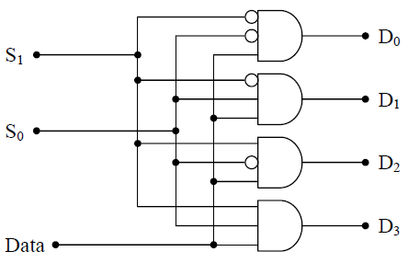
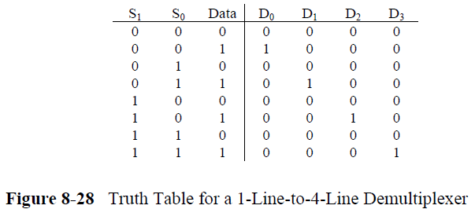
解多工器 -- 真值表

Slide 9
解碼、編碼與多工器
陳鍾誠 於金門大學

Slide 10

授權限制
本投影片部份取材自邏輯與計算機設計 之投影片
  來源：http://writphotec.com/mano4/
  使用時請遵照下列條款

Slide 11
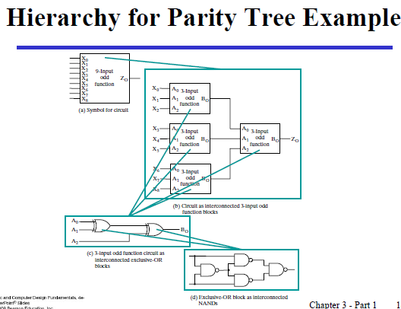
同位檢查 (Parity Check) 電路

Slide 12
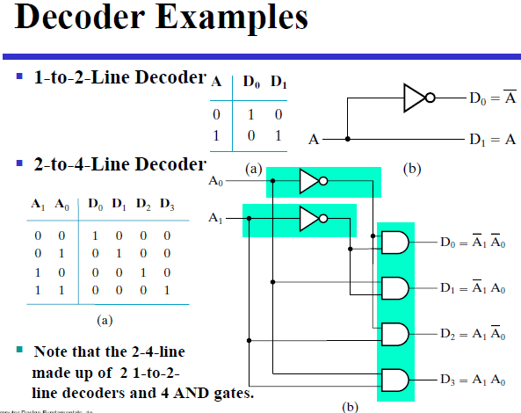
解碼器

Slide 13
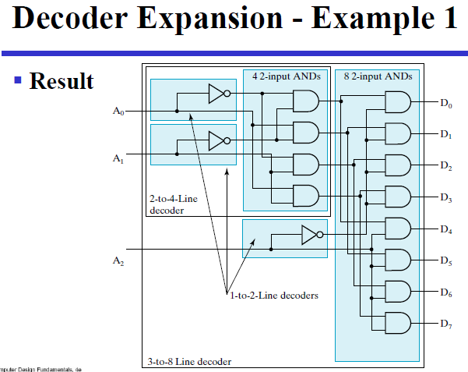
解碼器的擴展

Slide 14
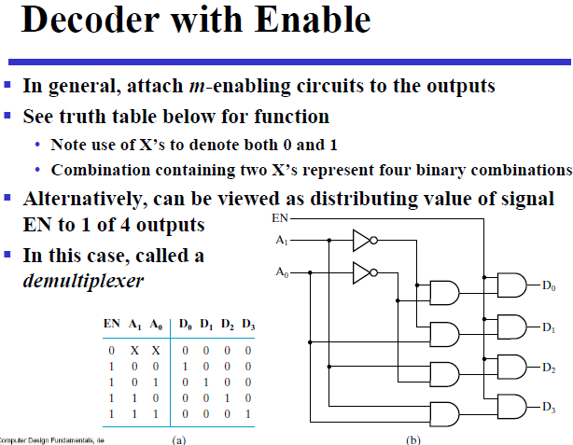
有 Enable 的解碼器

Slide 15
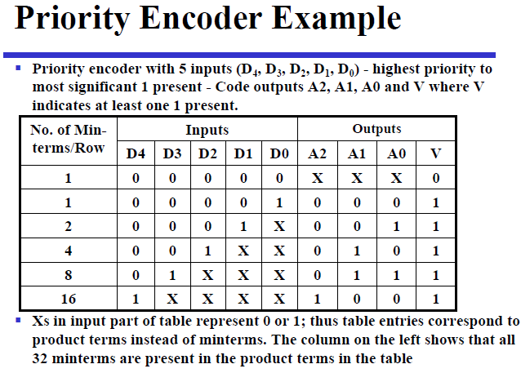

Slide 16
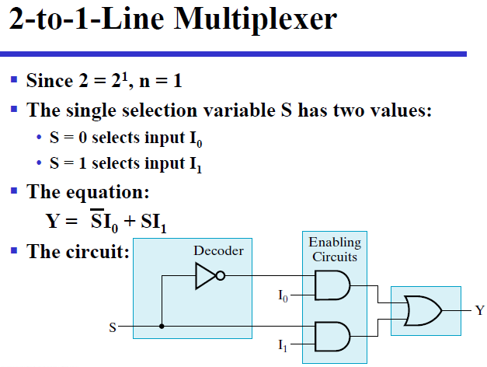
2 對 1 多工器

Slide 17
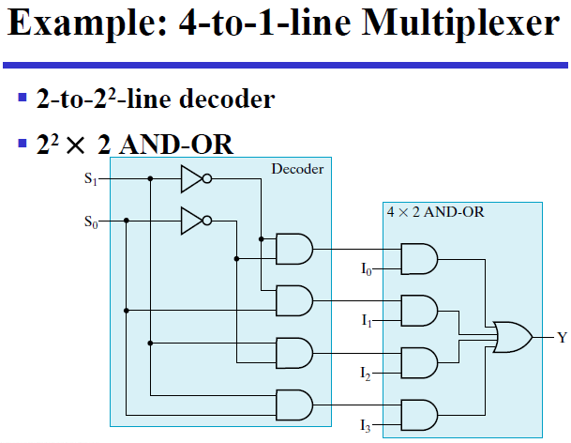
4 對 1 多工器

Slide 18
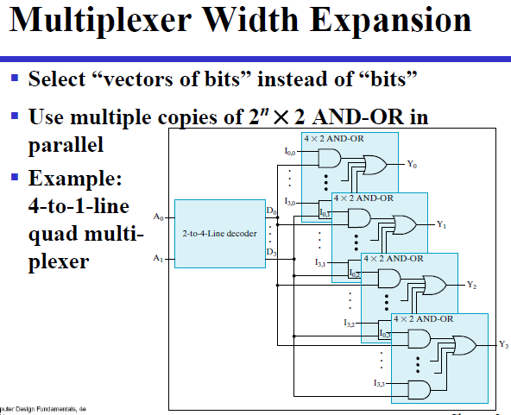
多工器的擴展

Slide 19
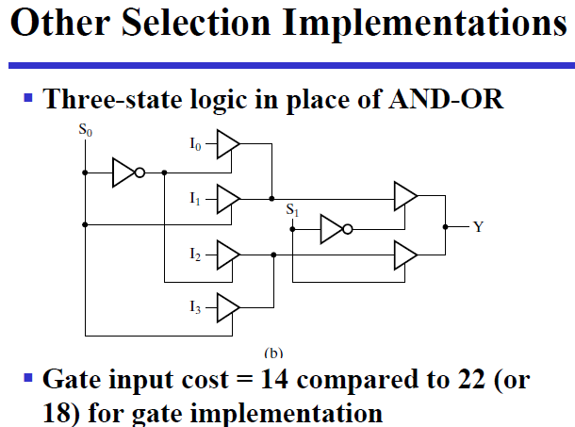
使用三態緩衝器實作

Slide 20
授權限制
本投影片部份取材自邏輯與計算機設計 之投影片
  來源：http://writphotec.com/mano4/
  使用時請遵照下列條款

Slide 21
第 11 章
State Machines (狀態機)
Computer Organization and Design Fundamental
書籍作者：David Tarnoff
投影片製作者：陳鍾誠

Slide 22
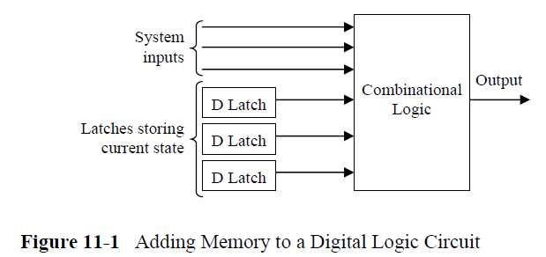
11.1 Introduction to State Machines

Slide 23
11.1.1 States

Slide 24
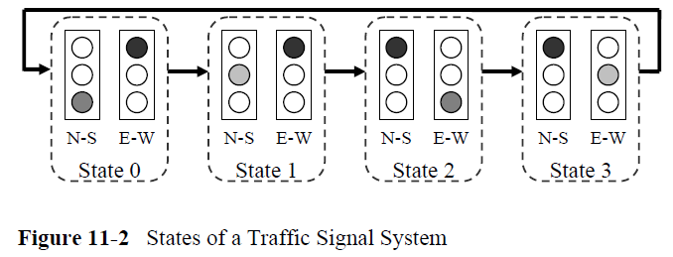
traffic signal controls
The most basic traffic signal controls an intersection with two directions, North-South and East-West for example

Slide 25
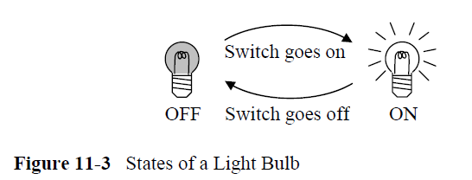
light bulb
A state machine might also be as simple as a light bulb. The light bulb can have two states: on and off. The light switch moves the condition of the bulb from one state to another

Slide 26
11.1.2 State Diagrams

Slide 27
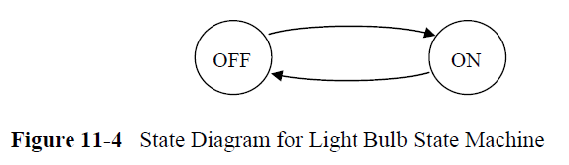
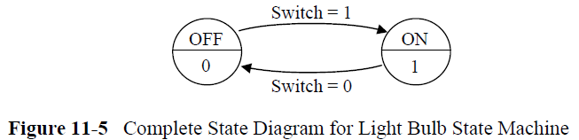
State Machine : light bulb

Slide 28
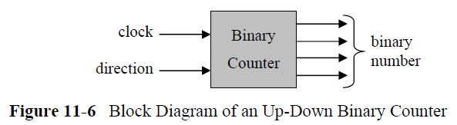
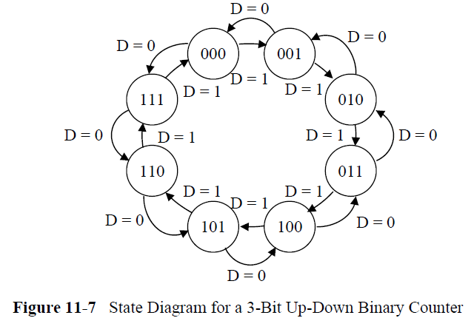
Up-Down Binary Counter

Slide 29
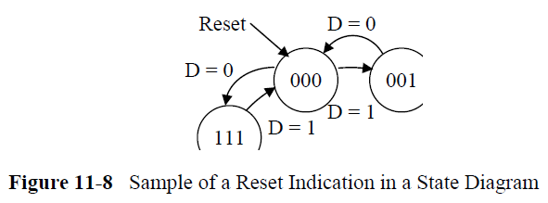
Up-Down Binary Counter
(加入 Reset)

Slide 30
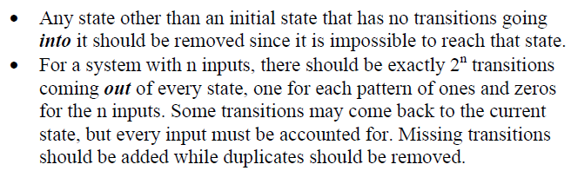
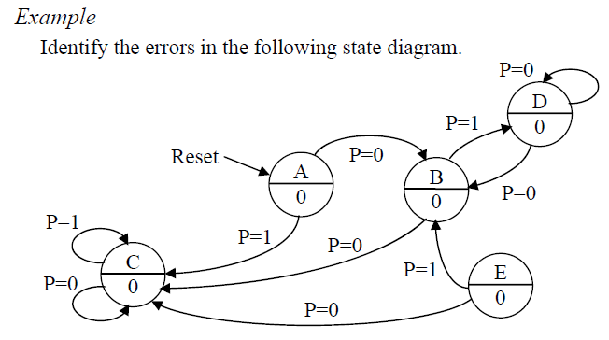
11.1.3 Errors in State Diagrams

Slide 31
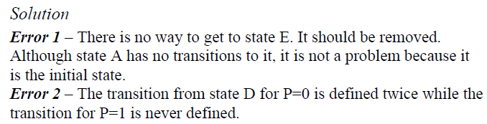
Example : State Diagrams Error

Slide 32
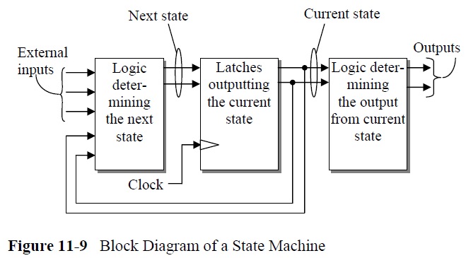
State Machines 的電路

Slide 33
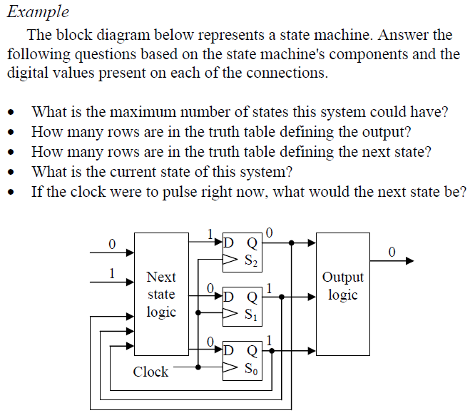
State Machines 的電路 -- 範例 1

Slide 34
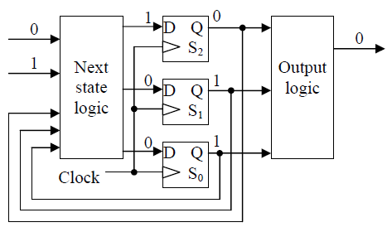
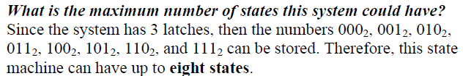
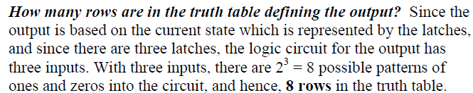
範例 1 -- 解答 (a,b)

Slide 35
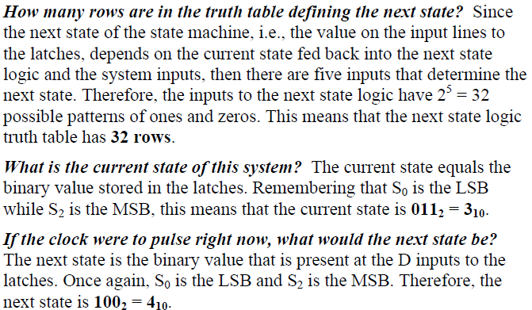
範例 1 - 解答 (c,d,e)

Slide 36
範例 1 -- 解答 (a,b)

Slide 37
11.2 State Machine Design Process

Slide 38
燈號狀態機
按钮亮燈，再按熄滅
  The example we will be using is a push button circuit used to control a light bulb. When the button is pressed, the light bulb turns on. When the button is released, it stays on. Pushing the button a second time turns off the bulb, and the bulb stays off when the button is released

Slide 39
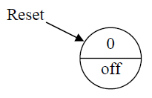
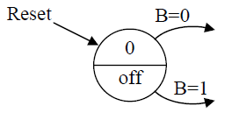
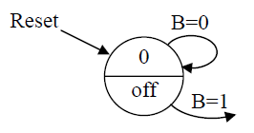
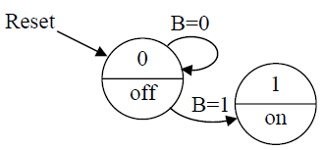
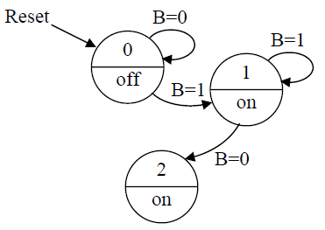
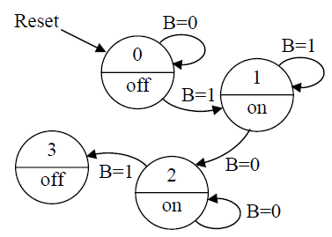
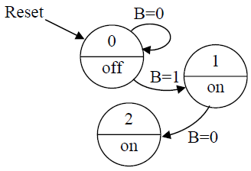
燈號狀態機 -- 設計過程
(1)
(2)
(3)
(4)
(5)
(6)
(7)

Slide 40
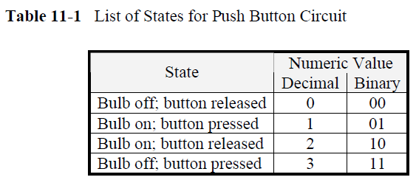
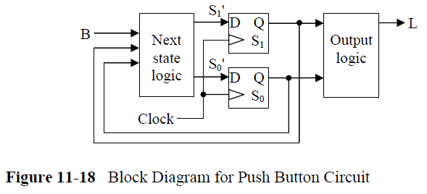
燈號狀態機 – 電路方塊圖
狀態數
電路

Slide 41
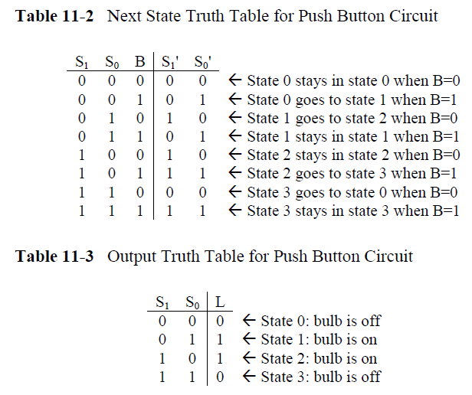
燈號狀態機 – 電路真值表

Slide 42
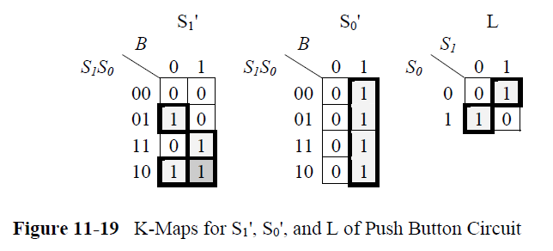
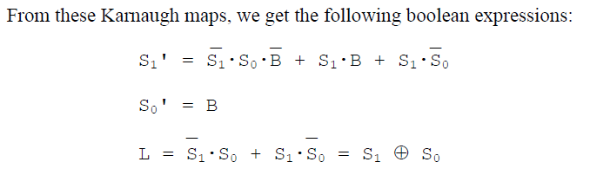
燈號狀態機 – 化簡
卡諾圖化簡
運算式

Slide 43
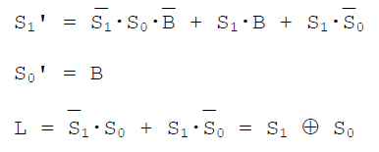
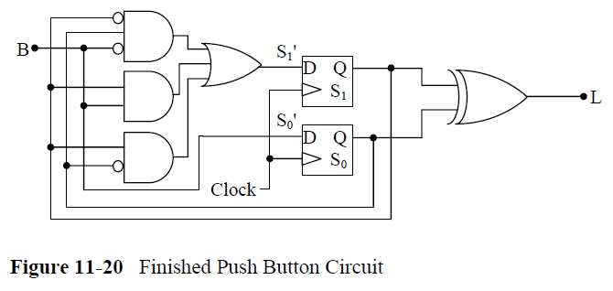
燈號狀態機 – 最終電路圖

Slide 44



燈號狀態機 – 有這麼複雜嗎？
如果將 State 2, 3 反過來

Slide 45

11.3 Another State Machine Design: Pattern Detection
偵測 101
設計想法
  The state machine used to detect the bit pattern "101" will have four states, each state representing the number of bits that we have received up to this point that match the pattern: 0, 1, 2, or 3.

Slide 46

偵測 101 – 狀態圖

Slide 47


偵測 101 – 真值表

Slide 48

偵測 101 –卡諾圖

Slide 49

偵測 101 – 最終電路

Slide 50
11.4 Mealy Versus Moore State Machines
Moore machine
  The state machine design covered in the previous sections is referred to as a Moore machine. The distinguishing characteristic of a Moore machine is that its output is determined only by the current state.
Mealy machine
  The output of the second type of state machine, the Mealy machine, is based on both the current state of the machine and the system's input.

Slide 51


Moore 與 Mealy 狀態機的不同 – 電路
Moore machine
Mealy machine

Slide 52


Moore 與 Mealy 狀態機的不同 – 狀態圖
Moore machine
Mealy machine

Slide 53


Mealy 狀態機 – 範例

Slide 54


