Slide 1
計算機結構
(記憶體的運作)
陳鍾誠 於金門大學

Slide 2
第 10 章
Memory Cells (記憶單元)
Computer Organization and Design Fundamental
書籍作者：David Tarnoff
投影片製作者：陳鍾誠

Slide 3
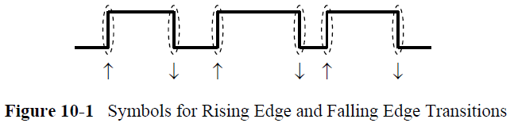
10.1 New Truth Table Symbols

Slide 4
10.1.1 Edges/Transitions

Slide 5
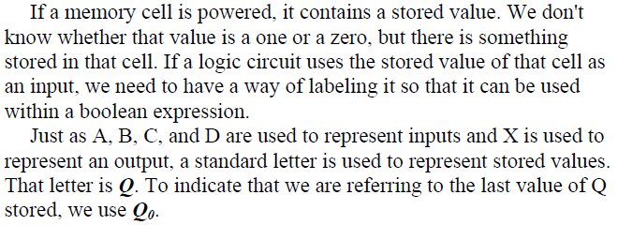
10.1.2 Previously Stored Values

Slide 6
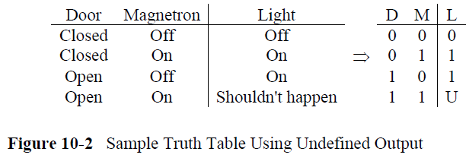
10.1.3 Undefined Values

Slide 7
10.2 The S-R Latch

Slide 8
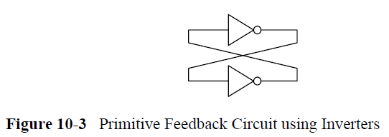
用 not 鎖住位元

Slide 9
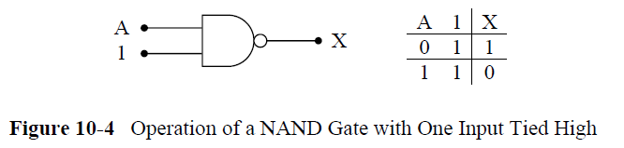
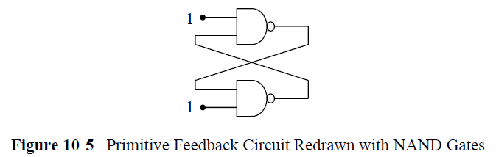
用 AND 鎖住位元

Slide 10
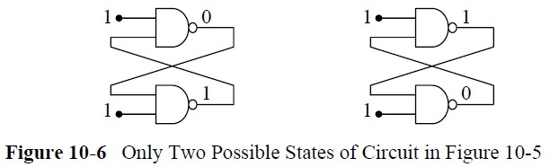

Slide 11
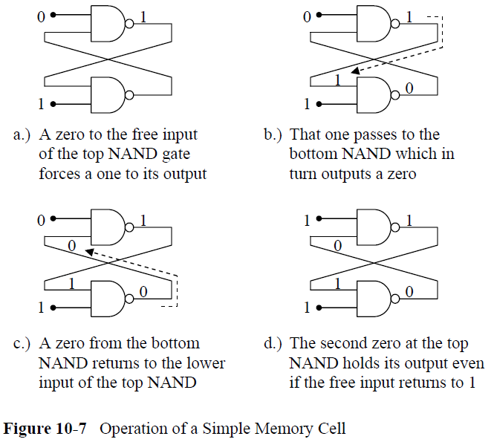
S-R Latch 的運作原理

Slide 12
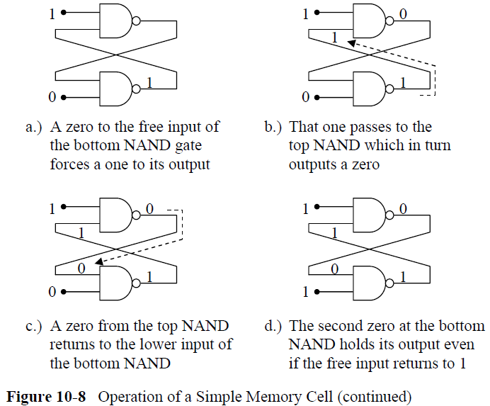
S-R Latch 的運作原理 (續)

Slide 13
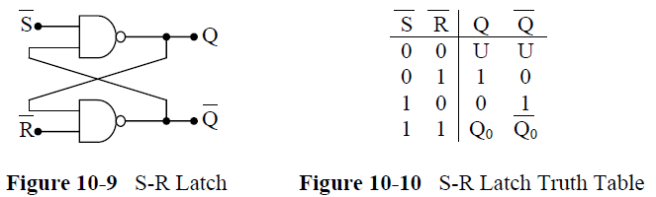
S-R Latch 的真值表

Slide 14
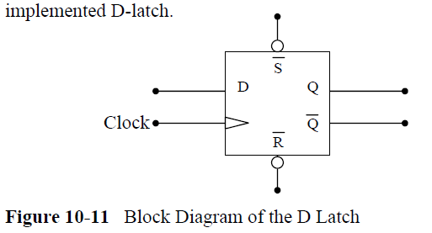
10.3 The D Latch

Slide 15
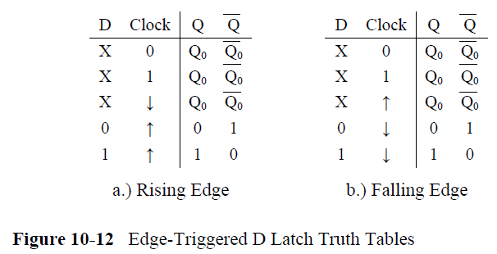
Edge-Triggered D Latch

Slide 16
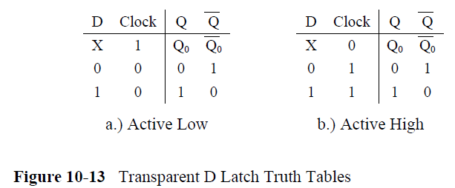
Active Low/Active High D-Lash

Slide 17
10.4 Divide-By-Two Circuit

Slide 18
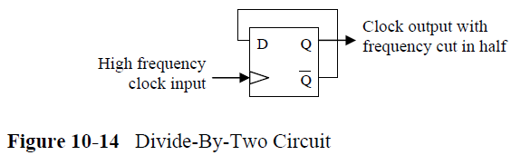
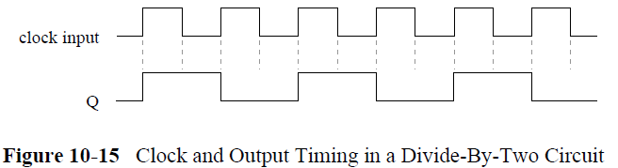
10.4 Divide-By-Two Circuit
除頻電路：http://www.csie.ntu.edu.tw/~b7506026/logic_exp/exp4.htm

Slide 19
10.5 Counter

Slide 20
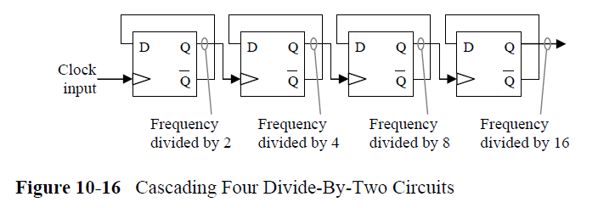
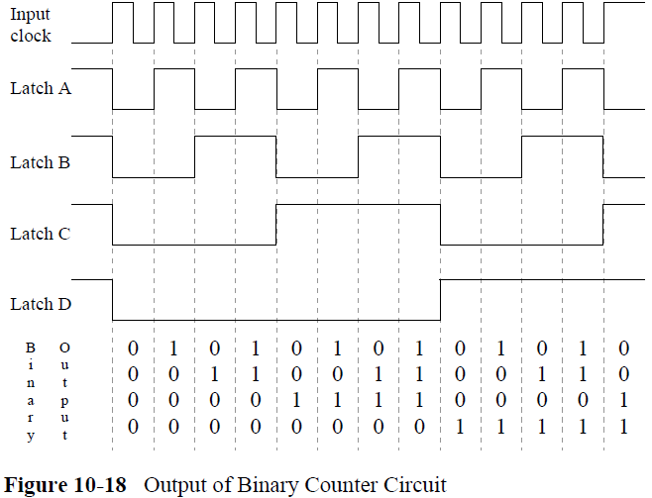

Slide 21
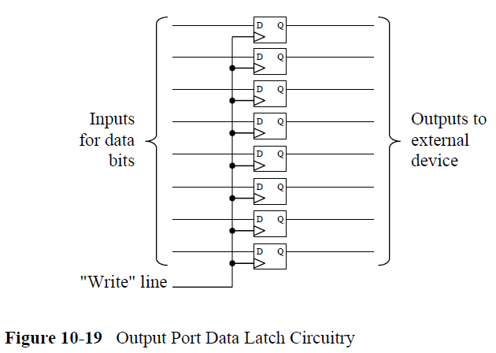
10.6 Parallel Data Output

Slide 22
第 12 章
Memory Organization (記憶體的組織)
Computer Organization and Design Fundamental
書籍作者：David Tarnoff
投影片製作者：陳鍾誠

Slide 23
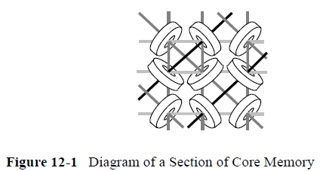
12.1 Early Memory (早期的記憶裝置)
Magnetic core memory (磁核記憶體)
  Much like recording music to a magnetic tape, when electrical current was sent through the center of one of the magnetic rings, it polarized it with a magnetic charge. Each of these rings could have a charge that flowed clockwise or counter-clockwise. One direction was considered a binary 1 while the other was considered a binary 0.
  Since the rings are enormous relative to the scale of electronics, a memory of 1024 bytes (referred to as a 1K x 8 or "1K by 8") had physical dimensions of approximately 8 inches by 8 inches.

Slide 24
12.2 Organization of Memory Device
D-Latch
  Modern memory has the same basic configuration as magnetic core memory although the rings have been replaced with electronic memory cells such as the D-Latch.
Store/Retrieve – 位址線、資料線、控制線
  To store to or retrieve data from a memory device, the processor must place a binary number called an address on special inputs to the memory device. This address identifies which row of the memory matrix or array the processor is interested in communicating with, and enables it.
  Three additional lines, chip select, read enable, and write enable, are used to control the transaction.

Slide 25
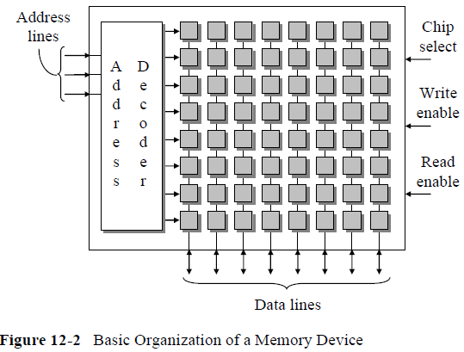
記憶裝置的結構

Slide 26
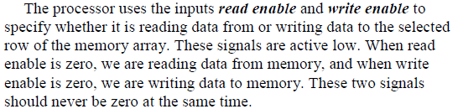

讀寫控制線
讀寫分離
讀寫合併

Slide 27

D-latch 的讀寫

Slide 28
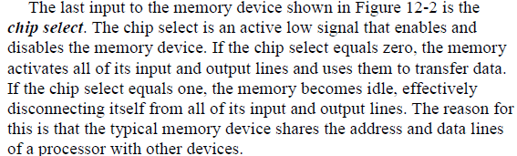
Chip Select 控制線

Slide 29
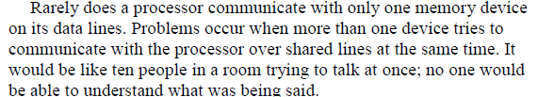
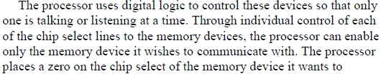
多記憶體的讀寫控制

Slide 30
12.3 Interfacing Memory to a Processor

Slide 31
12.3.1 Buses (匯流排)

Slide 32
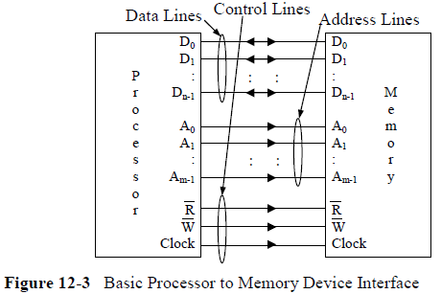
單一記憶體

Slide 33
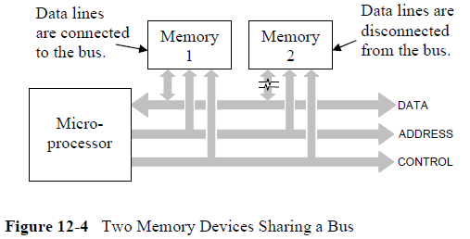
多顆記憶體共享 Bus

Slide 34
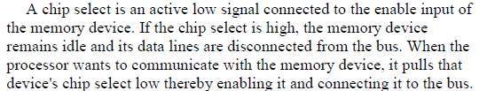

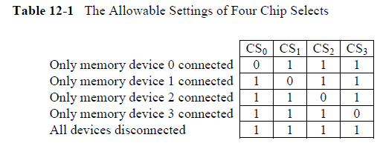
共享 Bus 的存取控制

Slide 35
Chip select 控制 – 使用三態開關
三態開關：0, 1, z
  Z 代表高阻抗
  The disconnection of the data lines is performed using tristate outputs for the data lines of the memory chips. A tristate output is digital output with a third state added to it. This output can be a logic 1, a logic 0, or a third state that acts as a high impedance or open circuit. It is like someone opened a switch and nothing is connected.
用三態開關控制記憶體讀寫
  This third state is controlled by the chip select. When the active low chip select equals 1, data lines are set to high impedance, sometimescalled the Z state. A chip select equal to 0 causes the data lines to be active and allow input or output.

Slide 36
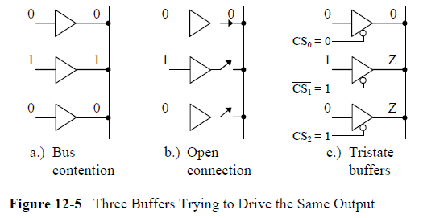
Chip select 控制 – 使用三態開關
(圖示範例)

Slide 37
12.3.2 Memory Maps
記憶体映射地圖
  Some sections of memory are assigned to a predefined purpose which may place constraints on how they are arranged.
  For example, the BIOS from which the computer performs its initial startup sequence is located at a specific address range in non-volatile memory.
  Video memory may also be located at a specific address range

Slide 38
為何要有記憶体映射地圖？
System designers must have a method to describe the arrangement of memory in a system.
Since multiple memory devices and different types of memory may be present in a single system,
  hardware designers need to be able to show what addresses correspond to which memory devices.
  Software designers also need to have a way to show how the memory is being used.
  For example, which parts of memory will be used for the operating system, which parts will be used to store a program, or which parts will be used to store the data for a program.

Slide 39
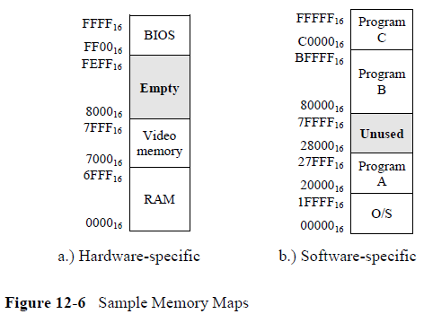
記憶体映射地圖的範例

Slide 40
12.3.3 Address Decoding
Address decoding is a method for using an address to enable a unique memory device while leaving all other devices idle
All address decoding schemes have one thing in common: the bits of the full address are divided into two groups, one group that is used to identify the memory device and one group that identifies the memory location within the selected memory device
In order to determine how to divide the full address into these two groups of bits, we need to know how large the memory device is and how large the memory space is.
Once we know the size of the memory device, then we know the
number of bits that will be required from the full address to point to a memory location within the memory device.

Slide 41
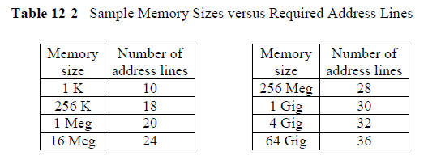
位址線與定址空間

Slide 42
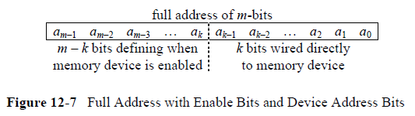
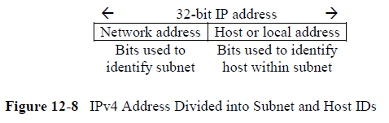
記憶空間分割與定址
辦法與 IP 遮罩類似

Slide 43

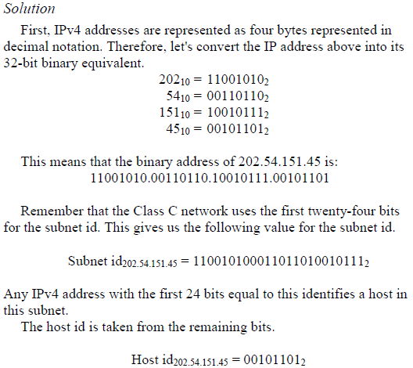
IP 遮罩

Slide 44
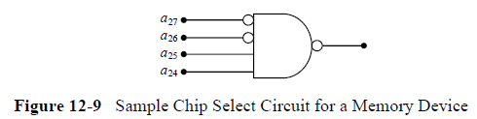
12.3.4 Chip Select Hardware

Slide 45
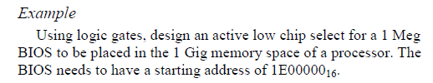


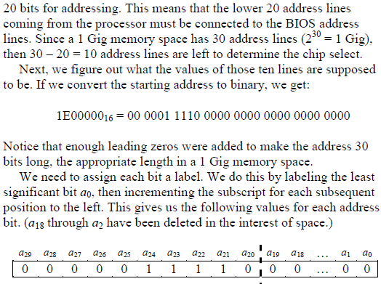
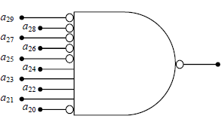

Slide 46

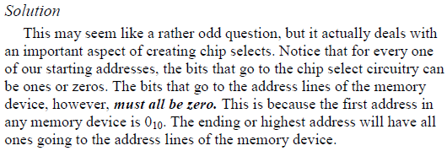
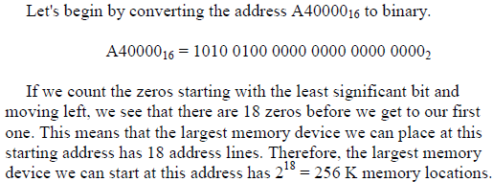

Slide 47
12.4 Memory Mapped Input/Output

Slide 48
12.5 Memory Terminology

Slide 49
12.5.1 Random Access Memory

Slide 50
12.5.2 Read Only Memory

Slide 51
12.5.3 Static RAM versus Dynamic RAM

Slide 52
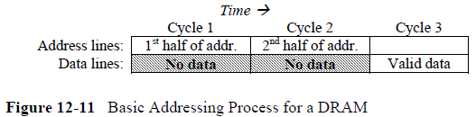
12.5.4 Types of DRAM and Their Timing

Slide 53
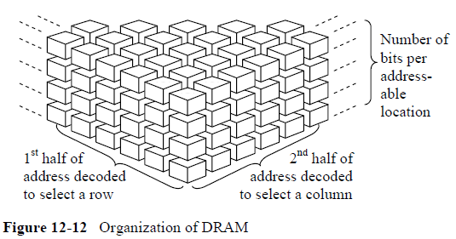

Slide 54
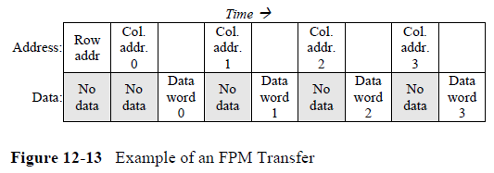
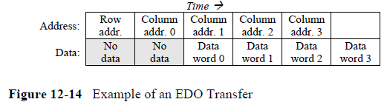

Slide 55
12.5.5 Asynchronous versus Synchronous
Memory Interfacing

