Slide 1
計算機結構
(輸出入 I/O 界面)
陳鍾誠 於金門大學

Slide 2
第 8 章
Combinational Logic Applications
Computer Organization and Design Fundamental
書籍作者：David Tarnoff
投影片製作者：陳鍾誠

Slide 3
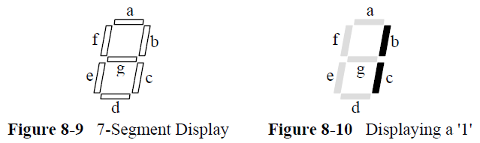
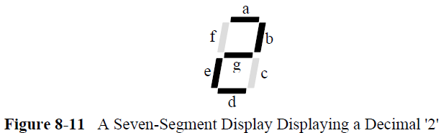
8.2 Seven-Segment Displays
(七段顯示器 )

Slide 4
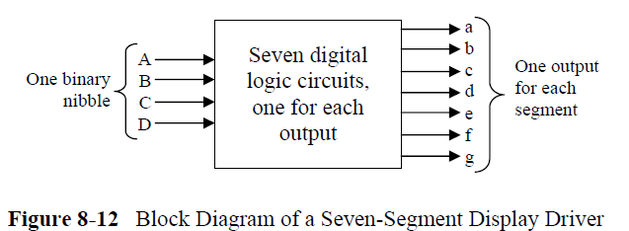
七段顯示器 – 方塊圖

Slide 5
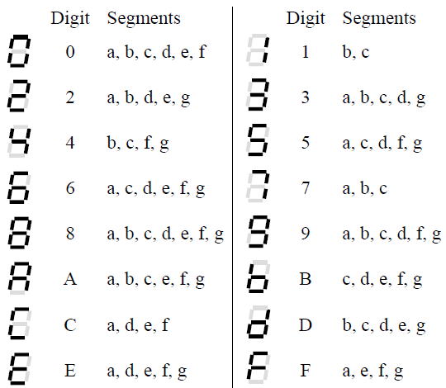
七段顯示器 – 輸出入分析

Slide 6
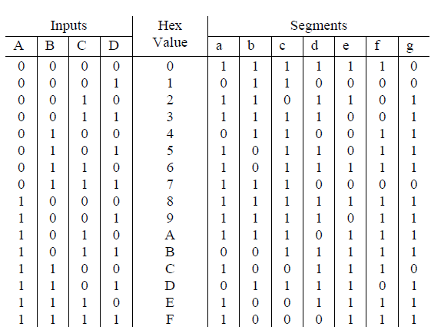
七段顯示器 – 真值表

Slide 7
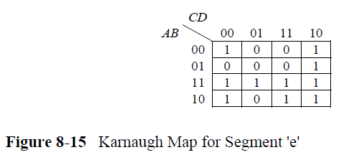
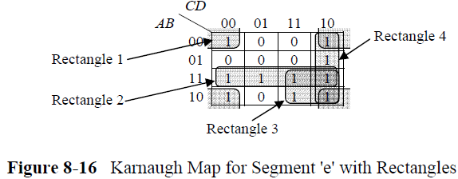
七段顯示器 -- E 字母的卡諾圖

Slide 8
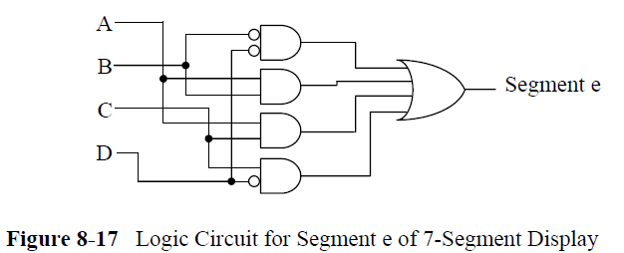
七段顯示器 -- E 字母的電路圖

Slide 9
第 8 章
Combinational Logic Applications
Computer Organization and Design Fundamental
書籍作者：David Tarnoff
投影片製作者：陳鍾誠

Slide 10
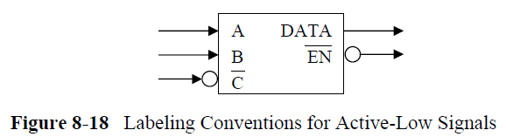
8.3 Active-Low Signals
Our discussion previous to this suggests that the "on" signal is equivalent to a logic 1, but for a number of reasons, the standard method of enabling a device is not to send a logic 1. Instead, due to the nature of electronics, it is standard practice to enable devices with a logic 0 and disable them with a logic 1. This is called active-low operation, i.e., the device is active when its enable signal is low or logic 0. The device is inactive when the enable is high or logic 1.

Slide 11
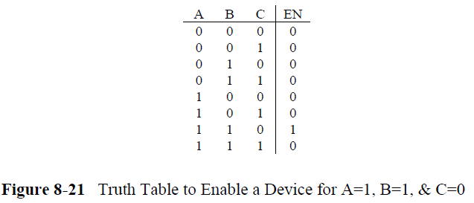
8.4 Decoders
在某個條件下啟動 (致能=Enable)

Slide 12
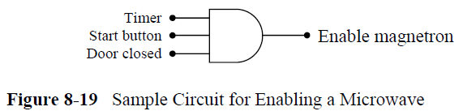
微波爐啟動控制

Slide 13
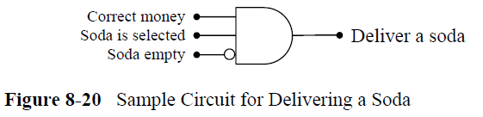
蘇打水遞送

