Slide 1
計算機結構
(記憶體管理單元 -- MMU)
陳鍾誠 於金門大學

Slide 2
第 12 章
Memory Organization (記憶體的組織)
Computer Organization and Design Fundamental
書籍作者：David Tarnoff
投影片製作者：陳鍾誠

Slide 3
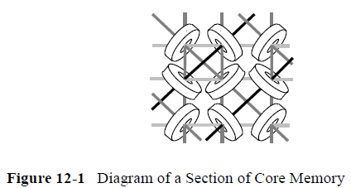
12.1 Early Memory (早期的記憶裝置)
Magnetic core memory (磁核記憶體)
  Much like recording music to a magnetic tape, when electrical current was sent through the center of one of the magnetic rings, it polarized it with a magnetic charge. Each of these rings could have a charge that flowed clockwise or counter-clockwise. One direction was considered a binary 1 while the other was considered a binary 0.
  Since the rings are enormous relative to the scale of electronics, a memory of 1024 bytes (referred to as a 1K x 8 or "1K by 8") had physical dimensions of approximately 8 inches by 8 inches.

Slide 4
12.2 Organization of Memory Device
D-Latch
  Modern memory has the same basic configuration as magnetic core memory although the rings have been replaced with electronic memory cells such as the D-Latch.
Store/Retrieve – 位址線、資料線、控制線
  To store to or retrieve data from a memory device, the processor must place a binary number called an address on special inputs to the memory device. This address identifies which row of the memory matrix or array the processor is interested in communicating with, and enables it.
  Three additional lines, chip select, read enable, and write enable, are used to control the transaction.

Slide 5
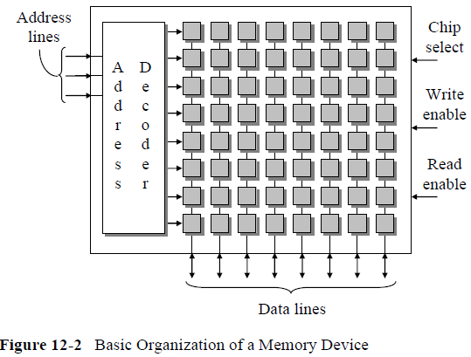
記憶裝置的結構

Slide 6
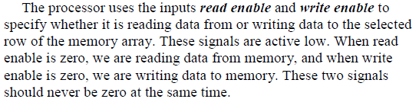

讀寫控制線
讀寫分離
讀寫合併

Slide 7

D-latch 的讀寫

Slide 8
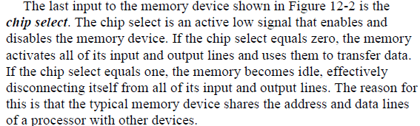
Chip Select 控制線

Slide 9
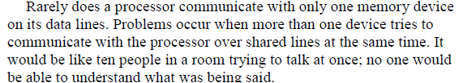
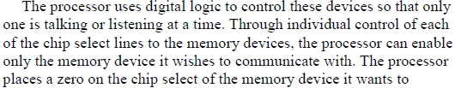
多記憶體的讀寫控制

Slide 10
12.3 Interfacing Memory to a Processor

Slide 11
12.3.1 Buses (匯流排)

Slide 12
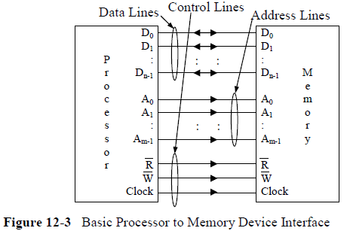
單一記憶體

Slide 13
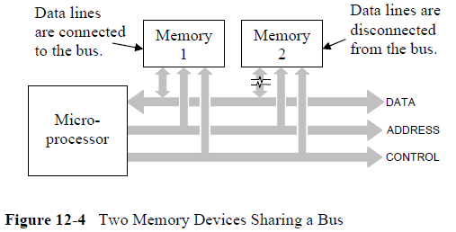
多顆記憶體共享 Bus

Slide 14
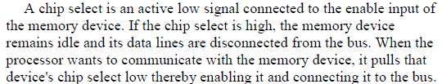

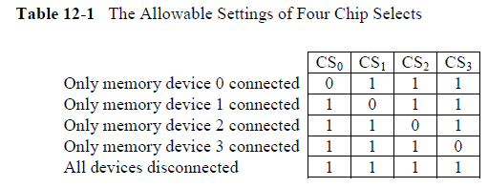
共享 Bus 的存取控制

Slide 15
Chip select 控制 – 使用三態開關
三態開關：0, 1, z
  Z 代表高阻抗
  The disconnection of the data lines is performed using tristate outputs for the data lines of the memory chips. A tristate output is digital output with a third state added to it. This output can be a logic 1, a logic 0, or a third state that acts as a high impedance or open circuit. It is like someone opened a switch and nothing is connected.
用三態開關控制記憶體讀寫
  This third state is controlled by the chip select. When the active low chip select equals 1, data lines are set to high impedance, sometimescalled the Z state. A chip select equal to 0 causes the data lines to be active and allow input or output.

Slide 16
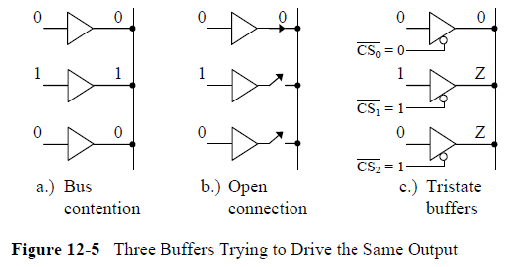
Chip select 控制 – 使用三態開關
(圖示範例)

Slide 17
12.3.2 Memory Maps
記憶体映射地圖
  Some sections of memory are assigned to a predefined purpose which may place constraints on how they are arranged.
  For example, the BIOS from which the computer performs its initial startup sequence is located at a specific address range in non-volatile memory.
  Video memory may also be located at a specific address range

Slide 18
為何要有記憶体映射地圖？
System designers must have a method to describe the arrangement of memory in a system.
Since multiple memory devices and different types of memory may be present in a single system,
  hardware designers need to be able to show what addresses correspond to which memory devices.
  Software designers also need to have a way to show how the memory is being used.
  For example, which parts of memory will be used for the operating system, which parts will be used to store a program, or which parts will be used to store the data for a program.

Slide 19
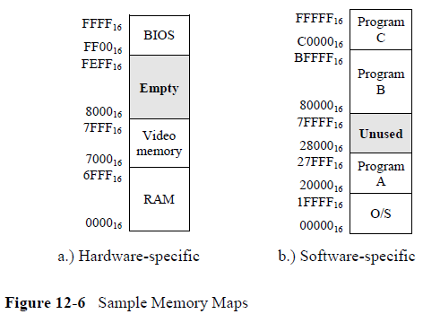
記憶体映射地圖的範例

Slide 20
12.3.3 Address Decoding
Address decoding is a method for using an address to enable a unique memory device while leaving all other devices idle
All address decoding schemes have one thing in common: the bits of the full address are divided into two groups, one group that is used to identify the memory device and one group that identifies the memory location within the selected memory device
In order to determine how to divide the full address into these two groups of bits, we need to know how large the memory device is and how large the memory space is.
Once we know the size of the memory device, then we know the
number of bits that will be required from the full address to point to a memory location within the memory device.

Slide 21
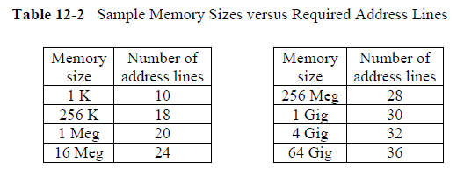
位址線與定址空間

Slide 22
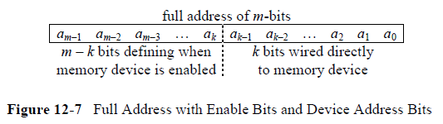
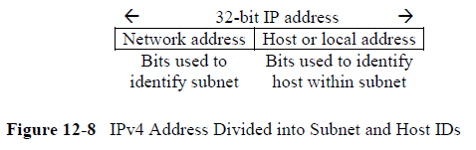
記憶空間分割與定址
辦法與 IP 遮罩類似

Slide 23

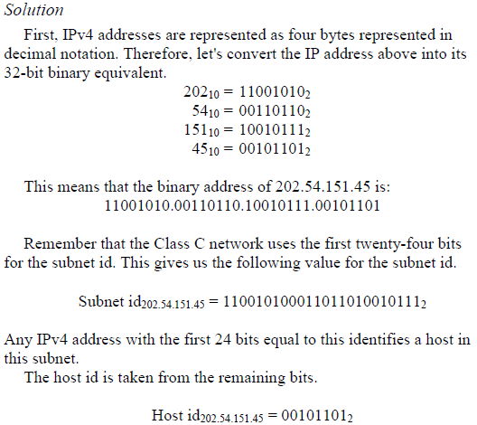
IP 遮罩

Slide 24
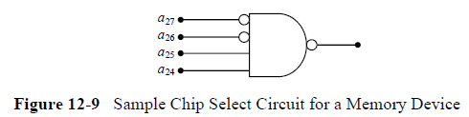
12.3.4 Chip Select Hardware

Slide 25
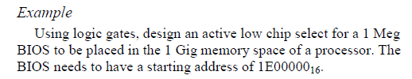


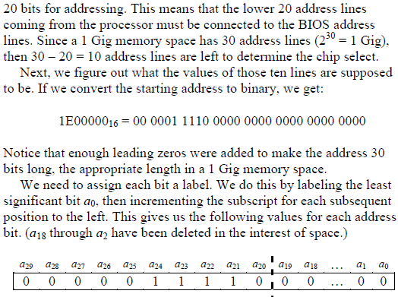
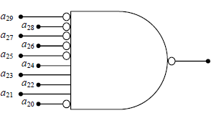

Slide 26

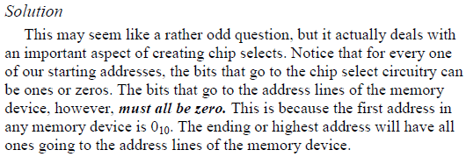
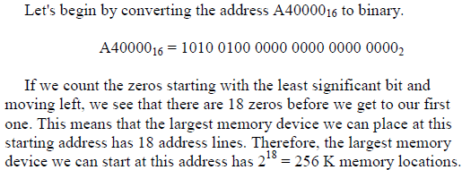

Slide 27
12.4 Memory Mapped Input/Output

Slide 28
12.5 Memory Terminology

Slide 29
12.5.1 Random Access Memory

Slide 30
12.5.2 Read Only Memory

Slide 31
12.5.3 Static RAM versus Dynamic RAM

Slide 32
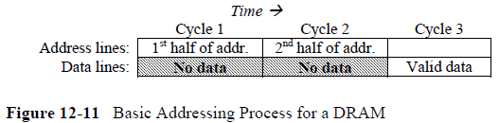
12.5.4 Types of DRAM and Their Timing

Slide 33
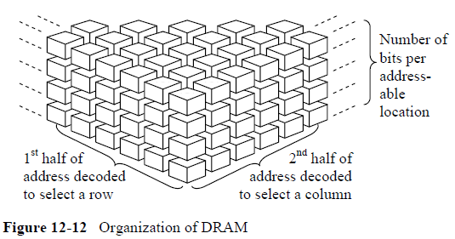

Slide 34
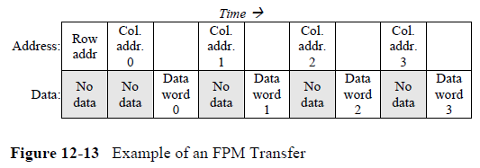
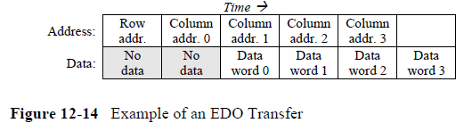

Slide 35
12.5.5 Asynchronous versus Synchronous
Memory Interfacing

Slide 36
第 13 章
Memory Hierarchy(記憶階層)
Computer Organization and Design Fundamental
書籍作者：David Tarnoff
投影片製作者：陳鍾誠

Slide 37
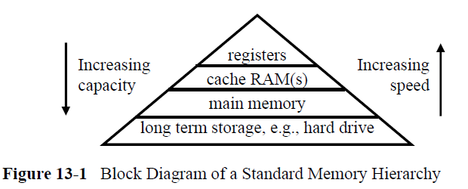
13.1 Characteristics of the Memory Hierarchy

Slide 38
13.2 Physical Characteristics of a Hard Drive

Slide 39
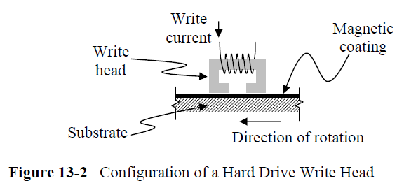
13.2.1 Hard Drive Read/Write Head
This magnetic material is spread either on one or both sides of a lightweight, rigid disk called a substrate. The substrate needs to be lightweight because it is meant to spin at very high speeds. The combination of magnetic material and substrate is called a platter
Substrates used to be made from aluminum. Unfortunately, extreme heat sometimes warped the aluminum disk. Now glass is used as a substrate.

Slide 40
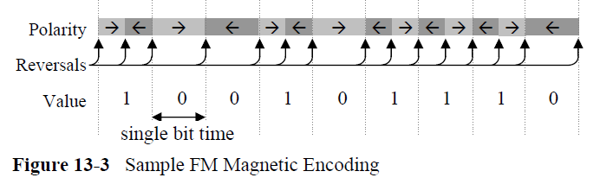
13.2.2 Data Encoding

Slide 41
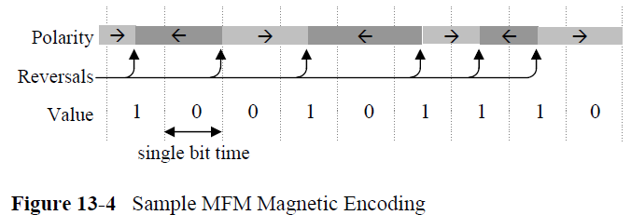
MFM 編碼法
Modified Frequency Modulation (MFM) does this by changing the way in which the magnetic polarization represents a one or a zero. MFM defines a change in polarization in the middle of a bit time as a one and no change in the middle as a zero.
http://en.wikipedia.org/wiki/Modified_Frequency_Modulation

Slide 42
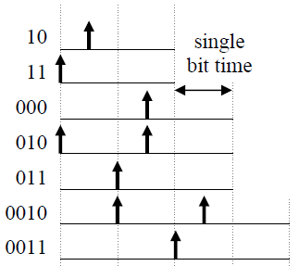
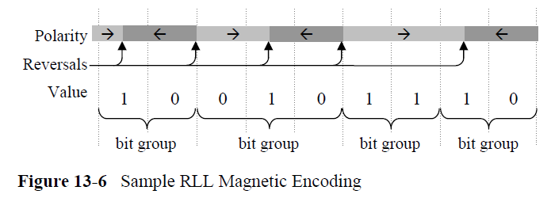
Run Length Limited (RLL)
Run Length Limited (RLL) encoding uses polarity changes to define sequences of bits rather than single bits. By equating different patterns of polarity changes to different sequences of ones and zeros, the density of bits stored to a platter can be further increased. There is a science behind generating these sequences and their corresponding polarity changes. It is based on satisfying the following requirements:

Slide 43

13.2.3 Hard Drive Access Time
We can use the following calculation to determine the time required for a platter in a 7200 RPM drive to make a full rotation

Slide 44
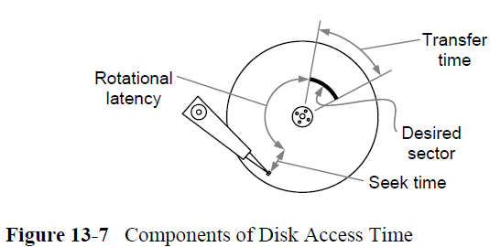
Figure 13-7 Components of Disk Access Time

Slide 45
13.2.4 Self-Monitoring, Analysis & Reporting Technology System

Slide 46
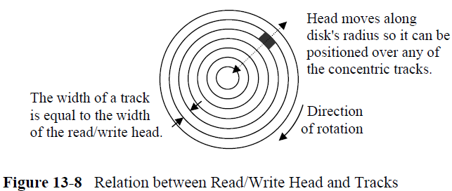
13.3 Organization of Data on a Hard Drive

Slide 47
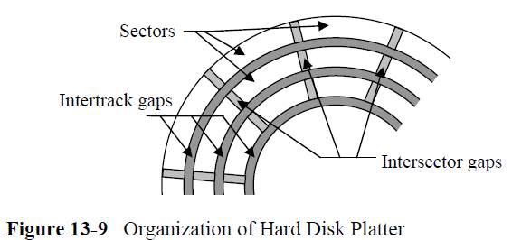

Slide 48
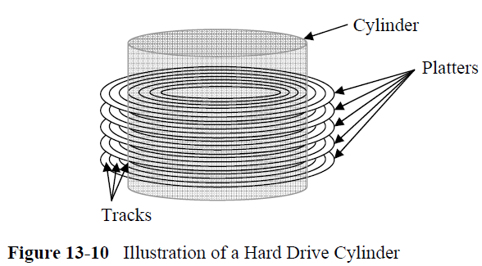

Slide 49
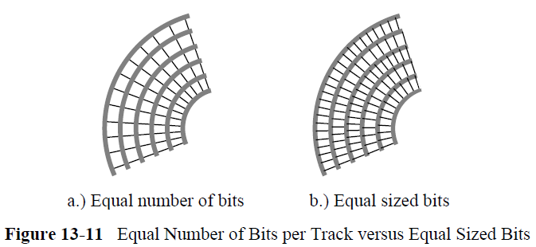

Slide 50
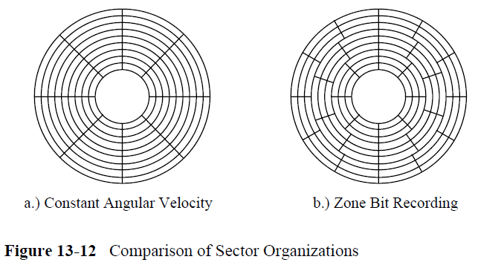

Slide 51
13.4 Cache RAM

Slide 52
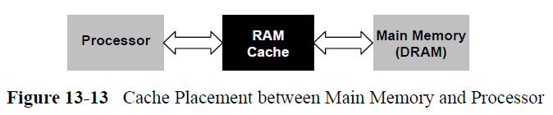
Cache Placement between Main Memory and Processor

Slide 53
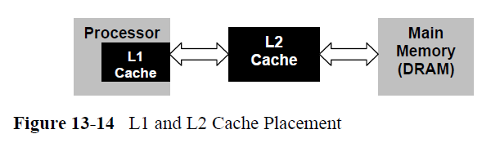
L1 and L2 Cache Placement

Slide 54
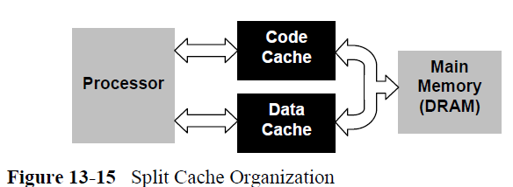
Split Cache Organization

Slide 55
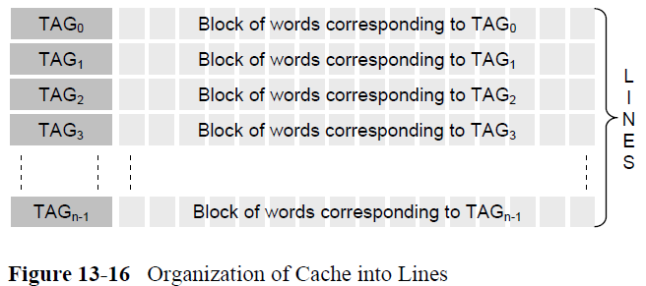
Organization of Cache into Lines

Slide 56
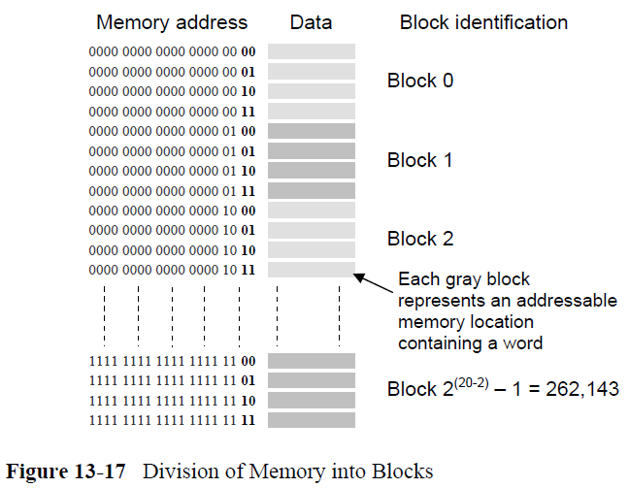
Division of Memory into Blocks

Slide 57
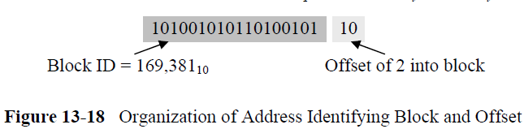
Organization of Address Identifying Block and Offset

Slide 58
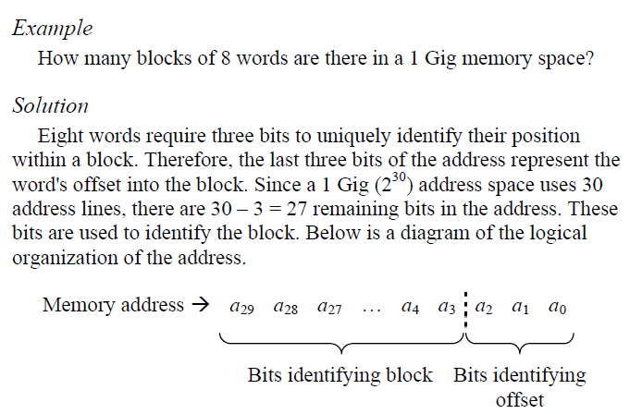

Slide 59
13.4.3 Cache Operation
When the processor needs a word from memory, it first checks the cache. The circuits used to access the same word from main memory may be activated simultaneously so no time is lost in case the data is not available in the cache, a condition known as a miss. If the search of the cache is successful, then the processor will use the cache's word and disregard the results from main memory. This is referred to as a hit.

Slide 60
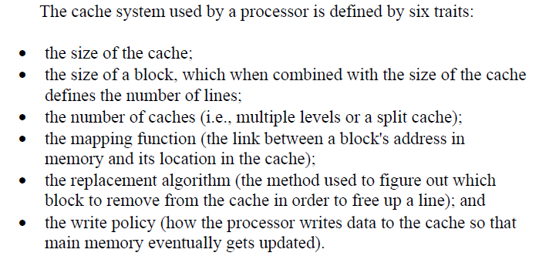
13.4.4 Cache Characteristics

Slide 61
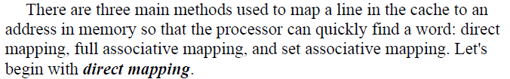
13.4.5 Cache Mapping Functions

Slide 62
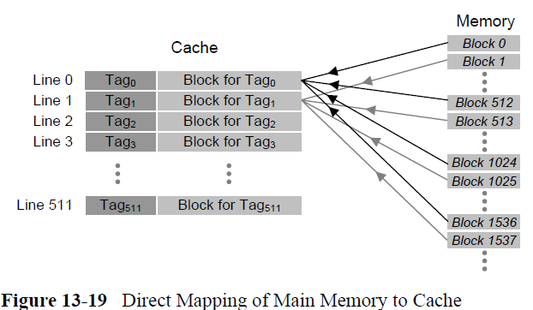
Direct Mapping

Slide 63
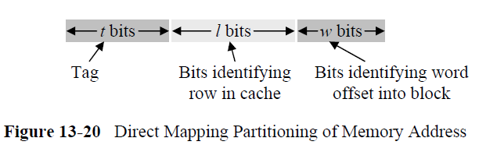
Direct Mapping Partitioning of Memory Address

Slide 64
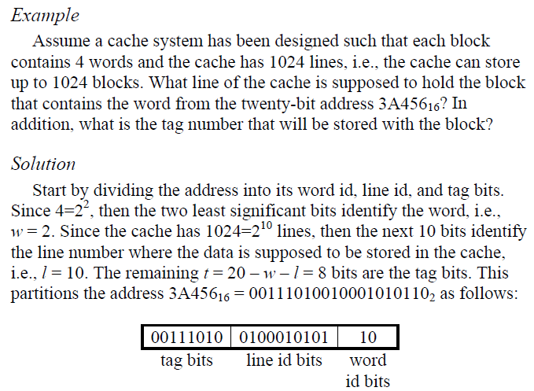


Slide 65

Fully associative mapping

Slide 66

replacement algorithms

Slide 67


Slide 68

set associative mapping

Slide 69


Slide 70



Slide 71


Slide 72
13.4.6 Cache Write Policy

Slide 73
13.5 Registers

