Slide 1
計算機結構
(記憶單元)
陳鍾誠 於金門大學

Slide 2
狹義的Memory
RAM
  SRAM
  DRAM
  Flash
ROM
  EEPROM
  EPROM

Slide 3
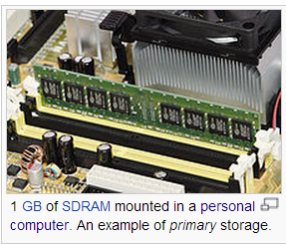
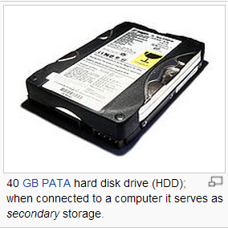
廣義的Memory
ROM
  BIOS ….
SRAM
  Level 1 Cache ...
  Level 2 Cache ...
DRAM
  Main Memory
Disk
  Virtual Memory
http://en.wikipedia.org/wiki/Computer_data_storage

Slide 4
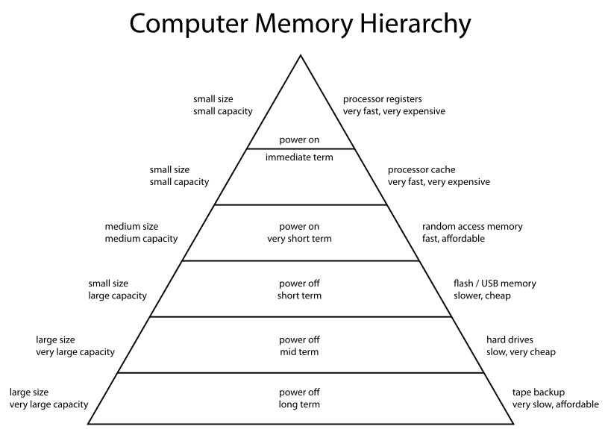
http://en.wikipedia.org/wiki/Memory_hierarchy

Slide 5
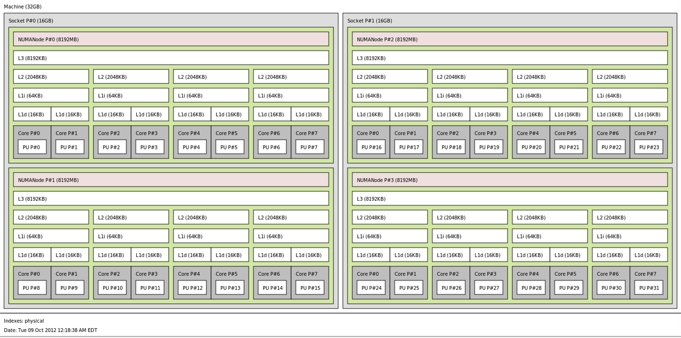
Memory hierarchy of an AMD Bulldozer server.
http://upload.wikimedia.org/wikipedia/commons/9/95/Hwloc.png

Slide 6
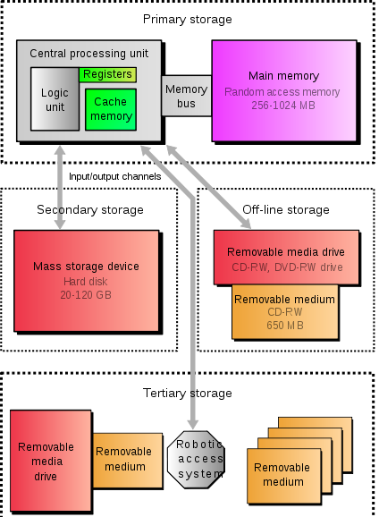
記憶體階層
http://en.wikipedia.org/wiki/Computer_data_storage

Slide 7
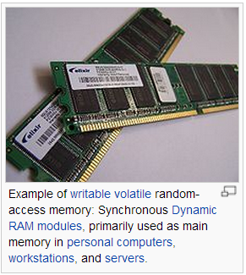
RAM

Slide 8
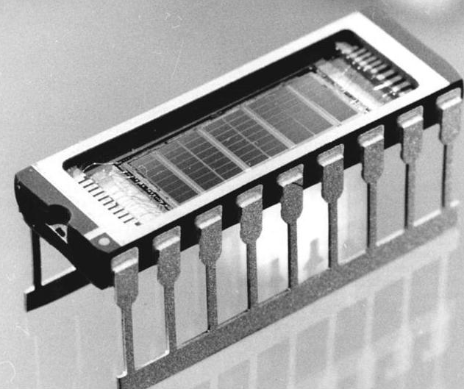
RAM 的內部結構

Slide 9
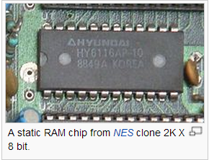
SRAM
http://en.wikipedia.org/wiki/Static_random-access_memory

Slide 10
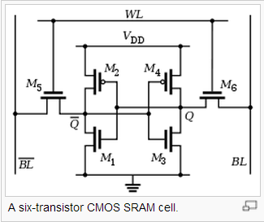
SRAM Cell (6 個電晶體)

Slide 11
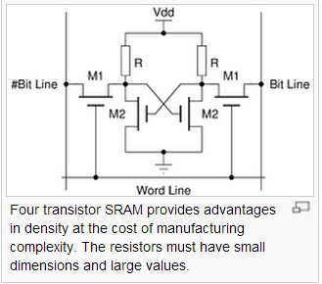
SRAM Cell (4個電晶體+2電阻)

Slide 12
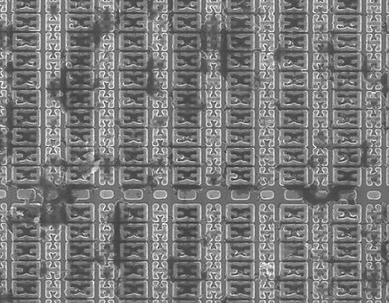
顯微鏡下的 SRAM
SRAM cells on the die of a STM32F103VGT6 microcontroller as seen by a scanning electron microscope. Manufactured by STMicroelectronics using a 180 nanometre process.
http://en.wikipedia.org/wiki/File:STM32-SEM-HD.jpg

Slide 13
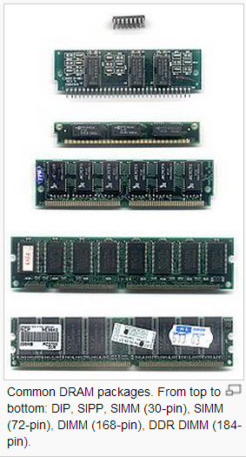
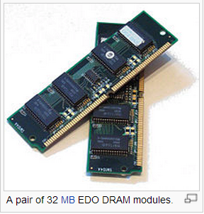
DRAM
http://en.wikipedia.org/wiki/Dynamic_random_access_memory

Slide 14
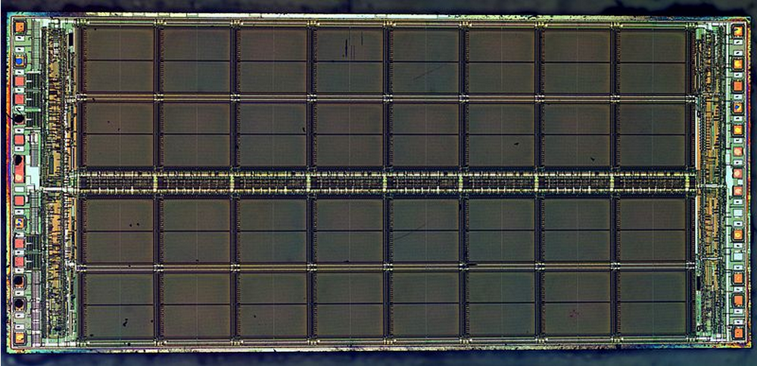
DRAM
Die of the MT4C1024 1 mebibit Dynamic Random Access Memory (DRAM) integrated circuit from Micron Technology.
http://en.wikipedia.org/wiki/File:MT4C1024-HD.jpg

Slide 16
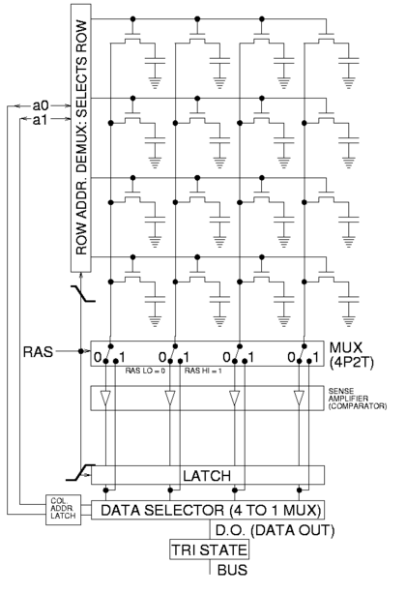
DRAM 的結構
http://en.wikipedia.org/wiki/File:Square_array_of_mosfet_cells_read.png

Slide 17
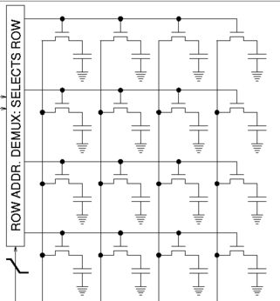
DRAM 的結構 (放大)

Slide 18
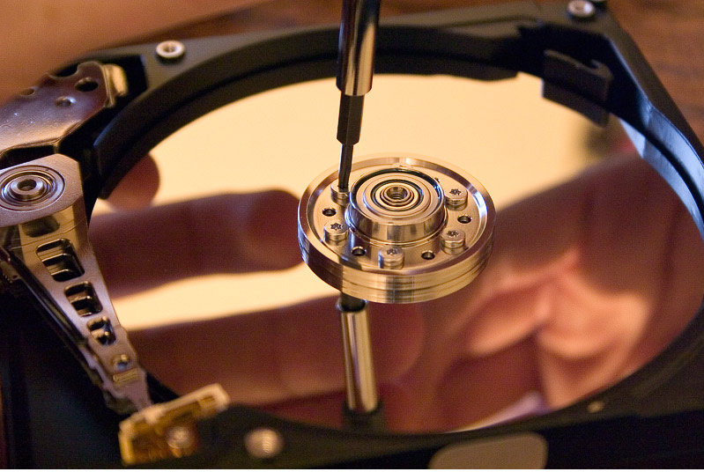
硬碟
http://en.wikipedia.org/wiki/Computer_data_storage
http://en.wikipedia.org/wiki/File:Hard_disk_platter_reflection.jpg

Slide 19
廣義的Memory
ROM
  BIOS ….
SRAM
  Level 1 Cache ...
  Level 2 Cache ...
DRAM
  Main Memory
Disk
  Virtual Memory
http://en.wikipedia.org/wiki/Computer_data_storage

Slide 20
http://en.wikipedia.org/wiki/Memory_hierarchy

Slide 21
Memory hierarchy of an AMD Bulldozer server.
http://upload.wikimedia.org/wikipedia/commons/9/95/Hwloc.png

Slide 22
記憶體階層
http://en.wikipedia.org/wiki/Computer_data_storage

Slide 23

Locality of reference
http://en.wikipedia.org/wiki/Locality_of_reference

Slide 24
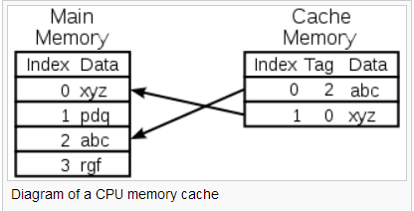
快取 cache 的概念
http://en.wikipedia.org/wiki/Cache_(computing)

Slide 25
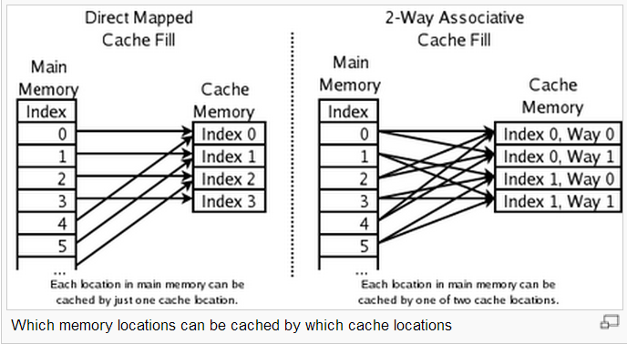
Cache 的映射方法
http://en.wikipedia.org/wiki/Cache_algorithms
http://en.wikipedia.org/wiki/File:Cache,associative-fill-both.png

Slide 26
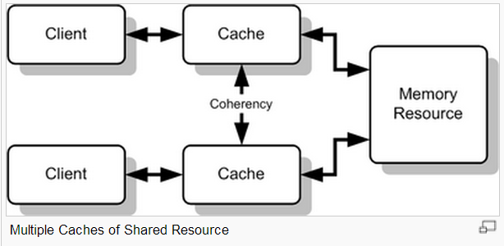
快取不一致問題
http://en.wikipedia.org/wiki/Cache_coherence

Slide 27
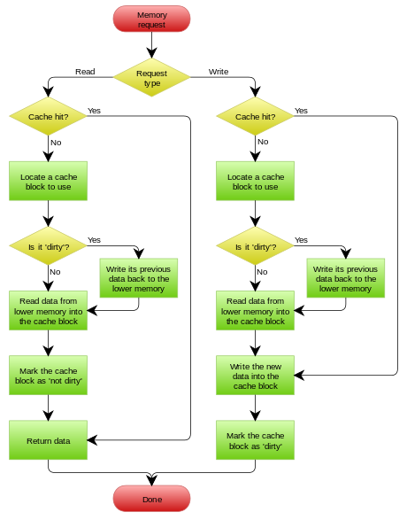
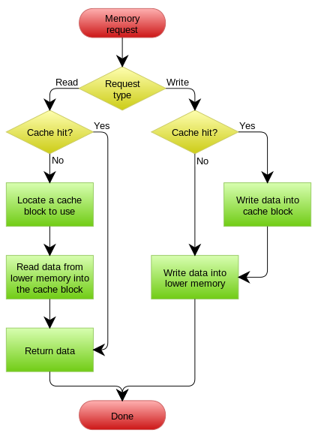
寫穿與寫回策略
A Write-Through cache with No-Write Allocation
A Write-Back cache with Write Allocation

Slide 28
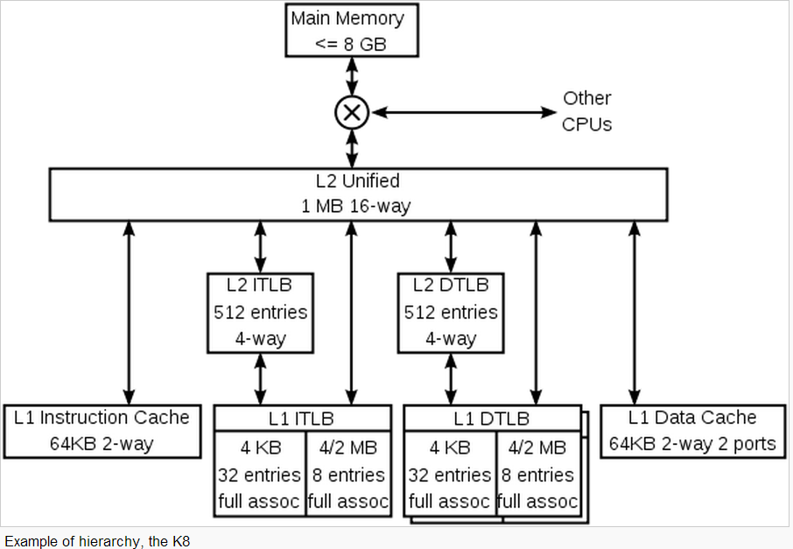
cache hierarchy : K8@AMD Athlon 64 CPU
http://en.wikipedia.org/wiki/File:Cache,hierarchy-example.svg

Slide 29
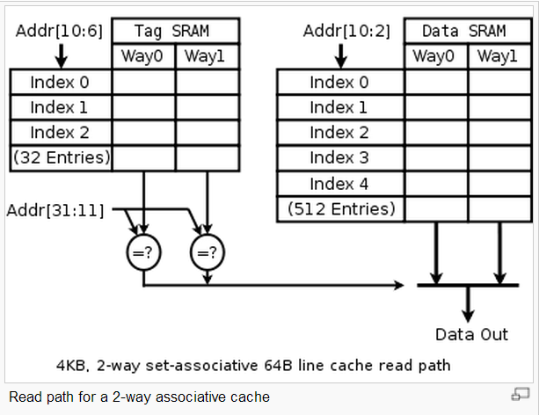
Read path for a 2-way associative cache
http://en.wikipedia.org/wiki/Cache_hierarchy
http://en.wikipedia.org/wiki/File:Cache,associative-read.svg

Slide 30
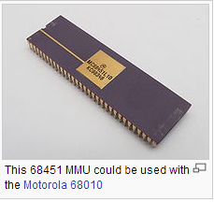
MMU
http://en.wikipedia.org/wiki/Memory_management_unit

Slide 31
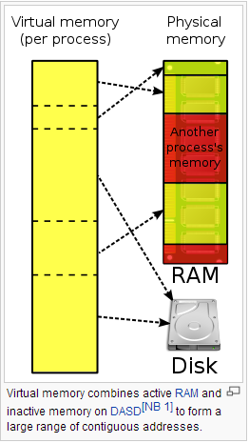
虛擬記憶體
http://en.wikipedia.org/wiki/Virtual_memory
http://en.wikipedia.org/wiki/File:Virtual_memory.svg

Slide 32
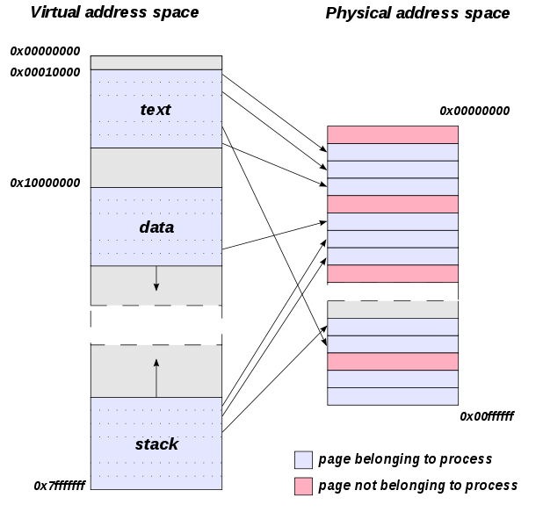
虛擬記憶體
的位址轉換
Relationship between pages addressed by virtual addresses and the frames in physical memory, within a simple address space scheme. Physical memory can contain pages belonging to many processes. Pages can be paged to disk if used infrequently, or if physical memory is full. Not all pages are in physical memory in the above diagram.

Slide 33
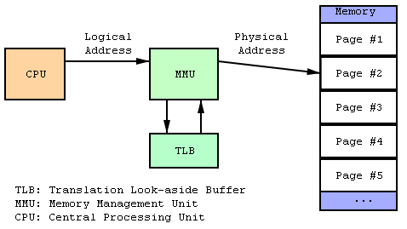
MMU (分頁管理)

Slide 34
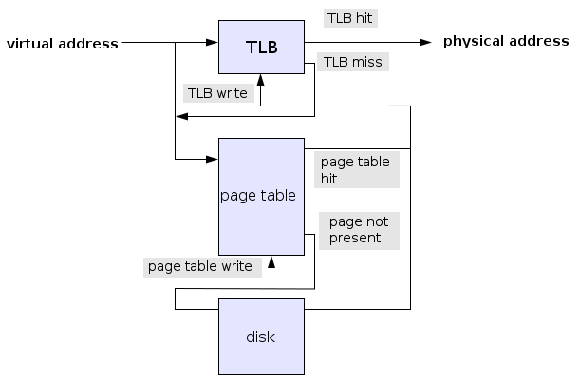
分頁表的使用過程
虛擬位址轉實體位址
http://en.wikipedia.org/wiki/File:Page_table_actions.svg

Slide 35
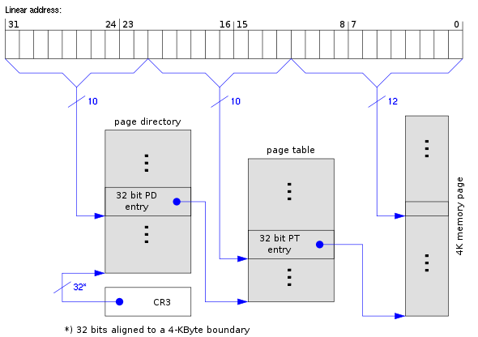
Intel x86 的兩層式分頁
http://en.wikipedia.org/wiki/File:X86_Paging_4K.svg

Slide 36
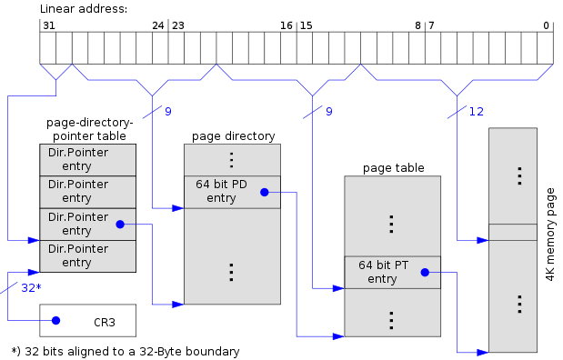
X86 的三層式分頁
http://en.wikipedia.org/wiki/File:X86_Paging_PAE_4K.svg

Slide 37
分頁表
http://en.wikipedia.org/wiki/Page_table

Slide 38
