Slide 1
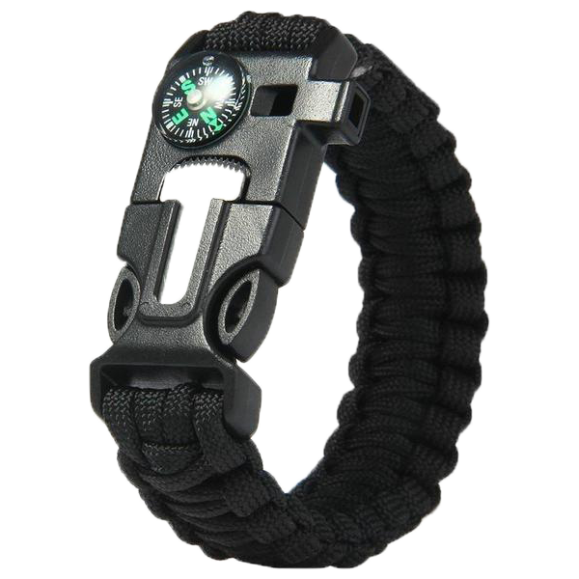
Survival Wristband
Group 1
Teamwork 2

Slide 2
Group Member
B10423002 Leon
B10423003 Kurumi
B10423009 Jerry
B10423015 Justin
B10423032 Kevin
B10423041 Dan
B10423045 Rong
A10423050 Ian
W10523301 Ben

Slide 3
Content

Slide 4
Content
1)Please explain the Law of Demeter (LoD) by using any piece of your project.
2)Here are six (or seven) types of interaction coupling, each falling on different on different parts of a good-to-bad continuum. Choose three pieces of your project to describe what types of the coupling they belong to.
3)There are seven types of method cohesion, choose three pieces of your project to describe what types of the cohesion they belong to.
4)Connascence generalized the ideas of cohesion and coupling, use three pieces of your project to describe what types of the connascence they belong to.
5)Use one class from your project that can create a set of invariants and add them to the CRC card or the class diagram.

Slide 5
Content
6)Use a method of a class from your project that can create a contract and describe its algorithm specification. Specify the pre- or post- condition and use both Structured English and an activity diagram to specify the algorithm.
7)Please evaluate any piece of your project in terms of cohesion, coupling, and connascence perspective.
8)What are the factors in determining the type of object persistence format that will be adopted in your project?
9)Map problem domain objects of your project to a RDBMS format, and use an example to describe the steps of normalization and apply it to the class diagram in third normal form.

Slide 6
1. Law Of Demeter

Slide 7
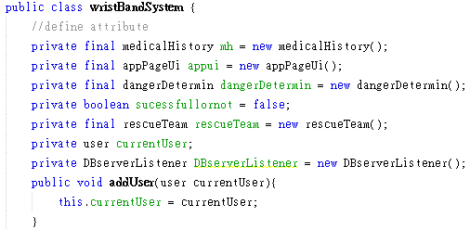
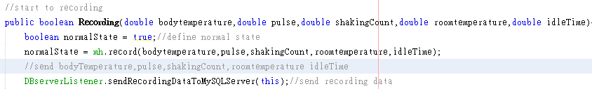
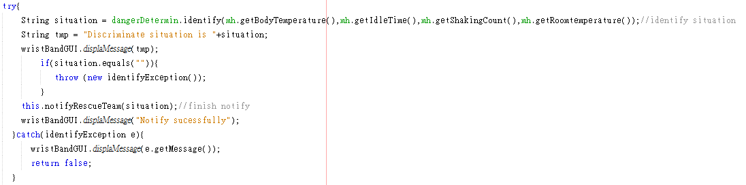


Class wristBandSystem









type: to an object that is passed as a parameter to the method (M’s parameters)
type: to an object that is created by the method (O's direct component objects)
type:to itself (O itself)
type: to objects contained in attributes of itself or a superclass (Any objects created/instantiated within M)
❍
type describe the parameter will catch the exception to execute message.
❍
type describe the situation created in this method to execute method.


type describe method defined in this class to notifyrescue team.
●
●
type will use method defined in this class’s object to record, press button, send data.


Slide 8
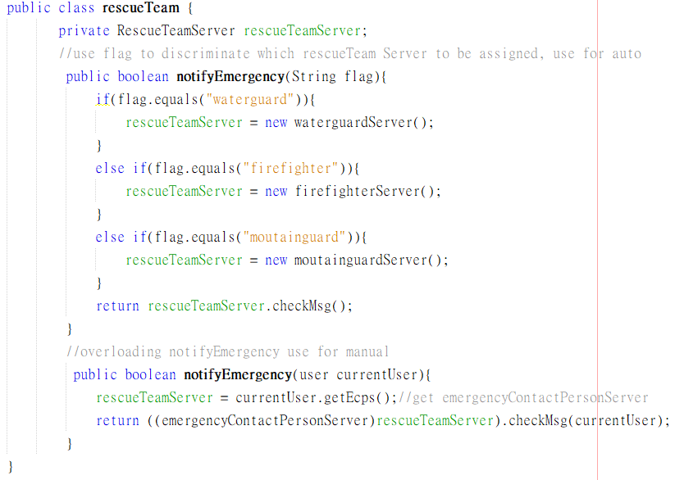
Class rescueTeam

●
●
type: to objects contained in attributes of itself or a superclass (Any objects created/instantiated within M)

●



type describe the parameter will catch the exception to execute message.

type describe the object passed by the parameter will distinguish String or getting.
❍
type describe the object created in this class will check message.

●
●


Slide 9
2. Coupling

Slide 10
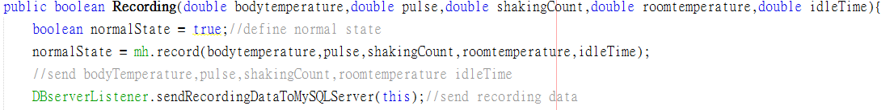
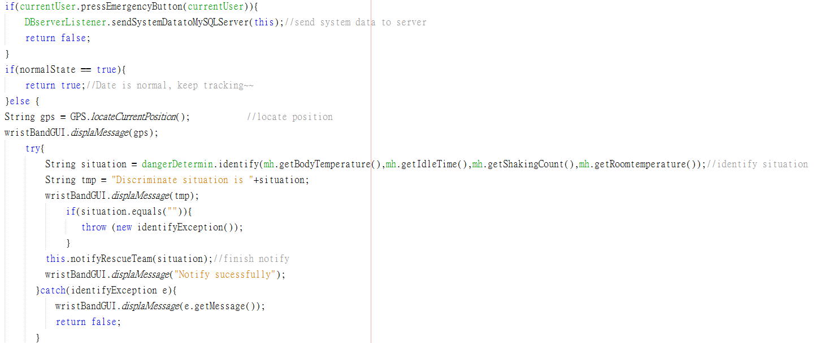
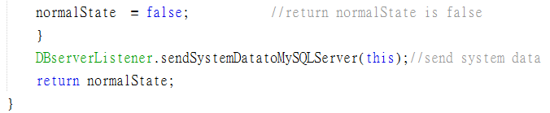
Recording Method Field

We will use some highlighted in the red box method to explain interaction coupling.




❍

●

Slide 11
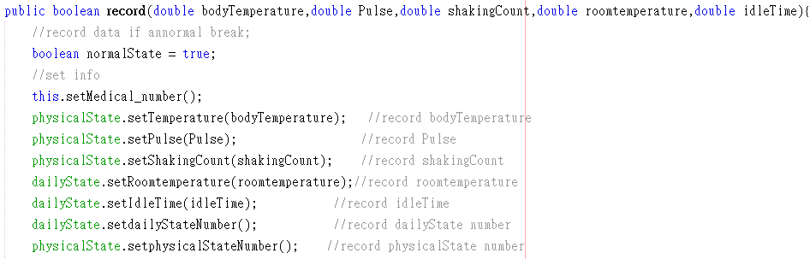
Data Type - Record





❍

This “record” method just send primitive type data to medical history class, so is the lowest coupling.
●

Slide 12
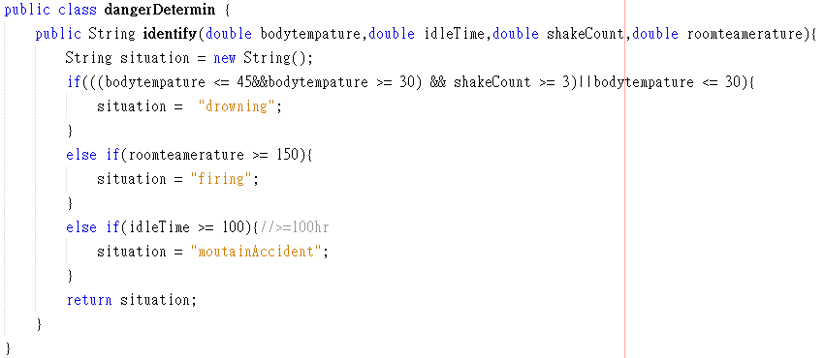
Data Type - Identify





❍

●
This method send primitive data type to dangerDermin class to calculate the danger.

Slide 13
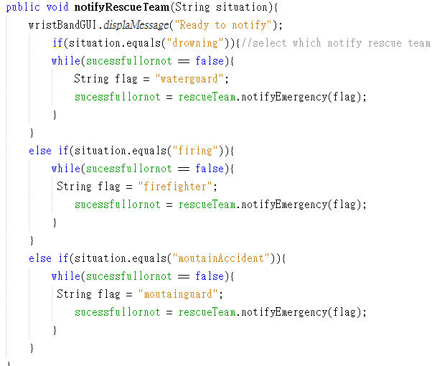
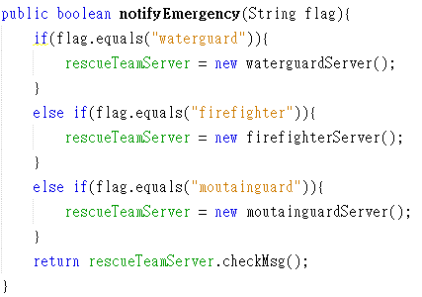
Control Type





❍

The client will send the flag to this method, and this server will distinguish flag to call the rescue team.
Ex: if flag is waterguard, the waterguard server will be notified.
●

Slide 14
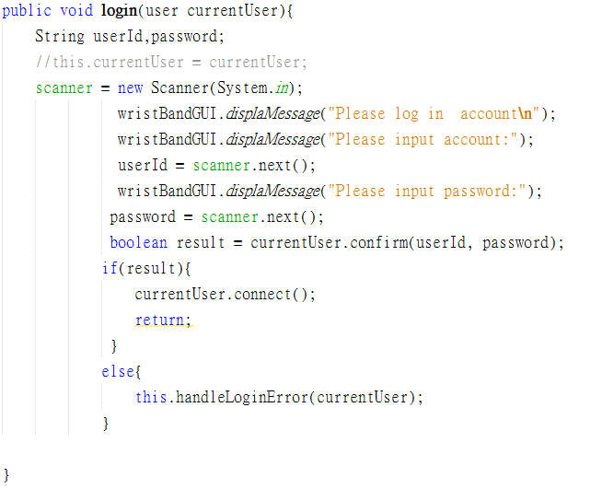
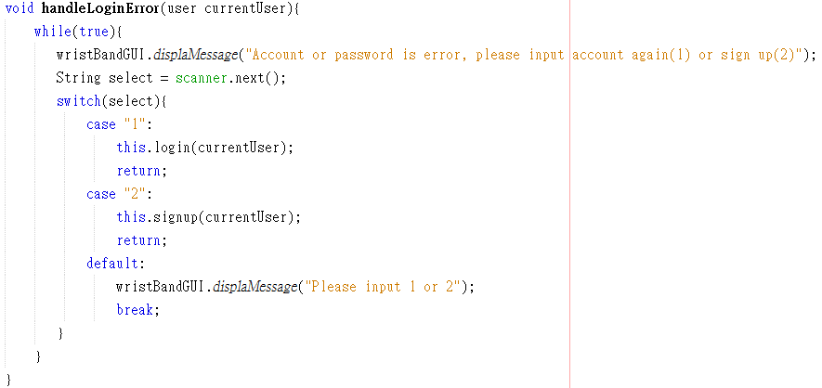

Stamp Type





❍

All of the method in this block will send the currentUser which is an object to server method, the server just can do partial function in this object.
so this is the stamp type.
●

Slide 15
3. Cohesion

Slide 16
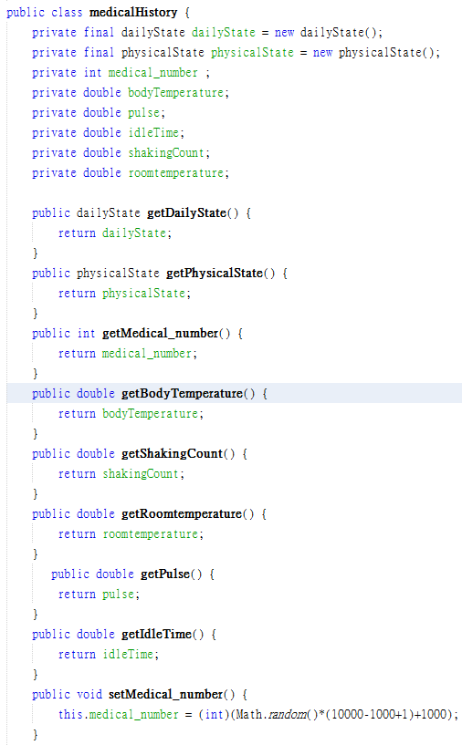
Functional Cohesion





❍

●

Slide 17
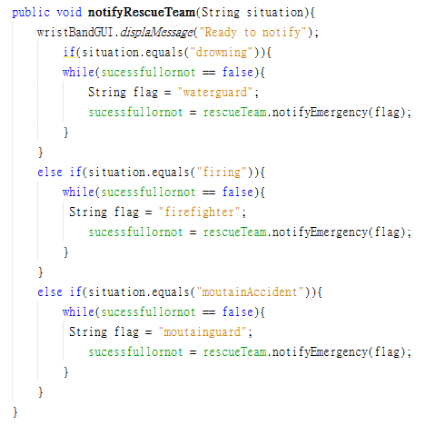
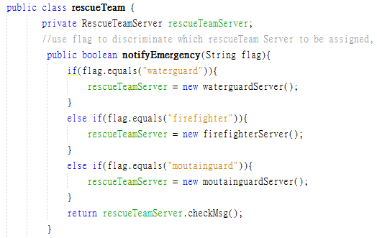
Logical Cohesion





❍

●

Slide 18
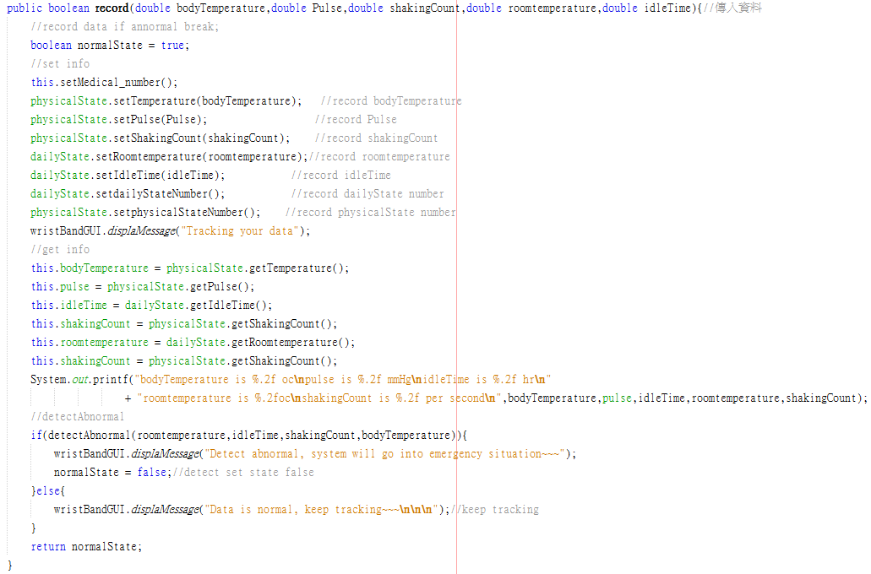
Temporary & Classical Cohesion





❍

●

Slide 19
4. Connascence

Slide 20
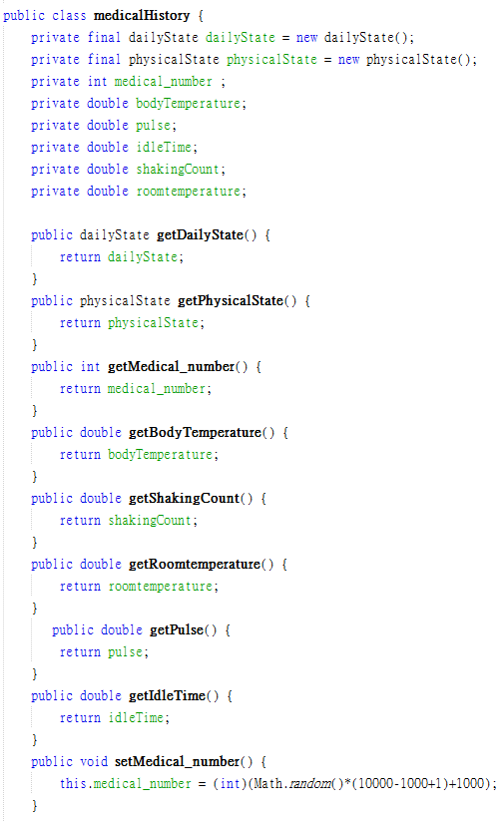
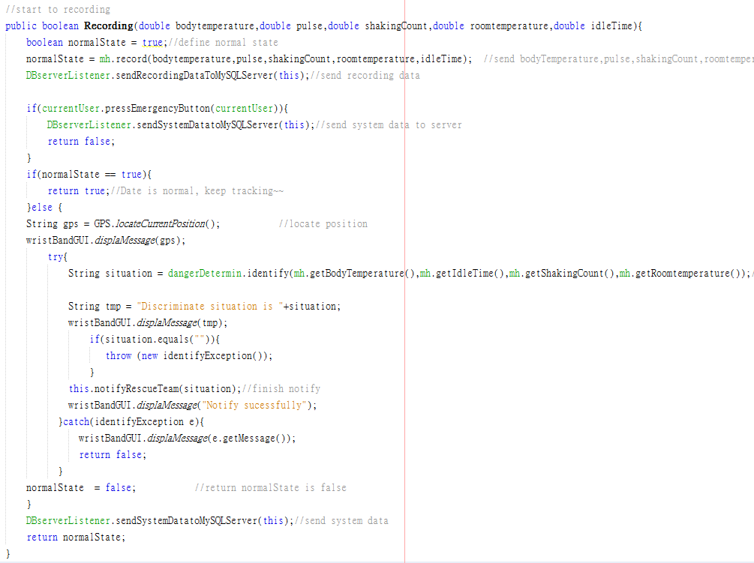
Name Connascence





❍

●

Slide 21
Position Connascence





❍

●

Slide 22
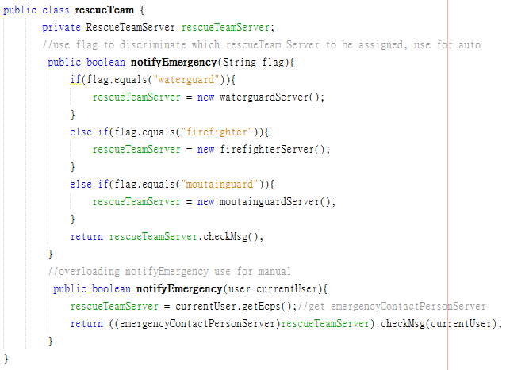
Algorithm Connascence





❍

●

Slide 23
5. Invariants

Slide 24
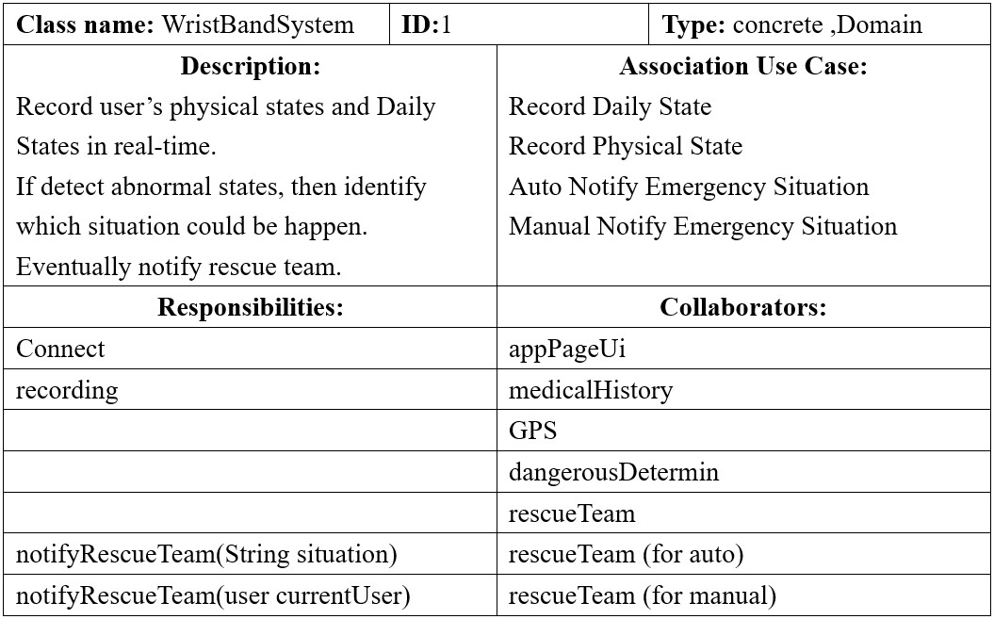
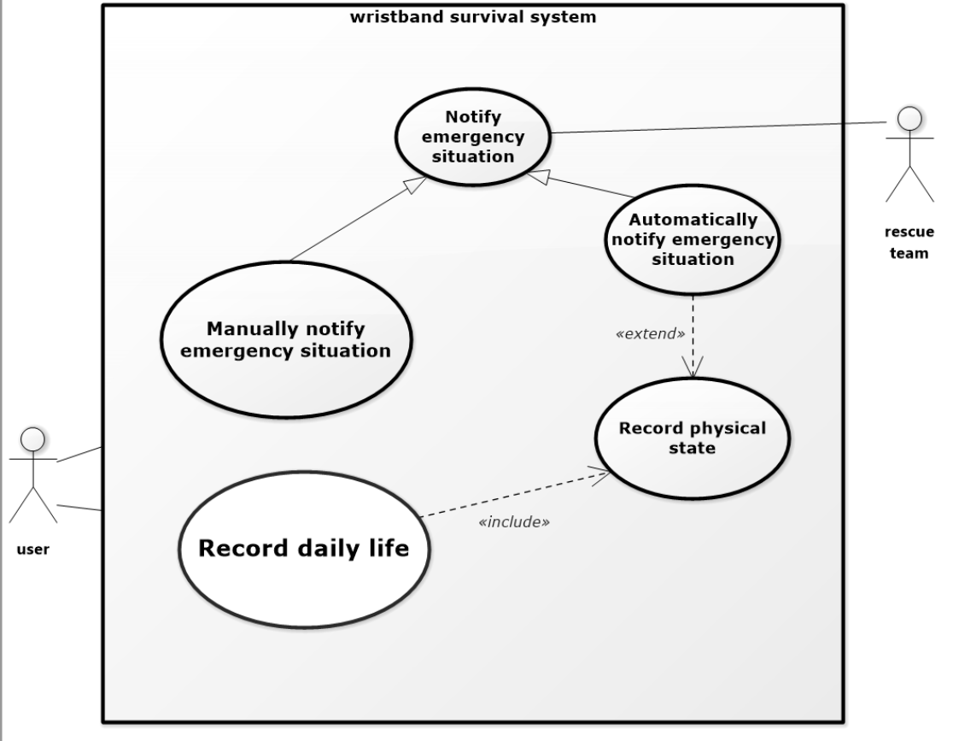
CRC Card - Front





❍

●

Slide 25
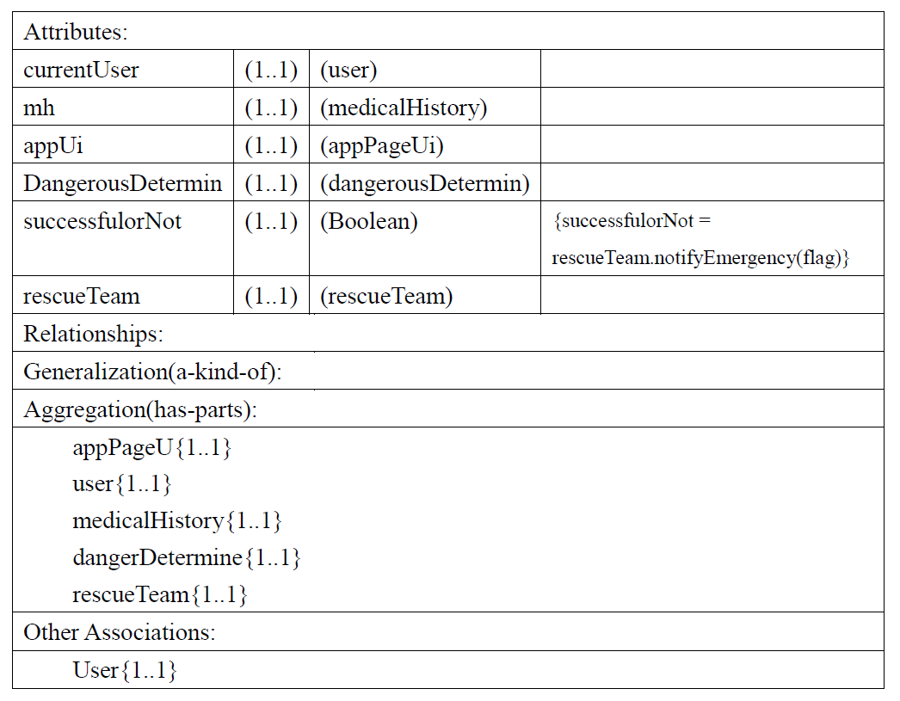
CRC Card - Back





❍

●

Slide 26
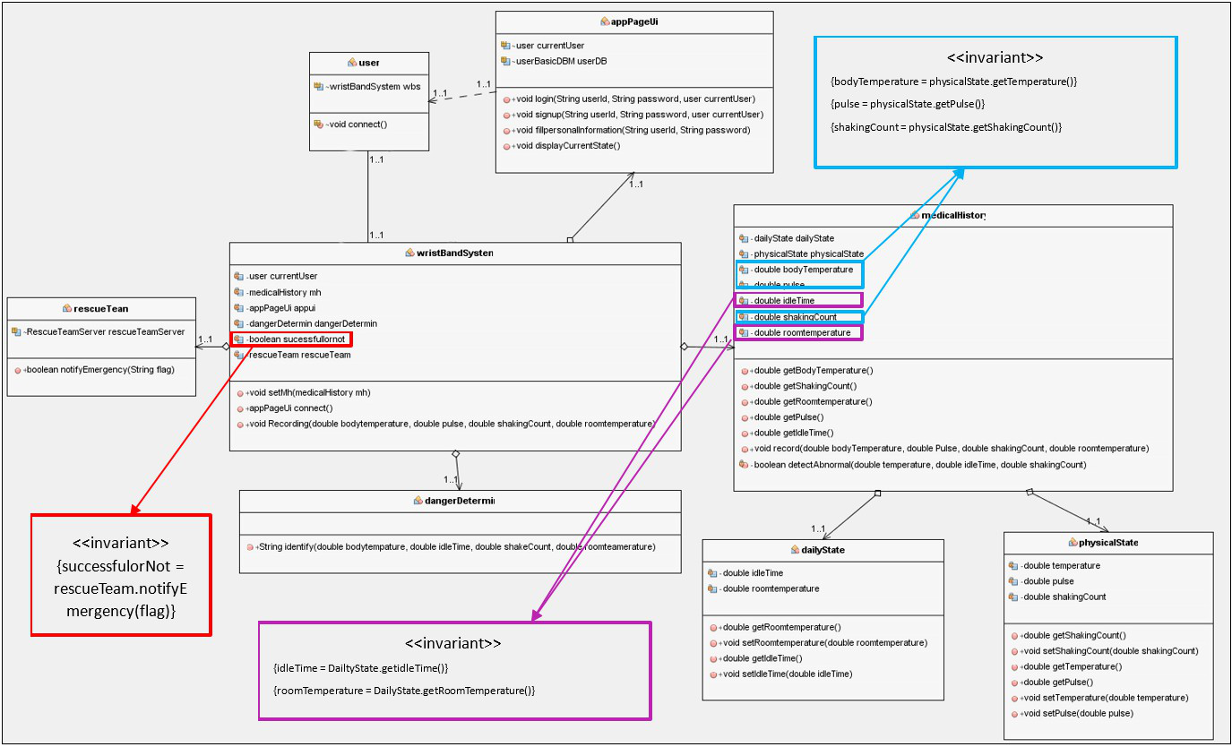
Class Diagram





❍

●

Slide 27
Text File





❍

●

Slide 28
6. Contract & Method Specification & Activity Diagram

Slide 29
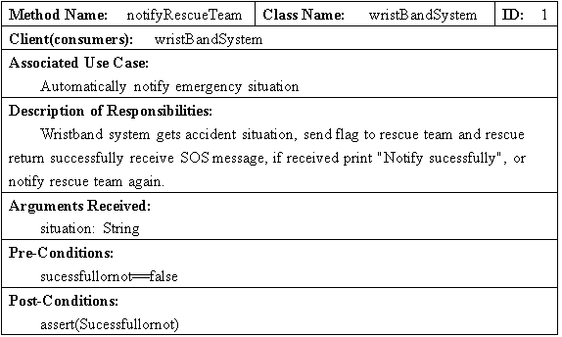
Contract





❍

●

Slide 30
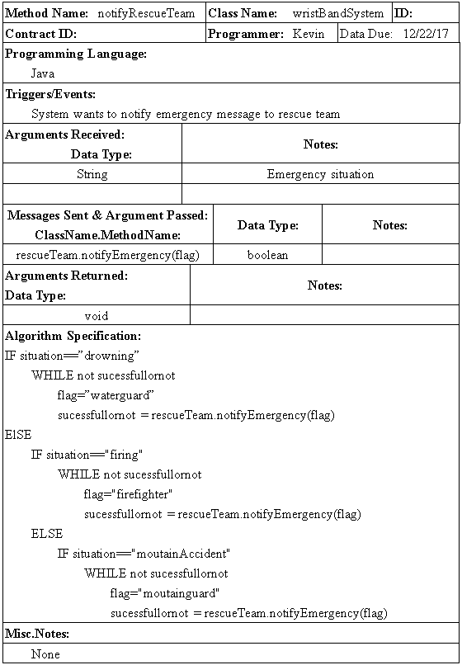
Method Specification

Slide 31
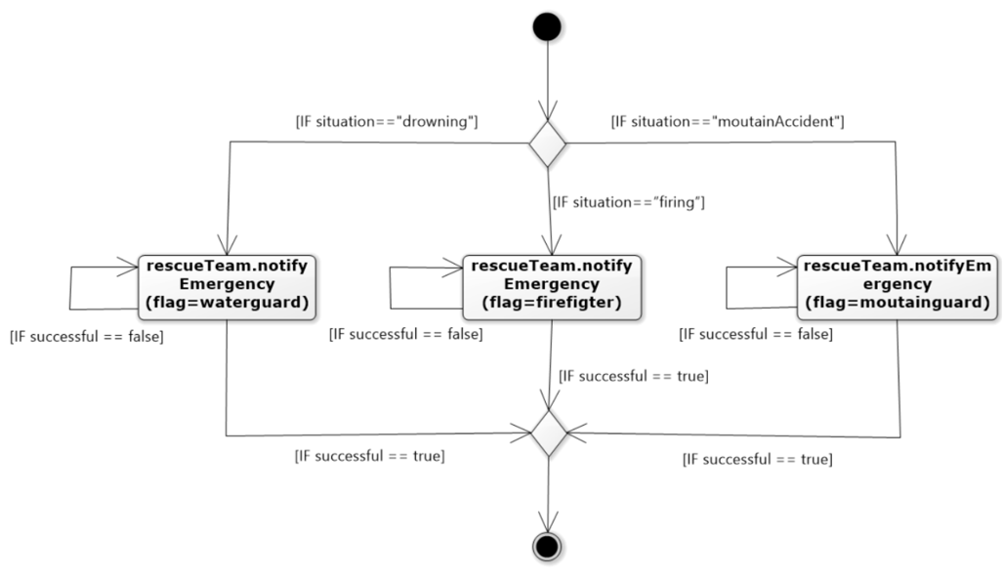
Activity Diagram

Slide 32
7. Coupling & Cohesion & Connanse

Slide 33
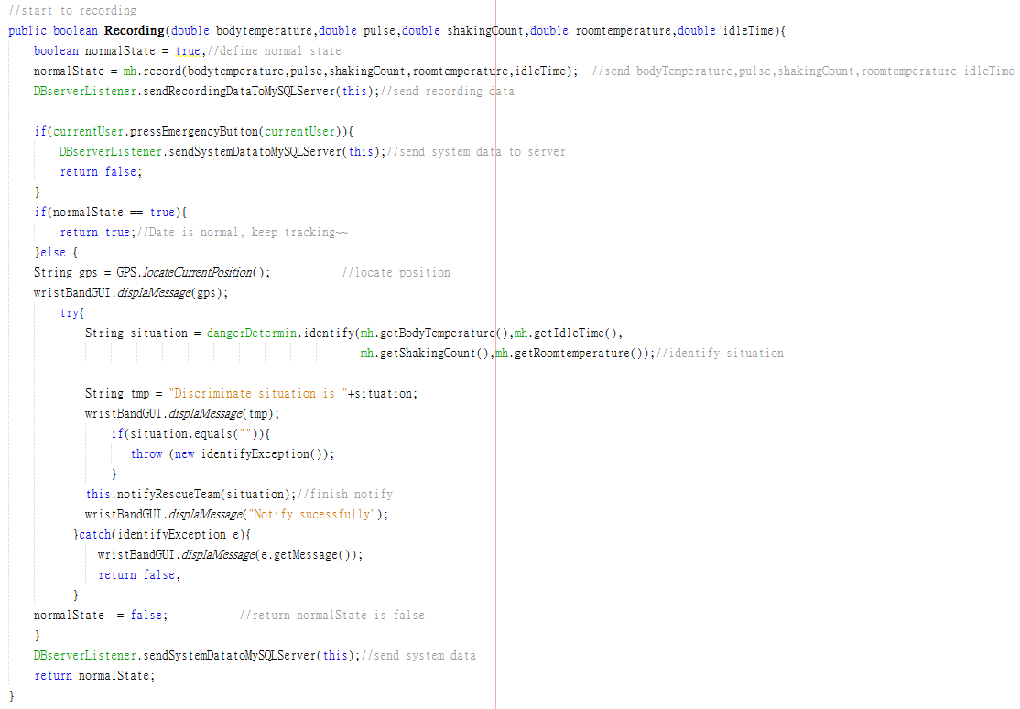
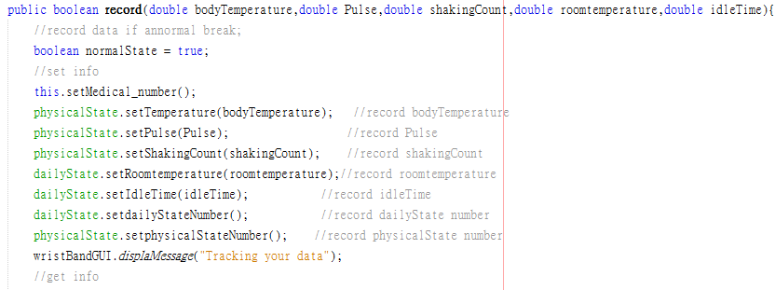
Coupling - Interaction, Data

Send Variable




❍

●

Slide 34
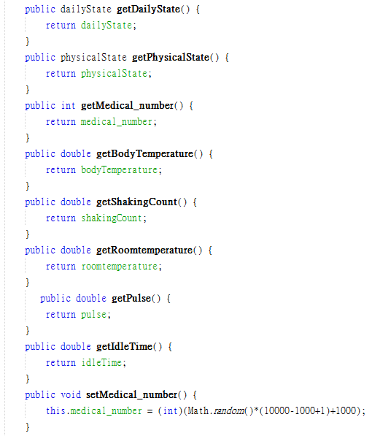
Cohesion - Method, Functional





❍

●

Slide 35
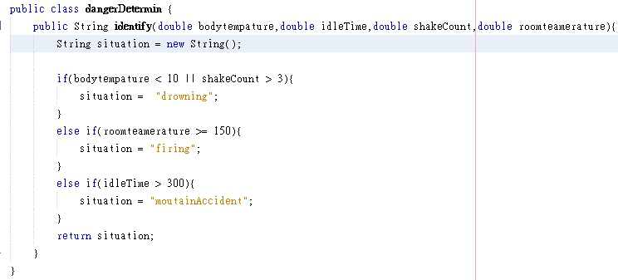
Connascence - Position

Send Variable




❍

●

Slide 36
8. Object Persistence Format

Slide 37
We Choose……

RDBMS
ORDBMS




❍

OODBMS
●

Slide 38
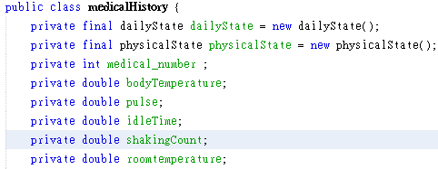
Structured Data

All of our data are structured. For examples in our medical history data like pulse, body temperature, hand shaking count and these data are all numeric.




❍

●

Slide 39
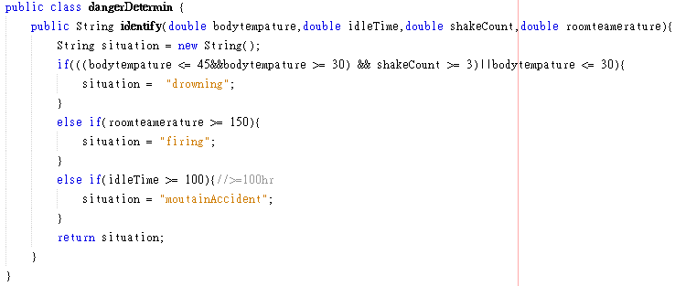
Simple Data

Our system does not require to process over complicated data. Our data are only use to basic calculation or determining the value is out of range or not.




❍

●

Slide 40
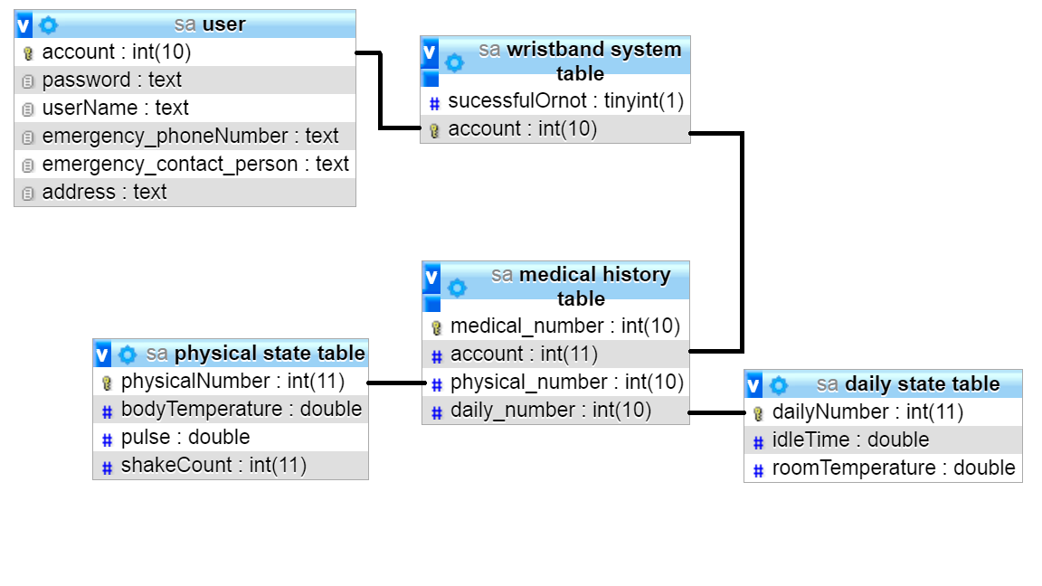
Simple Relation

Since the data or table of our system are simple, the relations of table are simple too. It seldom occurs impendence mismatch.




❍

●

Slide 41

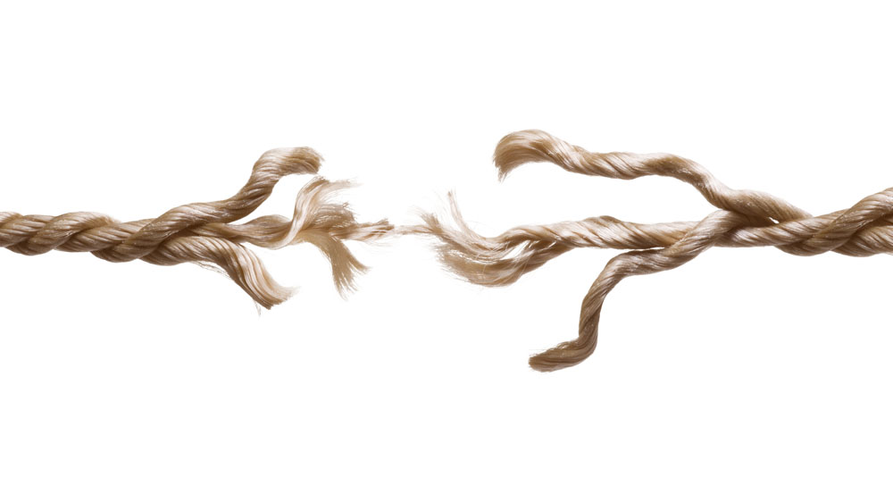
Security Issue





❍

●

Slide 42
9. RDBMS Format

Slide 43
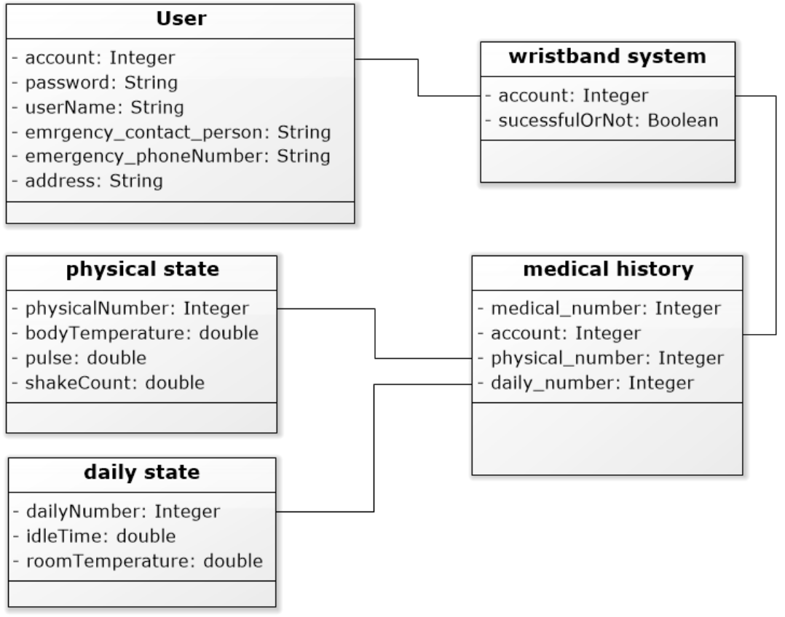
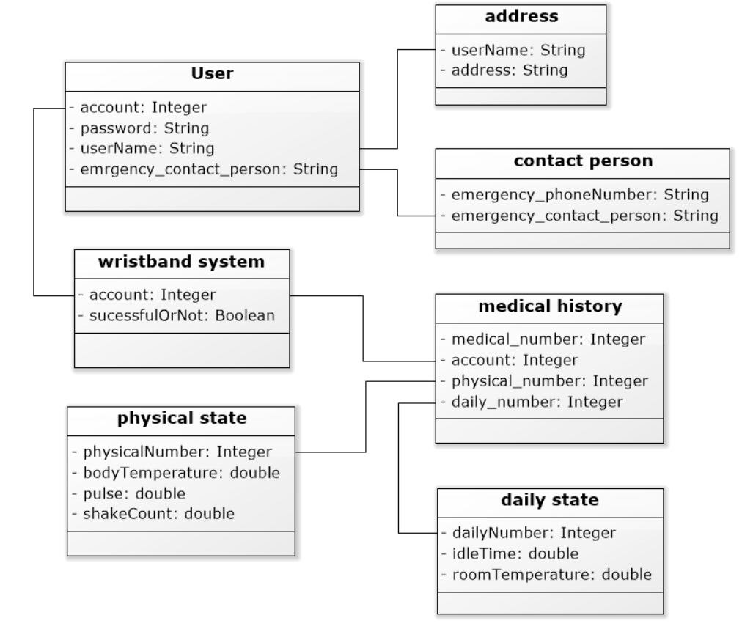
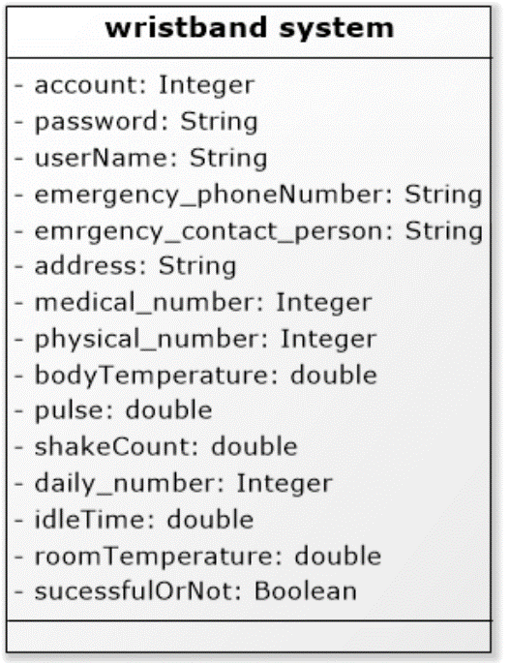
Class Diagram





❍

●
First Normal Form Class Diagram
Third Normal Form
Class Diagram
Second Normal Form Class Diagram

Slide 44
Zero Normal Form





❍

●
primary key

Slide 45
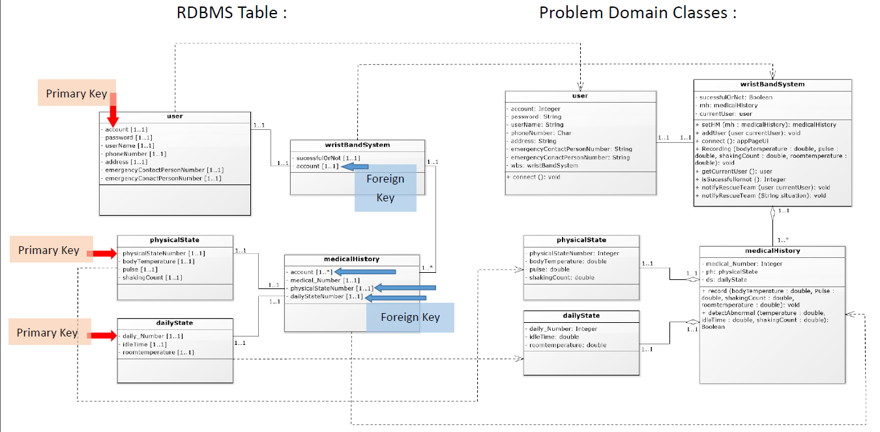
Mapping





❍

●

Slide 46
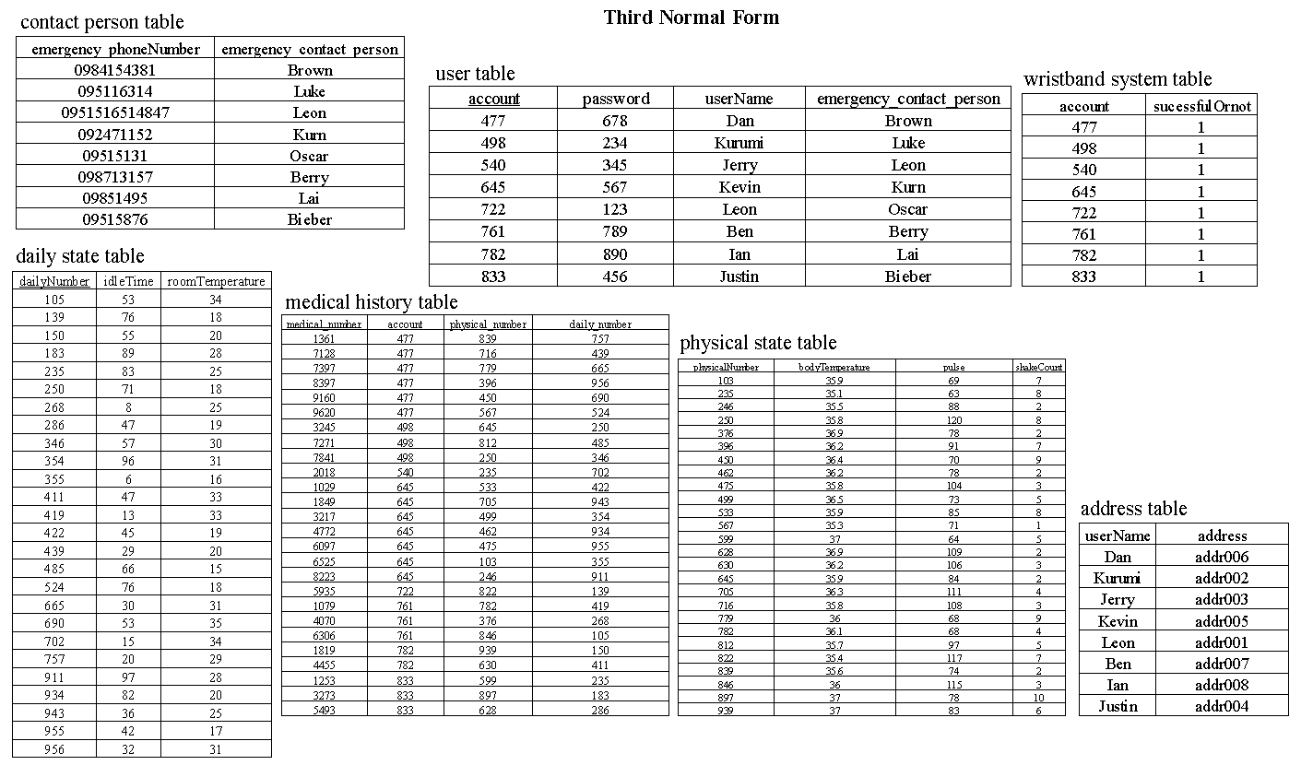
Third Normal Form





❍

●

Slide 47
Thank you!

