Slide 1
SynScreen User’s guide
April 2018
D.R. Perez, B.S. Edwards, L.A. Sklar, A. Chigaev

Slide 2
Contents
1. Access to SynScreen installation files | 4
2. SynScreen Installation | 5-11
3. Preparation of Data | 12-15
4. Using SynScreen | 16-28
5. SynScreen Data Output | 29-32

Slide 3
About SynScreen
Currently, SynScreen can only be installed in computers running a 64-bit version of Microsoft Windows
SynScreen was developed to facilitate the visualization and analysis of data from drug combination assays, especially for high throughput experimental approaches.
SynScreen uses the Bliss and Loewe models to determine drug interactions.
Review articles should be consulted for explanations of mathematical models for drug combination analyses.
This user guide only provides instructions on how to use the SynScreen application, and it is the responsibility of the user to design and interpret experimental results.
The publication, “High-throughput flow cytometry (HTFC) drug combination discovery with novel synergy analysis software, SynScreen” contains additional information and may be cited.

Slide 4
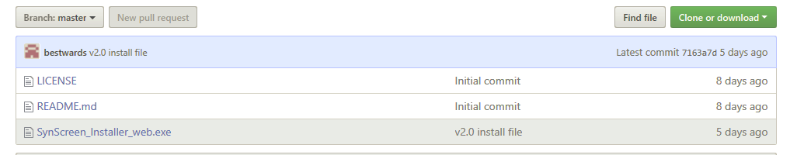
Access to SynScreen installation files
SynScreen may be downloaded from:
https://github.com/bestwards/FlowProg
Notes:
Website image and instructions

Slide 5
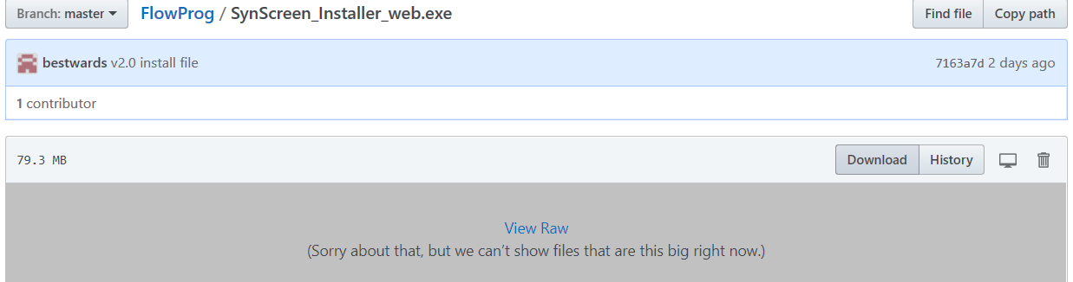
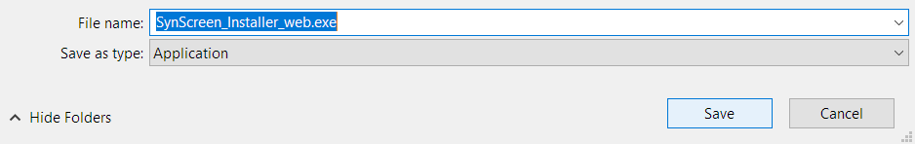
SynScreen Installation (1/7)
Click to download the installer
Save the installation file

Slide 6
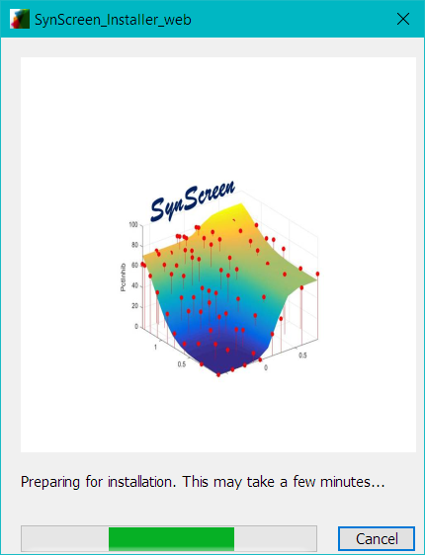
SynScreen Installation (2/7)
The installation will begin with an installer initialization screen
Notes:
Information on installer.
This may have separate steps for the installation of the MATLAB compiler prior to the installation of SynScreen.

Slide 7
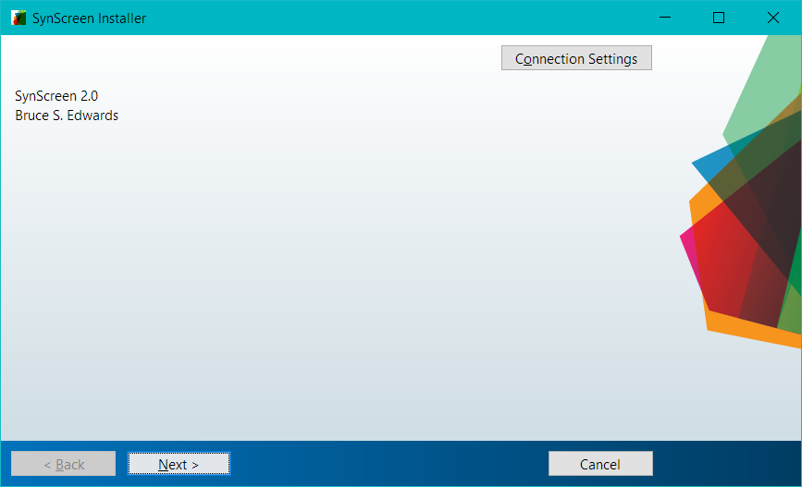
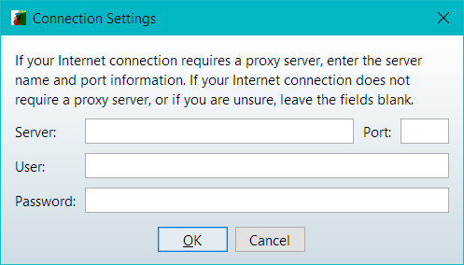
SynScreen Installation (3/7)
The SynScreen installer will proceed in several steps
Adjust connection settings if necessary

Slide 8
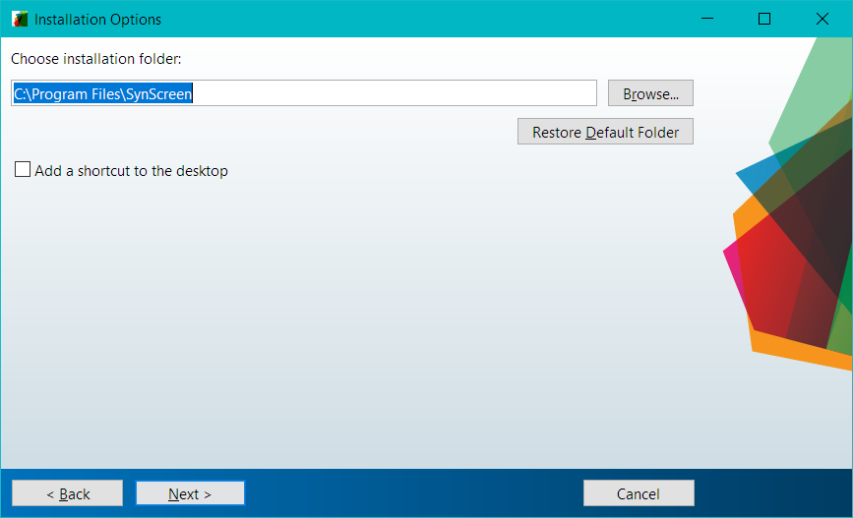
SynScreen Installation (4/7)
Choose an installation folder for the SynScreen application

Slide 9
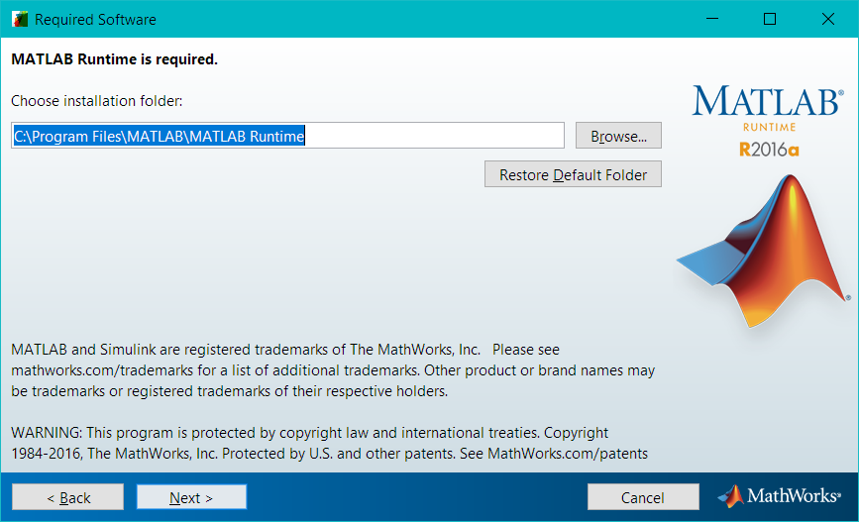
SynScreen Installation (5/7)
Install the MATLAB Runtime files

Slide 10
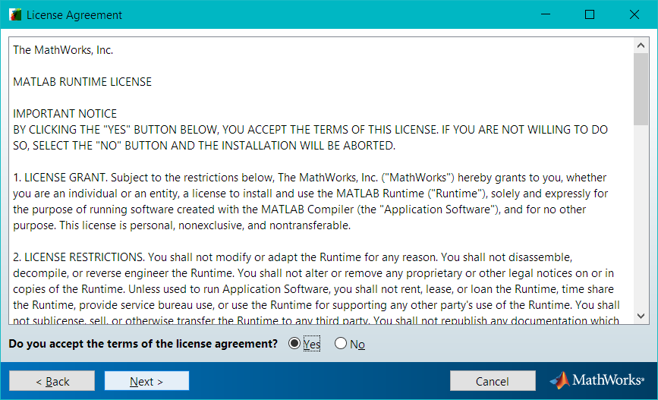
SynScreen Installation (6/7)
Agree to the MATBLAB Runtime license agreement

Slide 11
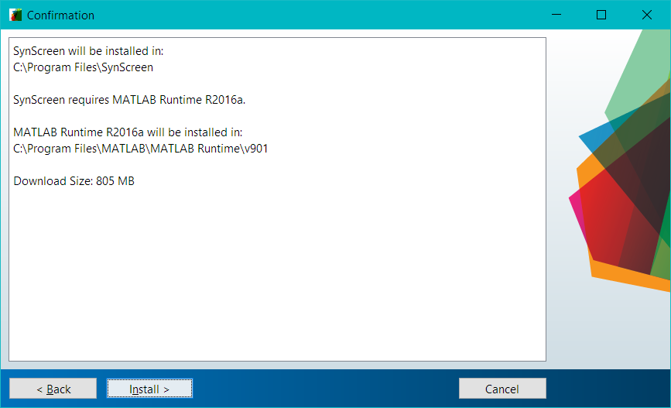
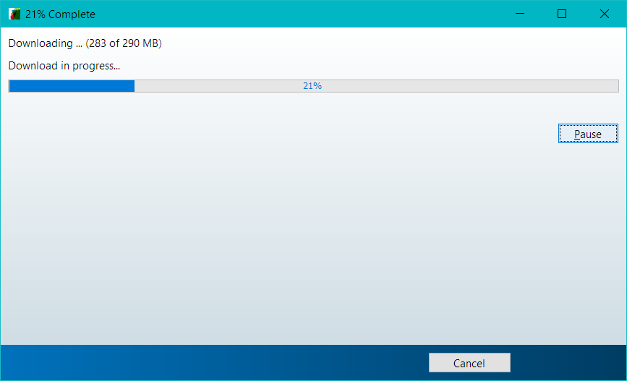
SynScreen Installation (7/7)
Confirm all steps and installation will begin
Note: This may take several minutes

Slide 12
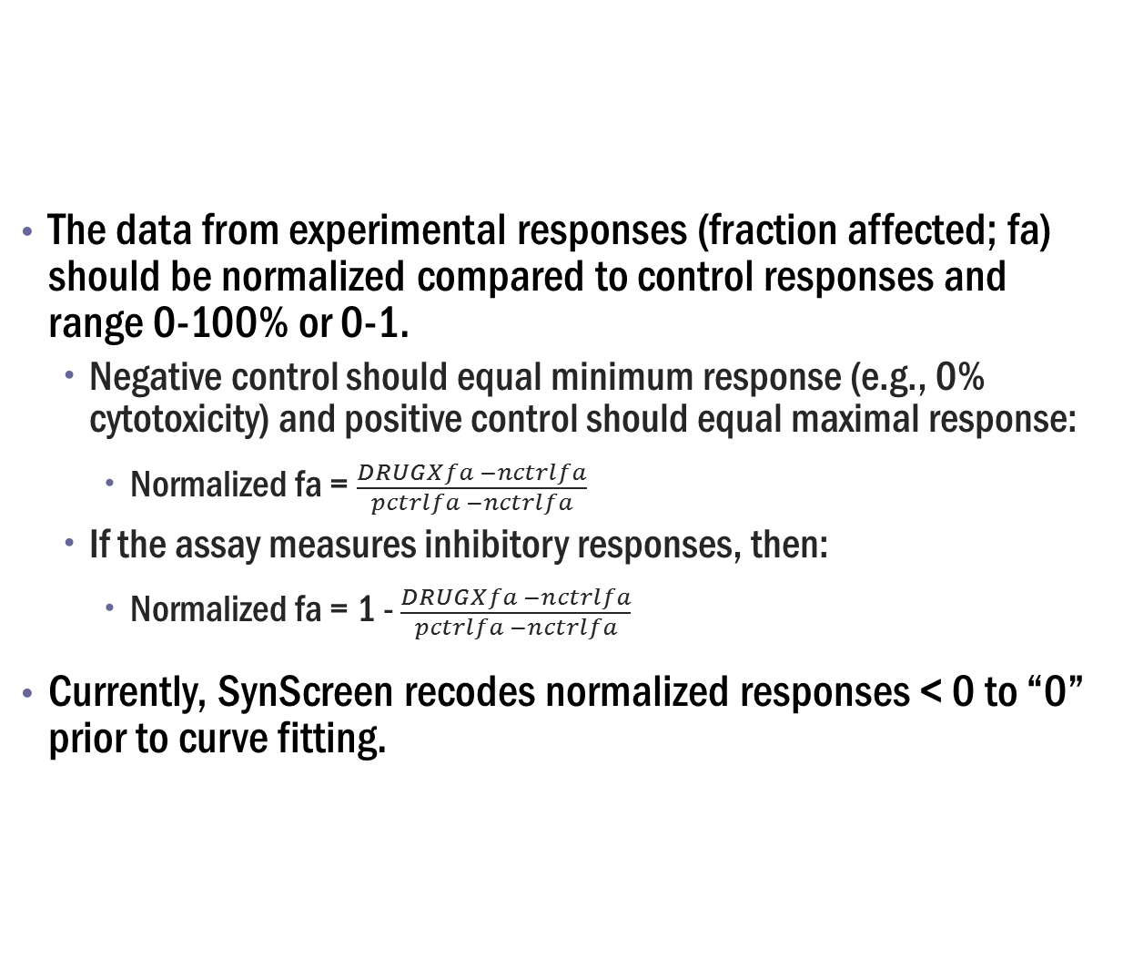
Preparation of Data (1/4)
The data from experimental responses (fraction affected; fa) should be normalized compared to control responses and range 0-100% or 0-1.
Negative control should equal minimum response (e.g., 0% cytotoxicity) and positive control should equal maximal response:
Normalized fa = $\frac{DRUGXfa −nctrlfa}{pctrlfa −nctrlfa}$
If the assay measures inhibitory responses, then:
Normalized fa = 1 - $\frac{DRUGXfa −nctrlfa}{pctrlfa −nctrlfa}$
Currently, SynScreen recodes normalized responses < 0 to “0” prior to curve fitting.
Sample data are provided in zip files.
If you want the normalized range to include responses that are < 0 using standard normalization equations above, then determine the minimum observed response and substitute this for ncntrlfa in the equations above

Slide 13
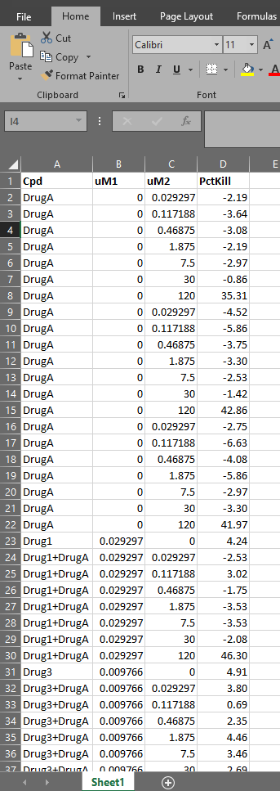
Preparation of Data (2/4)
The data should be annotated into 4 columns:
Name of compound or drug pair
For combinations, the annotation is Drug1+Drug2
The “+” is necessary for the software to determine that there is a combination
The nomenclature must be consistent for drugs used alone and in combination.
Concentration of Drug1, in micromolar (uM) units
Concentration of Drug2, in micromolar (uM) units
Normalized response
There should not be spaces between characters in the annotations.

Slide 14
Preparation of Data (3/4)
Data from one or multiple experiments may be incorporated into the file.
SynScreen can analyze data from replicates.
For single agents, the dose responses are averaged.
For combinations, the software has the option to process and display the individual data points or the means from replicates.
Example file 1 contains data from one replicate of a high-throughput screen of 25 drug pairs.
Example file 2 contains data from four replicates of a 25 drug pair screen.

Slide 15
Preparation of Data (4/4)
Save the annotated, normalized data into one of the following file formats:
.xlsx
.xls
Take note of the data range in the file to be imported. This will be needed in the SynScreen interface.
For the example1 data file, the range of data for import is: A1:D1876.
The imported data must be continuous. SynScreen cannot discern spreadsheets with row gaps.

Slide 16
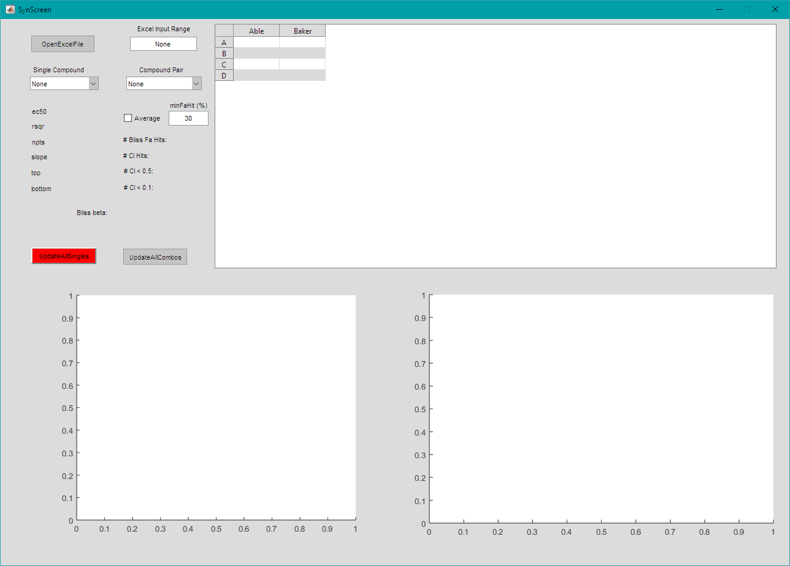
Using SynScreen (1/13)
This is the SynScreen interface upon opening the program.
Note: The PC display settings may need to be set to 100% in order to see the entire interface.

Slide 17
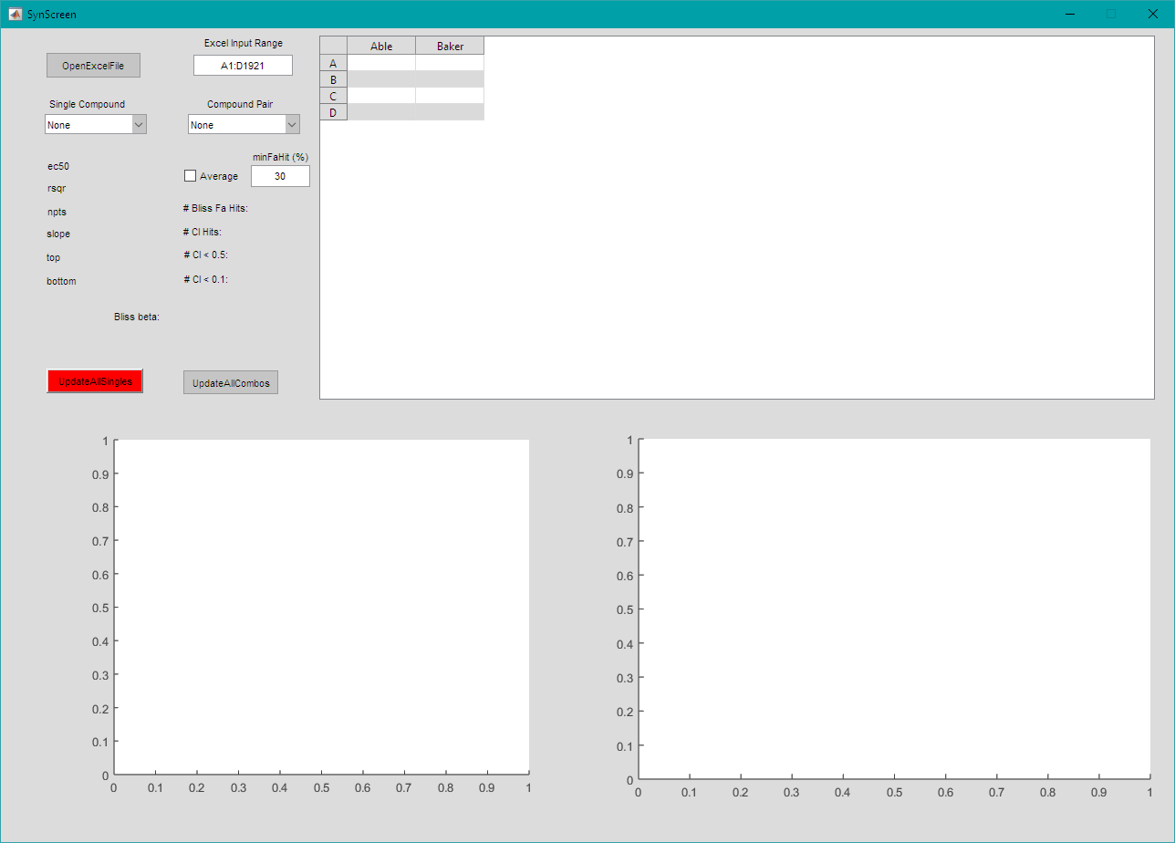
Using SynScreen (2/13)
1. Enter the data range of the data file into the interface
2. Click “OpenExcelFile”
2
1

Slide 18
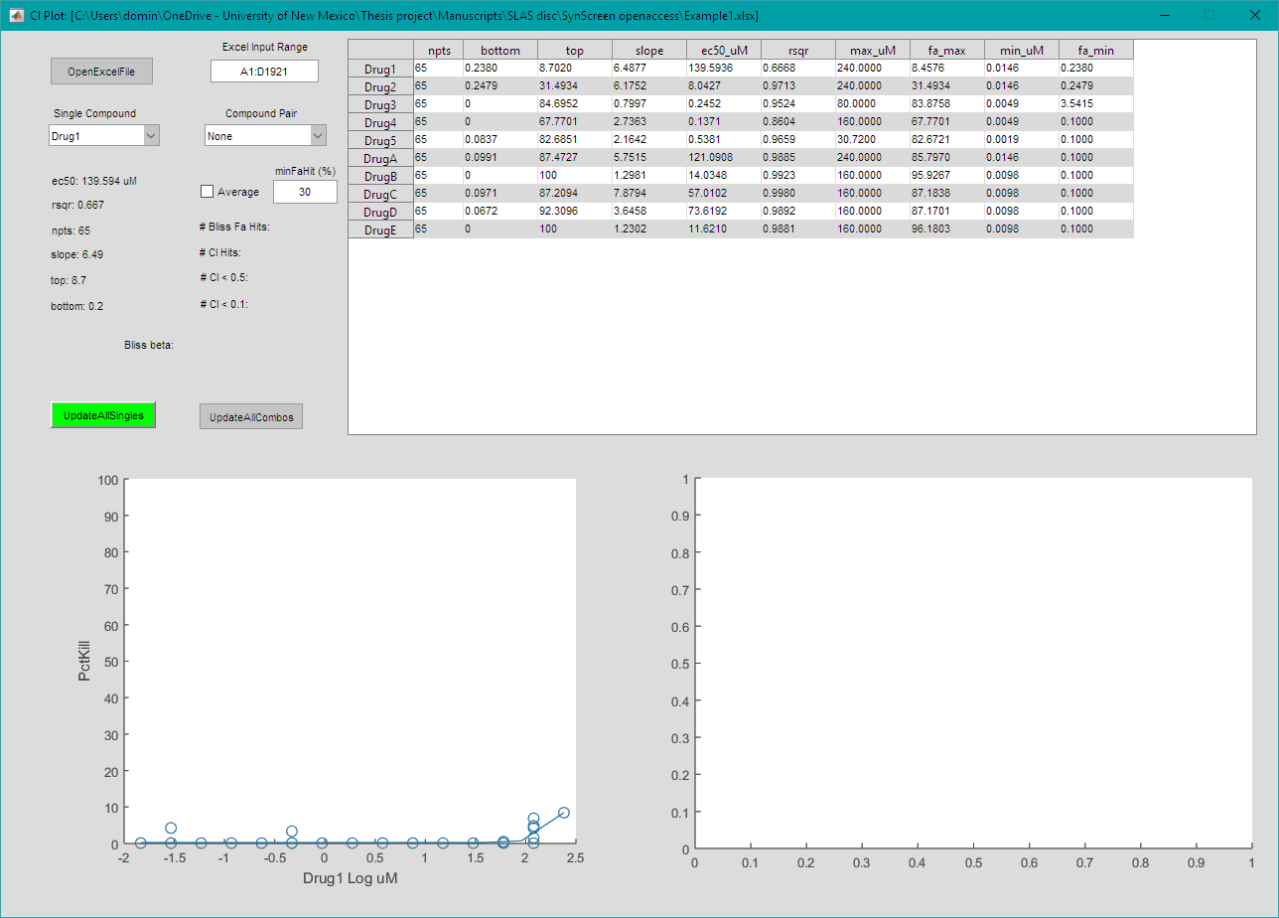
Using SynScreen (3/13)
Once the data file has been successfully imported, SynScreen automatically provides a preliminary assessment of the dose response fits for the single agents on the top right of the interface.

Slide 19
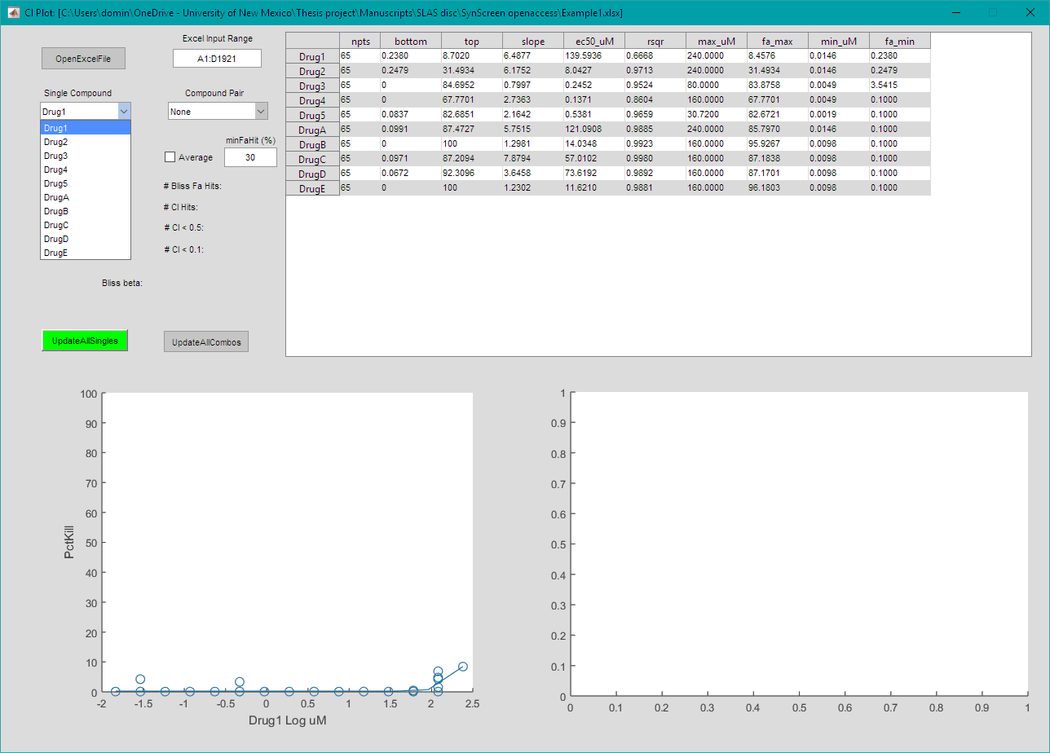
Using SynScreen (4/13)
Use the “Single Compound” dropdown menu to select individual agents and see the dose response fit on the bottom left of the interface.

Slide 20
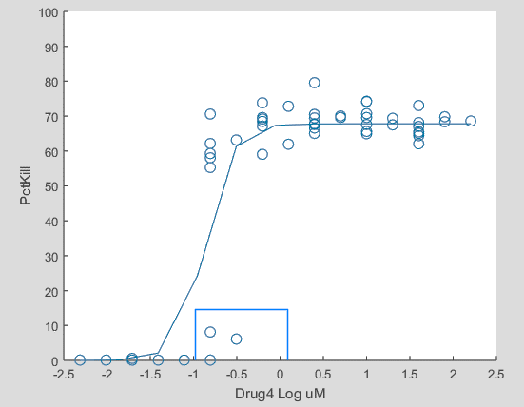
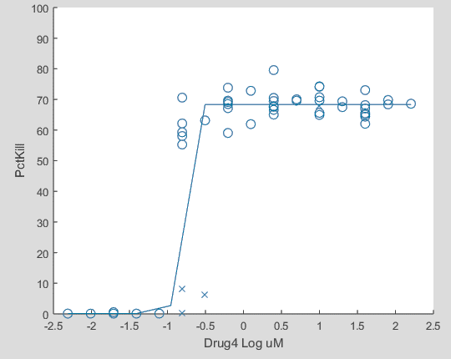
Using SynScreen (5/13)
To improve the fit of the individual agent dose responses, points may be excluded. Click on individual points or click and drag to select multiple adjacent points (left). Excluded points will turn into an “x” symbol (right).
Clicking on a point again will un-exclude the point, turning it into an “o” symbol.

Slide 21
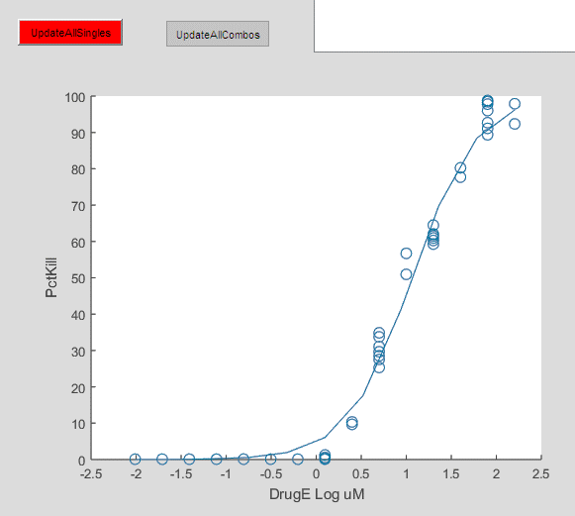

Using SynScreen (6/13)
If any points have been changed in the data set, the “UpdateAllSingles” button will turn red.
Click the button to update the dose response fits before proceeding.
This will turn the button green.
Changes to the dose response fits must be updated before proceeding to analyses of the drug combinations.

Slide 22
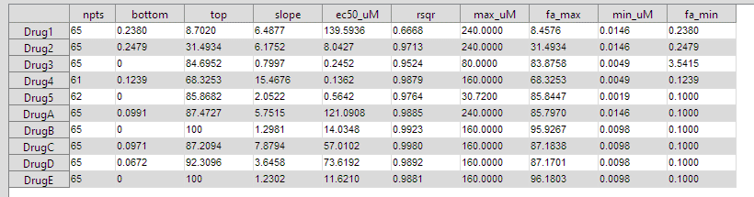
Using SynScreen (7/13)
After updating the dose response curves, the new metrics for the drugs will be displayed on the top right of the interface.
Annotation |  | Meaning
Single agent stats | cpd | Compound or drug identifier
 | npts | Total number of points used in curve fit to data (non-linear regression)
 | bottom | Bottom effect value estimated from curve fit to data
 | top | Top effect value estimated from curve fit to data
 | slope | Hill slope estimated from curve fit to data
 | ec50_uM | Concentration determined by data fit to elicit 50% response (uM)
 | rsqr | Data goodness of fit (correlation coefficient)
 | max_uM | Maximum concentration of a compound used in the assay (uM)
 | fa_max | Maximum measured response for each compound (expressed as %)
 | min_uM | Minimum concentration of a compound used in data fit (uM)
 | fa_min | Minimum measured response for each compound (expressed as %)

Slide 23
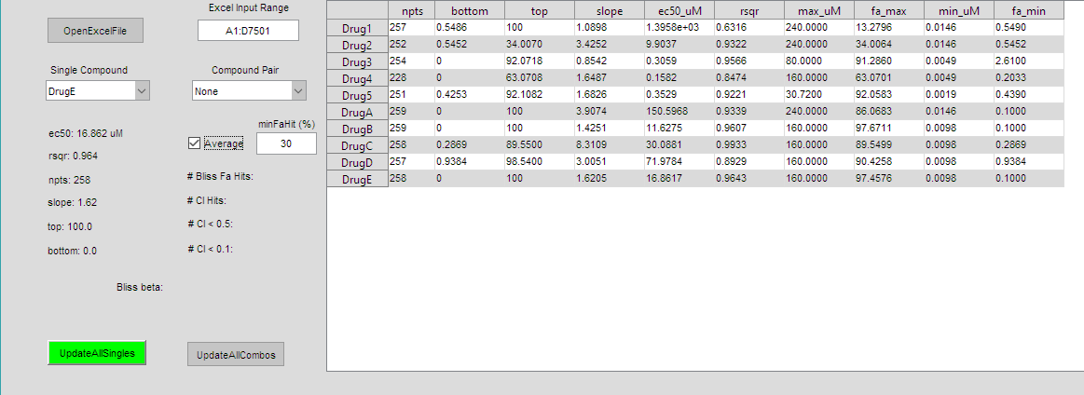
Using SynScreen (8/13)
For data sets with multiple replicates, the user has the option to plot each individual data point or the average of the data points for each drug combination concentration ratio.
To plot the average of multiple replicates, click in the “Average” box next to the “minFaHit” dropdown menu.

Slide 24
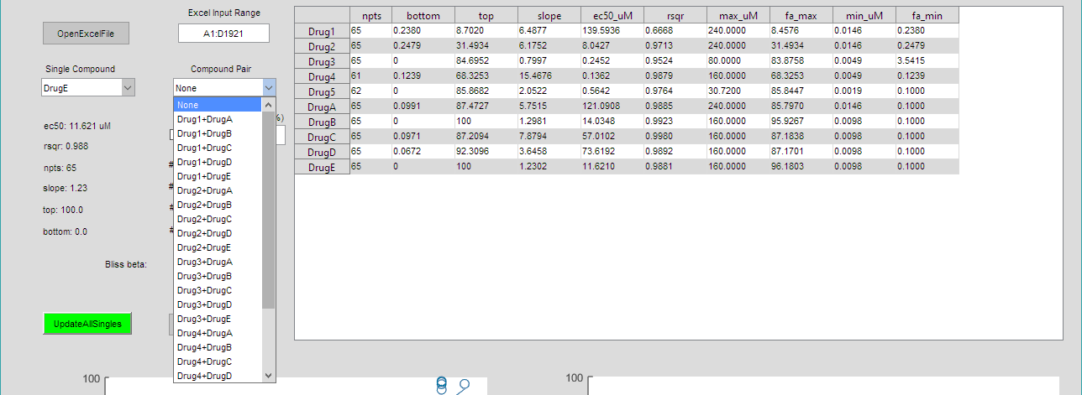
Using SynScreen (9/13)
1
The “minFahit (%)” box allows for a minimum response threshold to be set for the determination of synergy “hits” from combination data.
E.g., only data points with > 30% response are considered for the summaries of synergistic hits.
The “Compound Pair” dropdown menu allows for plots from each combination to be displayed.
2

Slide 25
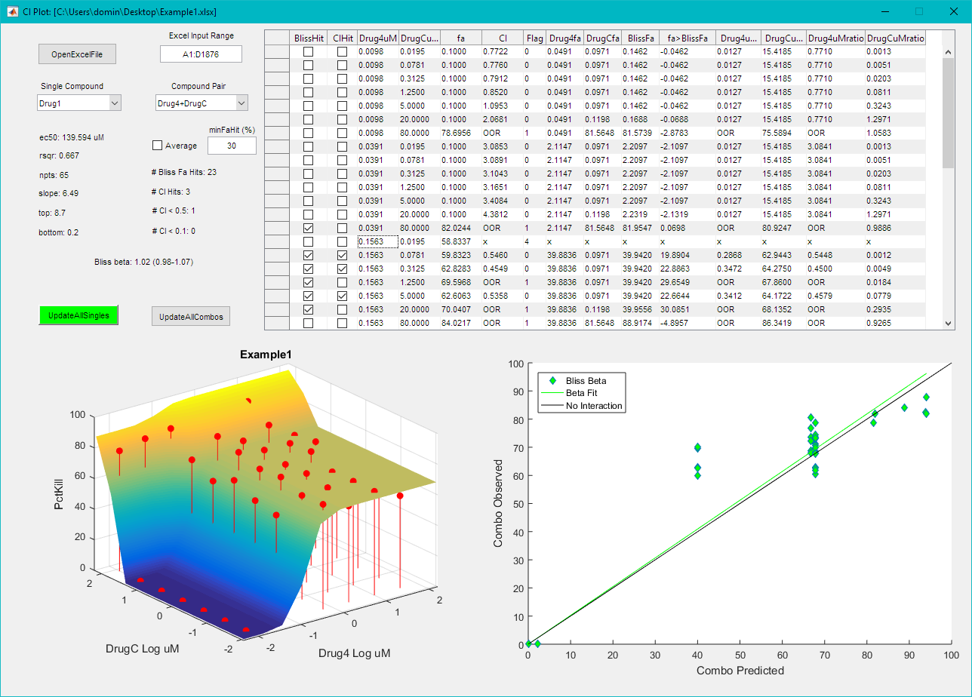
Using SynScreen (10/13)
The SynScreen interface shows a table describing analyses of each data point (top right), and both a 3D plot and Bliss activity plot for the selected drug combination.
Descriptions of the data table and each plot follow on the next slides.
Points from the combination data may be excluded by clicking anywhere within a row of the specific data point on the data table.
The annotation on the row will change to an “x”.
The 3D and Bliss plots will update as well.
Click again to restore inclusion of the row data

Slide 26
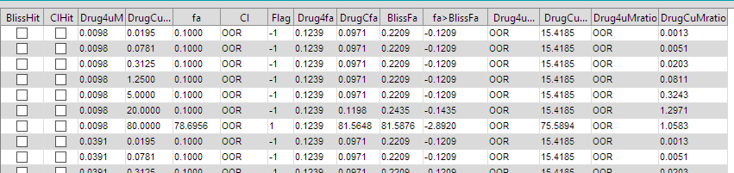
Using SynScreen (11/13)
The data table produced from analysis of the drug combination data.
Note on OOR designation:
The Loewe Additivity model assumes the dose equivalence principle in which, for a given response produced by a dose of compound 1, there is a dose of compound 2 that can produce the equivalent response.
It is often the case that there will be a regime of combinations in which the response produced by the combination cannot be reproduced by the compounds when applied as single agents (e.g., when response maxima of either or both of the compounds are limiting). In such a case, a combination index (CI) cannot be calculated and is designated as out of range (OOR).
It is still possible that there is synergy (e.g., if the combination response exceeds the response maxima of both single agents). Thus, the OOR indication DOES NOT rule out synergy. It only indicates that it is not possible to quantify synergy (or antagonism) via calculation of a CI.
Annotation |  | Meaning
Combo Hit stats | DRUGuM | Concentration of a compound used (uM)
 | fa | Fraction affected; observed normalized response (expressed as %)
 | CI | Combination index value determined by Loewe additivity model analysis
 | DRUGfa | Dose of drug, when applied as a single agent, that is required to attain the response produced by the combination of two drugs
 | BlissFa | Based on the single agent dose responses, this is the theoretical additive response in which those drugs used in combination would produce by the Bliss independence model (expressed as %)
 | fa>BlissFa | Difference between the observed response and the Bliss theoretical response value for additivity, i.e., distance of observed response from the 3D Bliss surface in SynScreen 3D graphs (expressed as %)
 | OOR (out of range) | The response elicited by the combination exceeds the maximum measured response of individual drugs. Therefore, a CI value cannot be calculated.
 | DRUGuMratio | The ratio of DRUGuM to DRUGuMfa

Slide 27
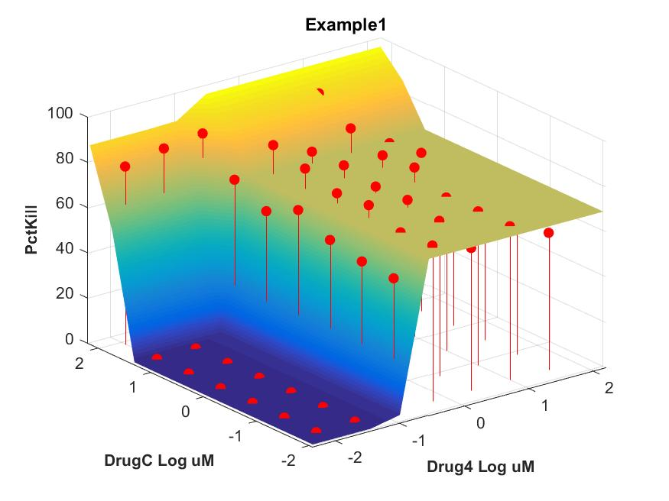
Using SynScreen (12/13)
3D plot of drug combination data
The x and y axes are plotted as log µM.
The dose response curves for the individual drugs are on the edges of the surface.
The 3D surface represents the theoretical responses at which Bliss additivity would occur based on the single agent dose responses.
The red dots indicate the observed experimental data.
Results visible above the surface are considered to be potentially synergistic.

Slide 28
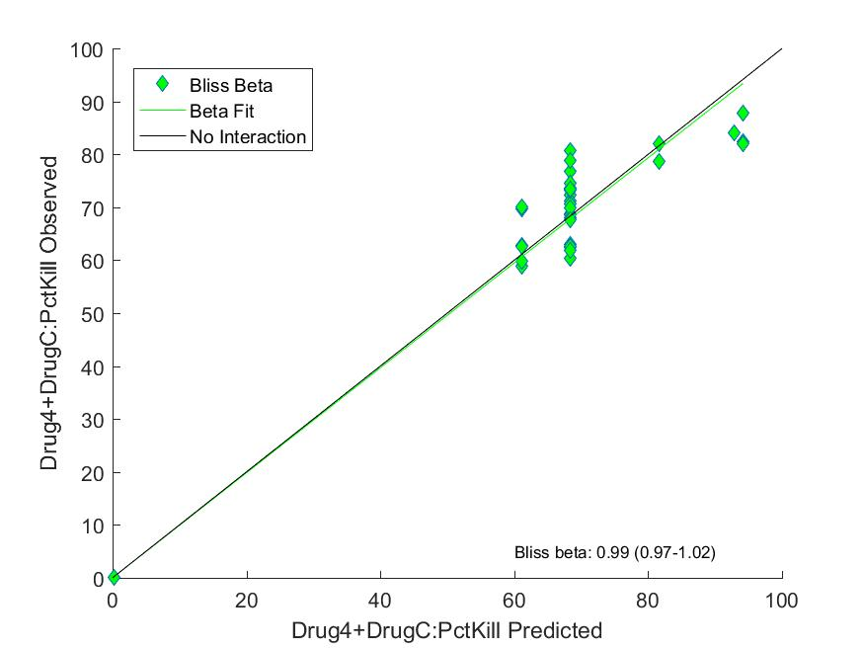
Using SynScreen (13/13)
Bliss additivity plot
The x axis represents the responses predicted based on the Bliss independent model.
The y axis represents observed responses.
The 95% confidence interval for the Bliss beta coefficient is indicated in parentheses.
Note: The overall Bliss beta & 95% confidence interval only appear in the exported plot.
Data points plotted above the “No Interaction” line are considered to be potentially synergistic.

Slide 29
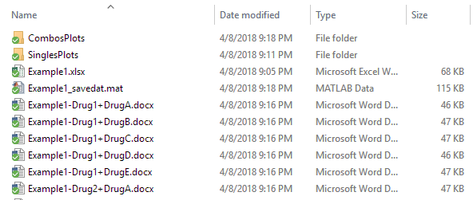
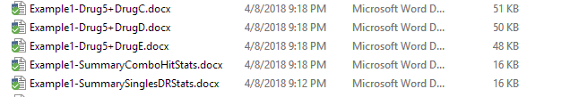
SynScreen data output (1/4)
Click on “UpdateAllcombos”. Plots from each combination will flash on the screen and then be automatically exported into the same folder as the originally imported data file.
Folders will be generated that include images of the single agent dose response curves, 3D combination plots, and Bliss additivity plots.
.docx files for individual combinations will be produced to include synergy hit analyses for the observed data.
Two summary .docx files are produced as well: “ComboHitStats” and “SinglesDRStats”, which are explained on the next slides.
…

Slide 30
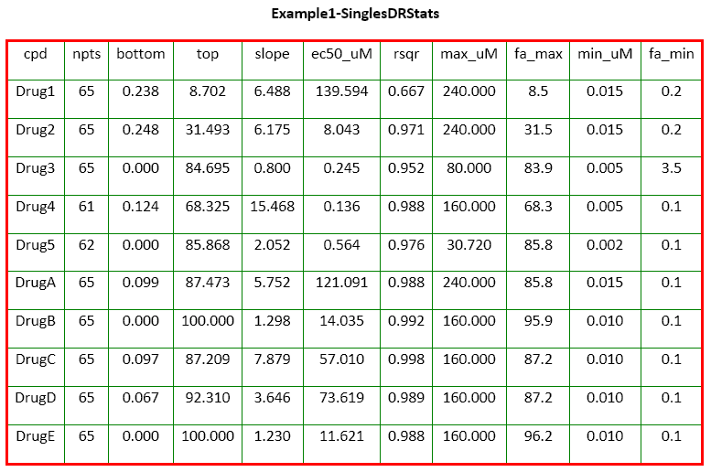
SynScreen data output (2/4)
Single DR stats
This is a summary of the dose response curve fits generated by SynScreen for each drug.
Annotation |  | Meaning
Single agent stats | cpd | Compound or drug identifier
 | npts | Total number of points used in curve fit to data (non-linear regression)
 | bottom | Bottom effect value estimated from curve fit to data
 | top | Top effect value estimated from curve fit to data
 | slope | Hill slope estimated from curve fit to data
 | ec50_uM | Concentration determined by data fit to elicit 50% response (uM)
 | rsqr | Data goodness of fit (correlation coefficient)
 | max_uM | Maximum concentration of a compound used in the assay (uM)
 | fa_max | Maximum measured response for each compound (expressed as %)
 | min_uM | Minimum concentration of a compound used in data fit (uM)
 | fa_min | Minimum measured response for each compound (expressed as %)

Slide 31
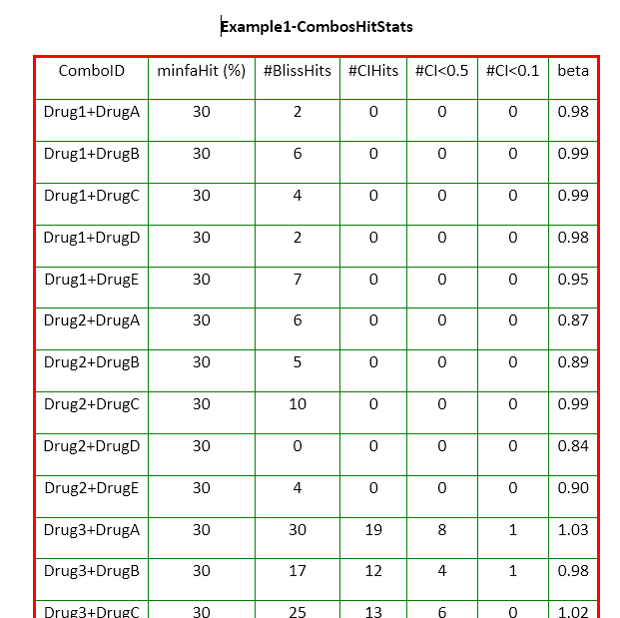
SynScreen data output (3/4)
Combos Hit Stats
This is a summary of the overall numbers of synergistic hits determined for each drug combination.
Annotation |  | Meaning
Combo Hit stats | ComboID | Compound or drug combination identifier
 | minfaHit (%) | Threshold set for minimum response considered for synergy hits
 | #BlissHits | Total number of combinations producing effects in excess of that predicted from the Bliss independence model
 | #CIHits | Total number of synergistic hits determined by combination index based on Loewe additivity model, i.e., CI < 1
 | #CI<0.5 | Total number of combinations that have CI values < 0.5
 | #CI<0.1 | Total number of combinations that have CI values < 0.1
 | Bliss beta | A characterization of the deviation of observed data from the additive response predicted from the Bliss independence model
 | BlissHit | True/false indication of whether an observed response is greater than additive as predicted by Bliss Independence model
 | CIHit | True/false indication of whether an observed response is considered synergistic as predicted by the Loewe additivity model (CI < 1)

Slide 32
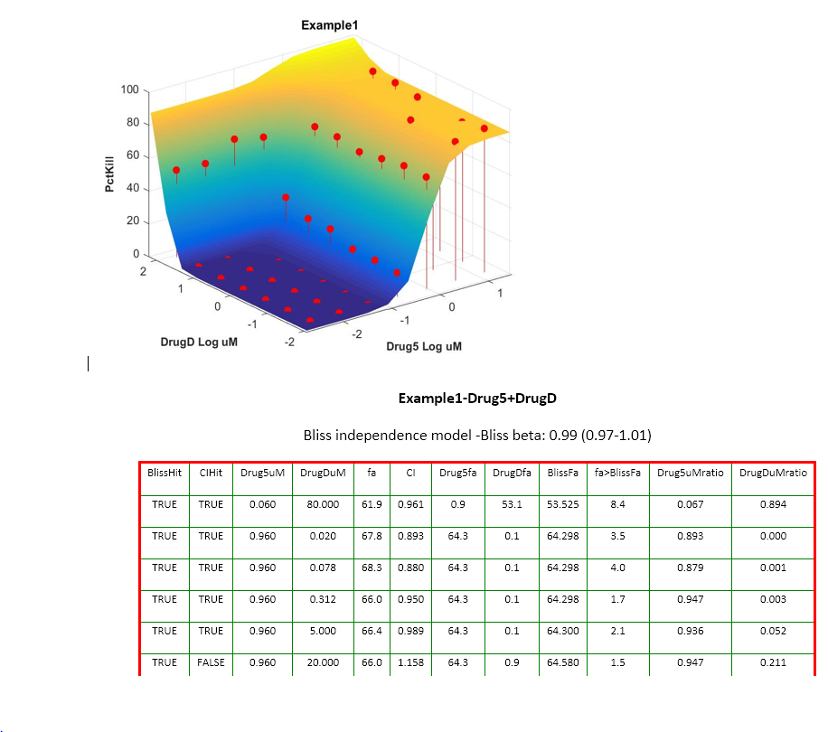
SynScreen data output (4/4)
For each drug combination, .docx files provide a 3D plot of the data, as well as a table containing information about each synergistic data point.
Annotation |  | Meaning
Combo Hit stats | DRUGuM | Concentration of a compound used (uM)
 | fa | Fraction affected; observed normalized response (expressed as %)
 | CI | Combination index value determined by Loewe additivity model analysis
 | DRUGfa | Dose of drug, when applied as a single agent, that is required to attain the response produced by the combination of two drugs
 | BlissFa | Based on the single agent dose responses, this is the theoretical additive response in which those drugs used in combination would produce by the Bliss independence model (expressed as %)
 | fa>BlissFa | Difference between the observed response and the Bliss theoretical response value for additivity, i.e., distance of observed response from the 3D Bliss surface in SynScreen 3D graphs (expressed as %)
 | OOR (out of range) | The response elicited by the combination exceeds the maximum measured response of individual drugs. Therefore, a CI value cannot be calculated.
 | DRUGuMratio | The ratio of DRUGuM to DRUGuMfa

