Slide 1
Adel’s 5comp model
DK’s old 3comp model
New 3comp model
1um
2.5um
3um
350um
118.5um
270um
50um
2um
25um
25um
25um
400um
555um
555um
5um
5um
5um

Slide 2
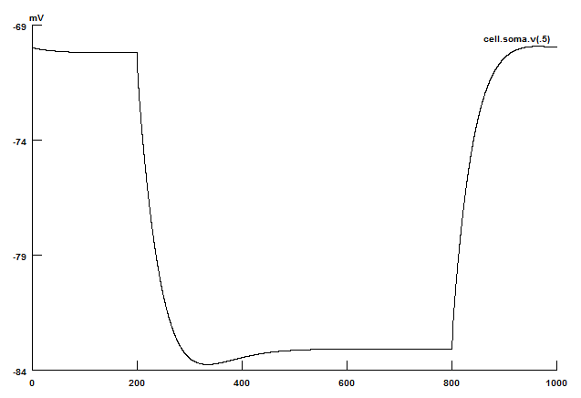
New 3comp model
Passive Properties
R_{in} = 138 MΩ
τ_{m} = 32 ms
Ra=150Ω-cm
Vrest= -70.2mV
Iinject=0.1nA

Slide 3
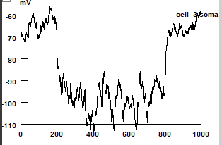
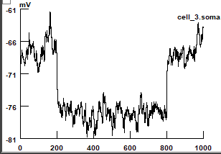
New 3comp model
Passive Properties—adding noise
Iinject=1nA
R_{in} = 138 MΩ
τ_{m} = 32 ms
Ra=150Ω-cm
excnoise 0.0032/0.003
inhnoise 0.021/0.008
Vrest= -70.2mV
R_{in} = 35 MΩ
τ_{m} = 14 ms
Vrest=-64mV
excnoise 0.01/0.002
inhnoise 0.09/0.02
R_{in} = 10 MΩ
τ_{m} = 0.85 ms
Vrest=-64mV

Slide 4
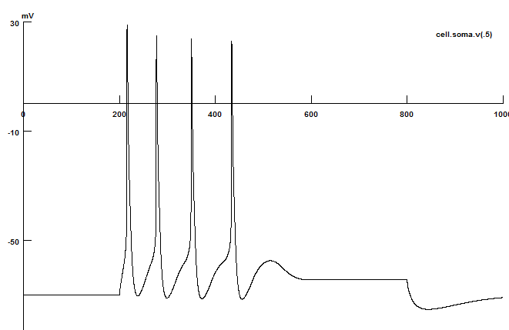
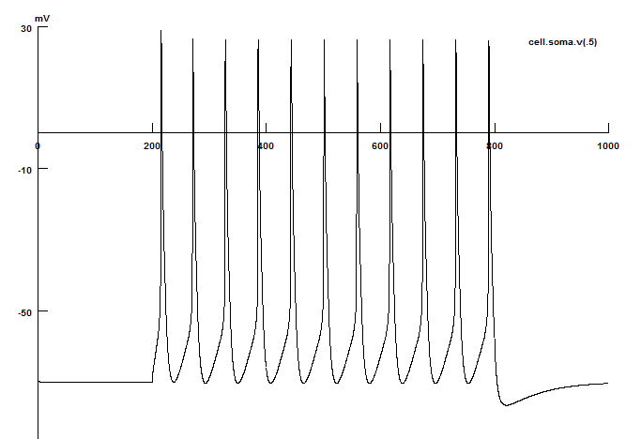
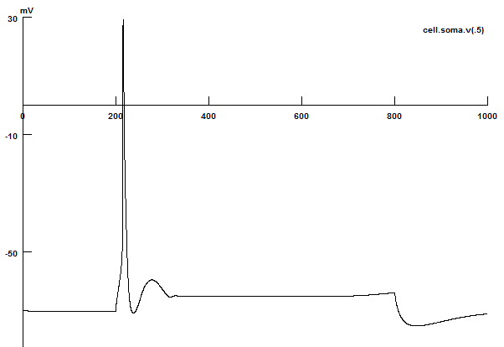
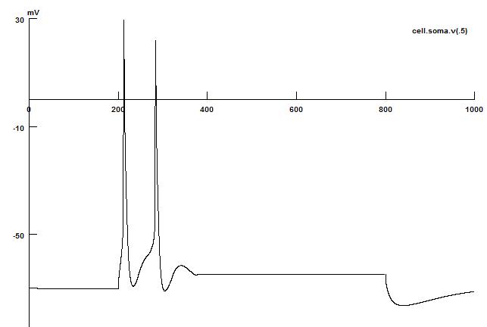
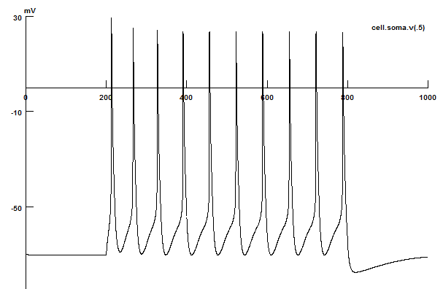
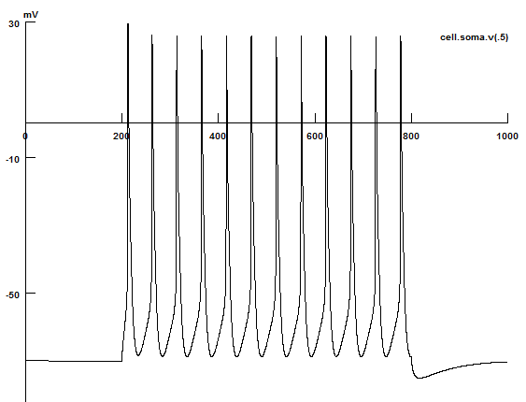
New 3comp model
Spiking Properties
Type A
Type B
Type C
When Iinject=0.3nA
When Iinject=0.4nA

Slide 5
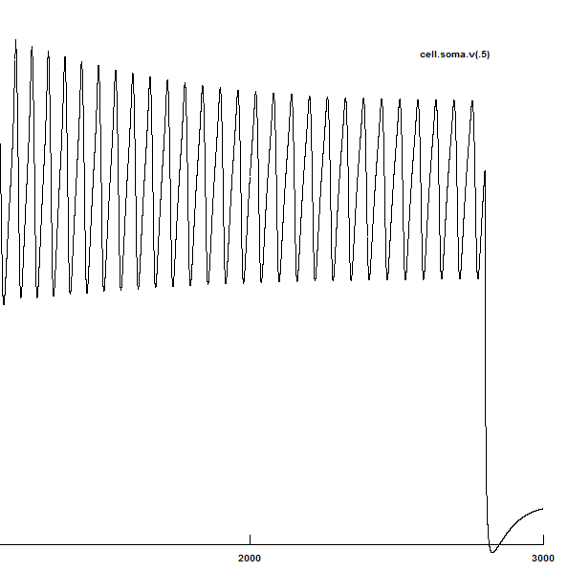

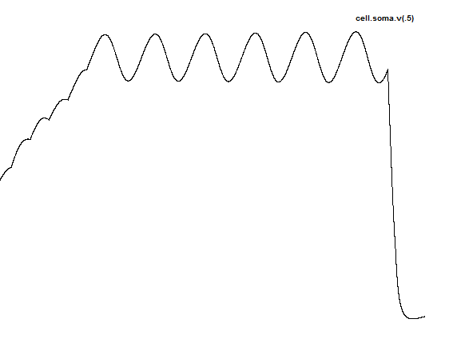
New 3comp model
Osci Properties
LTO
~3.7Hz

Slide 6
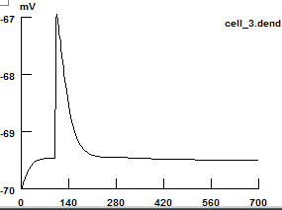
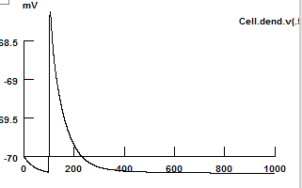
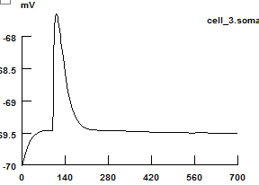
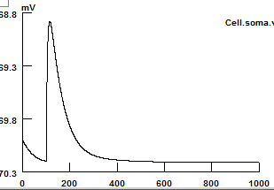
New 3comp model
EPSP attenuation (compare to DK’s old 3-comp model)
DK’s old 3comp model
New 3comp model
3um
2.5um
dend
dend
Exc syn
118.5um
Exc synapse
25um
25um
EPSP amp attenuated by 0.7mV
EPSP amp attenuated by 0.7mV
soma
soma
400um
555um
5um
5um

Slide 7
New 3comp model
1000 LA network results

Slide 8
New 3comp model
To Do
Add biology part for single cell
List all the differences among ABC types of cells
List all the network changes from competition model
Run the model with 800 noise inputs, but keep the protocol
Comparing the membrane voltage trace w/o 800 noise inputs
Weights changes plot/table needed

