Slide 1
Equinumerosity

Slide 2
Equinumerosity
To compare the cardinality (size) of finite sets, it is enough to count
the number of elements in each set and compare these numbers.

Slide 3

Equinumerosity
To compare the cardinality (size) of finite sets, it is enough to count
the number of elements in each set and compare these numbers.

Slide 4



Equinumerosity
To compare the cardinality (size) of finite sets, it is enough to count
the number of elements in each set and compare these numbers.
$$4$$
$$<$$
$$5$$

Slide 5
Equinumerosity
To compare the cardinality (size) of finite sets, it is enough to count
the number of elements in each set and compare these numbers.
$$4$$
$$<$$
$$5$$
However, we do not have the ability to "count" the elements of infinite
sets, but this is also something that discrete mathematics deals with.

Slide 6
Equinumerosity
Another way to compare two sets can be the "childish" method,
which allows comparing sets without knowing "numbers."

Slide 7

Equinumerosity
Another way to compare two sets can be the "childish" method,
which allows comparing sets without knowing "numbers."

Slide 8

Equinumerosity
Another way to compare two sets can be the "childish" method,
which allows comparing sets without knowing "numbers."

Slide 9


Equinumerosity
Another way to compare two sets can be the "childish" method,
which allows comparing sets without knowing "numbers."

Slide 10


Equinumerosity
Another way to compare two sets can be the "childish" method,
which allows comparing sets without knowing "numbers."

Slide 11

Equinumerosity
Another way to compare two sets can be the "childish" method,
which allows comparing sets without knowing "numbers."
The number of cups and saucers turned out to be the same.

Slide 12
Equinumerosity
The same method will work in the example with bags:

Slide 13


Equinumerosity
The same method will work in the example with bags:

Slide 14


Equinumerosity
The same method will work in the example with bags:
Conclusion: The second bag has more elements.

Slide 15
Equinumerosity
Two sets (finite or infinite) 𝐴 and 𝐵 are equinumerous if every element
of set 𝐴 corresponds to exactly one element of set 𝐵.

Slide 16
Equinumerosity
Two sets (finite or infinite) 𝐴 and 𝐵 are equinumerous if every element
of set 𝐴 corresponds to exactly one element of set 𝐵.
Two sets (finite or infinite) 𝐴 and 𝐵 are equinumerous if there is
a bijection between them (a one-to-one and onto function).

Slide 17
Equinumerosity
Two sets (finite or infinite) 𝐴 and 𝐵 are equinumerous if every element
of set 𝐴 corresponds to exactly one element of set 𝐵.
Two sets (finite or infinite) 𝐴 and 𝐵 are equinumerous if there is
a bijection between them (a one-to-one and onto function).
The sets are not equinumerous if such a function (such a matching)
does not exist.

Slide 18
Equinumerosity
Two sets (finite or infinite) 𝐴 and 𝐵 are equinumerous if every element
of set 𝐴 corresponds to exactly one element of set 𝐵.
Example: Prove that there are as many even numbers as odd numbers.

Slide 19

Equinumerosity
Two sets (finite or infinite) 𝐴 and 𝐵 are equinumerous if every element
of set 𝐴 corresponds to exactly one element of set 𝐵.
Example: Prove that there are as many even numbers as odd numbers.
Even: $2, 4, 6, 8, 10, 12, 14, …$

Slide 20

Equinumerosity
Two sets (finite or infinite) 𝐴 and 𝐵 are equinumerous if every element
of set 𝐴 corresponds to exactly one element of set 𝐵.
Example: Prove that there are as many even numbers as odd numbers.
Even: $2, 4, 6, 8, 10, 12, 14, …$
Odd: $1, 3, 5, 7, 9, 11, 13, …$

Slide 21


Equinumerosity
Two sets (finite or infinite) 𝐴 and 𝐵 are equinumerous if every element
of set 𝐴 corresponds to exactly one element of set 𝐵.
Example: Prove that there are as many even numbers as odd numbers.
Even: $2, 4, 6, 8, 10, 12, 14, …$
Odd: $1, 3, 5, 7, 9, 11, 13, …$
Solution: It is enough to pair the numbers:
$$1→2,$$
$$3→4, \\ 5→6, \\ …$$

Slide 22
Equinumerosity
Two sets (finite or infinite) 𝐴 and 𝐵 are equinumerous if every element
of set 𝐴 corresponds to exactly one element of set 𝐵.
Example: Prove that there are as many even numbers as odd numbers.
Even: $2, 4, 6, 8, 10, 12, 14, …$
Odd: $1, 3, 5, 7, 9, 11, 13, …$
Solution: It is enough to pair the numbers:
$$1→2,$$
$$3→4, \\ 5→6, \\ …$$
Notice that every even number has been
used exactly once, and that every odd
number is used exactly once.

Slide 23
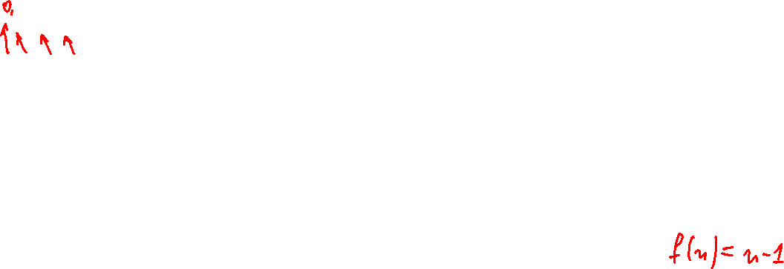


Equinumerosity
Two sets (finite or infinite) 𝐴 and 𝐵 are equinumerous if every element
of set 𝐴 corresponds to exactly one element of set 𝐵.
Example: Prove that there are as many even numbers as odd numbers.
Even: $2, 4, 6, 8, 10, 12, 14, …$
Odd: $1, 3, 5, 7, 9, 11, 13, …$
Solution: It is enough to pair the numbers:
$$1→2,$$
$$3→4, \\ 5→6, \\ …$$
Function:
$$f\left(n\right)=n+1$$
Notice that every even number has been
used exactly once, and that every odd
number is used exactly once.

