Slide 1
Discrete mathematics

Slide 2
Discrete mathematics
Discrete mathematics is a field that studies structures and objects
that can be counted — that is, those which are equinumerous
with the set of natural numbers.

Slide 3
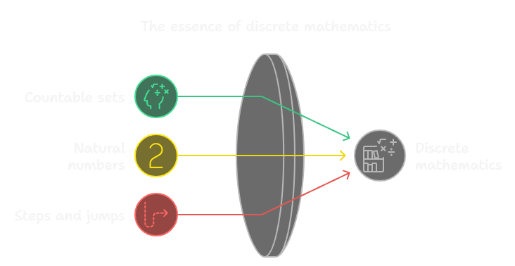
Discrete mathematics
Discrete mathematics is a field that studies structures and objects
that can be counted — that is, those which are equinumerous
with the set of natural numbers.

Slide 4
Discrete mathematics
Discrete mathematics is essentially a collection of branches
of mathematics, or subsets of other mathematical branches,
that focus on countable, stepwise structures.

Slide 5
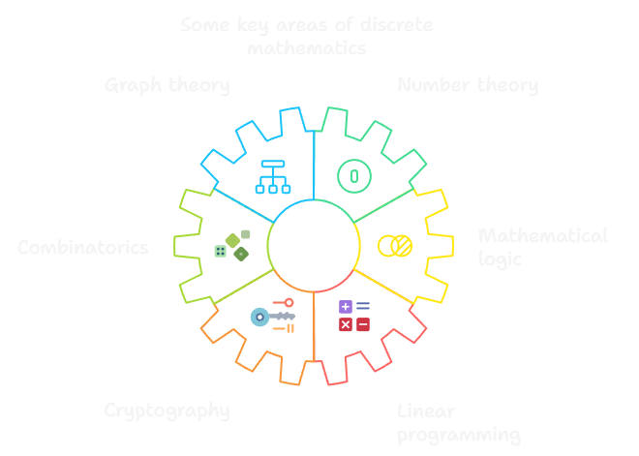
Discrete mathematics
Discrete mathematics is essentially a collection of branches
of mathematics, or subsets of other mathematical branches,
that focus on countable, stepwise structures.

Slide 6

Discrete mathematics
Imagine you are planning a trip through the city. You need to decide
how to get from one point to another, choosing from a limited number
of available routes. You can calculate all possible paths
and their costs — whether in terms of time, money, or other resources.
In discrete mathematics, we deal with such problems: how to optimally
plan a route and determine all possible options.

Slide 7

Discrete mathematics
Or think of digital photos on your phone. Each photo is a collection
of pixels, and each pixel is mapped to a specific color from a limited set.
Discrete mathematics helps model such data, compress it,
and analyze its structure — which has important applications
in computer science and data processing.

Slide 8

Discrete mathematics
Another example is cryptography. When you send an encrypted message,
its security often relies on prime numbers. Discrete mathematics
not only helps us identify these numbers, but also enables us to use
them in designing encryption algorithms that protect our data from
unauthorized access.

