Slide 1
K-Permutations and K-Tuples

Slide 2
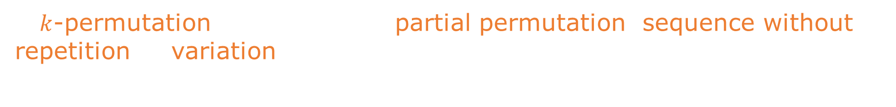
K-Permutations and K-Tuples
A $k$-permutation of a set (also: partial permutation, sequence without
repetition or variation) is an ordered arrangement of $k$ distinct elements
selected from the set.

Slide 3
K-Permutations and K-Tuples
A $k$-permutation of a set (also: partial permutation, sequence without
repetition or variation) is an ordered arrangement of $k$ distinct elements
selected from the set.
For the set $X=\left\{1,2,3\right\}$ examples of $k$-permutations are: $\left\{1\right\}, \left\{1,2\right\}, \left\{3,2\right\}, \left\{1,3,2\right\}$.

Slide 4
K-Permutations and K-Tuples
A $k$-permutation of a set (also: partial permutation, sequence without
repetition or variation) is an ordered arrangement of $k$ distinct elements
selected from the set.
For the set $X=\left\{1,2,3\right\}$ examples of $k$-permutations are: $\left\{1\right\}, \left\{1,2\right\}, \left\{3,2\right\}, \left\{1,3,2\right\}$.
There are:

Slide 5
K-Permutations and K-Tuples
A $k$-permutation of a set (also: partial permutation, sequence without
repetition or variation) is an ordered arrangement of $k$ distinct elements
selected from the set.
For the set $X=\left\{1,2,3\right\}$ examples of $k$-permutations are: $\left\{1\right\}, \left\{1,2\right\}, \left\{3,2\right\}, \left\{1,3,2\right\}$.
There are:
Three one-element $k$-permutations: $\left\{1\right\}, \left\{2\right\}, \left\{3\right\}$.

Slide 6
K-Permutations and K-Tuples
A $k$-permutation of a set (also: partial permutation, sequence without
repetition or variation) is an ordered arrangement of $k$ distinct elements
selected from the set.
For the set $X=\left\{1,2,3\right\}$ examples of $k$-permutations are: $\left\{1\right\}, \left\{1,2\right\}, \left\{3,2\right\}, \left\{1,3,2\right\}$.
There are:
Three one-element $k$-permutations: $\left\{1\right\}, \left\{2\right\}, \left\{3\right\}$.
Six two-element $k$-permutations:
$$\left\{1,2\right\},\left\{1,3\right\}, \left\{2,1\right\}, \left\{2,3\right\}, \left\{3,1\right\}, \left\{3,2\right\}$$

Slide 7
K-Permutations and K-Tuples
A $k$-permutation of a set (also: partial permutation, sequence without
repetition or variation) is an ordered arrangement of $k$ distinct elements
selected from the set.
For the set $X=\left\{1,2,3\right\}$ examples of $k$-permutations are: $\left\{1\right\}, \left\{1,2\right\}, \left\{3,2\right\}, \left\{1,3,2\right\}$.
There are:
Three one-element $k$-permutations: $\left\{1\right\}, \left\{2\right\}, \left\{3\right\}$.
Six two-element $k$-permutations:
$$\left\{1,2\right\},\left\{1,3\right\}, \left\{2,1\right\}, \left\{2,3\right\}, \left\{3,1\right\}, \left\{3,2\right\}$$
Six three-element $k$-permutations ($=$permutations):
$$\left\{1,2,3\right\}, \left\{1,3,2\right\}, \left\{2,1,3\right\},\left\{2,3,1\right\},\left\{3,1,2\right\},\left\{3,2,1\right\}$$

Slide 8
K-Permutations and K-Tuples
A $k$-permutation of a set (also: partial permutation, sequence without
repetition or variation) is an ordered arrangement of $k$ distinct elements
selected from the set.
For the set $X=\left\{1,2,3\right\}$ examples of $k$-permutations are: $\left\{1\right\}, \left\{1,2\right\}, \left\{3,2\right\}, \left\{1,3,2\right\}$.
There are:
Three one-element $k$-permutations: $\left\{1\right\}, \left\{2\right\}, \left\{3\right\}$.
Six two-element $k$-permutations:
$$\left\{1,2\right\},\left\{1,3\right\}, \left\{2,1\right\}, \left\{2,3\right\}, \left\{3,1\right\}, \left\{3,2\right\}$$
Six three-element $k$-permutations ($=$permutations):
$$\left\{1,2,3\right\}, \left\{1,3,2\right\}, \left\{2,1,3\right\},\left\{2,3,1\right\},\left\{3,1,2\right\},\left\{3,2,1\right\}$$
A full (normal) permutation is a special case of $k$-permutation where $k=n$.

Slide 9
K-Permutations and K-Tuples
A k-tuple of a set (also: permutation with repetition, sequence with
repetition, variation with repetition) is an ordered arrangement where
each element can be selected multiple times.

Slide 10
K-Permutations and K-Tuples
A k-tuple of a set (also: permutation with repetition, sequence with
repetition, variation with repetition) is an ordered arrangement where
each element can be selected multiple times.
For the set $X=\left\{1,2,3\right\}$ examples of k-tuples are:
$$\left\{1\right\}, \left\{1,1\right\}, \left\{2,3\right\}, \left\{3,2,1\right\}, \left\{3,3,2\right\}$$

Slide 11
K-Permutations and K-Tuples
A k-tuple of a set (also: permutation with repetition, sequence with
repetition, variation with repetition) is an ordered arrangement where
each element can be selected multiple times.
For the set $X=\left\{1,2,3\right\}$ examples of k-tuples are:
$$\left\{1\right\}, \left\{1,1\right\}, \left\{2,3\right\}, \left\{3,2,1\right\}, \left\{3,3,2\right\}$$
There are:

Slide 12
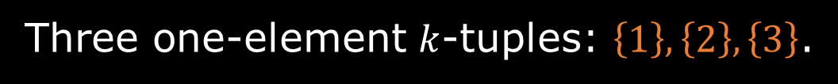
K-Permutations and K-Tuples
A k-tuple of a set (also: permutation with repetition, sequence with
repetition, variation with repetition) is an ordered arrangement where
each element can be selected multiple times.
For the set $X=\left\{1,2,3\right\}$ examples of k-tuples are:
$$\left\{1\right\}, \left\{1,1\right\}, \left\{2,3\right\}, \left\{3,2,1\right\}, \left\{3,3,2\right\}$$
There are:
Three one-element $k$-tuples: $\left\{1\right\}, \left\{2\right\}, \left\{3\right\}$.

Slide 13
K-Permutations and K-Tuples
A k-tuple of a set (also: permutation with repetition, sequence with
repetition, variation with repetition) is an ordered arrangement where
each element can be selected multiple times.
For the set $X=\left\{1,2,3\right\}$ examples of k-tuples are:
$$\left\{1\right\}, \left\{1,1\right\}, \left\{2,3\right\}, \left\{3,2,1\right\}, \left\{3,3,2\right\}$$
There are:
Three one-element $k$-tuples: $\left\{1\right\}, \left\{2\right\}, \left\{3\right\}$.
Nine two-element $k$-tuples:
$$\left\{1,1\right\},\left\{1,2\right\}, \left\{1,3\right\}, \left\{2,1\right\}, \left\{2,2\right\}, \left\{2,3\right\}, \left\{3,1\right\}, \left\{3,2\right\}, \left\{3,3\right\}$$

Slide 14

K-Permutations and K-Tuples
A k-tuple of a set (also: permutation with repetition, sequence with
repetition, variation with repetition) is an ordered arrangement where
each element can be selected multiple times.
For the set $X=\left\{1,2,3\right\}$ examples of k-tuples are:
$$\left\{1\right\}, \left\{1,1\right\}, \left\{2,3\right\}, \left\{3,2,1\right\}, \left\{3,3,2\right\}$$
There are:
Three one-element $k$-tuples: $\left\{1\right\}, \left\{2\right\}, \left\{3\right\}$.
Nine two-element $k$-tuples:
$$\left\{1,1\right\},\left\{1,2\right\}, \left\{1,3\right\}, \left\{2,1\right\}, \left\{2,2\right\}, \left\{2,3\right\}, \left\{3,1\right\}, \left\{3,2\right\}, \left\{3,3\right\}$$
Twenty-seven three-element $k$-tuples:
$$\left\{1,1,1\right\},\left\{1,1,2\right\}, \left\{1,1,3\right\}, \left\{1,2,1\right\}, \left\{1,2,2\right\}, \left\{1,2,3\right\}, \left\{1,3,1\right\}, \left\{1,3,2\right\}, \left\{1,3,3\right\}, \\ \left\{2,1,1\right\},\left\{2,1,2\right\}, \left\{2,1,3\right\}, \left\{2,2,1\right\}, \left\{2,2,2\right\}, \left\{2,2,3\right\}, \left\{2,3,1\right\}, \left\{2,3,2\right\}, \left\{2,3,3\right\}, \\ \left\{3,1,1\right\},\left\{3,1,2\right\}, \left\{3,1,3\right\}, \left\{3,2,1\right\}, \left\{3,2,2\right\}, \left\{3,2,3\right\}, \left\{3,3,1\right\}, \left\{3,3,2\right\}, \left\{3,3,3\right\}$$

Slide 15

K-Permutations and K-Tuples
The number of $k$-permutations of an $n$-element set (without repetition)
is given by:
$$P\left(n,k\right)=\frac{n!}{\left(n−k\right)!}$$

Slide 16
K-Permutations and K-Tuples
The number of $k$-permutations of an $n$-element set (without repetition)
is given by:
$$P\left(n,k\right)=\frac{n!}{\left(n−k\right)!}$$
$$P\left(n,k\right)=\left(n−k+1\right)⋅\left(n−k+2\right)⋅…⋅\left(n−1\right)⋅n$$

Slide 17

K-Permutations and K-Tuples
The number of $k$-permutations of an $n$-element set (without repetition)
is given by:
$$P\left(n,k\right)=\frac{n!}{\left(n−k\right)!}$$
$$P\left(n,k\right)=\left(n−k+1\right)⋅\left(n−k+2\right)⋅…⋅\left(n−1\right)⋅n$$
The number of $k$-tuples (with repetition) from an n-element set is given by
$$T\left(n,k\right)=n^{k}$$

Slide 18
K-Permutations and K-Tuples
How many three-element sequences can be formed
from a set of 7 elements?
a) without repetition
b) with repetition

Slide 19

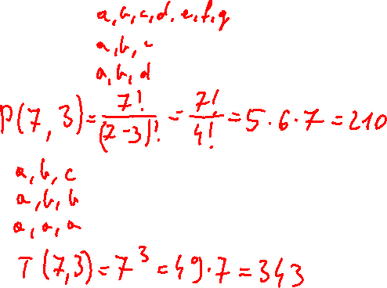

K-Permutations and K-Tuples
How many three-element sequences can be formed
from a set of 7 elements?
a) without repetition
b) with repetition
$$P\left(n,k\right)=\frac{n!}{\left(n−k\right)!}$$
$$P\left(n,k\right)=\left(n−k+1\right)⋅\left(n−k+2\right)⋅…⋅\left(n−1\right)⋅n$$
$$T\left(n,k\right)=n^{k}$$

