Slide 1

Bete (ቤቴ)
Household Repair & Maintenance Service
Senior Project Defense Presentation
• Presenter / Student: [Student Name(s)] • Department: Computer Science / Software Engineering • Institution: [University Name] • Academic Year: 2026 • Technology: React Native • TypeScript • Node.js • Express • MongoDB
Domestic Service Ecosystem
🔧 Plumbing & Water Systems
Pipe repairs, water tanks, pump installations
⚡ Electrical & Power
Breakers, rewiring, appliance repairs
📱 On-Demand Dispatch
Connects customers with verified nearby technicians
💬 Real-time Coordination
Direct in-app chat & instant push notifications
🛡️ Verified Artisan Trust
Vetted Kebele ID & certified trade qualifications
Notes:
Honorable members of the examination committee, academic advisor, and faculty: Welcome to my senior project defense for 'Bete – Household Repair & Maintenance Service'. Bete is a comprehensive mobile platform developed with React Native and Node.js to formalize, streamline, and secure domestic repairs across Ethiopian urban households.

Slide 2
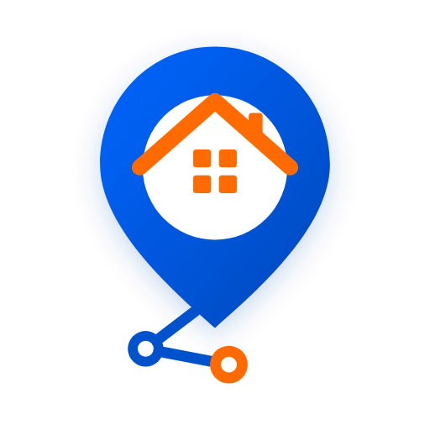
02 | Introduction
What is Bete and background of the project
🏠 What is Bete? (ቤቴ)
• An on-demand mobile marketplace connecting Ethiopian households with vetted repair technicians.
• 'Bete' translates to 'My Home' in Amharic, representing domestic safety, care, and reliable sanctuary.
• Serves homeowners, tenants, and verified trade professionals through dedicated, role-based mobile interfaces.
🌍 Project Background
• Rapid urbanization across Addis Ababa has created intense daily demand for home maintenance.
• Traditional sourcing relies heavily on word-of-mouth or street wall advertisements with zero verification.
• Technicians operate informally without digital tools to showcase qualifications or manage client bookings.
• High mobile phone adoption and mobile money growth in Ethiopia make this the perfect timing for formalization.
Notes:
To introduce Bete: It is an on-demand mobile ecosystem engineered specifically for Ethiopia. 'Bete' means 'My Home'. Today in urban centers like Addis Ababa, whenever a pipe bursts or an electrical short occurs, residents struggle to find trusted help. Bete bridges this gap through verified digital coordination.

Slide 3
03 | Problem Statement
Four primary structural barriers in the current traditional repair market
🚨 1. Difficulty Finding Trusted Technicians
Homeowners struggle to find reliable, vetted handymen promptly during emergencies. Informal networks offer zero background checks or skill verification.
⏱️ Delayed Household Repairs
• Emergency plumbing leaks and electrical faults cause compounding property damage
• Prolonged phone calls, repeated technician cancellations, and no-shows
• Lack of immediate emergency broadcast dispatch
📱 Lack of Convenient Service Booking
• No unified digital platform to browse standardized service categories and upfront prices
• Unpredictable price haggling and arbitrary on-site fee inflations
• Inefficient manual coordination with zero digital audit trail or warranty
📉 Difficulty for Technicians to Find Customers
• Skilled tradespeople rely on street advertisements or small neighborhood networks
• Irregular work pipeline leads to unstable daily income and financial insecurity
• No digital portfolio to showcase trade certifications or client testimonials
Notes:
Our problem statement identifies four core bottlenecks: First, the acute difficulty in finding trusted, verified technicians. Second, delays that lead to property damage. Third, the total absence of convenient digital booking. And fourth, the struggle of honest technicians to secure steady work.

Slide 4
04 | Project Objectives
Defining the overall mission and specific engineering targets of Bete
🎯 General Objective
To design, develop, and deploy a secure, mobile-first on-demand household repair and maintenance application that connects Ethiopian service seekers with verified, skilled technicians through real-time request broadcasting, competitive bidding, in-app messaging, and reliable quality ratings.
📱 Engineering & Mobile Access
• Build cross-platform Android/iOS client using React Native & Expo
• Create responsive, intuitive UI tailored for local user accessibility
• Implement role-based navigation for Customers and Technicians
⚡ Broadcasting & Real-Time Sync
• Implement instant job broadcasting by subcity & trade category
• Deploy WebSocket chat & Expo push notification alerts
• Establish Connects credit system to prevent spam proposals
🛡️ Security, Vetting & Trust
• Enforce JWT token authentication & bcrypt password hashing
• Support document upload for ID and vocational trade certificates
• Provide verified customer ratings to incentivize top workmanship
Notes:
Our general objective is building a secure, reliable marketplace for home repairs. Our specific objectives span cross-platform mobile development, real-time job broadcasting via WebSockets and push notifications, and rigorous security with verified trust mechanisms.

Slide 5
05 | Proposed Solution
How Bete addresses each traditional repair challenge systematically
📡 Instant Broadcasting
Customers post issue details, photos, and subcity location in under 2 minutes. The job is instantly dispatched to matching technicians.
✅ Verified Technician Profiles
Service providers must submit identification and trade qualifications. Customers can inspect ratings, past reviews, and completed tasks.
💰 Transparent Bidding Engine
Technicians submit itemized price proposals. Customers compare bids, preventing extortionate price haggling or hidden charges.
💬 Real-time In-App Chat
Built-in direct messaging powered by WebSockets allows seamless coordination, photo sharing, and arrival scheduling without sharing phone numbers.
Notes:
The proposed solution systematically dismantles the traditional market barriers through instant request broadcasting, verified technician credentials, a transparent bidding mechanism, and integrated real-time chat.

Slide 6
06 | Target Users & Stakeholders
Three primary roles interacting within the Bete digital ecosystem
👤 Service Seekers
Homeowners & Tenants
• Individuals and businesses requiring reliable maintenance
• Search by subcity and trade category
• Post service requests with photos and budgets
• Review provider profiles, chat, and rate services
🔧 Service Providers
Certified Technicians
• Plumbers, electricians, appliance technicians, carpenters
• Toggle on/off-duty availability status
• Receive real-time push alerts for matching jobs
• Submit competitive bids and grow digital reputation
🛡️ Platform Admin
System Oversight
• Platform administrators ensuring service quality
• Verify technician identity and trade certificates
• Monitor platform analytics, dispute mediation
• Manage service categories and user compliance
Notes:
Bete defines three primary stakeholders: Service Seekers who request repairs, Service Providers who deliver trade expertise, and System Administrators who oversee verification, quality control, and platform compliance.

Slide 7
07 | Main Features
Core capabilities delivered across the mobile platform
📋 Service Selection
5 core categories & 16+ granular specialties (plumbing, electrical, appliance repair).
📝 Problem Description
Detailed problem description with custom urgency levels: Today & Emergency (+5).
📷 Photo Attachment
Direct camera/gallery image picker to attach visual evidence of household damage.
🔍 Technician Discovery
Browse verified technicians filtered by subcity, trade category, and customer rating.
💼 Service Request & Bidding
Automated broadcasting with a competitive quotation engine and connects balance.
⭐ Ratings & Reviews
Verified customer feedback with 1–5 star scores to build long-term artisan trust.
👤 User Profiles & Vetting
Edit profile, upload credentials, manage availability, and view transaction history.
🔒 Role-Based Access
Dedicated navigation flows and distinct permissions for customers vs. technicians.
Notes:
Here are the eight core features of Bete: service selection, problem description with emergency priority, photo attachment, technician discovery, competitive bidding, verified ratings, profile management, and role-based access control.

Slide 8
08 | System Workflow / How Bete Works
Step-by-step lifecycle from request posting to completed repair
📝 Step 1
Customer Requests Service
Customer selects service category, writes issue description, attaches photos, sets urgency, and broadcasts request.
🔔 Step 2
Technician Receives Request
Matching technicians in the subcity receive instant push notifications & socket alerts on their Jobs feed.
🤝 Step 3
Technician Bids / Accepts
Technician reviews details and submits price proposal. Customer reviews bids and accepts preferred technician.
🔧 Step 4
Service Execution & Chat
Technician and customer coordinate arrival details via real-time in-app chat. Technician completes the repair.
⭐ Step 5
Completion & Rating
Customer confirms successful completion, settles payment, and submits a 1-5 star verified rating & review.
Notes:
The system workflow operates as a transparent 5-stage lifecycle: customer posts request, technician receives real-time alert, technician bids and customer accepts, repair is executed with chat coordination, and the customer finalizes by rating the artisan.

Slide 9
09 | System Architecture
Three-tier distributed architecture ensuring scalability, speed, and security
📱 Mobile Client (Presentation)
• React Native & Expo SDK 54
• Expo Router file-based navigation
• TypeScript for type safety & fewer runtime bugs
• SecureStore for encrypted local JWT tokens
• Responsive scaling utility across Android devices
⚙️ Backend Server (Application Logic)
• Node.js & Express.js REST API
• Socket.io for bidirectional live chat rooms
• JWT Middleware for role-based authentication
• Multer for photo/document multipart uploads
• Hosted on Render Cloud Infrastructure
🗄️ Data & Services (Persistence & Cloud)
• MongoDB Atlas NoSQL document database
• Mongoose ODM for structured data modeling
• Expo Push Notification HTTP Service
• RESTful API communication over TLS/HTTPS
• Automated database indexes for rapid queries
Notes:
Our architecture follows an enterprise 3-tier pattern: The mobile presentation tier built in React Native/Expo, the application logic tier running Node.js and Socket.io, and the persistence tier leveraging MongoDB Atlas with cloud push notification dispatch.

Slide 10
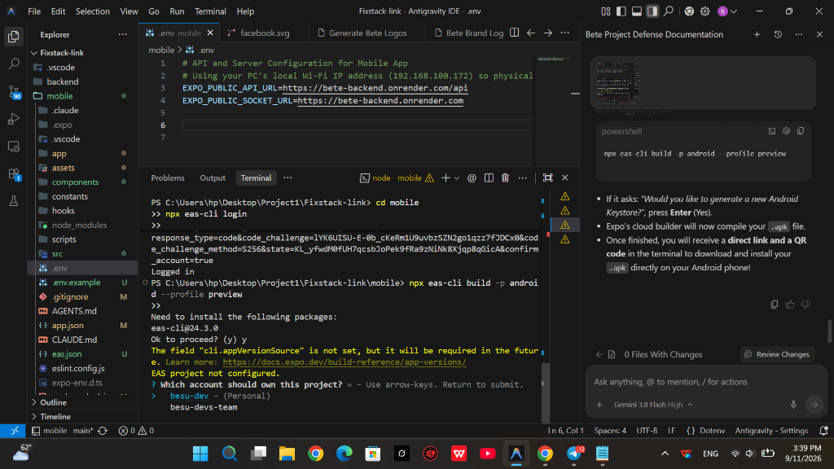
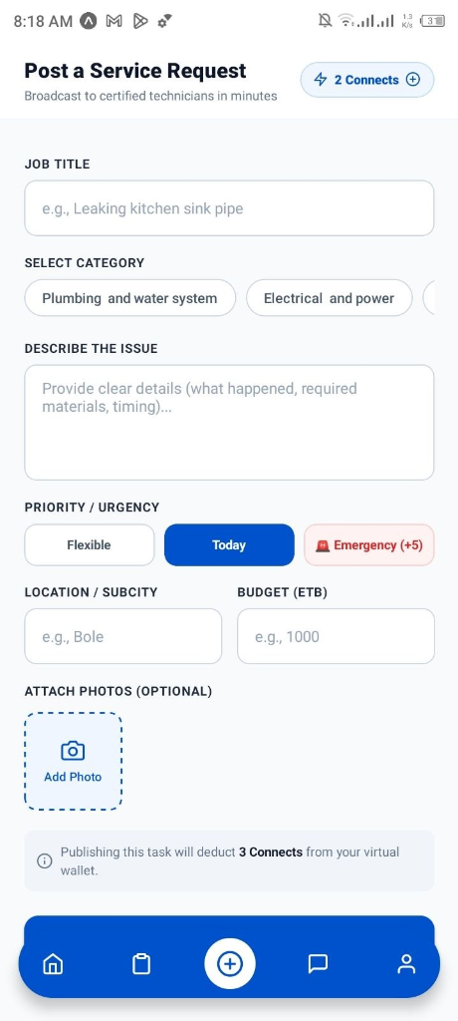
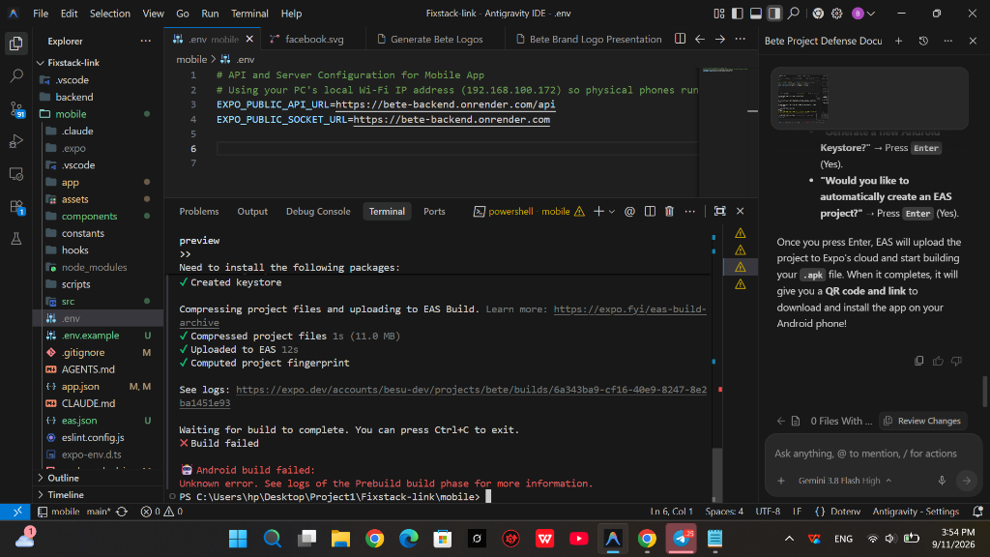
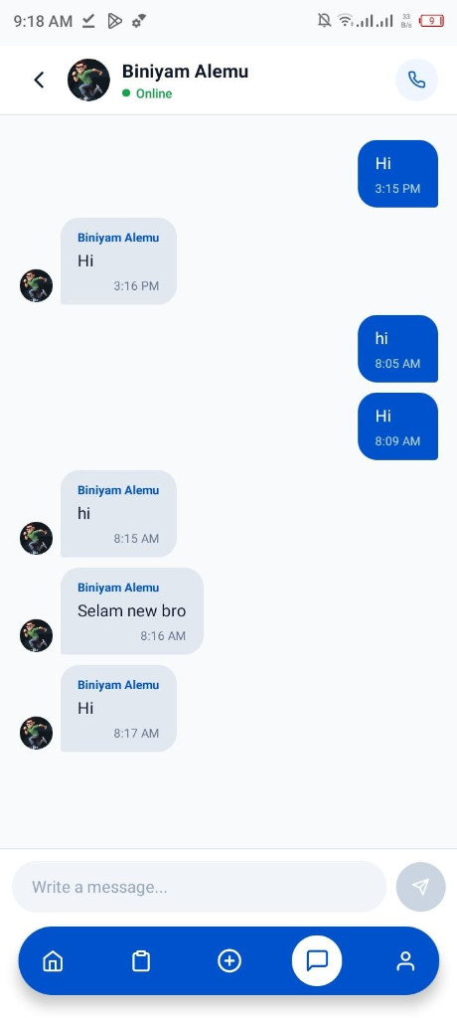
10 | UI/UX Design & Key Mobile Screens
Clean Ethiopian startup aesthetic with high visual contrast and intuitive layouts
Home & Services
Browse categories, view banner promotions, discover certified technicians.
Service Request Screen
Input problem details, select urgency (Today/Emergency), attach photos.
Technician Profile
View verified credentials, completed tasks, customer reviews, and direct hire.
In-App Direct Chat
Full-height conversation screen with online status, timestamps, and input dock.
Notes:
This slide showcases the UI/UX design: Onboarding, Home screen with quick service shortcuts, the Post Request interface, comprehensive Technician Profiles, and the active Chat interface which cleanly hides the bottom navigation bar.

Slide 11
11 | Database Design
Core MongoDB collections, document schemas, and relational integrity
👤 Users Collection
• fullName, email, phone, role (customer/provider/admin)
• password (bcrypt hashed), pushToken for alerts
• connectsBalance, isAvailable (on/off duty)
• avatarUrl, documents (ID & trade certifications)
📋 Jobs Collection
• title, category, description, subcity location
• budget (ETB), urgency (Today / Emergency)
• status (open, assigned, in-progress, completed)
• photos array, customerId (Ref: User), technicianId
💼 Bids Collection
• jobId (Ref: Job), providerId (Ref: User)
• proposedPrice, estimatedDays, coverNote
• status (pending, accepted, rejected)
• timestamps (createdAt, updatedAt)
💬 Messages & Notifications
• senderId, receiverId, jobId, text content
• isRead flag, timestamps for socket delivery
• Notifications: recipient, title, body, type, isRead
• Fast indexes on (userId, createdAt, jobId)
Notes:
Our database schema leverages MongoDB for flexible document storage: Users table with role-based attributes, Jobs collection with geolocation subcities, Bids collection connecting technicians with proposals, and Messages for real-time chat persistence.

Slide 12
12 | Implementation & Technologies Used
Production technology stack powering the Bete platform
📱 Frontend / Mobile
• React Native 0.76+ & Expo SDK 54
• TypeScript for robust static typing
• Expo Router for modern file-based routing
• React Native Reanimated for smooth UI animations
• Expo SecureStore & ImagePicker
⚙️ Backend & APIs
• Node.js runtime environment
• Express.js REST API framework
• Socket.io for low-latency WebSocket messaging
• Multer for multipart form & file handling
• JSON Web Tokens (JWT) & bcrypt.js
☁️ Database & DevOps
• MongoDB Atlas (cloud database)
• Mongoose ODM schema validation
• Expo Application Services (EAS Build) for APK
• Render Cloud Platform (backend hosting)
• Git & GitHub for version control
Notes:
We selected our tech stack for rapid cross-platform capability and real-time responsiveness: React Native and Expo for mobile, Node.js and Express with Socket.io for backend, and MongoDB Atlas for cloud storage.

Slide 13
13 | Security & Role-Based Access Control (RBAC)
Multi-layered defensive architecture protecting user identity, privacy, and data
🔐 Authentication & Passwords
• Industry-standard bcrypt hashing with 10 salt rounds
• Stateless JWT token authentication with configurable expiry
• Hardware-encrypted local token storage via Expo SecureStore
• Route guards preventing unauthorized API access
🛡️ Role-Based Access (RBAC)
• Service Seeker: Can post jobs, view bids, accept quotes, review pros
• Service Provider: Can view job broadcasts, submit bids, update duty status
• Admin: System-wide oversight, user verification, compliance enforcement
• Separate mobile navigation stacks preventing role crossover
🔒 Data Protection & Privacy
• Sensitive user credentials excluded from API responses (password omitted)
• Input validation and sanitization on all endpoints to prevent NoSQL injection
• TLS/HTTPS encrypted network traffic in transit
• Safe multipart file validation checking MIME types & sizes
⚡ Anti-Spam Virtual Connects
• Virtual connects mechanism limits proposal and posting spam
• Emergency requests deduct additional connects (+5) for priority queuing
• Account activity monitoring to prevent fraudulent reviews
• Secure balance deduction before task broadcast
Notes:
Security is fundamental to domestic services. We enforce JWT and bcrypt password encryption, strict role-based access separating customers from technicians, and virtual connects to eliminate spam requests.

Slide 14
14 | Testing & Quality Assurance
Comprehensive verification across functionality, UI/UX, APIs, and physical devices
🧪 Functional Testing
• Verified end-to-end user registration and role assignment
• Tested job broadcasting, proposal submission, and acceptance
• Validated connects deduction and wallet balance updates
• Verified rating submission upon order completion
📱 UI / UX Testing
• Screen responsiveness tested across different Android screen densities
• Verified keyboard avoidance and smooth message scrolling
• Tested dynamic tab bar hiding during active chat conversations
• Verified Amharic and English typography rendering
⚡ API & Integration Testing
• Tested REST endpoints via Postman with edge cases
• Validated JWT token expiration and route protection
• Verified Socket.io connection stability and room join logic
• Tested multipart image upload limits and error handling
📲 Physical Device Testing
• Tested live in Expo Go on real Android smartphone
• Built and installed standalone APK (com.bete.app)
• Validated Expo Push Notifications receiving remote banners
• Tested offline handling and network error recovery
Notes:
Testing covered four dimensions: functional verification of all user journeys, UI responsiveness testing across Android screen sizes, API testing of all backend endpoints, and live device testing on physical smartphones.

Slide 15
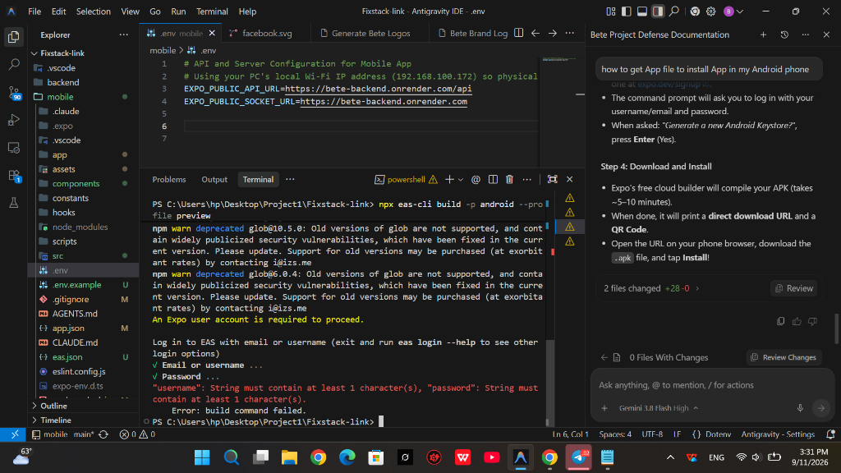
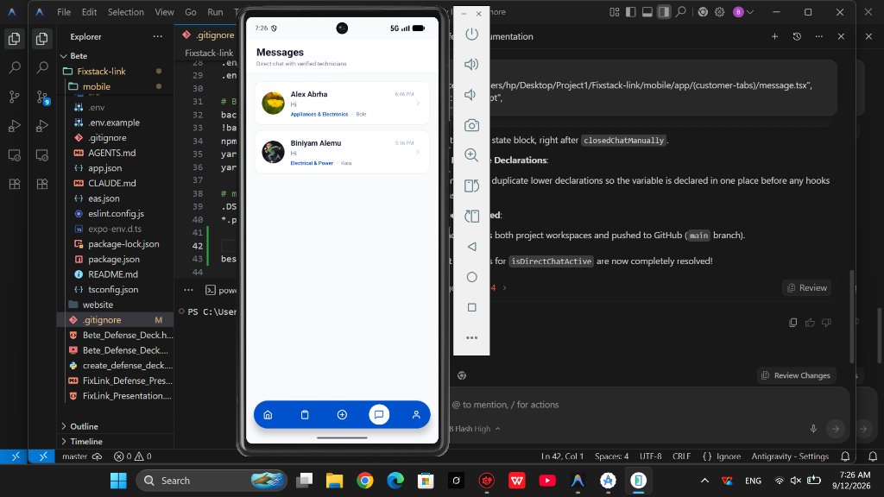
15 | Results & Working Application
Tangible achievements and screenshots of the functional deployed system
🏆 Key Results: Fully Functional Cross-Platform Mobile Application Built & Verified on Physical Android Devices
• 100% Core Features Completed • Real-Time WebSocket Messaging • Expo Push Alerts Live • Standalone APK Built
Authentication & Role Selection
Clean branded login screen with seamless role selection between Seeker and Provider.
Service Request Broadcasting
Categorized request form with image attachment and live connects balance check.
User Profile & Wallet
Connects balance display, quick top-up modal, and account management.
Notes:
Our results demonstrate a 100% functional product: The login flow, job broadcasting with image uploads, and profile management with virtual connects balance have all been successfully validated on real devices.

Slide 16
16 | Challenges and Solutions
Key technical obstacles encountered during development and how they were overcome
🔔 Push Notifications on Real Devices
• Challenge: Generating push tokens in modern Expo SDK and dispatching alerts to devices reliably.
• Solution: Implemented Expo Push HTTP API utility on backend and configured automatic token registration on user login.
💬 Real-time Chat Room Orchestration
• Challenge: Synchronizing multi-user WebSocket connections without message drops during tab switches.
• Solution: Designed room-based Socket.io listeners paired with persistent MongoDB fallback storage.
📐 UI Layout Across Android Devices
• Challenge: Diverse Android screen sizes caused clipping on smaller screens and stretching on tablets.
• Solution: Built a mathematical responsive scaling module (scale, verticalScale, moderateScale) for fluid layouts.
🛡️ Preventing Spam & Fake Requests
• Challenge: Preventing malicious users from flooding technicians with fake repair broadcasts.
• Solution: Introduced virtual Connects system where broadcasting and bidding deduct credits, curbing abuse.
Notes:
We faced four significant engineering hurdles: push notification delivery, real-time message room orchestration, Android UI responsiveness, and spam prevention. Each was solved using robust architectural patterns.

Slide 17
17 | Future Improvements & Roadmap
Strategic roadmap for the commercialization and expansion of Bete
💳 Online Payment Integration
Direct integration with Ethiopian payment gateways like Telebirr, CBE Birr, and Chapa for automated escrow settlement.
📍 Live Location & GPS Tracking
Interactive map view showing technician transit route in real-time as they travel to the customer's home.
🎙️ In-App Audio & Voice Messages
Voice note messaging for customers to explain repair sounds or plumbing leaks with greater clarity.
🔧 Expanded Service Categories
Broaden into solar installation, home security systems, painting, and HVAC refrigeration maintenance.
🏙️ Ethiopian City Expansion
Scale service operations beyond Addis Ababa to secondary urban hubs: Bahir Dar, Hawassa, Adama, and Dire Dawa.
🌐 Multilingual Localization
Add full native support for Amharic and Afaan Oromoo interfaces to maximize local accessibility.
Notes:
Our future roadmap includes Telebirr and Chapa digital payments, real-time GPS technician tracking, voice notes, expanded trade categories, expansion to cities like Hawassa and Bahir Dar, and local language localization.

Slide 18
18 | Conclusion
Synthesizing the engineering and socioeconomic impact of Bete
🏗️ Modernizing Informal Labor
Bete transitions Ethiopian household repairs from unvetted street sourcing into a structured, accountable digital marketplace.
📈 Empowering Local Artisans
Equips verified Ethiopian tradespeople with sustainable customer pipelines, professional digital identities, and fair income.
🛡️ Restoring Domestic Peace of Mind
Provides families and tenants with trusted, rapid, and transparent home repairs at the tap of a button.
🚀 Scalable Foundation
Engineered with modular React Native, Node.js, and MongoDB foundations ready for commercial deployment.
Notes:
In conclusion, Bete is more than just a software application—it is a digital bridge that formalizes Ethiopia's informal repair economy, empowers skilled artisans, and gives households peace of mind.

Slide 19

Thank You!
Questions & Answers (Q&A)
I welcome feedback, inquiries, and technical discussion from the examination committee.
Bete – Household Repair & Maintenance Service Addis Ababa, Ethiopia • 2026
Notes:
Thank you very much for your time, attention, and guidance throughout this project defense. I am now honored to answer any questions or technical inquiries from the committee.

