Slide 1

betgram

Slide 2
Problem
Sport gamblers and bettors uses simple knowledge and intuition for betting.
Those bets have a high degree of uncertainty, and uncertainty means risk of money losses.
Bettors don’t know new ways to improve their bets that help them to decrease the risk of money losses

Slide 3
Bettors need help!

Slide 4
Bettors need help!
Bettors need betgram

Slide 5
Bettors need help!
Bettors need betgram
betgram does what bettors need, bets with less uncertainty

Slide 6





Market
Online sports betting market worth:
$700 billion per year(*)
76% competitors accuracy
More than 750 Million twitter followers
3.5 Billion soccer fans
Online betting is legal in more than 25 countries
65% of soccer fans own a smartphone
GDP: $ 350 billion
30% of soccer fans are using Twitter actively
*Legal sport gambling

Slide 7
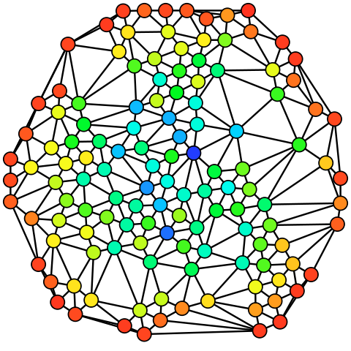



betgram + some keys
Statistical analysis + people’s wisdom

Slide 8
betgram + some keys
PAST
Statistical analysis + people’s wisdom

Slide 9
betgram + some keys
PAST
Statistical analysis + people’s wisdom
betgram

Slide 11
betgram analyses a huge amount of soccer related information in a clever way.
betgram uses past and present information to predict soccer matches.
So with the betgram-summary a bettor wins accuracy and let’s face it:
MONEY and tranquility

Slide 12








Why to trust
Competitive landscape
Theoretical background
Billy Walters

Slide 13
Let’s see it

Slide 14
Business Model
$99/month
$999/season
Basic free features
betgram-summary with analysis and results
Prediction of soccer match
Most favorable bookies
Basic free features
betgram-summary with analysis and results
Prediction of soccer match

Slide 15








We are betgram
We can do it!

Slide 16









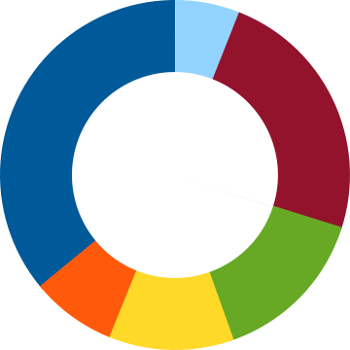

Technicalities
No legal requirements

Slide 17
Milestones
Besides product updates, optimisations, and minor bug fixing, here are some thing we’re focused on…
Launch web-app with free information
October 10 2015
Develop open tweet-factory API
October 10 2015
Implement first version of betgram-engine
October 15 2015
Develop back-end for the web-app
October 17 2015
Develop front-end for premium accounts
October 20 2015
Improve betgram-engine accuracy
October 25 2015 - November 03 2015
Launch betgram.io
November 05 2015

