Slide 1

betgram

Slide 2
Problem
Sport gamblers and bettors uses simple knowledge and intuition for betting.
Those bets have a high degree of uncertainty, and uncertainty means risk of money losses.
Bettors don’t know new ways to improve their bets that help them to decrease the risk of money losses
betgram does what bettors need, bets with less uncertainty

Slide 3





Market
Online sports betting market worth:
$700 billion per year(*)
More than 750 Million twitter followers
76% competitors accuracy
Online betting is legal in more than 25 countries
3.5 Billion soccer fans
GDP: $ 350 billion
65% of soccer fans own a smartphone
30% of soccer fans are using Twitter actively
*Legal sport gambling

Slide 4
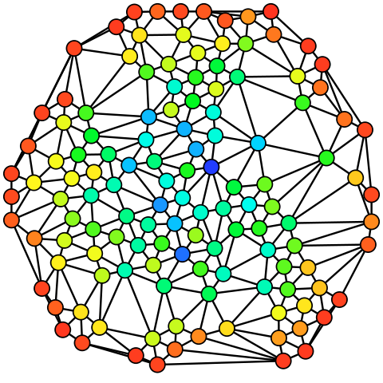



betgram + some keys
Statistical analysis +
people wisdom

Slide 5
betgram analyses a huge amount of soccer related information in a clever way.
betgram uses past and present information to predict soccer matches. If that information is not enough, betgram inserts common wisdom to the predictions (may sound naive, but think, we do classical statistical analysis and social trends analysis).

Slide 6








Why to trust
Competitive landscape
Theoretical background
There’s a lot of theoretical work done in this area. Just one startup using this work.
Billy Walters

Slide 7









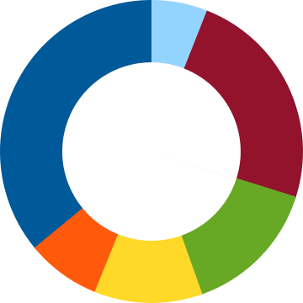

Technical stuff
No legal requirements
We support our system on amazon’s servers and powerful ML, statistical learning and NLP libraries and procedures

Slide 8
Prototype

Slide 9
Business Model
$99/month
$999/season
Basic free features
betgram-summary with analysis and results
Prediction of soccer match
Most favorable bookies
Basic free features
betgram-summary with analysis and results
Prediction of soccer match

Slide 10

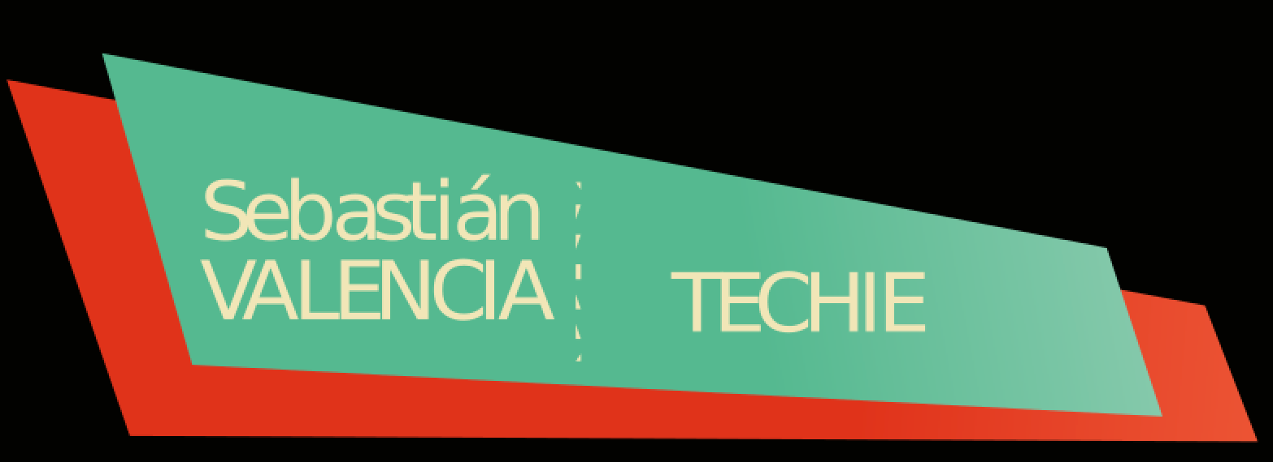






We are betgram
We can do it!

