Slide 1

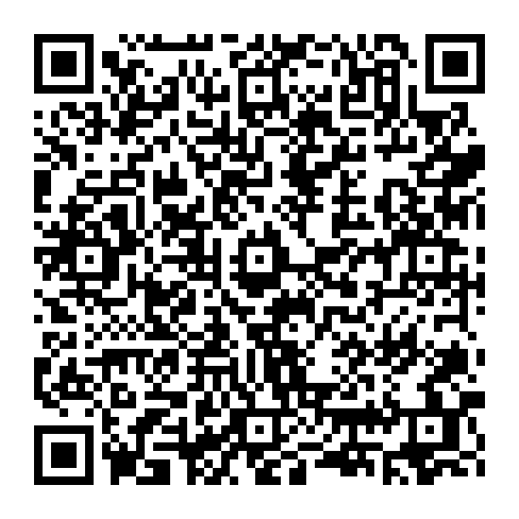
ChainShield
Wallet Security
Re-imagined
7
Detection Rules
5
Security Modules
Detect fraud. Simulate transactions. Protect every signature — before you sign.
100%
Pre-Sign Protection
Scan to view live demo

Slide 2



THE PROBLEM
Crypto wallets are blind to fraud — until it's too late.
No Pre-Sign Check
Phishing & Poisoning
Blind Signatures
MetaMask and most wallets show no risk analysis before a user approves a transaction. Malicious contracts pass through silently.
Scammers create addresses visually identical to trusted wallets. One mistaken paste and your funds are gone forever.
Signing an NFT listing at zero price, a token drain approval, or a permit signature looks identical to a legitimate action to the user.
💸 Over $3.8 billion lost to crypto hacks and scams in 2023 alone — most were preventable with pre-sign analysis.

Slide 3





SOLUTION
What is ChainShield?
ChainShield is a Rabby-inspired Web3 wallet security layer that intercepts every transaction, contract interaction, and signature request — and analyses it for fraud BEFORE the user signs.
Transaction Simulation
Phishing Detection
Approval Alerts
Simulate any tx before signing. See risk score, asset flow & recommendations.
Matches destination addresses against a live scam address database.
Flags unlimited ERC-20 approvals and recommends revocation.
Address Poisoning
Signature Parsing
Security Score
Detects look-alike addresses injected into transaction history.
Decodes blind signatures to warn about NFT listings & permit drains.
Live composite score combining all risk dimensions into one dashboard.

Slide 4





ARCHITECTURE
How ChainShield Works — System Overview
BROWSER LAYER
FRAUD ENGINE (client-side JS)
UI OUTPUT
HTML5 / CSS3
UI & Dashboard
7-Rule Detection
Engine
Risk Warning
& Score
JS call
result
User Inputs
& Scenarios
Risk Score
Calculator (0–100)
Safe / Abort
Decision
Data Flow: User Input → Vanilla JS Fraud Engine → Risk Score (0–100) → Safe / Abort Warning

Slide 5
DETECTION ENGINE
7 Fraud Detection Rules — Composite Risk Scoring
01
Amount Risk
COMPOSITE RISK SCORE
High ETH value = elevated risk weight
02
Address Reputation
Checks against known scam address database
0 – 30
03
Approval Scope
SAFE
Unlimited ERC-20 approvals flagged High
04
Contract Age
31 – 60
New/unverified contracts score higher risk
MODERATE
05
Phishing Match
Address pattern matches phishing registry
61 – 100
06
Signature Type
Blind NFT / permit signatures escalate score
HIGH RISK
07
Address Similarity
Each rule returns a weighted sub-score.
Scores sum to 0–100. Above 60 = Abort.
Look-alike poisoning detected via diff check
No transaction proceeds without a risk assessment — ChainShield's core guarantee.

Slide 6
LIVE DEMO
3 Scenarios That Show ChainShield in Action
01
High-Risk Transaction
02
Phishing Address
03
NFT Blind Signature
Risk Score: 92 — ABORT
Risk Score: 72
Signature Risk: 72 (High)
→ Submit tx to suspicious address
→ Destination matches phishing DB
→ Signature decoded by parser
→ Backend runs 7 detection rules
→ Address flagged as SCAM
→ Permit for BAYC #1234 detected
→ Score = 92 → Abort recommended
→ Look-alike comparison shown
→ Zero-price listing identified
→ Red warning + Abort button shown
→ Transaction blocked with evidence
→ High Risk warning displayed
Fraud prevented before signing
User sees the real vs. fake address
NFT protected — signature rejected

Slide 7
TECH STACK
Web Demo Tech Stack
Frontend
Logic Layer
Design / UX
▸ HTML5 (single file)
▸ 7-rule fraud engine
▸ Crypto dashboard UI
▸ CSS3 (custom theme)
▸ Risk score calculator
▸ Dark mode theme
▸ Vanilla JavaScript
▸ Address reputation DB
▸ Responsive layout
▸ DOM manipulation
▸ Simulation scenarios
▸ Interactive warnings
▸ Client-side simulation
▸ All client-side JS
▸ Professor Demo panel
This demo is a self-contained single HTML file — all fraud detection logic runs client-side in the browser.

Slide 8
COMPETITIVE EDGE
ChainShield vs. Existing Wallets
Feature
MetaMask
Rabby
Trust Wallet
ChainShield
Pre-sign simulation
✗
✓
✗
✓
Composite risk score
✗
✗
✗
✓
Phishing detection
Partial
✓
Partial
✓
Signature parsing
✗
✓
✗
✓
Address poisoning guard
✗
✓
✗
✓
Approval management
✗
✓
✗
✓
Chrome extension
✓
✓
✗
Dev
ChainShield's unique advantage: Composite risk score (0–100) — no existing wallet combines all detections into one live score.
* Chrome extension in active development. Web demo fully functional. Comparison based on public docs, 2026.

Slide 9
ChainShield
Protect every wallet action. Before you sign.
Full-stack Web3 security
7-rule fraud detection engine
Pre-sign protection
Live demo: website lnk
Thank you · Questions?

