Slide 1
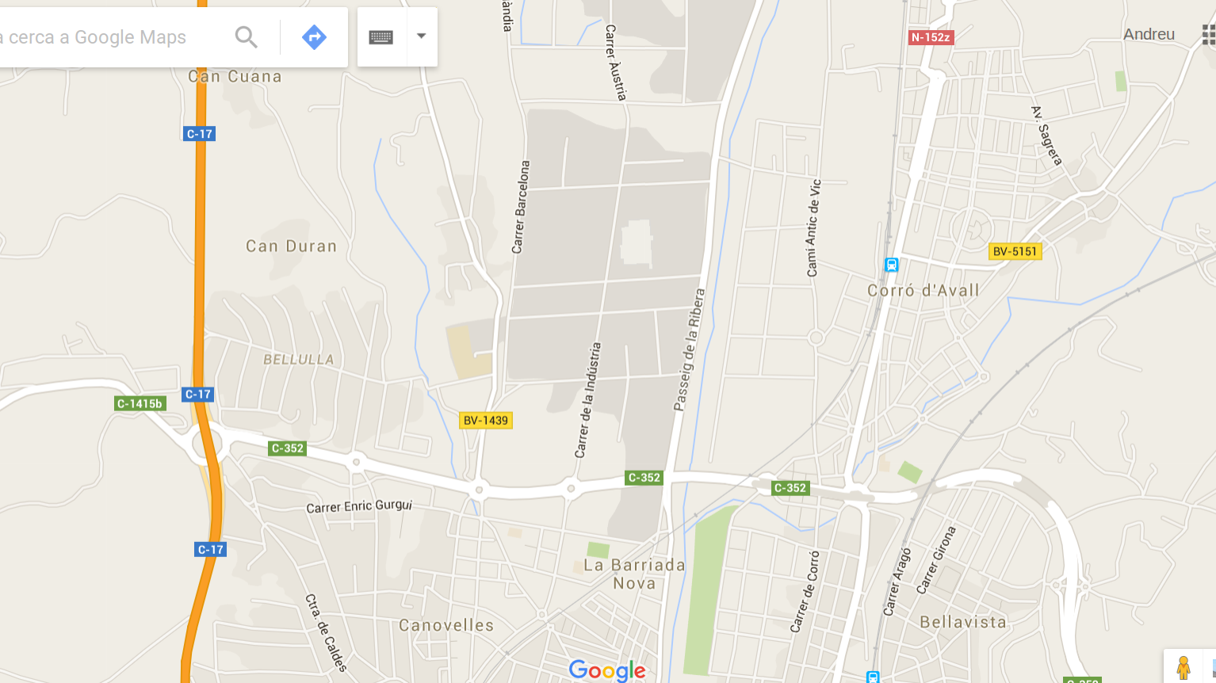

Train,
R3 to Vic
C-17, Vic
+
Train Stop, R3
Les Franqueses
Train,
R2N to Girona
Train Stop,
R2Nord
Granollers Nord
C-17, Barcelona
Train,
R3 to Barcelona
Granollers
Train,
R2N to Barcelona

