Slide 1
Light-weight Image Encryptor
Project Code: H22
REN, Zhengtong
YU, Yiduo
ZOU, Yiwen

Slide 2
Project Objectives
As stated in our proposal, our project objectives are as follows:
Blurring and deblurring an image using row-reduction algorithm
Hiding an image into another image and extracting the original image using least significant bit method
Inserting / Extracting an image into / from one frame of a gif animated image
Integrate these functions with a GUI made with Qt.
The user can choose one or more encryption methods provided by our program, and save the encrypted image. The user can then send it through the web, which will hopefully trick censoring software into judging it as harmless. The receiver can use the decryption functions of our software to get the original image.

Slide 3
Features Incorporated
The following slides are just screenshots of features and should not serve as guidelines for how to use or test our program.
For a complete User Manual, please read index.html inside documentation folder.
Thank you.
>.<
Note:
All source images can be uploaded by the user and all result images can be saved

Slide 4
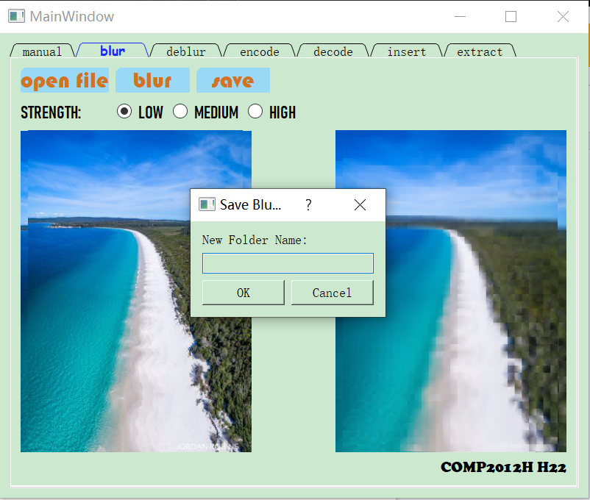
Feature #1: Blur
Blurred image is on the right.
Click “Save” to save the blurred image and the residue images into a new folder.

Slide 5
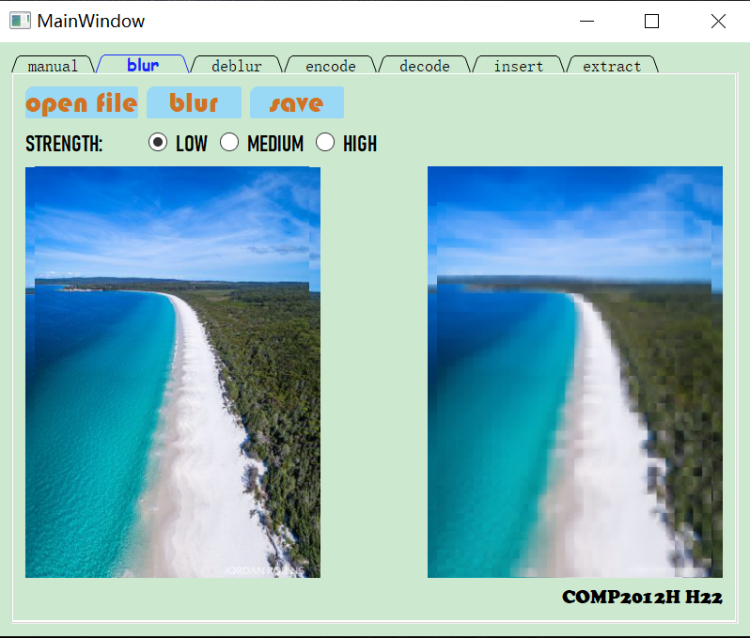

Feature #1: Blur with Different Strengths
Low Strength
High Strength

Slide 6
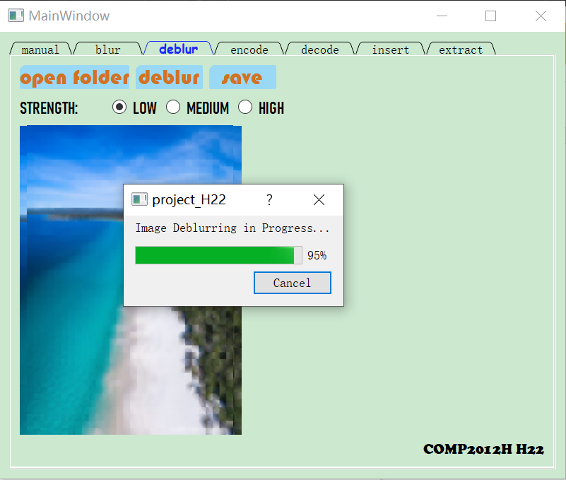

Feature #2: Deblur
Since high-quality deblurring can take as long as 20 minutes, a progress bar lets the user monitor the deblurring progress.
Deblurring in Progress
Deblurring FInished

Slide 7
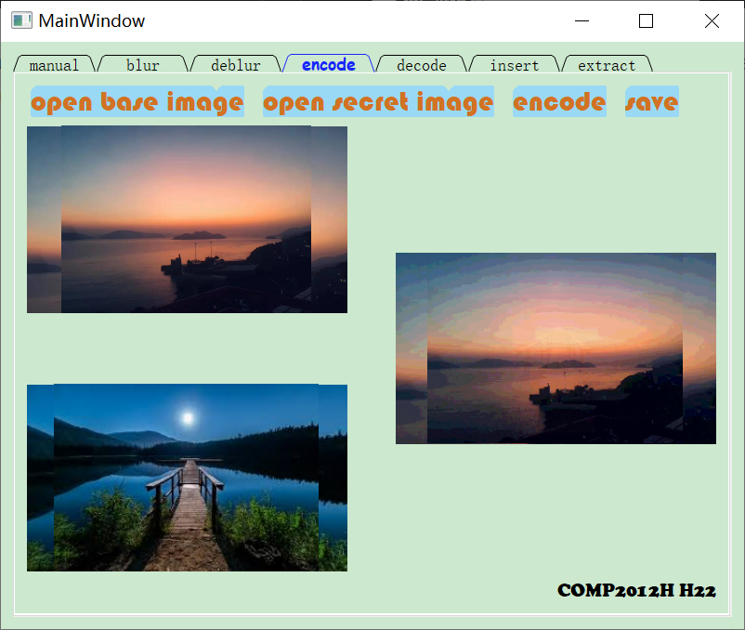
Feature #3: Encode
The upper-left image is the base image. The lower-left image is the secret image.
The image on the right is the cipher image containing the secret image in the last four bits of each pixel.

Slide 8
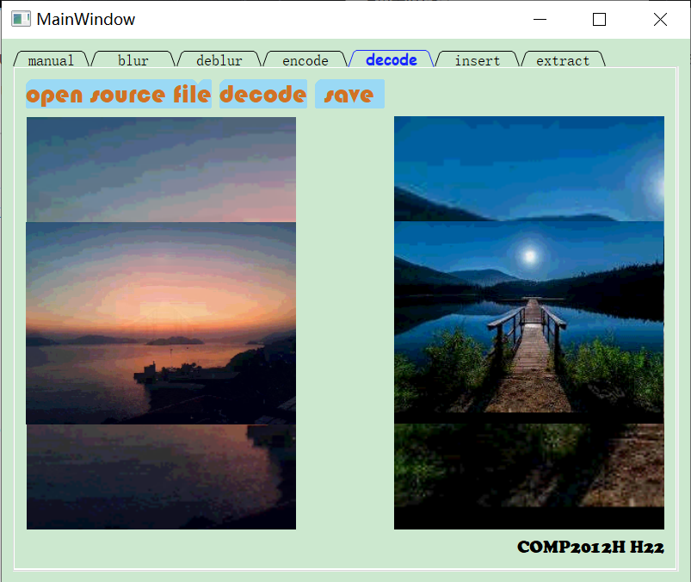
Feature #4: Decode
The image on the left is the cipher image. The image on the right is the secret image, which can be decoded quickly and with minimal loss of quality.

Slide 9
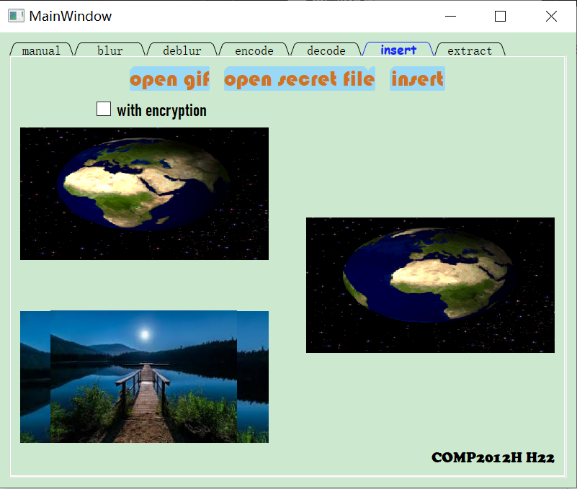
Feature #5: Insert
The upper-left image is the base gif. The lower-right image is the secret image.
The gif on the right is the result gif with the secret image inside one of its frames.
Check “with encryption” to make the gif appear smooth using Feature #3: Encode.

Slide 10
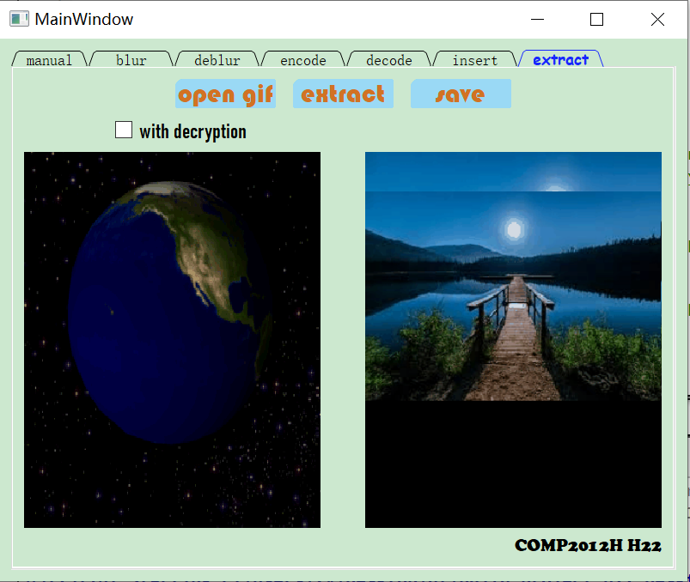
Feature #6: Extract
The image on the left is the cipher gif. The image on the right is the extracted image, which can be fully or partially recovered depending on if “with encryption” is checked at encryption.
Check “with decryption” to reveal secret image using Feature #4: Decode.

Slide 11
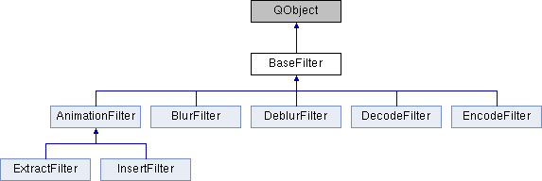
OOP Design
Here is a overview of class hierarchy:
See full details on next slide.

Slide 12
OOP Design
Our program features four layers of OOP Design:
All classes inherit QObject to be able to emit signals.
An abstract base class BaseFilter. Provides image reading and writing functionality, as well as a void apply() interface for all derived filters.
An abstract base class AnimationFilter. Provides gif animated image reading and writing functionality for ExtractFilter and InsertFilter.
Concrete classes BlurFilter, DeblurFilter, EncodeFilter, DecodeFilter, ExtractFilter, and InsertFilter. These derived classes implement the void apply() function and actually manipulates the images.

Slide 13
Data Structures
2D dynamic array: stores pixel color information for easy manipulation
Used in all blurfilter.cpp, deblurfilter.cpp, encodefilter.cpp, and decodefilter.cpp
Arrays are dynamic since the sizes of user-uploaded images are unknown at compile time.
Vector is not suitable since it is too slow.
Vector: stores image pixel information for generating gif using library gif.h
Used in insertfilter.cpp
Array with fixed size is not suitable since different frames of a gif may have different sizes, thus different lengths when converted to an array.
Vector is suitable since its length is flexible and we never have to delete elements.
LinkedList: stores individual frames of a gif uploaded by the user
Used in insertfilter.cpp
LinkedList is suitable since we need to insert the secret image, which is equivalent to one frame, into the middle of the data structure efficiently.
Vector is not suitable since insertion in the middle is very expensive in terms of time.

Slide 14
External Library
We used gif.h by charlietangora to generate gif from a linkedlist of frames.
We have to use external library since Qt can only read, but not write, gif files.
The source code is in public domain and can be accessed here:
https://github.com/charlietangora/gif-h/blob/master/gif.h
The code is slightly modified and separated into one .h file and one .cpp file when incorporated into our project. This is to avoid redefinition errors in OOP.

Slide 15
Conclusion
Our project is motivated by image processing but beyond image processing. We strived to make non-reversible processes, like blurring, reversible, and thus make our project useful in cybersecurity. Specifically, we achieved the following:
Applied row-reduction method learned in MATH2121 Linear Algebra to high-quality image deblurring, thus making our project interdisciplinary
Explored Qt GUI classes, such as QImage, QMovie, QMessageBox, and QProgressDialog, to implement better design and user interaction capability
Used virtual functions, enums, and lambda expressions to improve readability
Studied how jpeg, png, and gif images are formatted
Employed CSS stylesheets to create more decorated icons in GUI
Learned how to generate documentation with DOxygen

Slide 16
Conclusion
However, high-quality image-deblurring, a topic still at the forefront of research on image steganography, is more difficult than we assumed. Inserting one frame into gif is also more detectable than our expectation. Specifically, we made the following compromises:
After blurring and taking the average of nearby pixels, the pixel matrix contains double values. However, only an 8-bit integer can be stored in each color channel. Therefore, we had to use three residue images to store the numbers after the decimal point to enable high-quality deblurring.
Inserting one frame directly into a gif is visible to human eye. Therefore, we tried to encode the image into the target frame. However, too much information is lost during encoding and gif generating processes, and the secret image can only be partially recovered after extraction with decryption.

